Slide 1
Doctoral Capstone Project Presentation Finessing Fine Motor Skills: Implementing a Parent Education Module and the use of a Fine Motor Box to address Fine Motor Skills and Fine Motor Delays in Elementary Age Children
Rebecca Derrick Campbell, MS, OTR/L, IBCLC
Florence One Schools
Medical University of South Carolina

Slide 2
Background
Students ages 5 to 7 are at a critical stage for development of fine motor skills needed for handwriting tasks in the school-based setting.
As a result of schools being closed, students had a decreased opportunity to participate in fine motor activities, leading to fine motor delays seen in students ages 5 to 7.
2
Notes:
Put your notes here as memory guides

Slide 3
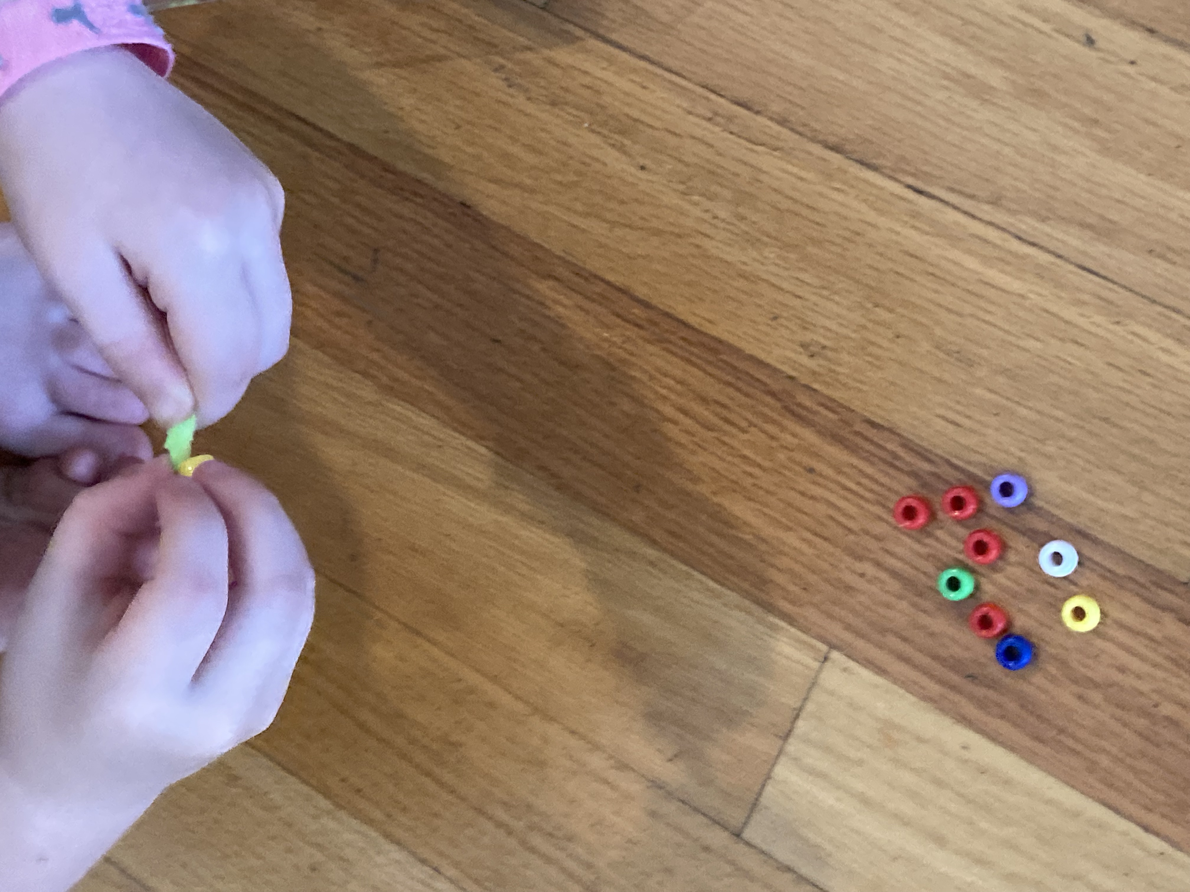
Motor Skills Acquisition Frame of Reference
The Motor Skills Acquisition Frame of Reference states that, “acquiring motor skills requires both practice, feedback, and involvement of the learner. (Kaplan, 2010).”
3
Notes:
List the capstone project purpose or research statement
Add your private notes here as a memory aid

Slide 4
The Fine Motor Box (MUSC #P22091; ©2022Rebecca Campbell)
The Fine Motor Box was used during the COVID-19 pandemic when schools were shut down by the Occupational Therapist at Briggs Elementary.
The items in the Fine Motor Box are used to encourage children to use their hands and complete fine motor tasks with small, fun items and activities that are easy to find.
4

Slide 5
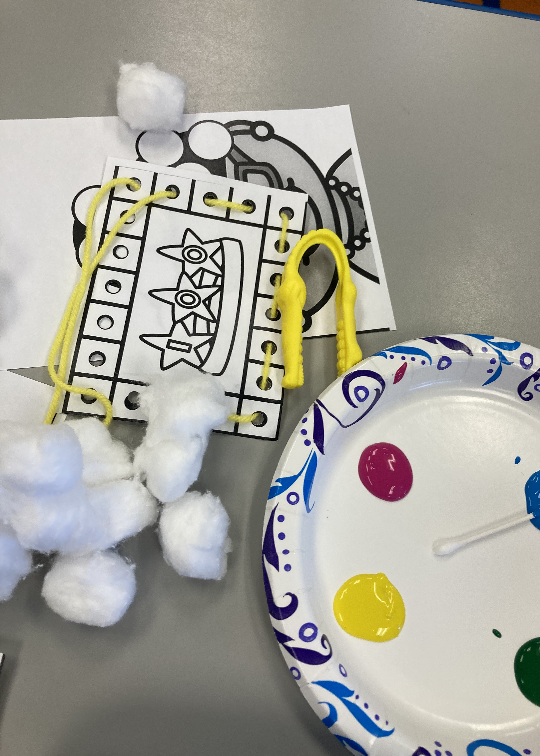
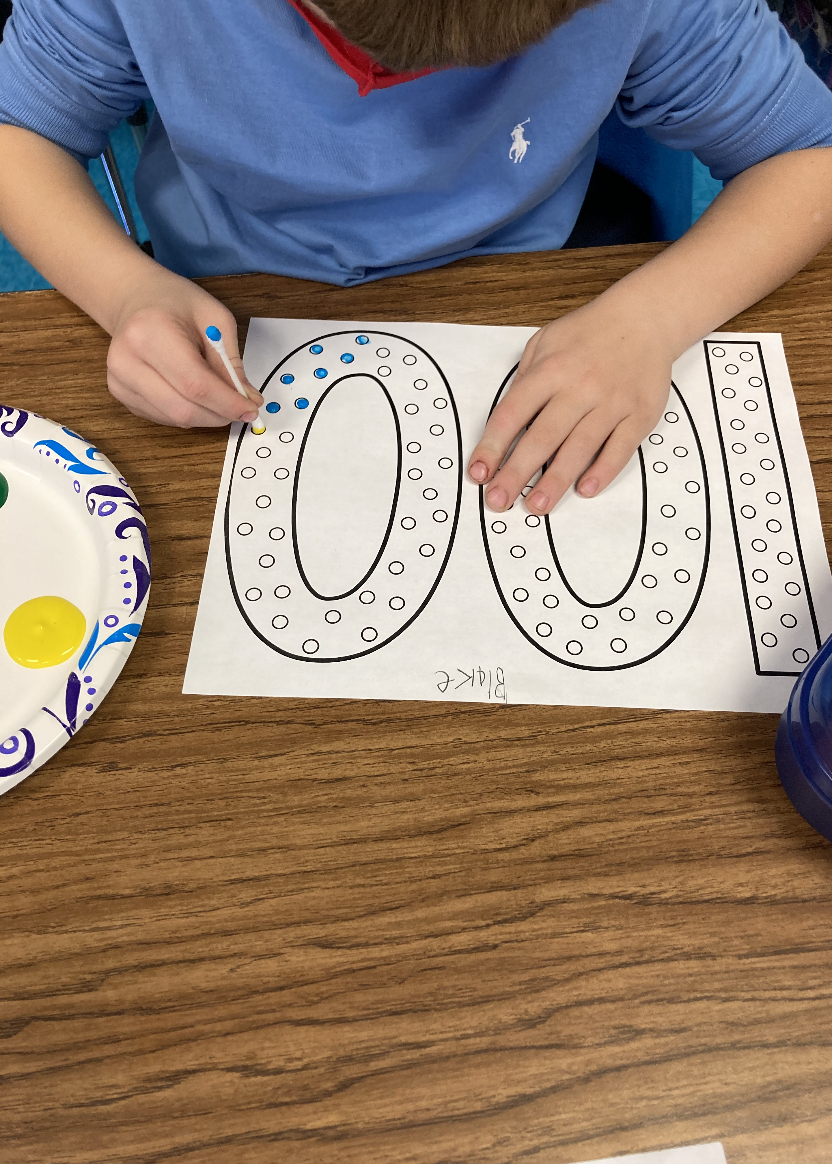
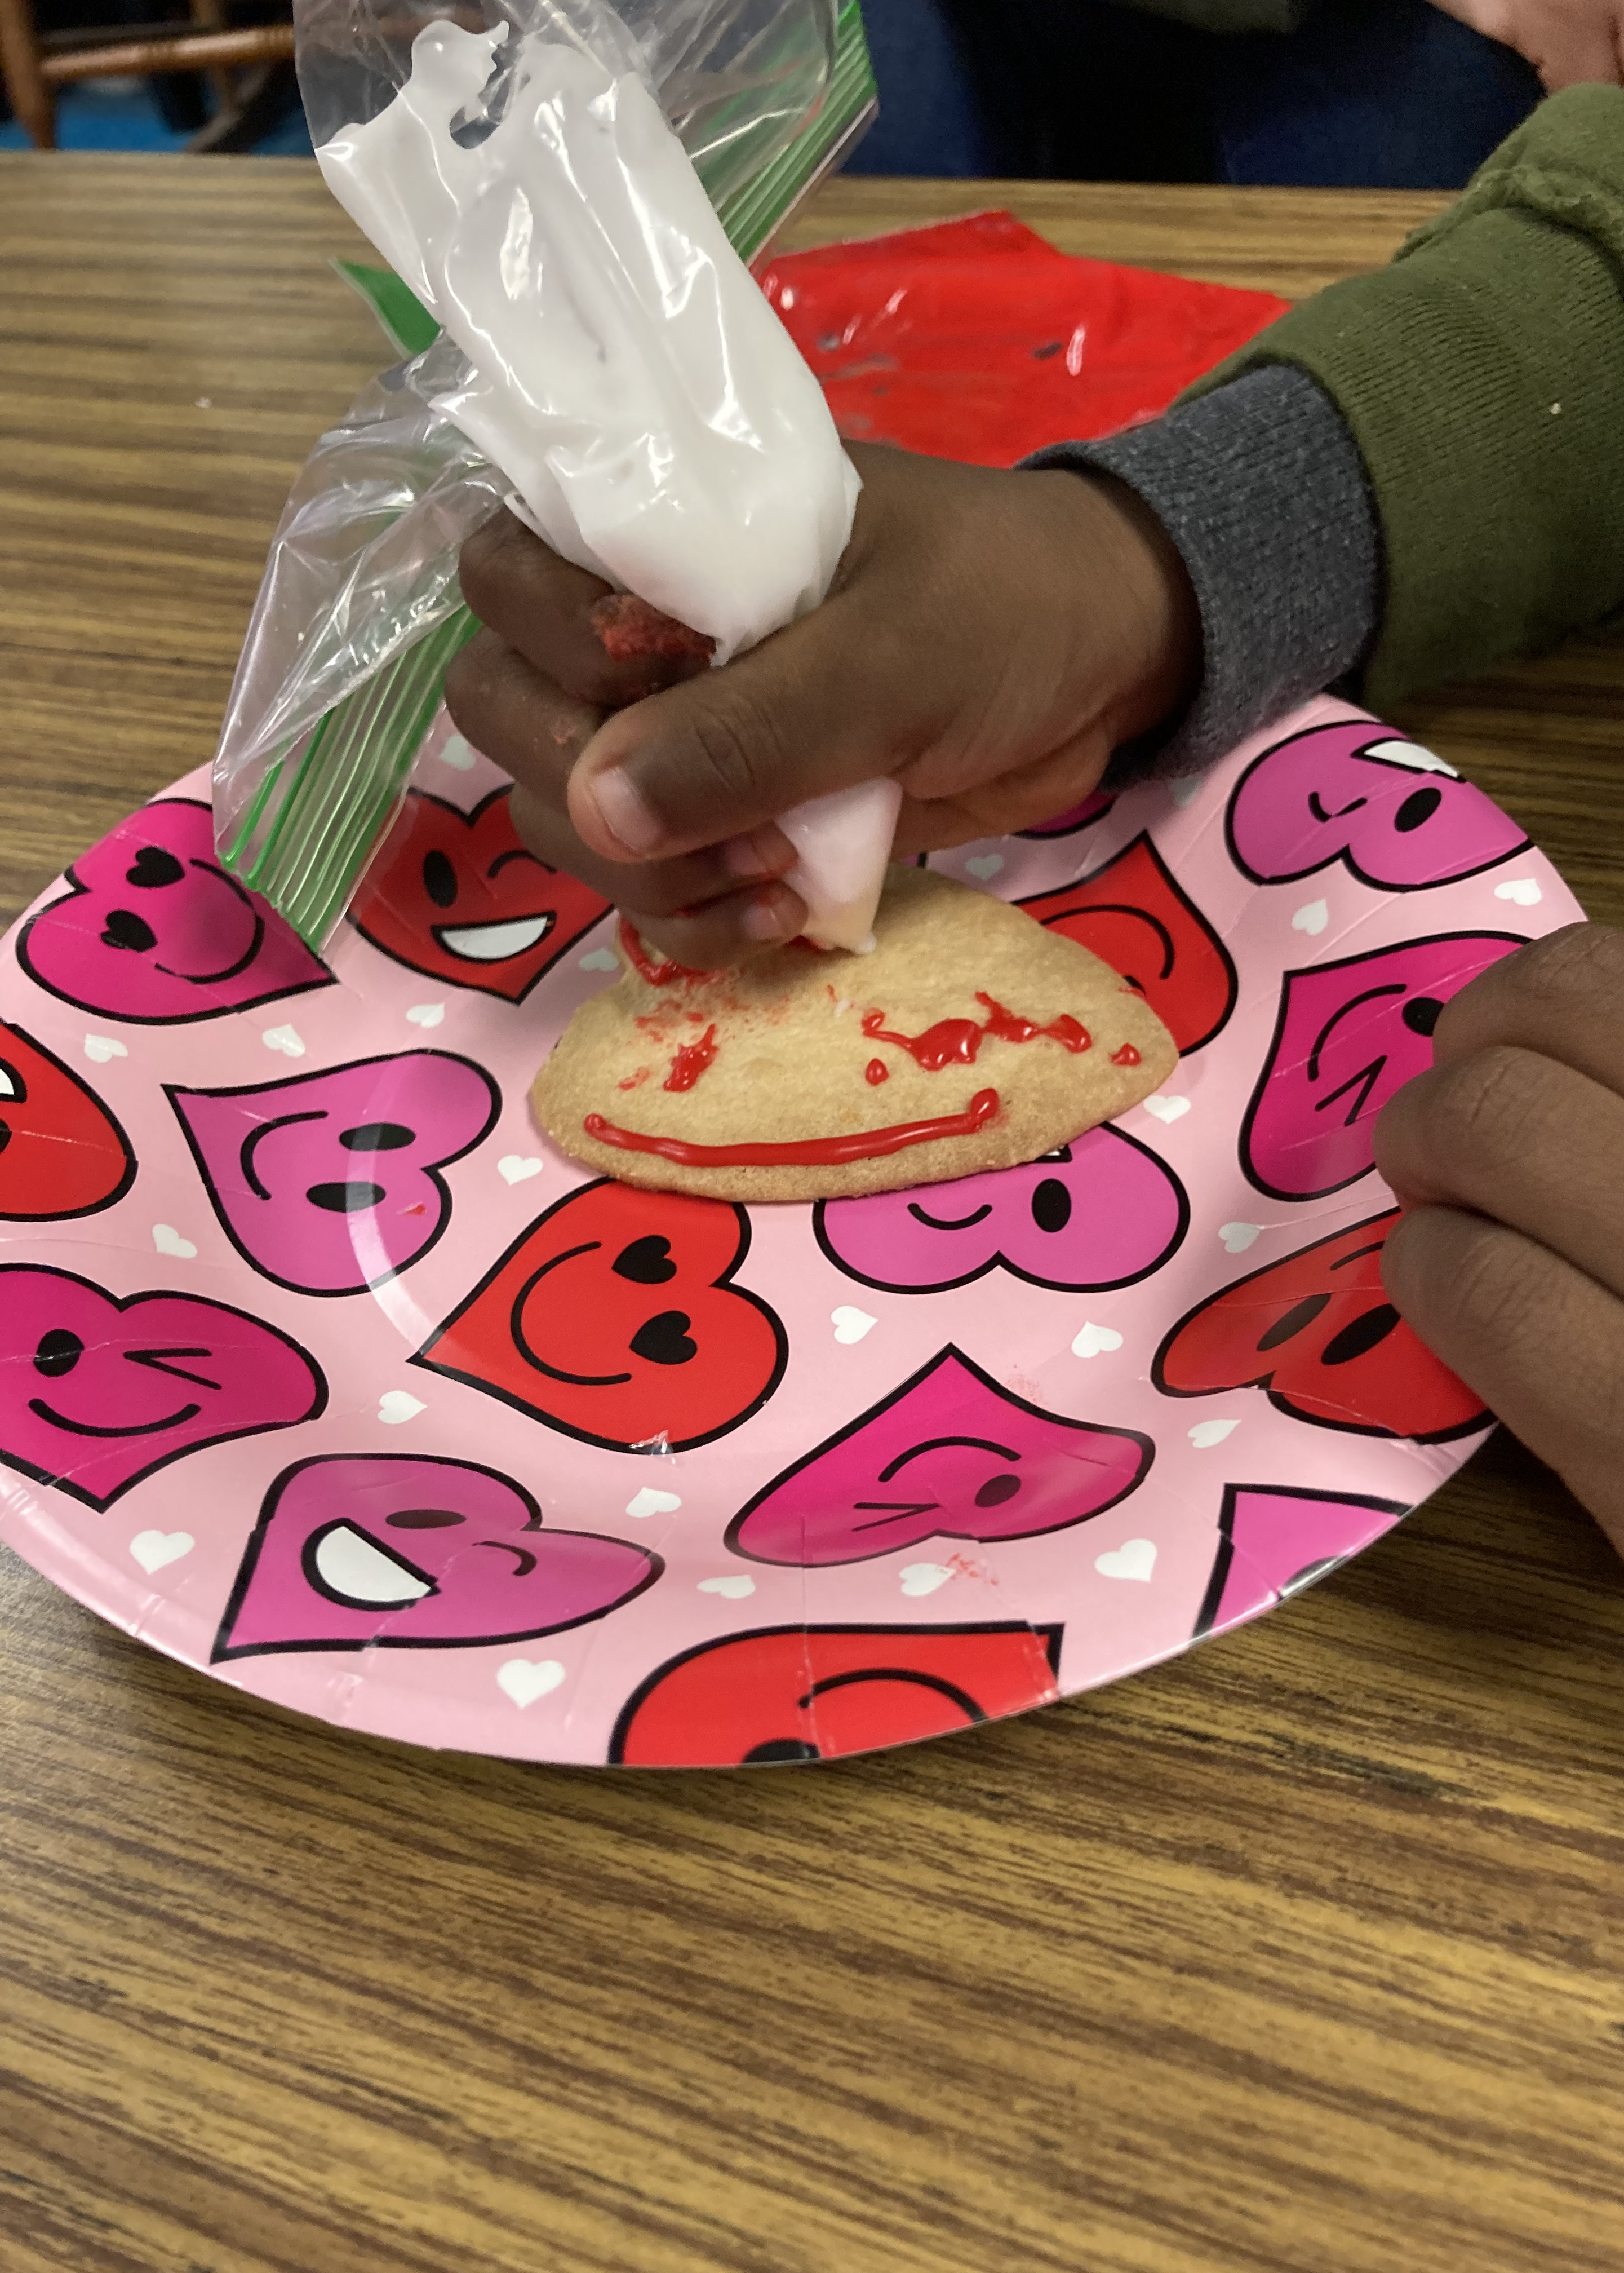
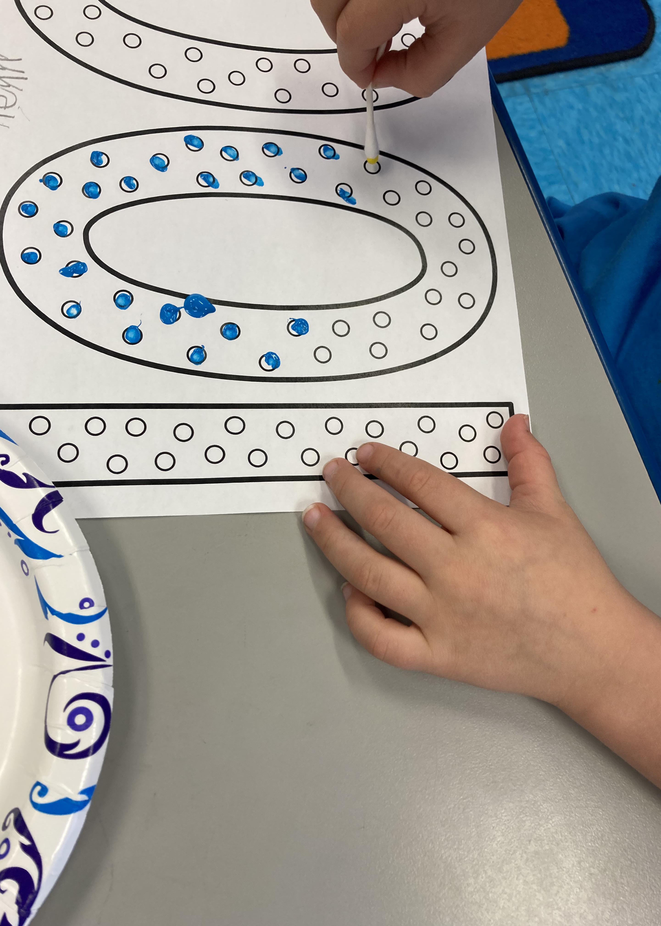
Kindergarten Fine Motor Groups
5

Slide 6
Purpose Statement
The purpose of Finessing Fine Motor Skills was to provide an education module for parents and a fine motor box to address fine motor delays in children ages 5 to 7 that have been amplified as a result of the COVID-19 pandemic.
6
Notes:
List problem statement here

Slide 7
Objectives for Finessing Fine Motor Skills
1. Needs Assessment for School-Based Occupational Therapists
2. Pre-Parent Education Survey Needs Assessment
3. Parent Education Module with a Pre and Post-Education Survey to gain qualitative data regarding knowledge gained on fine motor skills.
4. Therapist Survey post SCOTA presentation to gain qualitative data regarding the use of the parent education module and fine motor box.
7
Notes:
Add your private notes here as a memory aid
*This design allows…*

Slide 8
Objective 1: Why Finessing Fine Motor Skills?
Study data were collected and managed using REDCap electronic data capture tools hosted at the Medical University of South Carolina.^{1,2} REDCap (Research Electronic Data Capture) is a secure, web-based software platform designed to support data capture for research studies, providing 1) an intuitive interface for validated data capture; 2) audit trails for tracking data manipulation and export procedures; 3) automated export procedures for seamless data downloads to common statistical packages; and 4) procedures for data integration and interoperability with external sources.
8

Slide 9
Objective 2: Parent Pre-Education Module Survey
A 12 Question Survey was created via RedCap for parents to complete.
183 Parents completed the survey.
99 demonstrated the ability to define fine motor skills.
26 provided a response to Question 12.
9

Slide 10
Objective 2: Parent Pre-Education Module Survey
Study data were collected and managed using REDCap electronic data capture tools hosted at the Medical University of South Carolina.
10

Slide 11
Objective 3: Parent Education Module
Through data collected in the Parent Pre-Survey, the Parent Education Module was created.
Two more RedCap Surveys were created for parents to take pre-education module and post-education module when it was presented in February.
11

Slide 12
Fine Motor Education Session
On February 10, 2022, I presented Finessing Fine Motor Skills to parents at Briggs Elementary School.
12

Slide 13
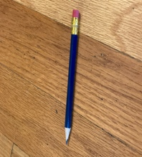
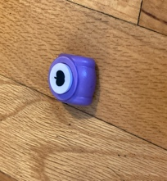
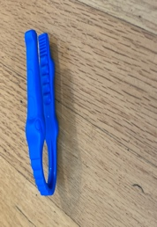
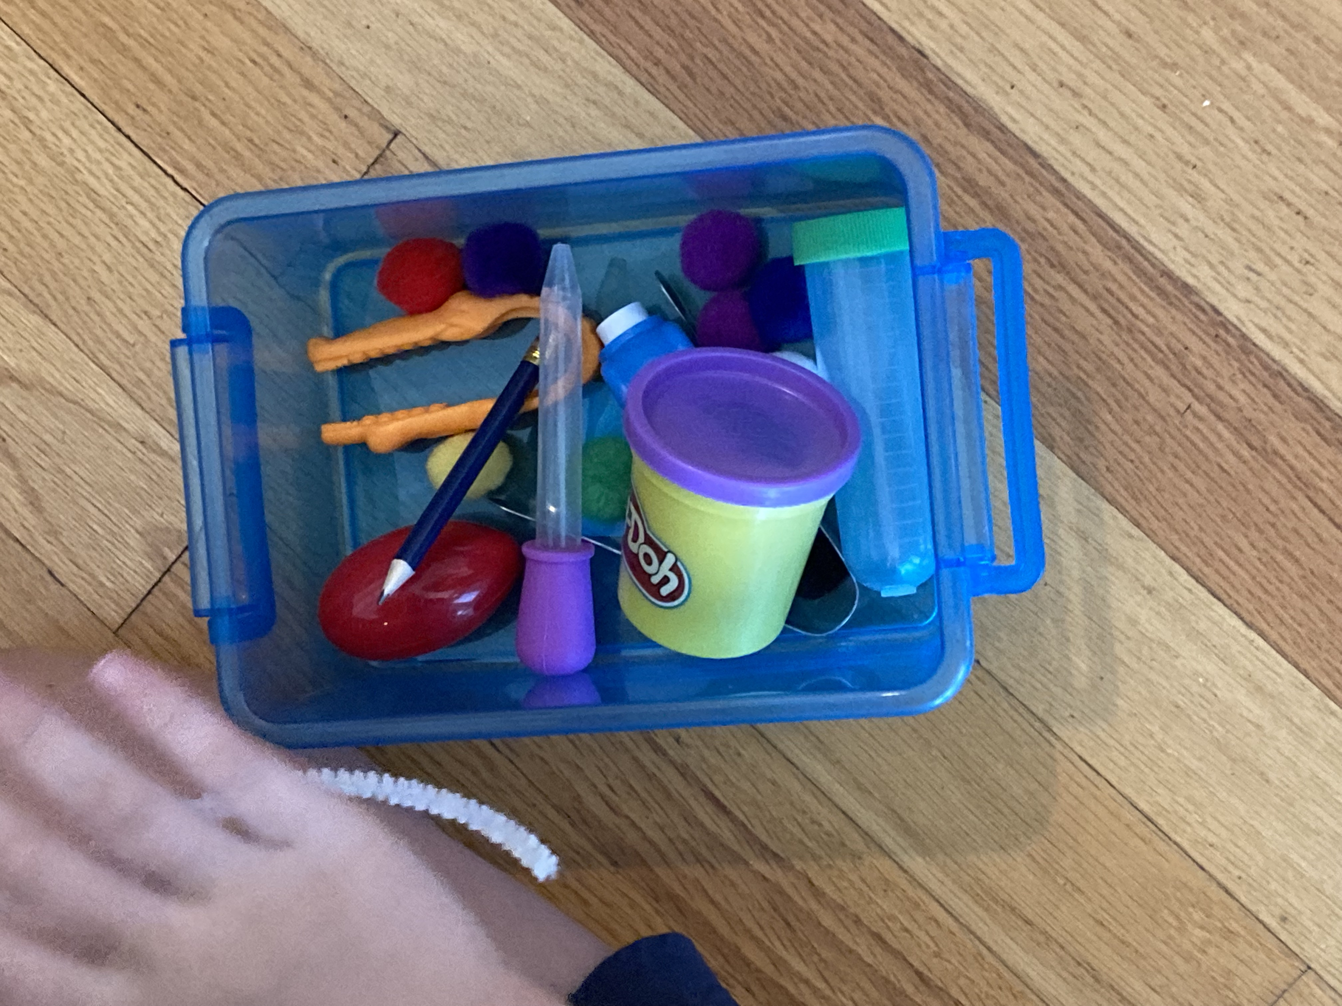
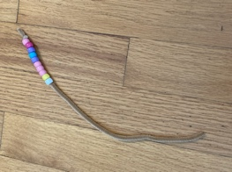
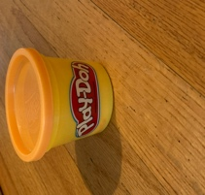
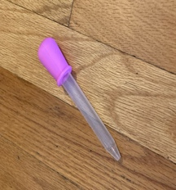
The Fine Motor Box (MUSC #P22091; ©2022 Rebecca Campbell)
13

Slide 14
Tongs
14

Slide 15
Beads on Pipe Cleaner
15

Slide 16
Eye Dropper Activity
16

Slide 17
Virtual Parent Education Session
Due to COVID-19 concerns, a virtual recording of the session was provided for our parents to view through a secure link.
By providing this virtual recording, I was able to gather more pre-education and post-education survey data.
https://watch.screencastify.com/v/gJSa0l2rD6QLtbL6yTJt
17

Slide 18
Results from Parent Education Session
Study data were collected and managed using REDCap electronic data capture tools hosted at the Medical University of South Carolina.^{1,2} REDCap (Research Electronic Data Capture) is a secure, web-based software platform designed to support data capture for research studies, providing 1) an intuitive interface for validated data capture; 2) audit trails for tracking data manipulation and export procedures; 3) automated export procedures for seamless data downloads to common statistical packages; and 4) procedures for data integration and interoperability with external sources.
18

Slide 19
Results from Parent Education Session
Study data were collected and managed using REDCap electronic data capture tools hosted at the Medical University of South Carolina.^{1,2} REDCap (Research Electronic Data Capture) is a secure, web-based software platform designed to support data capture for research studies, providing 1) an intuitive interface for validated data capture; 2) audit trails for tracking data manipulation and export procedures; 3) automated export procedures for seamless data downloads to common statistical packages; and 4) procedures for data integration and interoperability with external sources.
19

Slide 20
Results from Parent Education Session
Study data were collected and managed using REDCap electronic data capture tools hosted at the Medical University of South Carolina.^{1,2} REDCap (Research Electronic Data Capture) is a secure, web-based software platform designed to support data capture for research studies, providing 1) an intuitive interface for validated data capture; 2) audit trails for tracking data manipulation and export procedures; 3) automated export procedures for seamless data downloads to common statistical packages; and 4) procedures for data integration and interoperability with external sources.
20

Slide 21
Qualitative Data Gained from Parent Education Workshop
Importance of fine motor skills on child’s development.
The different pencil grasps, and the progression of grasps in children. (This response was provided 3 times.)
The impact of fine motor skills and the school environment.
The effects of the pandemic on fine motor skills.
Demonstration of activities that can be done to encourage fine motor skill development. (This response was provided 2 times.)
21

Slide 22
SCOTA Presentation
On February 26, 2022, I was provided with the opportunity to present “Finessing Fine Motor Skills” at the South Carolina Occupational Therapy Association Conference.
I surveyed the therapists who attended my session to gather more qualitative data in regards to the use and need of a fine motor box and parent education module on fine motor skills.
22

Slide 23
SCOTA Presentation
93% of therapists stated they had seen an increase in caseload since the beginning of the pandemic.
100% of therapists surveyed stated they would use the fine motor box in their clinical setting.
100% of therapists surveyed stated they would use the parent education module on fine motor skills to educate parents.
23

Slide 24
Comments from Therapists
“The activities within the fine motor box were good fine motor activities to address delays.”
“The fine motor box was important in addressing fine motor skills and it could be used as a home program.”
“The education module is one that would benefit parents who have children in the therapy setting.”
24

Slide 25
Results
Following the parent education module with education on activities using the fine motor box, I saw an increased knowledge of fine motor activities, fine motor delays, and participation in fine motor skill activities with children from parents in attendance.
The data from the parent survey affirms the need for parent education on fine motor skills.
25

Slide 26
Results
The Fine Motor Box (P#22091; ©2022 Rebecca Campbell) is beneficial in addressing fine motor skills and delays.
Therapists reported they would use the parent education module and fine motor box in clinical settings for fine motor awareness and education.
26

Slide 27
What Comes Next?
School Foundation Grant Submission (4/26/2022)
Continue educating parents using the Parent Education Module and Fine Motor Box (#P22091; ©2022 Rebecca Campbell)
Continue Kindergarten Fine Motor Groups during the 2022-2023 School Year
27

Slide 28
What Comes Next?
Submit a Paper to OT Practice
Present at the Maralynne Mitcham Lectureship (May 2022)
Submit a proposal to the 2023 AOTA Conference
28

Slide 29
Summary
Short fine motor activities that can be completed daily help to develop fine motor skills in children ages 5 to 7.
Fine motor boxes are easy and inexpensive to put together.
Education modules for parents are important to assist with addressing fine motor delays and encouraging fine motor play at early ages.
29

Slide 30
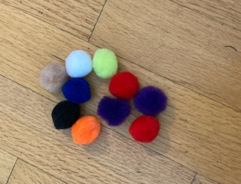
Summary
My ultimate goal for “Finessing Fine Motor Skills” was to have an education module that was easy to present to parents, with a simple “tool” box that could be provided for them to encourage their children to use fine motor skills to reverse delays impacting their ability to complete fine motor activities within the school system.
30
Notes:
List the capstone project purpose or research statement
Add your private notes here as a memory aid

Slide 31
References
PA Harris, R Taylor, R Thielke, J Payne, N Gonzalez, JG. Conde, Research electronic data capture
(REDCap) – A metadata-driven methodology and workflow process for providing translational research informatics support, J Biomed Inform. 2009 Apr;42(2):377-81.
PA Harris, R Taylor, BL Minor, V Elliott, M Fernandez, L O’Neal, L McLeod, G Delacqua, F
Delacqua, J Kirby, SN Duda, REDCap Consortium, The REDCap consortium: Building an international community of software partners, J Biomed Inform. 2019 May 9 [doi: 10.1016/j.jbi.2019.103208]
Link to articles:
http://www.sciencedirect.com/science/article/pii/S1532046408001226
https://www.sciencedirect.com/science/article/pii/S1532046419301261
Kaplan, M. (2010). A frame of reference for motor skill acquisition. In P. Kramer & J. Hinojosa
(Eds.), Frames of reference for pediatric occupational therapy (3rd ed., pp. 390-424). Philadelphia: Lippincott Williams & Wilkins.
Fine Motor Box MUSC #P22091 ©2022RebeccaCampbell
31

Slide 32
Special Thanks
Dr. Michelle Woodbury-Medical University of South Carolina
Dr. Karen Long- Florence One Schools
Shannon Belk, OTR/L-Florence One Schools
Briggs Elementary School
Tara Newton
Angie Willard
The Briggs 5K Students and Teachers
32

