Slide 1
The Use of Spirituality to Enhance the Well-Being in Individuals Who Are Homeless
Alexis Annette Dula, OTDS
Faculty Mentor: Dr. J. Crawford
Capstone Site: Keys to Change

Slide 2
BACKGROUND & SIGNIFICANCE
Homeless population
Numerous health conditions among people who are homeless are frequently a complex mix of serious physical, mental health, substance use, and social problems.
The homeless may experience feelings like shame, demoralization, loss of dignity, fear, and turmoil daily
Most individuals acknowledge their physical and mental health needed to be improved, but it was not their top priority.
The Method of Spirituality
It helps understand answers to ultimate questions about life, meaning, and relationship with the sacred or transcendent
Spiritual or religious practices, such as prayer or meditation, music, and praise can lead to better health outcomes, including increased energy, longer lifespan, better coping skills, and overall quality of life during an illness.
An estimated 160 million adults have more positive experiences (experienced enjoyment, smiled/laughed a lot, treated with respect, learned something, felt well-rested) than they would if they were not religious or spiritual.

Slide 3
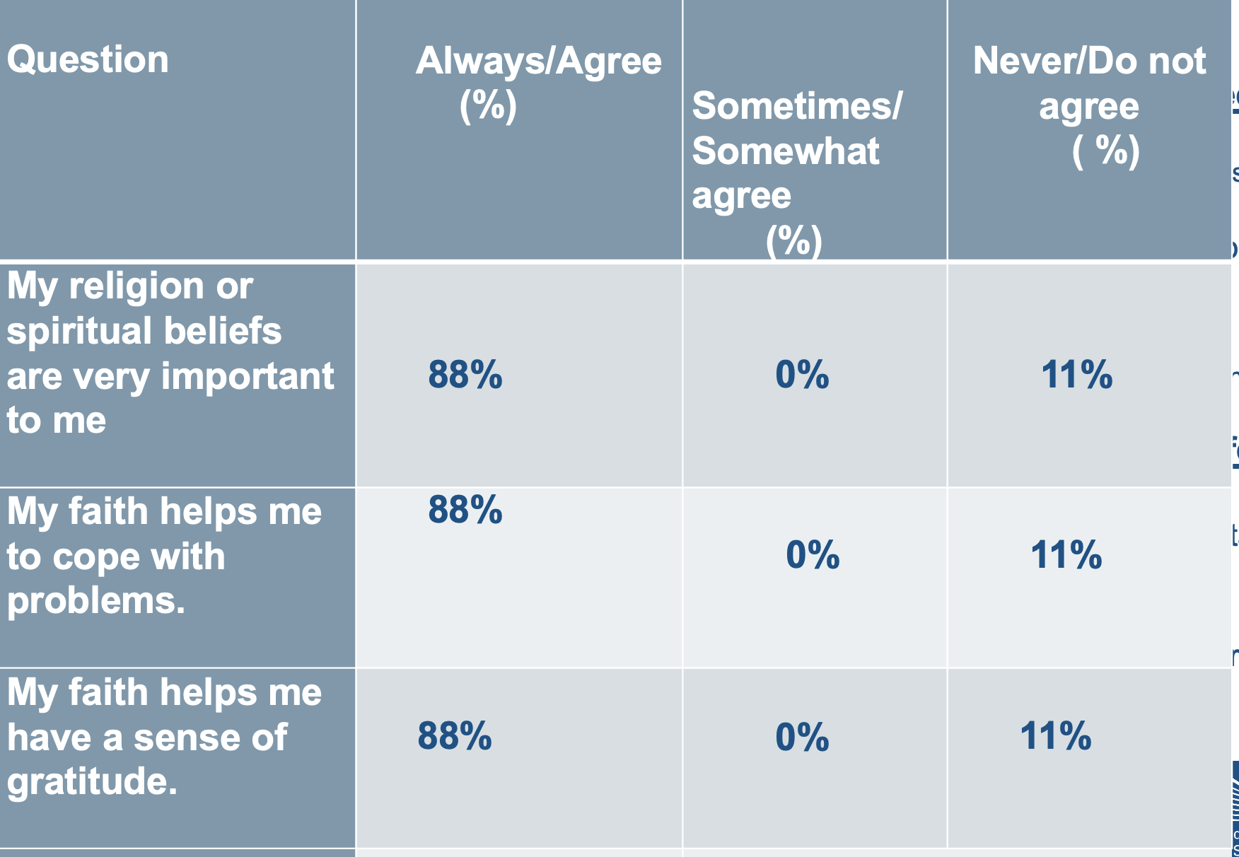
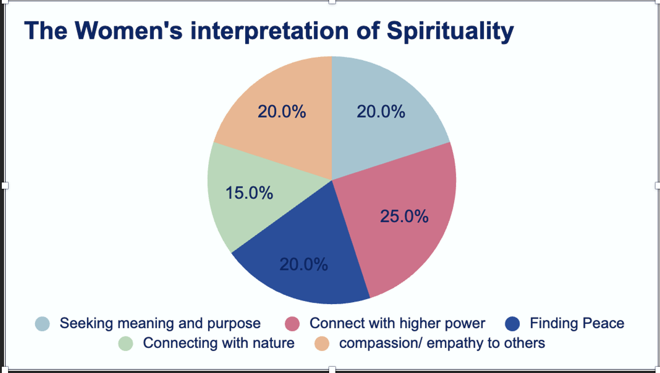
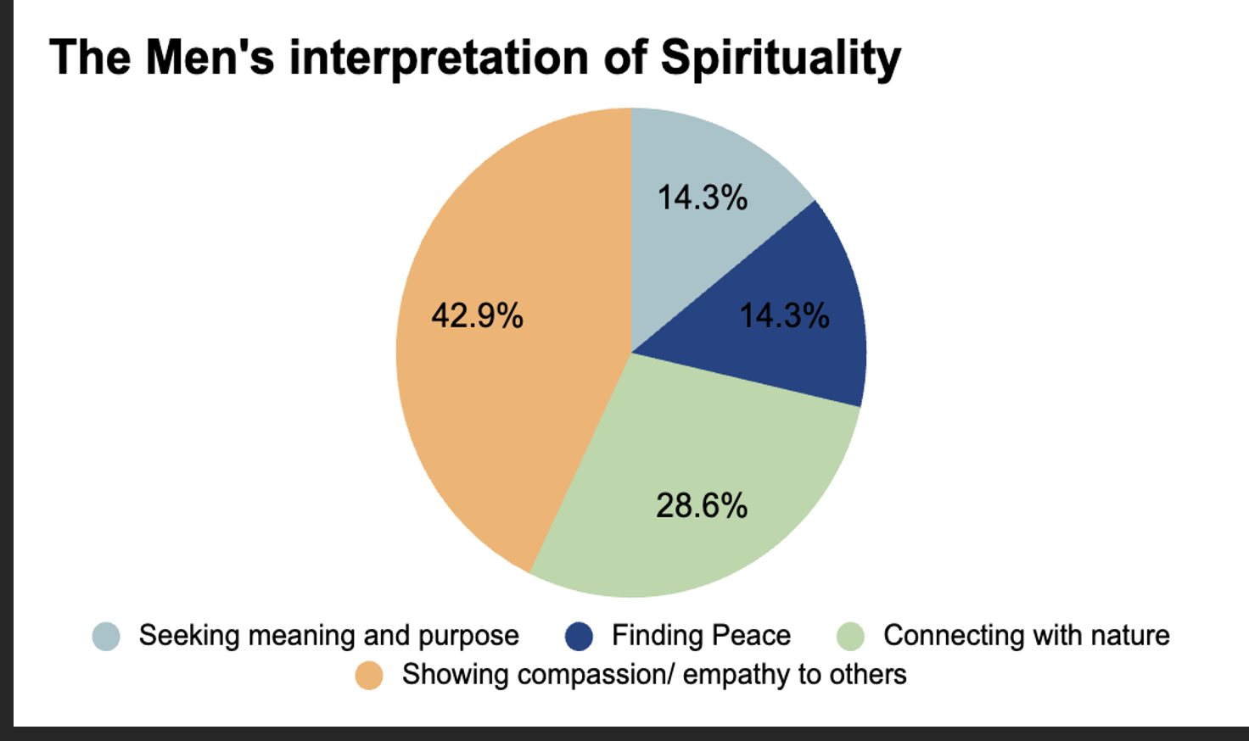
The Needs
Needs Assessment
Current Needs Provided Effectively
Shelter
Jobs
Clothing
Transportation / limited
Food
Health care
Needs that are Not Addressed Effectively
Physical
Mental health
Fostering good
relationships
Spirituality
Figure 1. The men's and women’s responses about their spirituality
Notes:
Talk about emotion statistic

Slide 4
AIM
Programing
Program development within community setting for adults who are homeless
Education
Educate current residents on faith-based coping strategies and methods to improve their wellbeing
Deliverable
Create resources and activities for staff to implement with the residents to improve their wellbeing
Educate staff on how to implement activities in the facilities

Slide 5
Framework of Reference

Slide 6
Canadian Model of Occupational Performance and Engagement
Person
Spirituality: The core of the model, representing personal meaning and motivation.
Occupation
Categories of activities that are meaningful and fulfilling.
Environment
External factors that influence performance and occupational engagement
Continuous interplay between person, environment, and occupation.
Notes:
Spirituality is central to this model, representing the core of an individual’s identity and meaning.
Spiritual environments- support spiritual occupations.
If I made the environment conducive and created fulfilling activites that were spiritual then it could that who enhance their spirit being/ person. Offently, it help it become the foundation for their self care social, etc
Spiritual occupations may include prayer, meditation, and community worship.

Slide 7
Stakeholders and Population
Participants
Staff and Volunteer
Community Partners
Light House
House up to 8 women
Age: 21+
No serve physical or mental disability
Light House
2 staff members
The Least of These Ministry
Anchor House
Houses up to 16 men
Age: 21+
No serve physical or mental disability
Anchor House
2 staff members
One volunteer

Slide 8
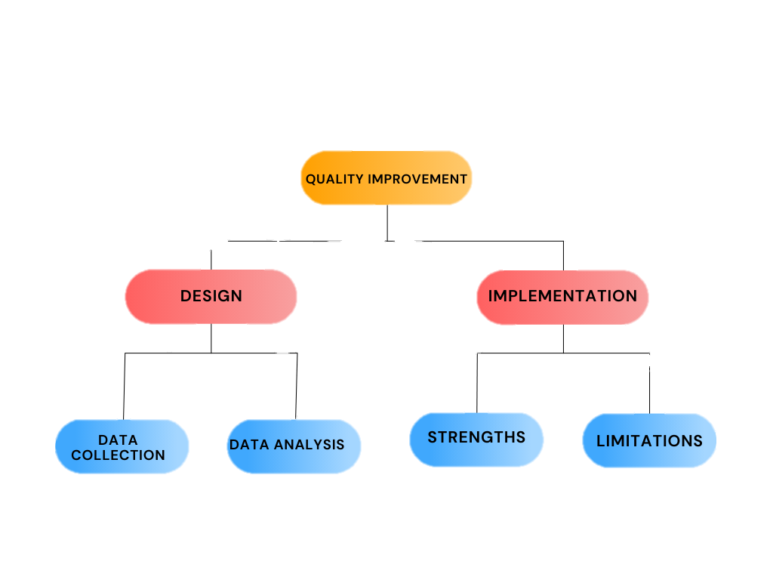
Method
Completed a 1- 2hr session based on each topic biweekly
Staff/ community partners
- Interviews
Surveys
Observations
Participants
-initial wellbeing survey/ interviews
-satisfaction of the activity survey
-Observations
- Impact survey
Strong collaboration with staff, women participants and community
Great participant from the lighthouse
Address the missing needs needed for a meaningful life
Little to no participation in activities from the men
Limited feedback due to small staff & participant size
Quantitative & Qualitative data has been reviewed by Frequency & Thematic Analysis
Notes:
Little to no particapaint due to work schedule and not wanting to do hand ones activity

Slide 9
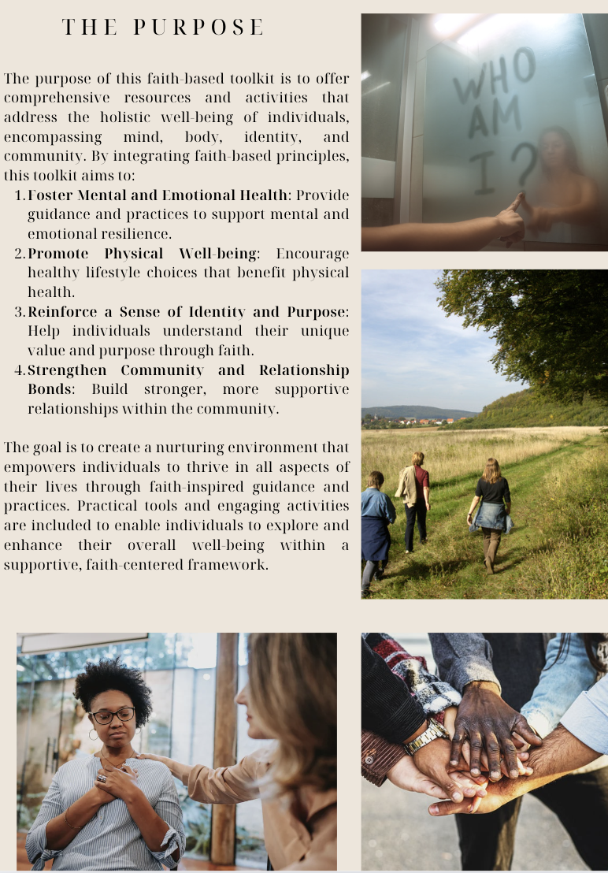
CAPSTONE EXPERIENCE & DELIVERABLE
Faith-Based Tool-Kit
Assessments
Activities
Worksheet
Educational resources/ handouts
Online resources
Group Session
Lesson
Hands on activity
Reflection
handout
Core Topics
Fostering Emotional health
Promoting Physical Wellbeing
Reinforcing a Sense of Identity and Purpose Strengthening Relationships, and Community
Notes:
Talk about some of the activities and lessons for each session.

Slide 10
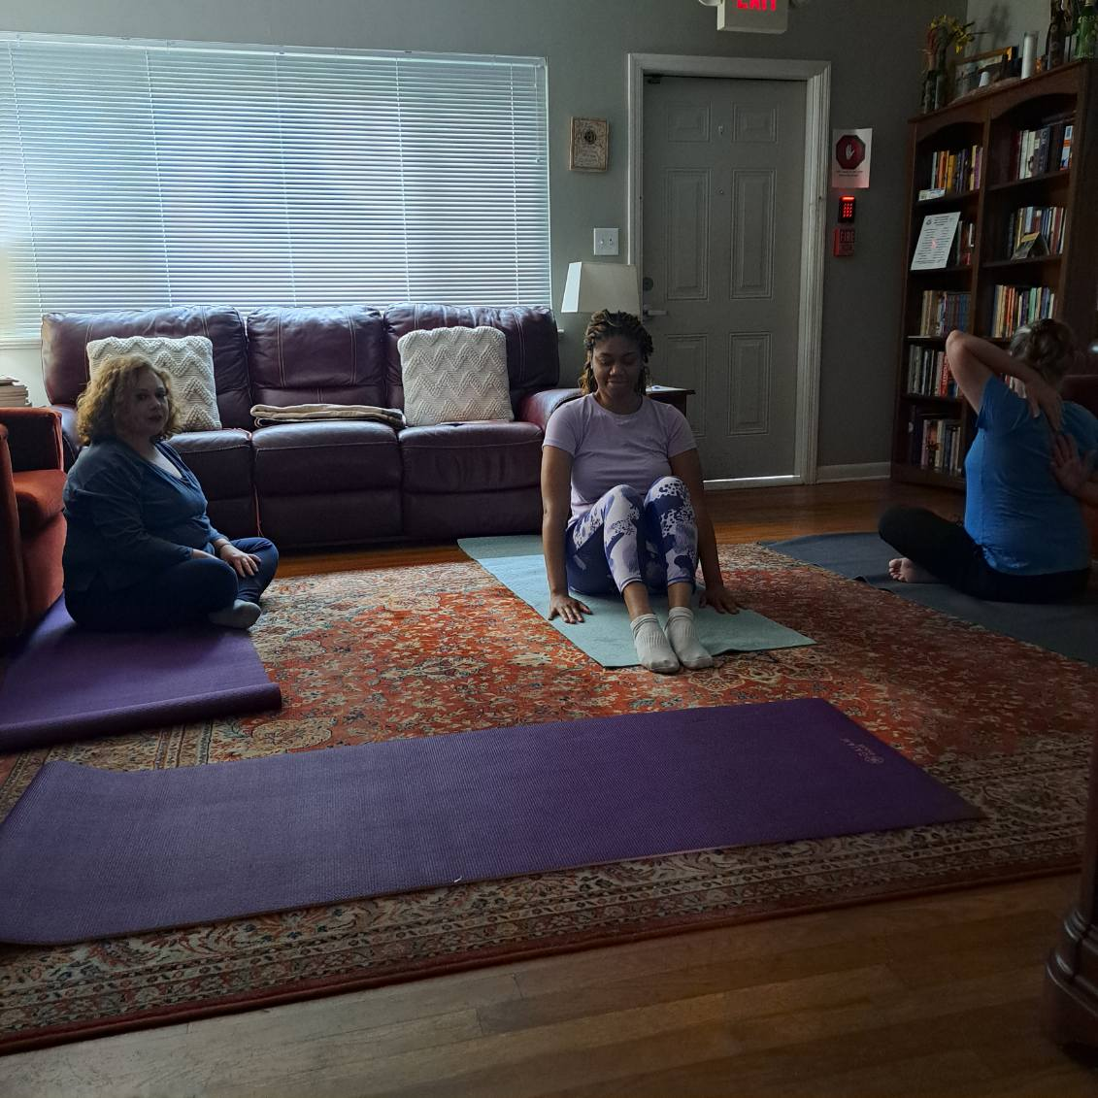
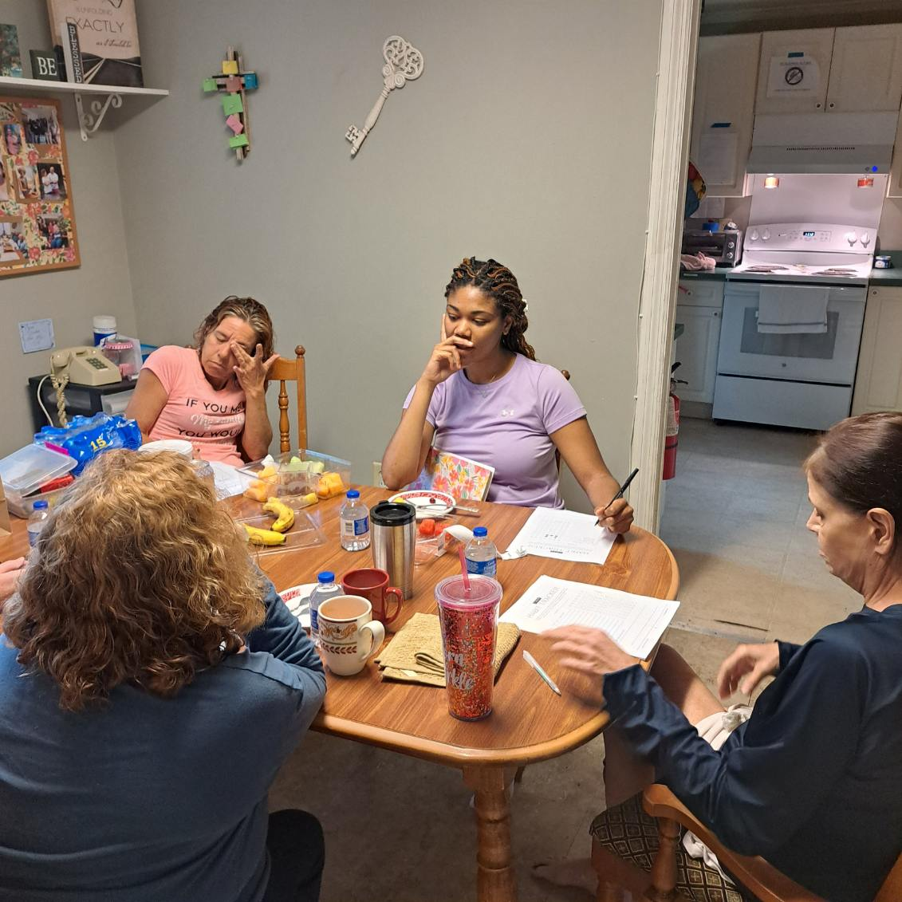
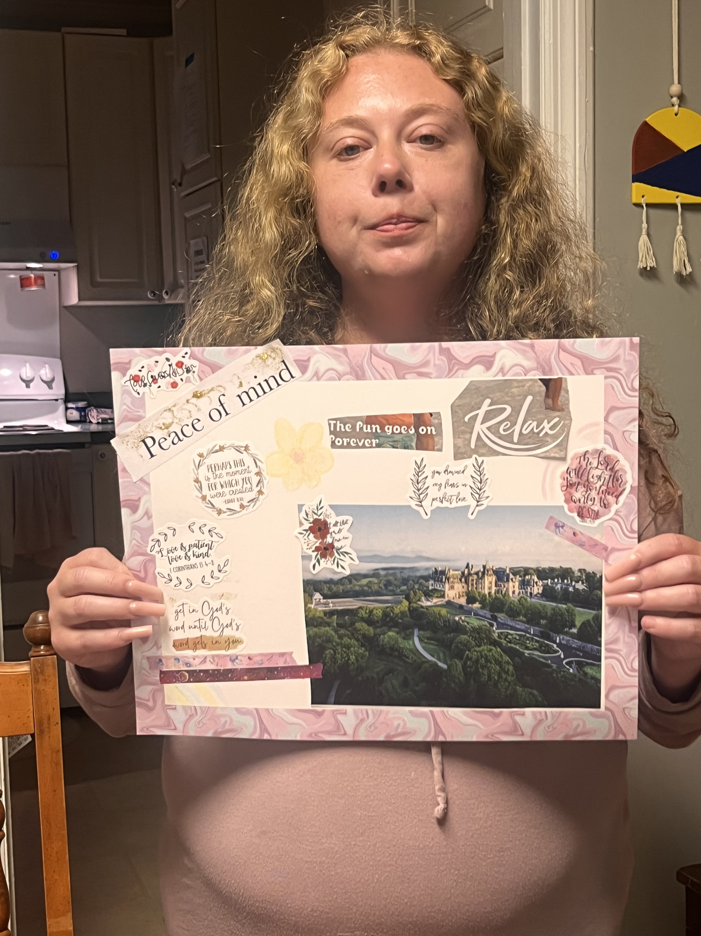
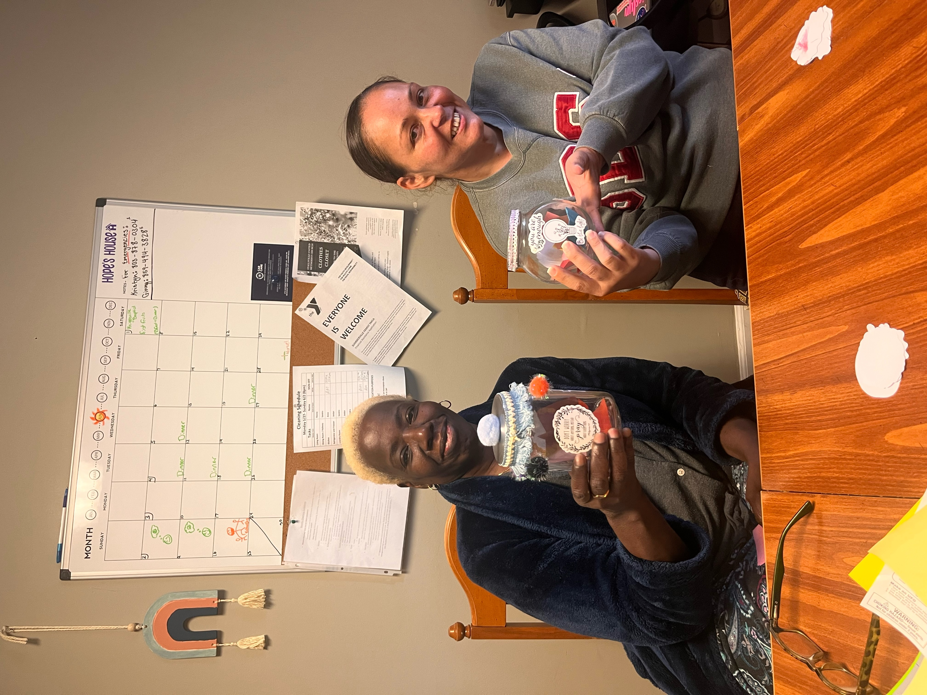
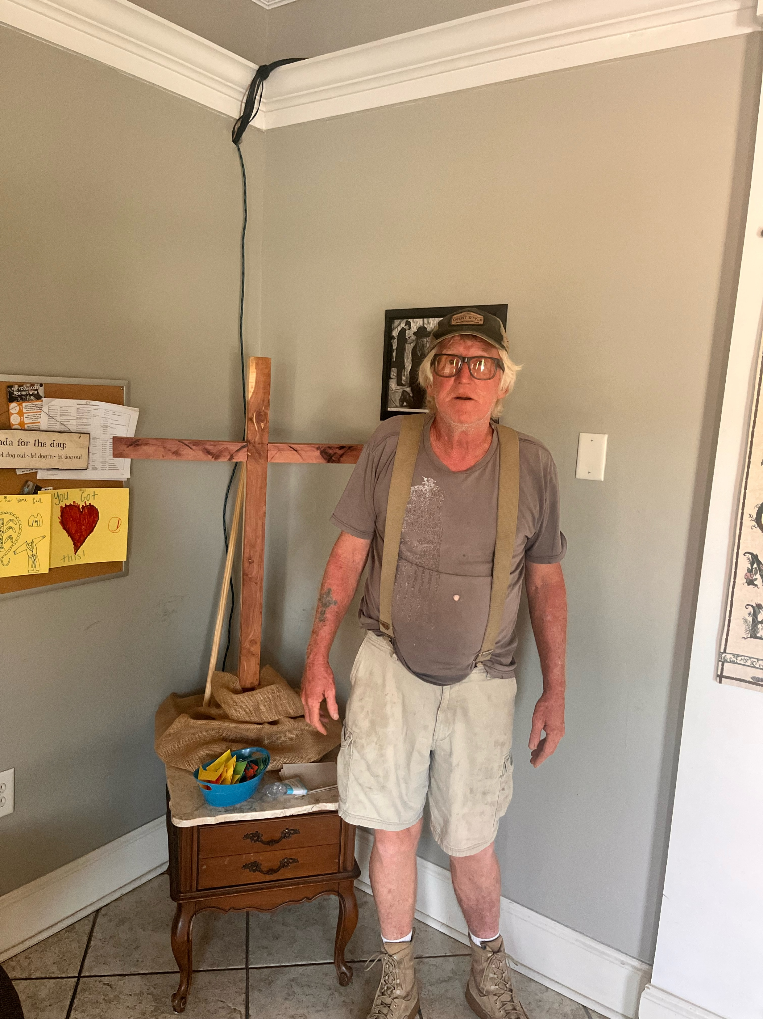
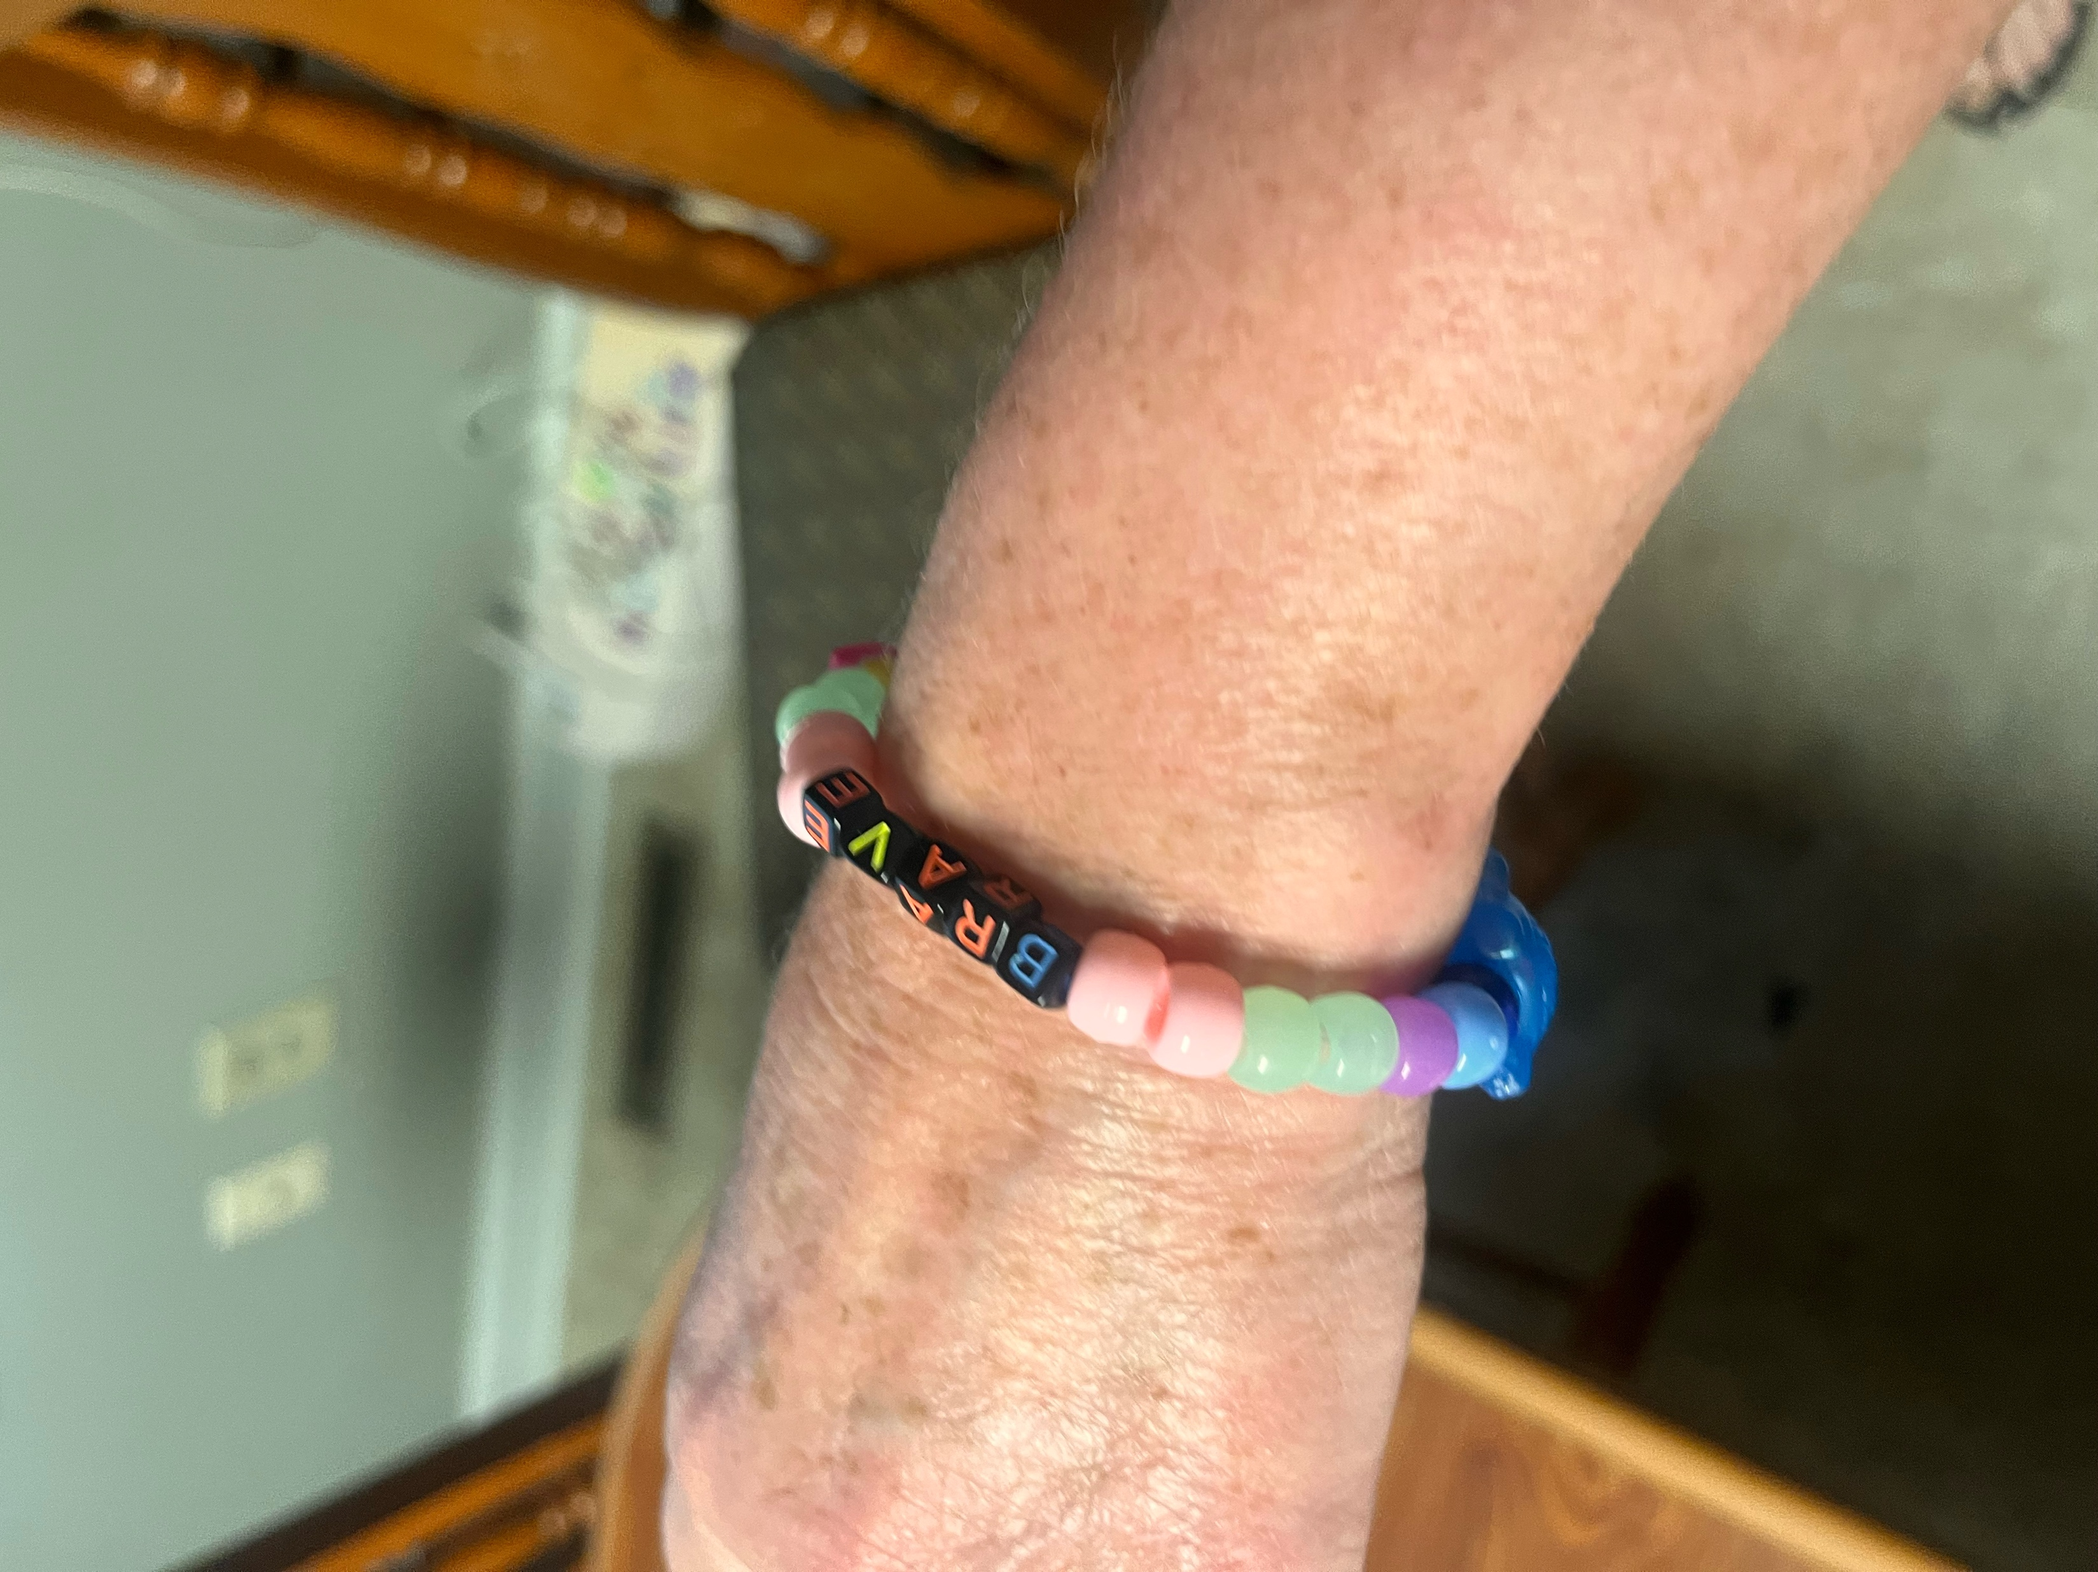
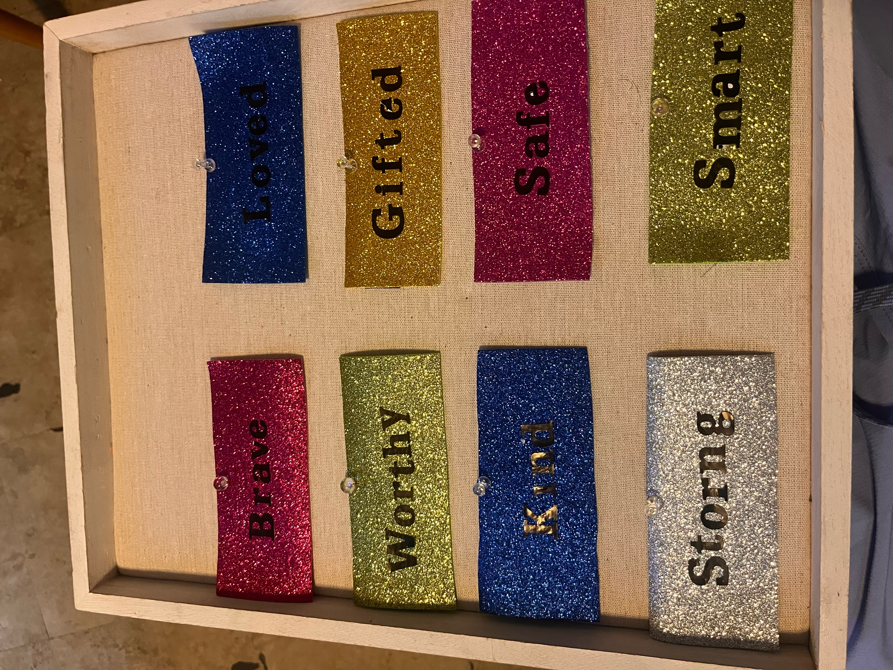

Slide 11
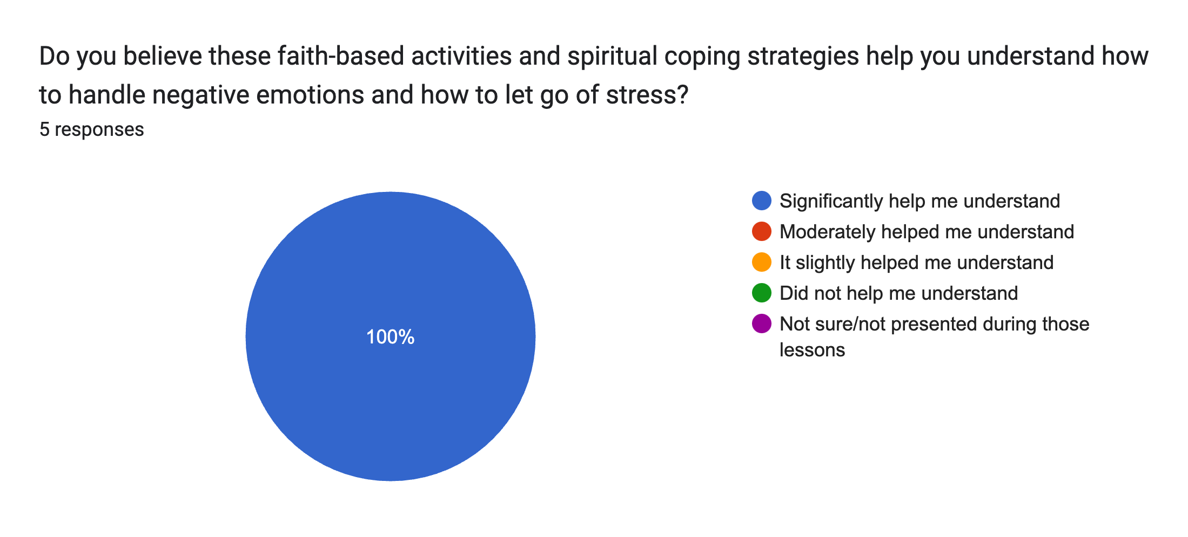
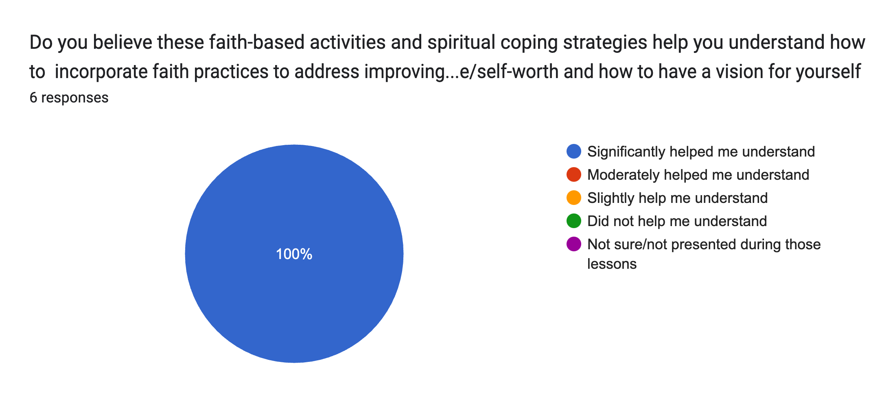
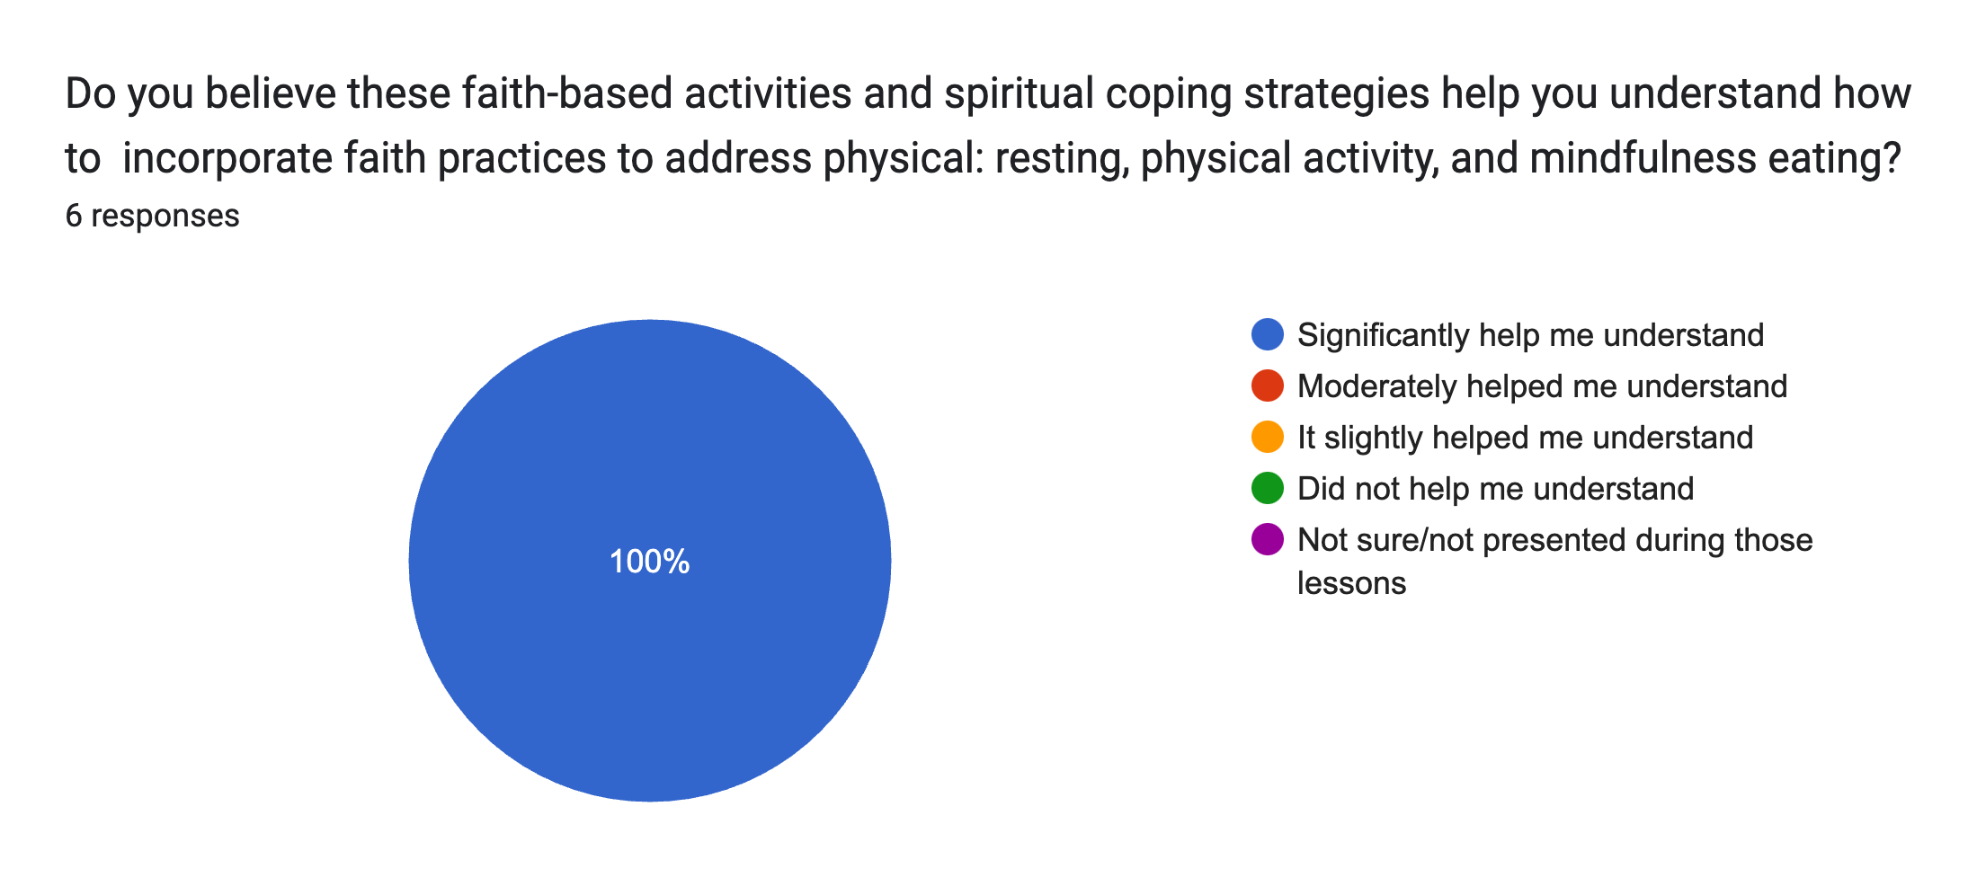
The Impact on The Light House’s Residences

Slide 12
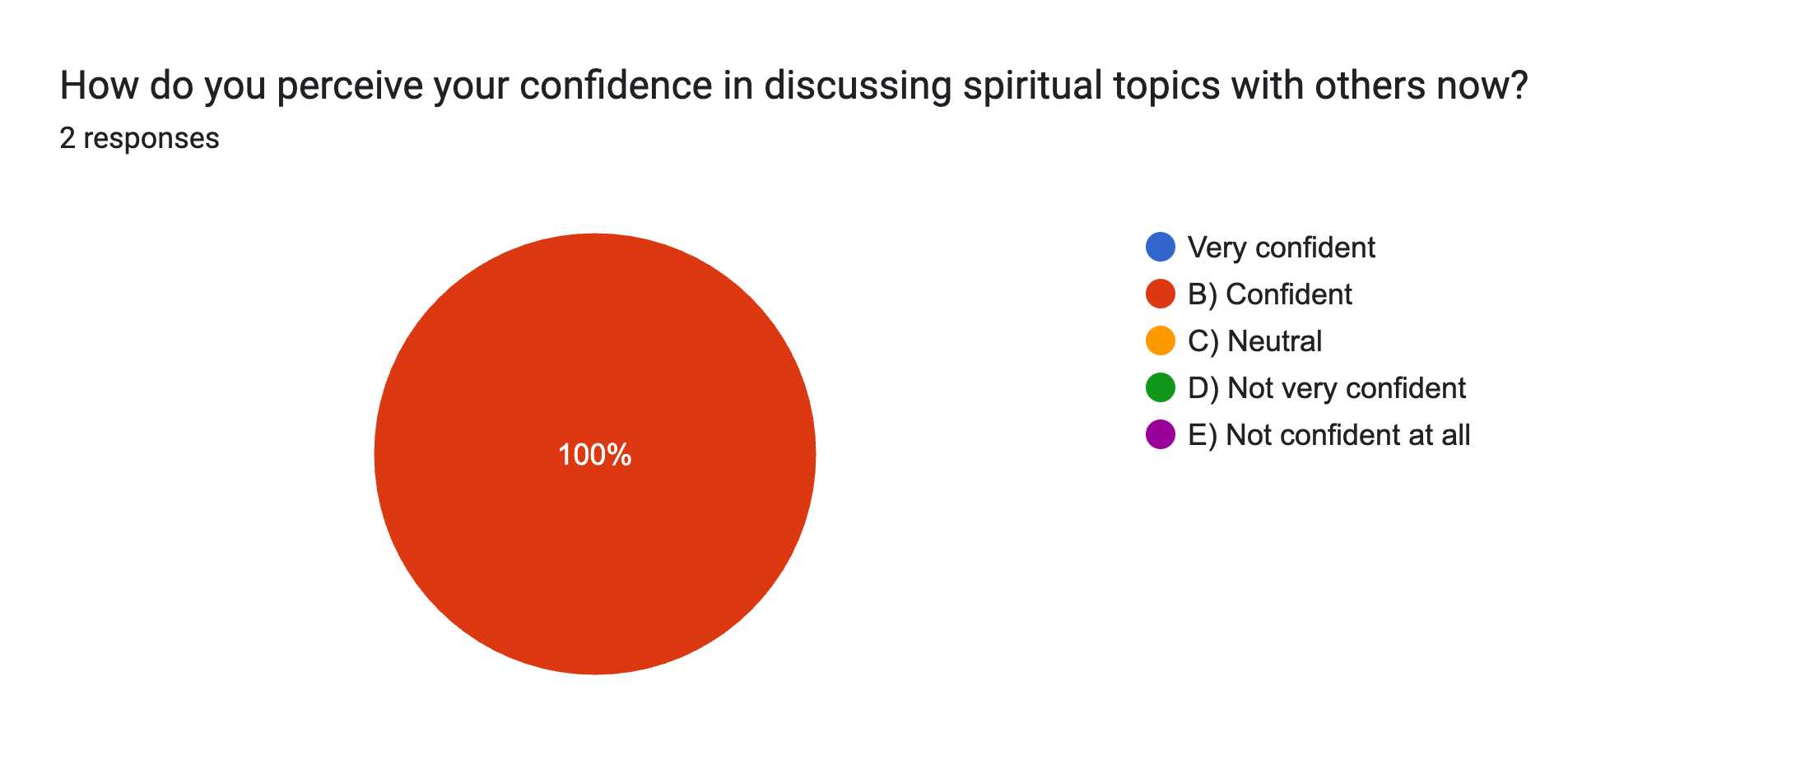
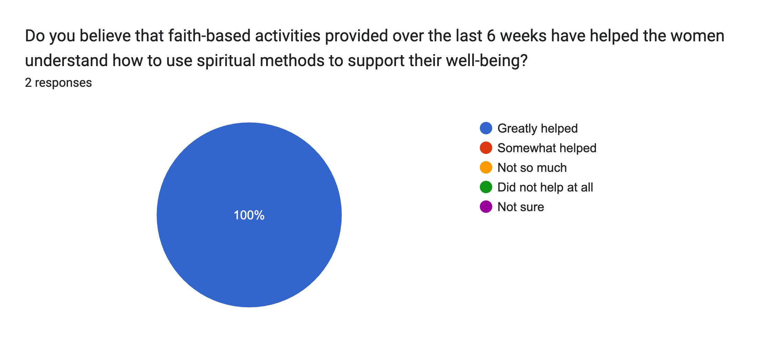
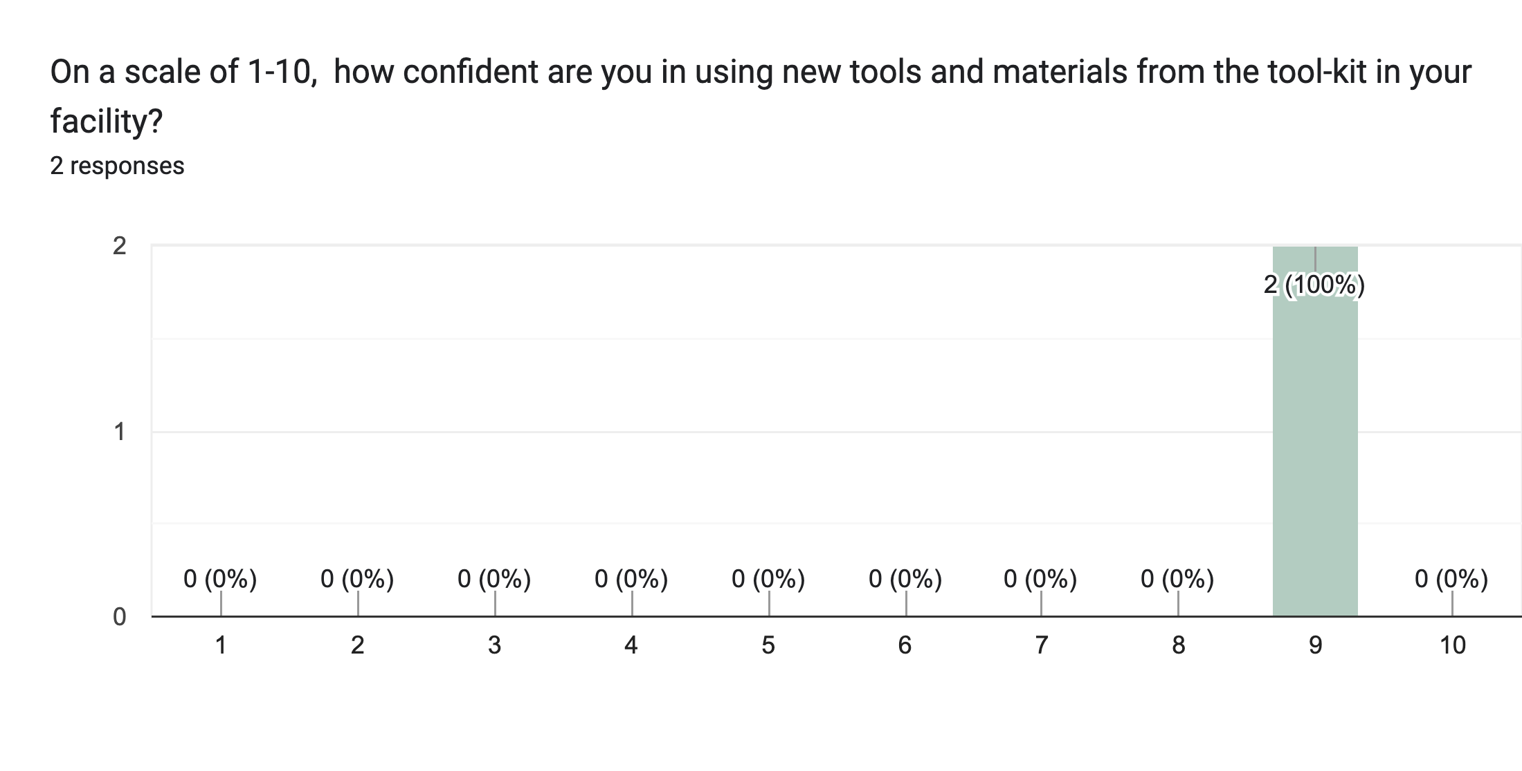
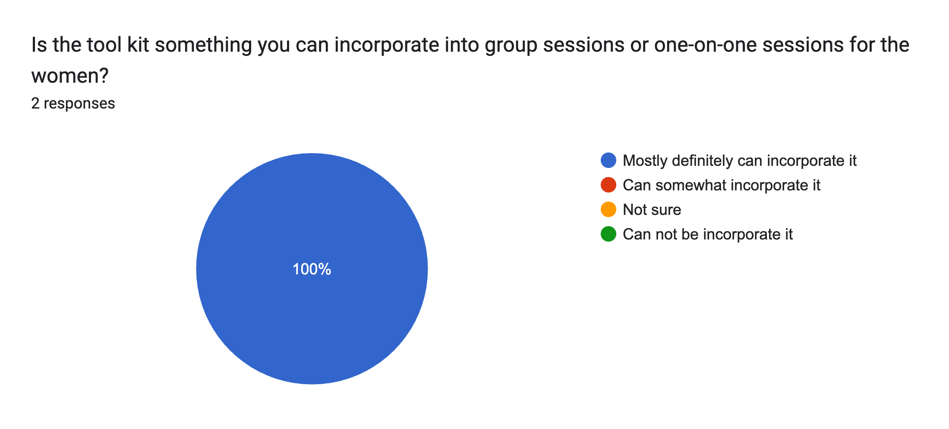
Staff Perspective from The Light House

Slide 13
Personal Statements From The Light House
Participants
Staff
“I didn't realize I needed these activities in my life. It helped me spiritually, mentally, and physically. I am going to continue to practice these coping strategies.”
Resident 1
“The activities and lessons were well-rounded and I love that the guests can do it on their own time.”
Kristyn Lewis Main Supervisor
“I noticed that the activities have helped the newer women come out of their shells, boost their confidence, and give them hope about life.”
- Jay, Afternoon Supervisor
”It was fun to explore the different topics and learn how faith can affect the mind, emotions, and body. It helped me realize I have a stronger power(God) helping me”
Resident 2
"You helped us realize that this population has been unhoused and experienced trauma for some time and that addressing their mental and physical needs is important.”
- Jay, Afternoon supervisor

Slide 14
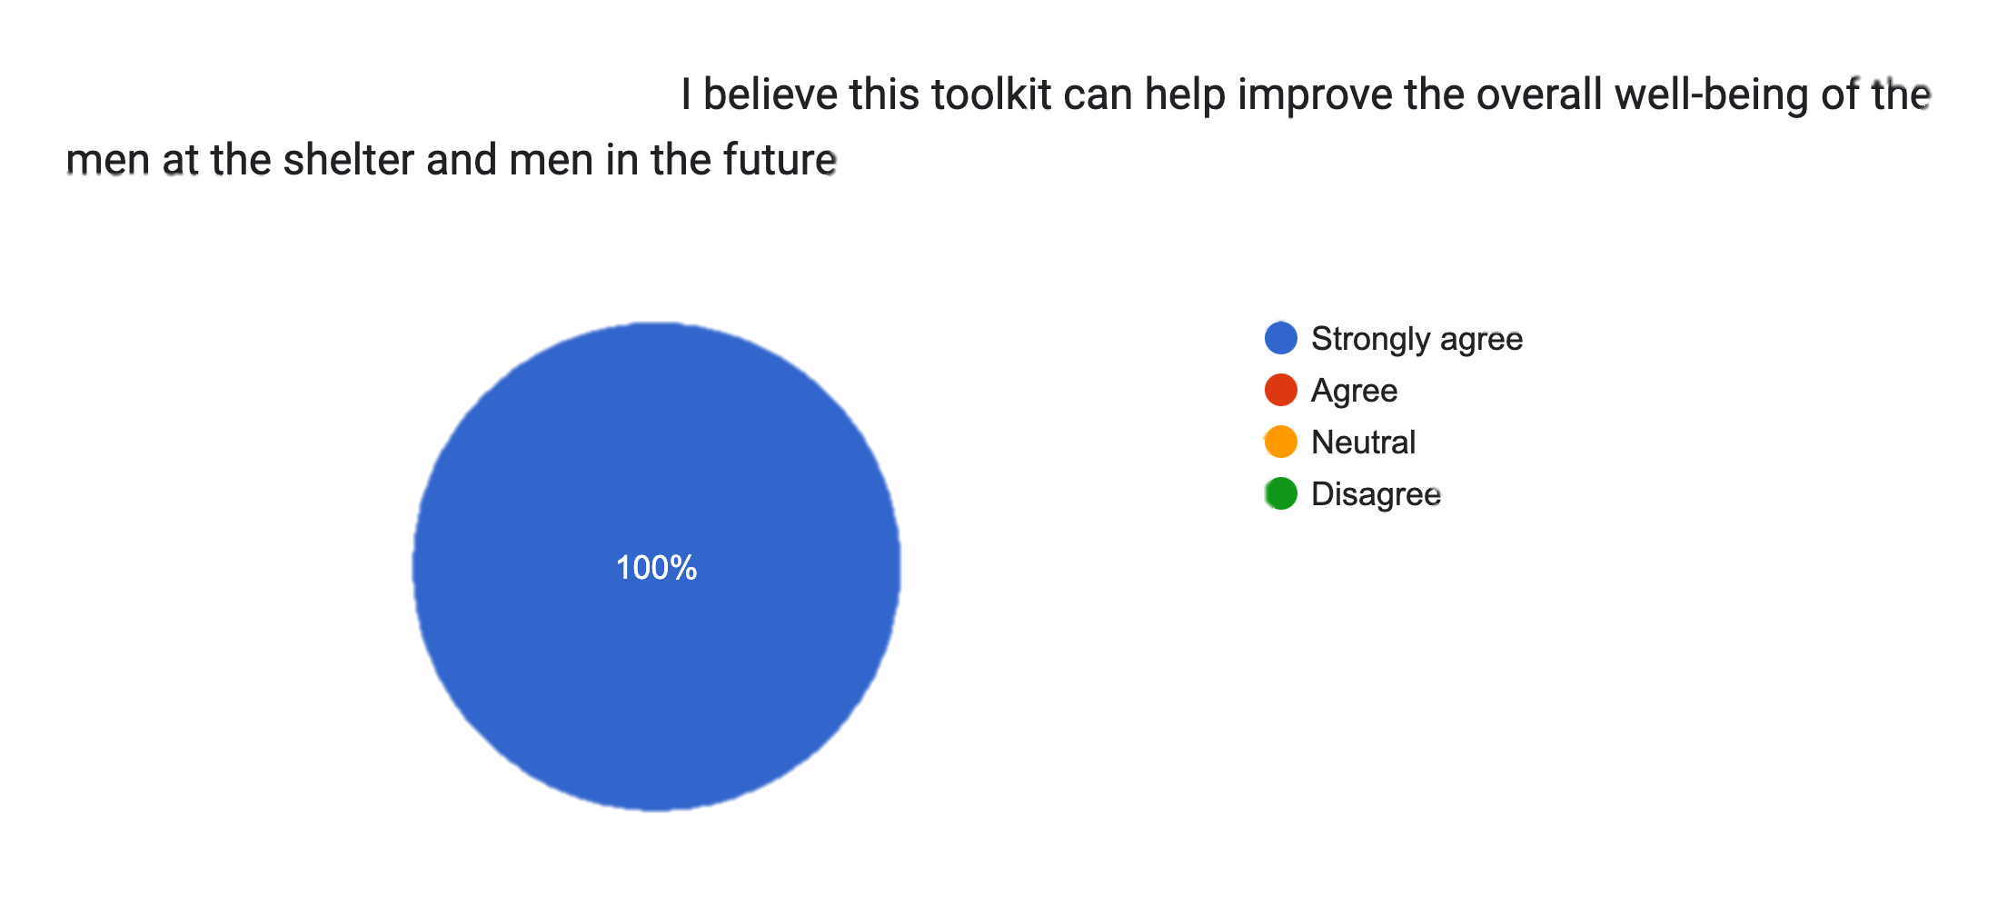
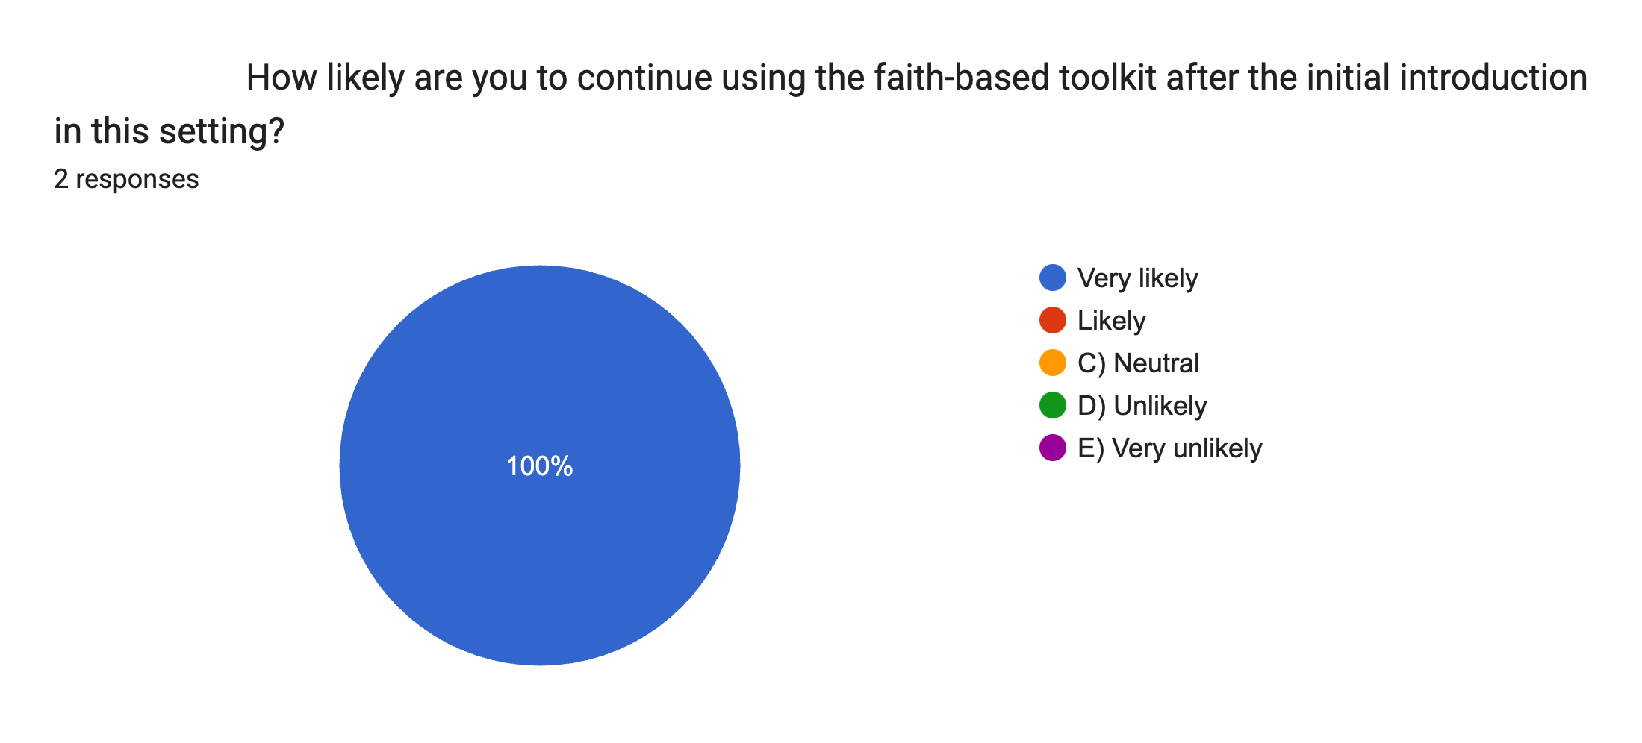
The Impact / Sustainability on The Anchor House
Staff/ Community Partners
“It provides us with input to better understand the needs, concerns, and issues, which helps guide our ministry. Additionally, it allows us to build rapport with the men and others involved.”
The Least of These Ministry
“We can incorporate various avenues of well-being based on faith principles to enlighten individuals in the knowledge of Christ in all areas of our lives.”
- The least of These Ministry
"The men appreciated the resources you provided, even though they didn't participate in the activities."
- Ginny, Executive Director of Keys to Change
Notes:
Lack of participation due to work schdules (40 – 65 hrs a week) or wanting to do it on their own time

Slide 15
Recommendation
Continue to collaborate with participants to make the activities meaningful and purposeful
Stay consistent with doing group activities to continue to improve overall well-being - create a visual schedule/ calendar
Continue to partner with faith-based community partners to ensure support with the implantation of the new program
Adjust and adapt the resources and activities in the toolkit to fit the participant's needs to ensure relevance and effectiveness.
Notes:
Schedules is important because of work schedules and the eagerness of participating

Slide 16
Conclusion
Outcomes
Improved perceived staff confidence & knowledge on how to provide faith-based interventions with residences
Increase future participation in faith-based activities with women
Address the gap in evidence-based research of using spiritual interventions with the homeless population to enhance wellbeing
Enhance a community partner ministry by promoting how to tailor their faith - based interventions to address the needs, concerns, and issues of this population

Slide 17
Impact Of OT
Incorporating spirituality in OT can lead to comprehensive care to addresses both tangible and intangible needs, fostering resilience and hope.
The Capstone Project and experience helped address the gap between the use of spirituality with the homeless population from the OT standpoint.
-That spirituality does have a positive impact on the population
May impact OT practitioners ' awareness of providing services to homeless populations due to their needs being holistic
- use evidence-based research to support this claim
In the same way, let your light shine before others, that they may see your good deeds and glorify your Father in heaven.
Matthew 5:16

Slide 18
ACKNOWLEDGEMENTS
Dr. Joy Crawford, OTD, OTR/L Capstone Faculty Mentor & Coordinator
Kristen, Lewis, Light House’s Main Supervisor Capstone Site Mentor
Jay Reynolds, Light House Secondary Supervisor Capstone supporter
Miss Bell, Anchor House’s Main Supervisor Capstone Site Co-Mentor
The Least of These Ministry Community Supporters

Slide 19
References
NHCHC. (2019, February). Homelessness & Health: What’s the Connection? NHCHC.org. https://nhchc.org/wp-content/uploads/2019/08/homelessness-and-health.pdf
Townsend, E. A., & Polatajko, H. J. (2007). Enabling occupation II: Advancing an occupational therapy vision for health, well-being, & justice through occupation. Ottawa: CAOT Publications ACE.
Vadnais, E. (n.d.). What Spirituality is and How Can it Impact Health &amp, Healing and OT Practice. emmyvadnais. Retrieved September 15, 2022, from https://www.citationmachine.net/apa/citeawebsite/search?q=https%3A%2F%2Fseniorsflourish.com%2Fwp-content%2Fuploads%2F2019%2F07%2FSpiritOT.pdf
Whitehead, L., Vafeas, C., & Towell-Barnard, A. (2022). A qualitative systematic review on the experiences of homelessness among older adults. BMC geriatrics, 22(1), 363–363. England: BioMed Central Ltd.

