Slide 1
Capstone Defense Yoga and Wellness-Based Interventions with Marginalized Populations
Marisa Moore, OTDS
Faculty Mentor: Dr. Hanner
Capstone Site: Upward Inertia

Slide 2
Background and Significance
In the realm of mental health, the intersection of addiction and trauma requires specialized understanding and treatment approaches.
Traumatic experiences, particularly those occurring during childhood, can shape one's beliefs, behaviors, and coping mechanisms well into adulthood.
Due to limited research within the carceral system, additional research is necessary to demonstrate a clear causal relationship between mind-body based interventions (such as yoga asana, breathwork, and mindfulness practices) and recidivism reduction.

Slide 3
Background and Significance
Upward Inertia is a Boise based nonprofit, whose mission is to improve the mental, physical, and social-emotional health and wellbeing of marginalized populations through the use of therapeutic yoga and mind-body based interventions. Ongoing programming is currently offered at 5 Idaho prisons, both men's and women's facilities, ranging from minimum to maximum security (Upward Inertia, 2022).
Upward Inertia meets the criteria for trauma programming through a variety of methods and approaches tailored to the specific needs of trauma survivors.
Need for funding to expand Upward Inertia’s programming to pediatrics and other underserved populations.

Slide 4
Purpose and Specific Aims
PURPOSE:
To support marginalized populations with increased access to effective holistic health programming within their communities.
AIMS:
Increase my knowledge of yoga and wellness-based related activities to gain insights into how the programming affects different populations.
Enhance my leadership skills needed to support a nonprofit organization and individuals of marginalized communities.
Gain an understanding of how program curriculum is created and maintained to enhance Upward Inertia’s program for at-risk and underserved communities.

Slide 5
Supporting Framework
The Person-Environment-Occupation-Performance Model (PEOP)
Three components of the PEOP Model are characteristics of the person, features of the environment, and characteristics of the activity, task, or role (Baum, et. al, 2015).
The needs assessment found that there is a need for Upward Inertia’s expansion to the pediatric population, so the curriculum will be adapted to fit the characteristics of the pediatric population, environment, and their roles.

Slide 6
Stakeholders and Population
Participants:
Kaelyn Rogers, OTR/L: Upward Inertia executive director and program developer
Dr. Linsey Belisle: Boise State University, Department of Criminal Justice
Dr. Jacoba Rock: Boise State University, Department of Social Work
Stakeholders:
Idaho Department of Corrections
Community-Based Organizations in Boise, ID: Boise Area Schools, Agency for New Americans, Center for Change, Women’s and Children’s Alliance, Boise Rescue Ministries, and Boys and Girls Club.

Slide 7
Methods

Slide 8
Methods
Participants:
Sample size: n = 11
(5 prisons + 6 Community-Based Organizations)
Idaho State Correction Center (Medium and Minimum Security Men's), Idaho State Correctional Institute (Medium Security Men's), Idaho Maximum Security Institute (Maximum Security Men's), South Idaho Correctional Institute (Minimum Security Men's, Minimum and Medium Security Women's), and South Boise Women's Correctional Center (Minimum Security Women’s).
Community-Based Organizations in Boise, ID: Boise Area Schools, Agency for New Americans, Center for Change, Women’s and Children’s Alliance, Boise Rescue Ministries, and Boys and Girls Club.
Type of project:
Quality improvement
Participated in preparation for research through the IRB approval process

Slide 9
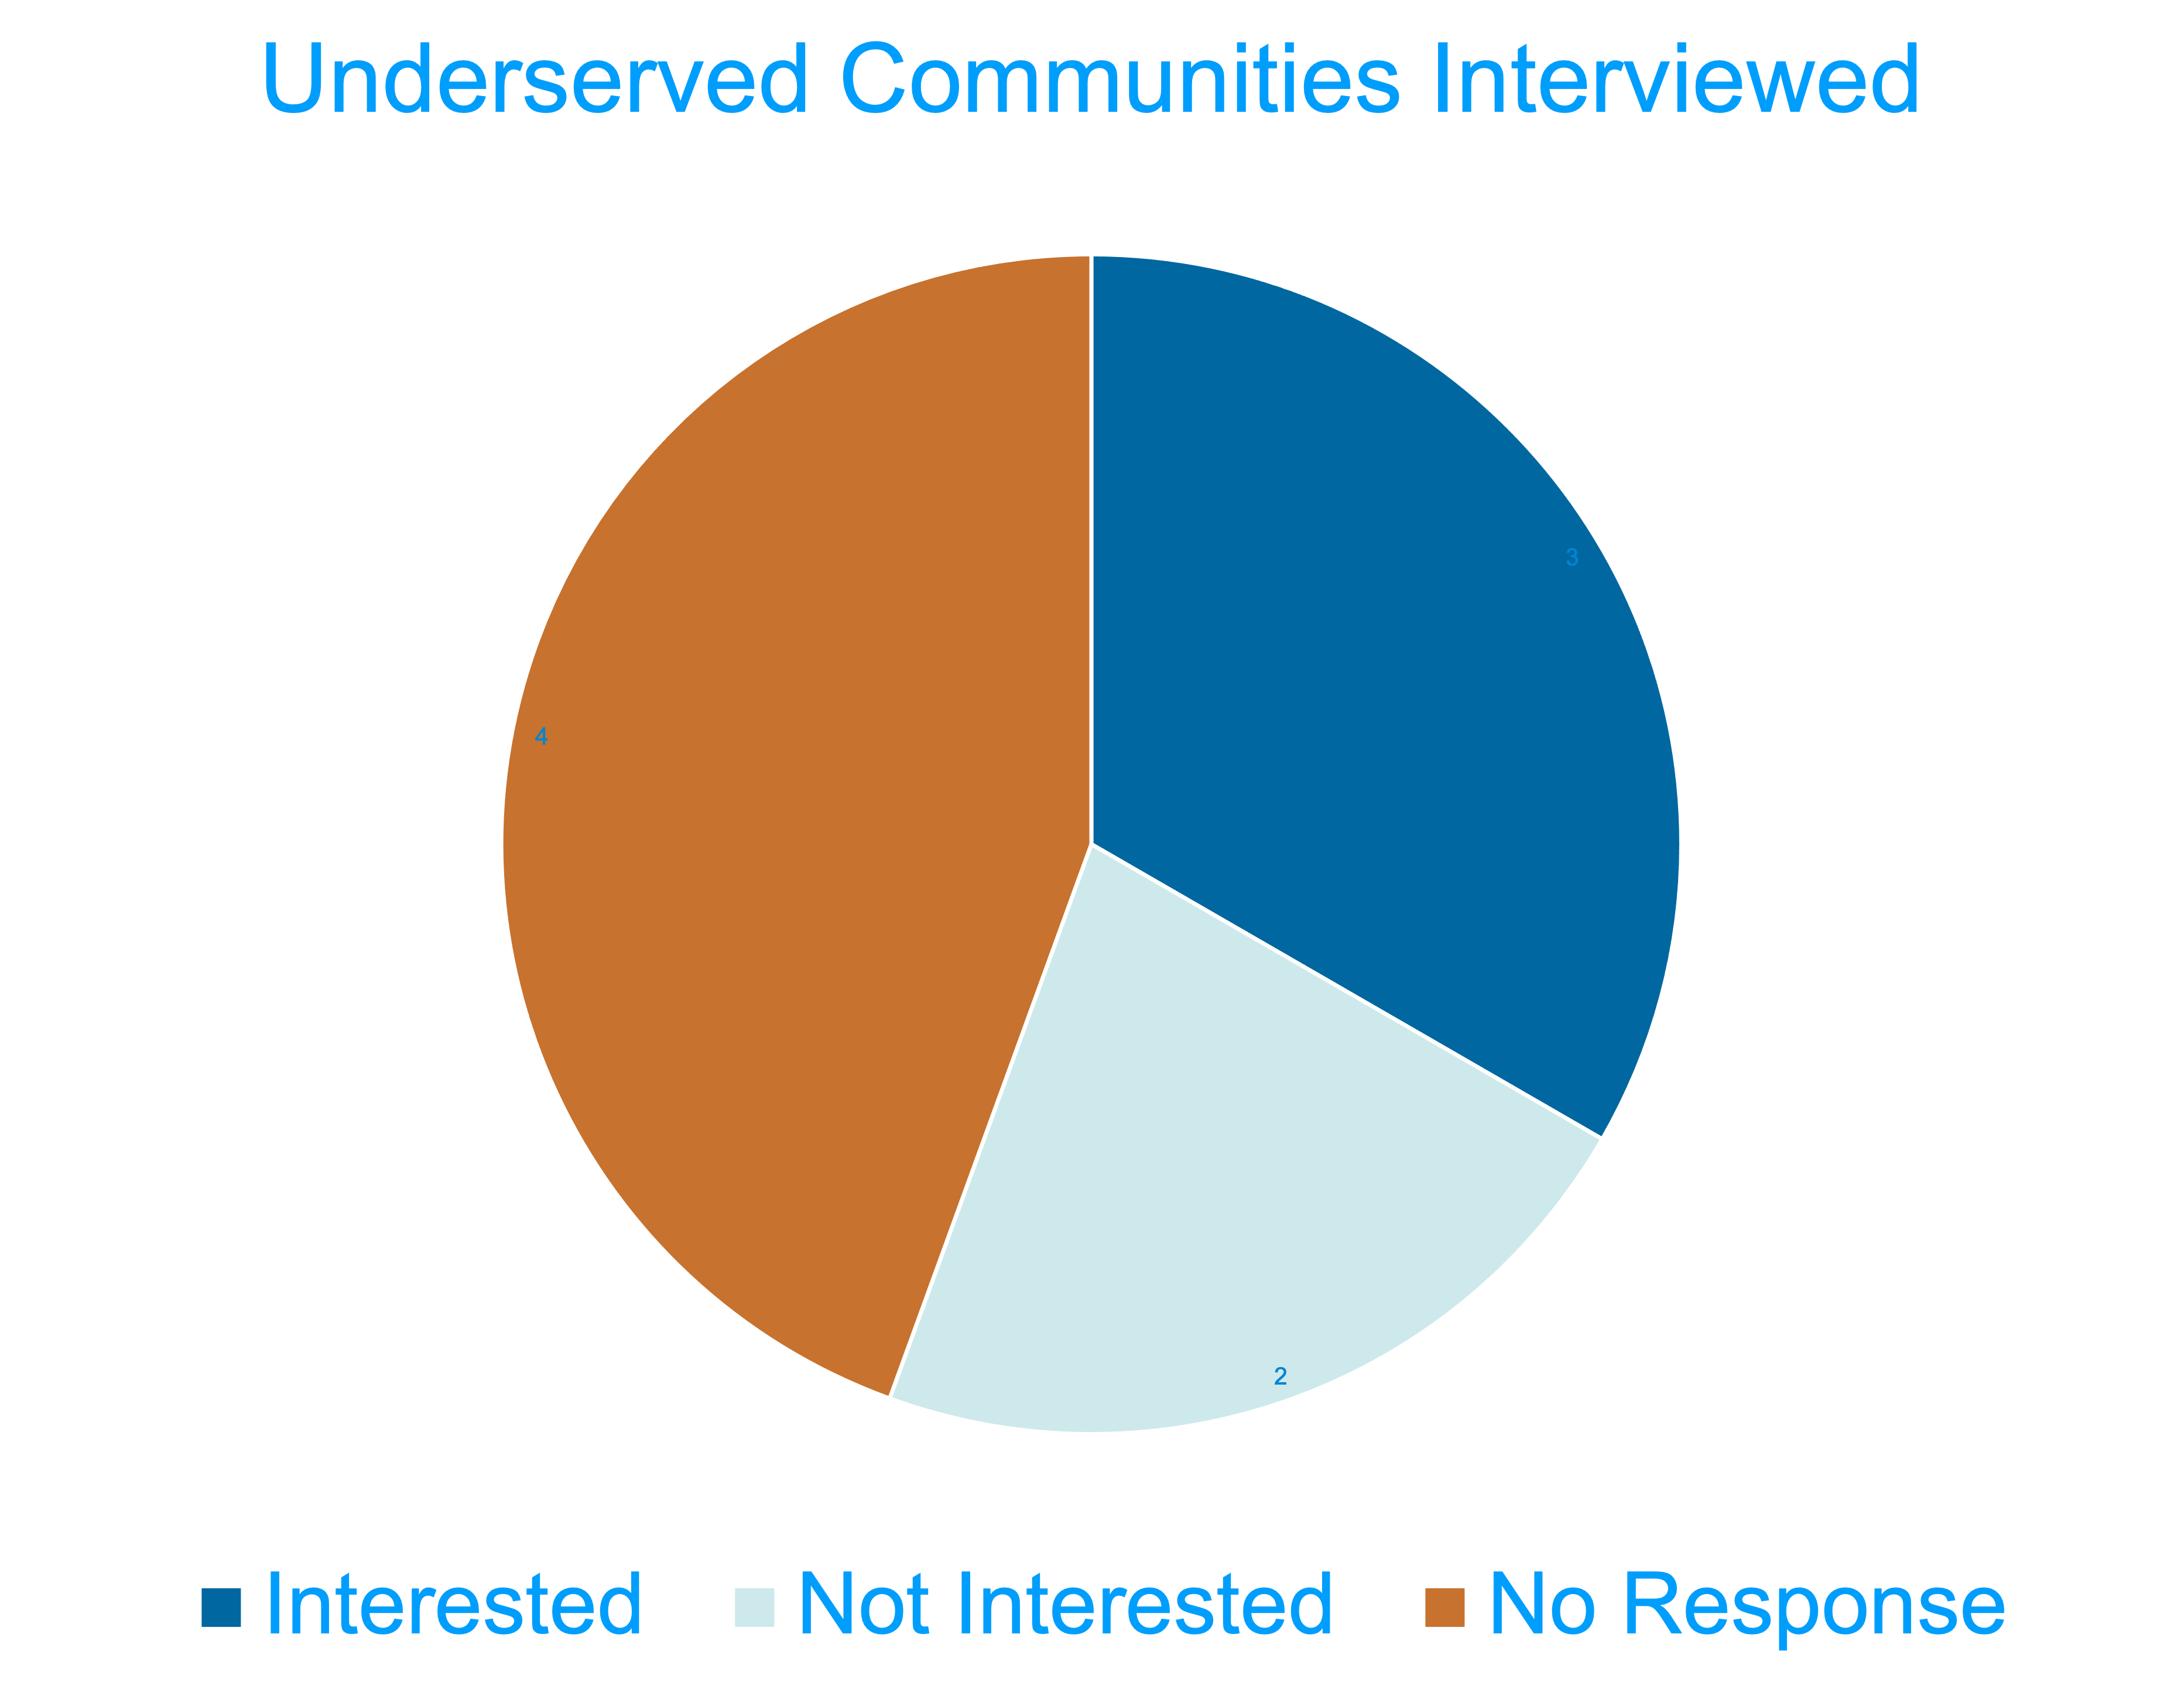
Data Collected and Key Findings
Participants:
An analysis of qualitative interview data with five community-based institutions in Boise identified a common theme of the need for more curriculum-based mental health programming. The five community-based organizations identified that they currently all provide mental health and wellness-based services, however, their members would benefit from a structured, research-based program like Upward Inertia provided that would be accessible to everyone.
Key Findings:
There is a community interest, however, there is difficulty to move forward without communication, staffing, and funding. While community organizations originally expressed interest, it was noted that communication was often lacking and follow through on their part was limited. From Upward Inertia's perspective, they will require additional funding and staffing to move forward.

Slide 10
Data Analysis and Results
Analysis:
Difficulty reconnecting with interested stakeholders from prior year
There is excitement to expand Upward Inertia, but difficulty securing sustainable funding limiting expansion efforts at this time.
Results:
Current stakeholder and participant verbal buy-in
Pending connection with different organizations

Slide 11
Strengths and Weaknesses
Strengths:
Staff leadership and time investment into program
Participant buy-in and positive impact on mental and physical health
Sense of community and routine with weekly classes and structured curriculum
Limitations:
Limited ongoing communication with community stakeholders
Current limited funding to facilitate expansion
Staffing changes with Upward Inertia and stakeholders
More time = More attrition
Should shorten curriculum due to participants being released from prison
Class cancelations lead to poor attendance following weeks

Slide 12
Experience and Deliverables

Slide 13
Experience and Deliverables
Experience:
Participated in Upward Inertia classes with current curriculum in 5 different prisons
Contacted stakeholders
Participated in pediatric self-regulation programming CEU
Participated in weekly yoga classes
Researched and applied for grants and sponsorships
Weekly meetings with faculty and staff
Evidence-based research on a variety of pediatric and trauma-informed topics
Participated in IRB approval process
Deliverables:
Adapted and created pediatric curriculum
Assisted in IRB approval process by creating:
Literature reviews
Backgrounds on trauma, mental health, yoga, wellness-based programming
PowerPoint presentations
Formatted surveys
Canva posts to facilitate with program's mission and facilitate expansion

Slide 14
Deliverables
Pediatric Curriculum:
Paper to Kaelyn Rogers
Will be utilized and submitted to IDOC once more funding and staffing are resolved
Dependent on stakeholder responses
Will start with juvenile department of corrections
Slowly integrate into community stakeholders

Slide 15
Deliverables and Measures
IRB Surveys:
Research for current prison population
Delivered March 16
Paper submission to IRB along with abstract/ literature review/ background
Pending approval this month
Approval would mean more research can be conducted to show the effectiveness of Upward Inertia's programming for future stakeholders to help facilitate expansion to other populations

Slide 16
Impact
Impact of expanding Upward Inertia to work with other marginalized populations
based off prior research in the adult prison system:
Improved mental health outcomes
Improved physical health outcomes
Safe space to address and cope with hard topics surrounding topics
Sense of community
Sense of routine

Slide 17
Feedback
Participants from Idaho Department of Corrections:
“This class has made me feel more at peace and more mindful to others. Yoga has dramatically affected my PTSD in ways that that I never thought possible. I sleep better and am able to call my kids without having any issues because of the combination of breathing techniques and other teachings that Kaelyn presents to us. I try to get all of my friends to go to this yoga class because it just makes you a better person. “
- Inmate at ISCI
“My total wellbeing has improved since I began to attend. Not only am I improving my physical health but my emotional health and stability are markedly better…I tend to be more at peace, mindful of others, and compassionate. It seems to me that every person at this facility reaps the benefits either directly or indirectly. It is truly my favorite time of the week and I look forward to everything I will learn.”
- Inmate at ISCI

Slide 18
Feedback
Interview with Kaelyn Rogers:
“I think it’s so important to offer this curriculum for children so that this information can be provided in a preventative capacity.
My hope is that if they get the information it will help them to navigate stressful situations in the future with a sense of empowerment and clarity (and subsequently reduce drug use and impulsive behavior).
With your curriculum, I appreciate that you made the topics and activities more kid friendly by making it bite sized and experiential - mostly through adapting the discussion.
I think kids will have less experience to pull from and less self awareness, so addressing the topics through experiences and collaboration will feel more relevant. They also likely wouldn’t have the attention span to benefit from the discussion.”

Slide 19
Sustainability
To keep this program sustainable, there must be:
Stakeholder buy in
Funding through grants, donations, and stakeholders
Staffing consistency
Positive outcome measures
Continuous evidence-based research

Slide 20
Future Impact
Decrease in recidivism rates
Coping mechanisms and tools for mental health and wellness taught to younger generations
Create a sense of community and support for those who participate in the structured programming

Slide 21
Recommendations
Underserved communities in Boise, ID outside of the prison system have the opportunity to incorporate Upward Inertia’s curriculum into their organizations to meet the psychosocial needs of their members. Upward Inertia should continue to expand to other populations and settings that also include youth participants through teacher trainings, revised curriculum, and additional funding.

Slide 22
Potential impact of your project on the discipline of OT
OTs can work in nontraditional settings and promote health and wellness through this capstone project.
This curriculum can be integrated into the school setting, outpatient setting, and inpatient setting as well.
Clients will be given the tools and resources they need to participate in mental health and wellness education.

Slide 23
Conclusion
Improved staff knowledge on pediatric programming
Improved outcomes of participant mental health levels
Positive feedback given from participants on capstone project
“I wouldn’t have been in jail if I had this program when I was younger.”
Successful set-up for expansion of nonprofit
Now dependent on IRB process, funding, stakeholder buy-in, and staffing

Slide 24
Acknowledgements
Faculty mentors: Dr. Nadine Hanner and Dr. Sammons
Capstone Site Mentor: Kaelyn Rogers, OTR/L, RYT
Capstone Coordinator: Dr. Joy Crawford
Capstone Site and Staff: Upward Inertia

Slide 25
References
Conscious empowerment through yoga therapy. Upward Inertia. (2022). Retrieved July 28,
2022, from https://www.upwardinertia.com/
Craswell, G., Dieleman, C., & Ghanouni, P. (2020). An integrative review of sensory
approaches in Adult Inpatient Mental Health: Implications for occupational therapy in prison-based mental health services. Occupational Therapy in Mental Health, 1–28. https://doi.org/10.1080/0164212x.2020.1853654
Kerekes, N., Brändström, S., & Nilsson, T. (2019). Imprisoning Yoga: Yoga Practice May
Increase the Character Maturity of Male Prison Inmates. Frontiers in Psychiatry, 10, 406–406. Switzerland: Frontiers Research Foundation.
Moscoso, D. I., Goese, D., Van Hyfte, G. J., Mayer, Z., Cain, L., Kobiernicki, F., Cano-Garcia,
A., Unzueta, C., Ormaza, L. T., & Jones, K. (2019). The impact of yoga in medically underserved populations: A mixed-methods study. Complementary therapies in medicine, 43, 201–207. https://doi.org/10.1016/j.ctim.2019.02.005

Slide 26
Thank You!

