Slide 1
Camp Cardiac:
A Pediatric Inpatient Camp Program Aimed to Improve and/or Remediate Psychosocial Difficulties Through Play
Katja Ehlers OTDS
Faculty Mentor: Dr. Joy Crawford
Capstone Site: Camp Rise Above

Slide 2
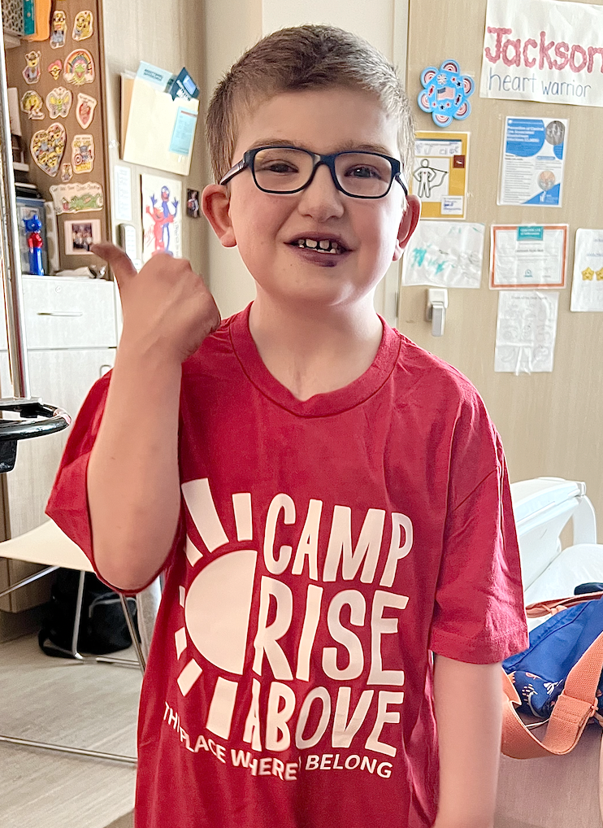
Abbreviation Key:
CRA = Camp Rise Above
SJCH = Shawn Jenkins Children’s Hospital
OT = Occupational Therapy
RN = Nurse
CLS = Child Life Specialist
LOS = Length of Stay (in days)

Slide 3
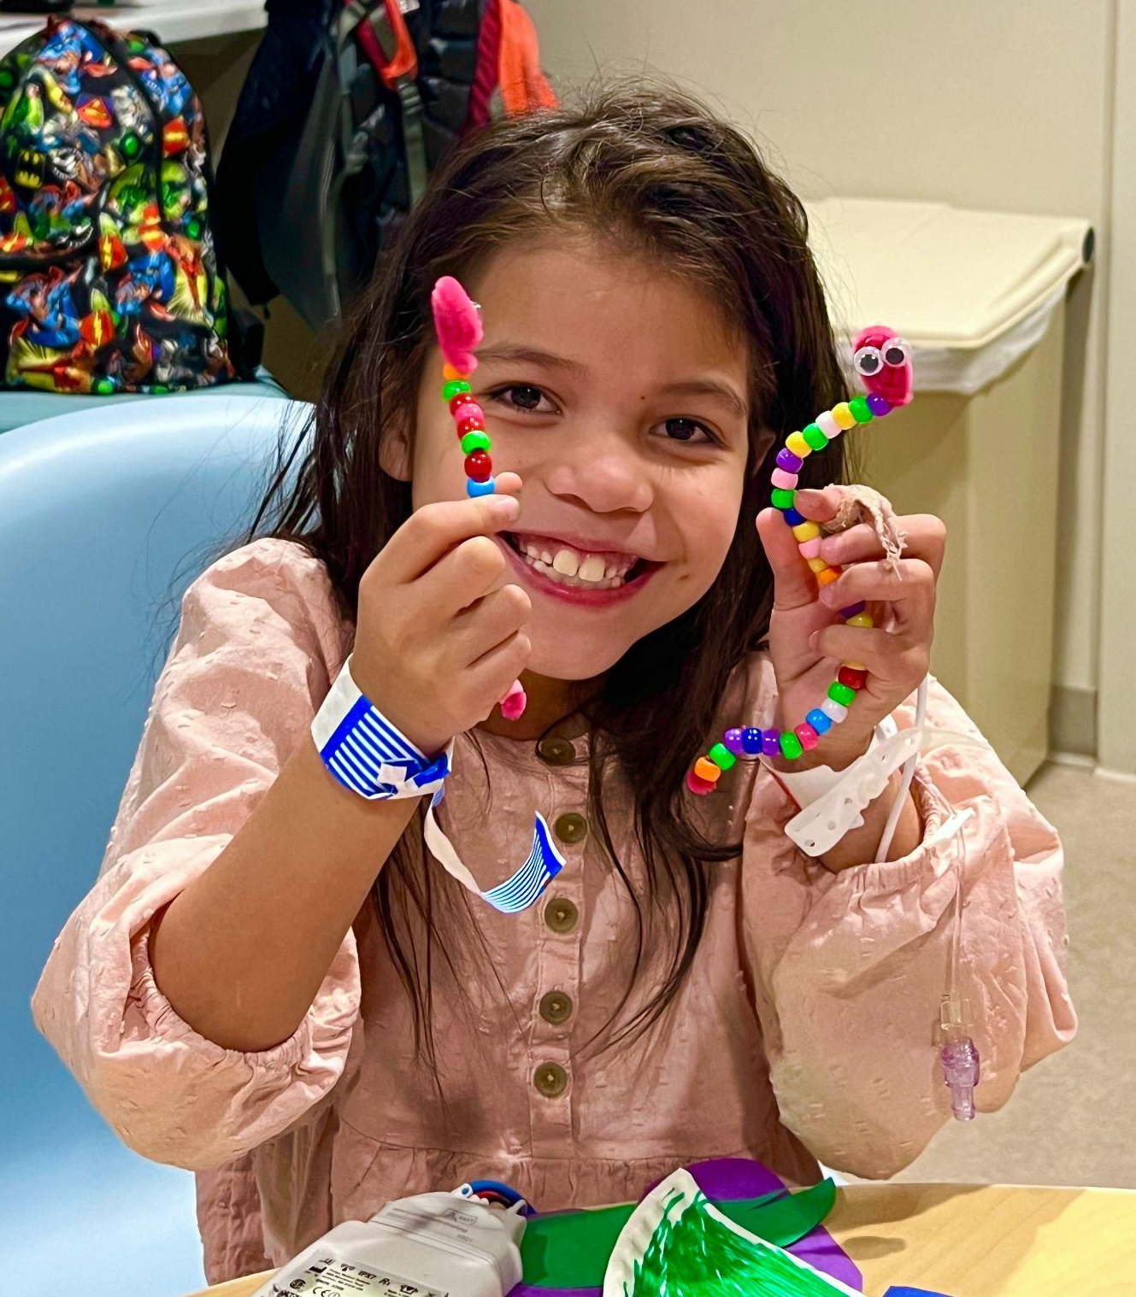
Background & Gap
Why hospital camps?
When children are placed in acute care, their time for play may be limited for many reasons. In order to meet crucial milestones in areas such as imaginative and social play, autonomy development, and emotional ideas, play must be utilized
(Nijhof, et.al, 2018).
Play allows for the interpretation and expression of some of the strong emotions the children may be experiencing daily
(Cahill, et. al, 2020).
Need for increased opportunities for peer interaction and play

Slide 4
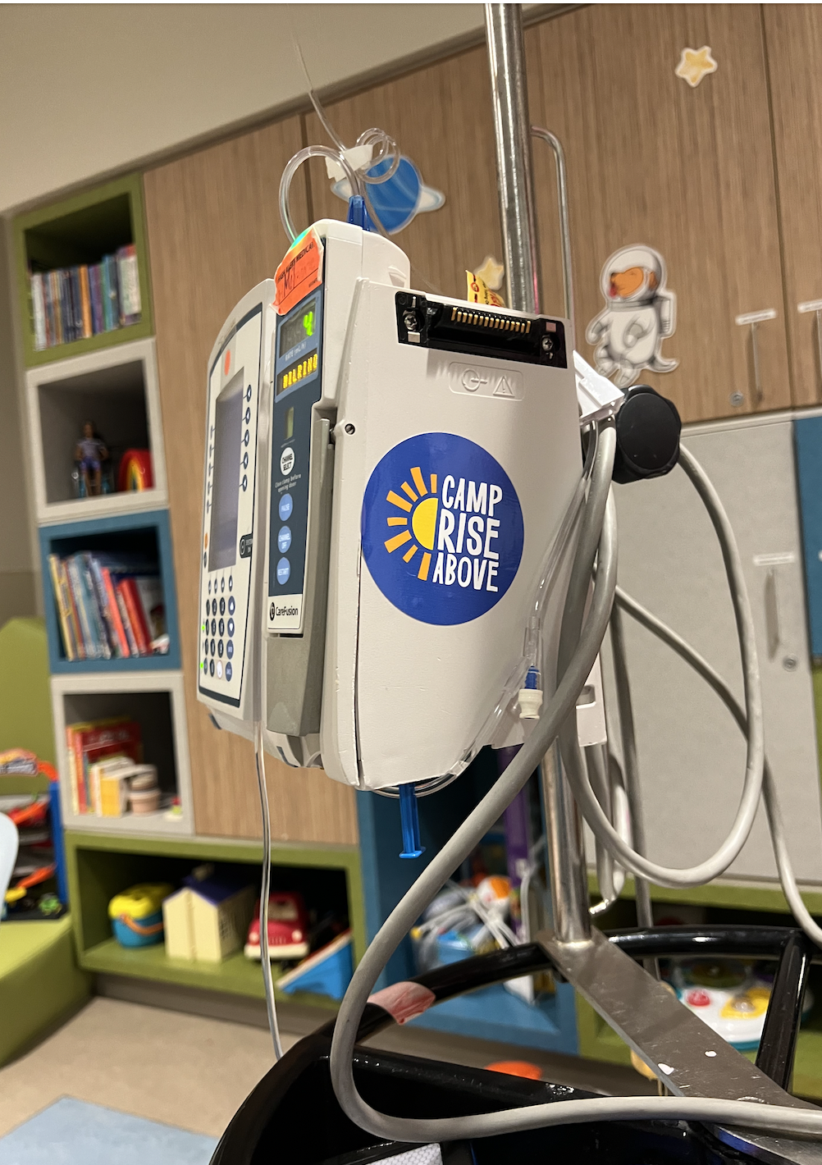
Background & Gap
Why the SJCH Heart Center?
On average a child with a congenital heart defect has a 4x longer length of stay in a hospital than that of a child without a congenital heart defect (Edelson,2021)
For status 1A candidates, median wait times were 108 days (Williams, 2022)
Increased chance of psychosocial difficulties due to prolonged hospitalizations
The Society of Thoracic Surgeons National Database 2018 Annual Report (STS 2018)
Surgery | Off Bypass Aortic Constriction | VSD | TOF | AVC | ASO | ASO + VSD | Glenn/Hemi Fontan | Fontan | Truncus | Norwood
Average postoperative LOS (days) | 12.5 | 8.5 | 11.9 | 16.9 | 16.8 | 19.1 | 14.3 | 13.6 | 33.5 | 45.7

Slide 5
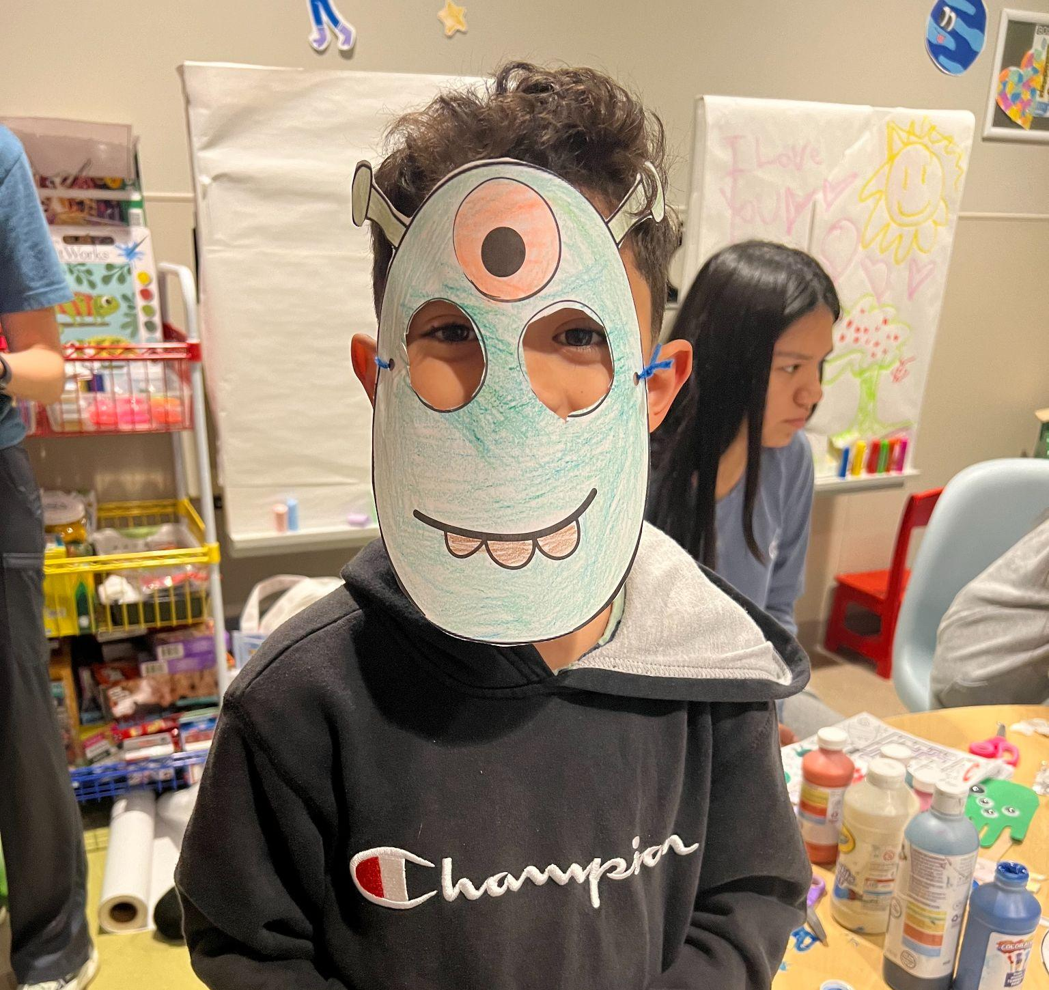
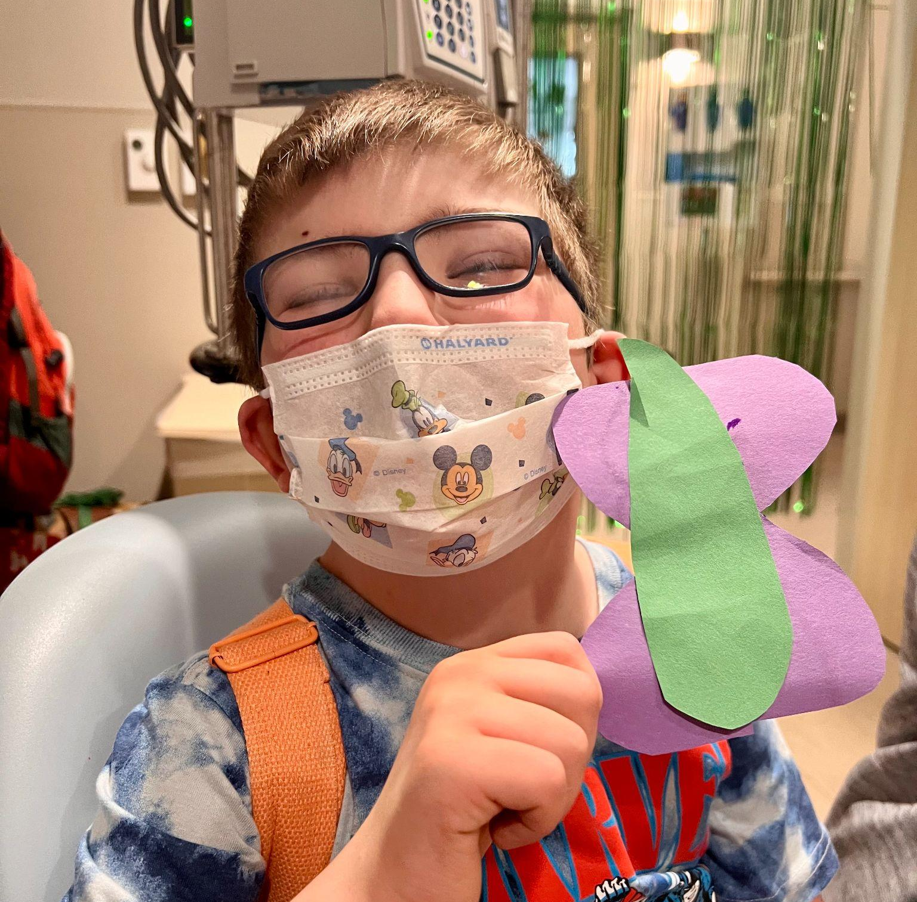
Purpose and Aims
Aim
Increase patient and family members’ engagement in the occupation of play
Purpose
Develop and implement day camp sessions to increase engagement in play to lessen and/or remediate psychosocial difficulties children potentially face following prolonged hospital stays
Deliverable
Create unit specific hospital camp programming and resources for Camp Rise Above

Slide 6
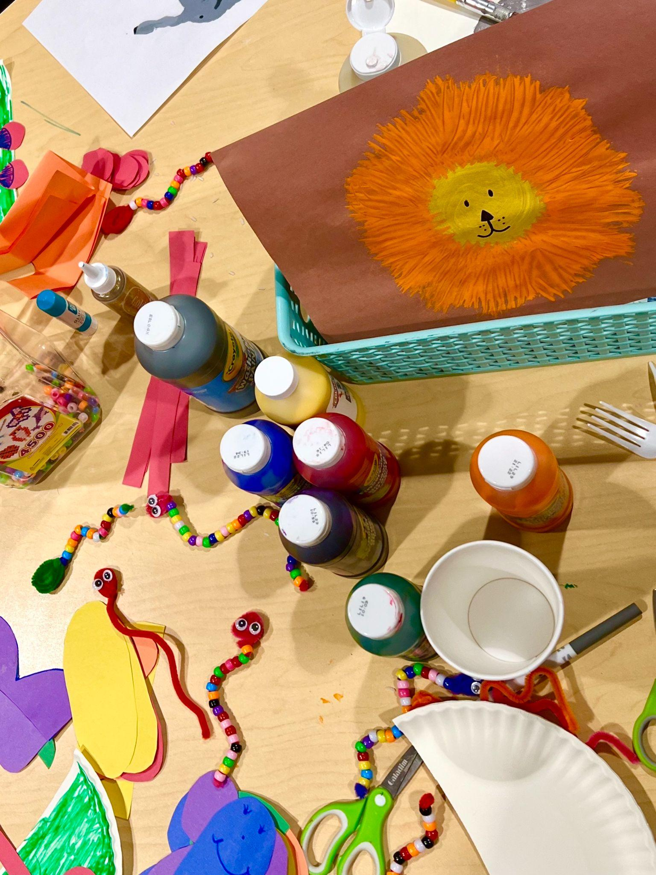
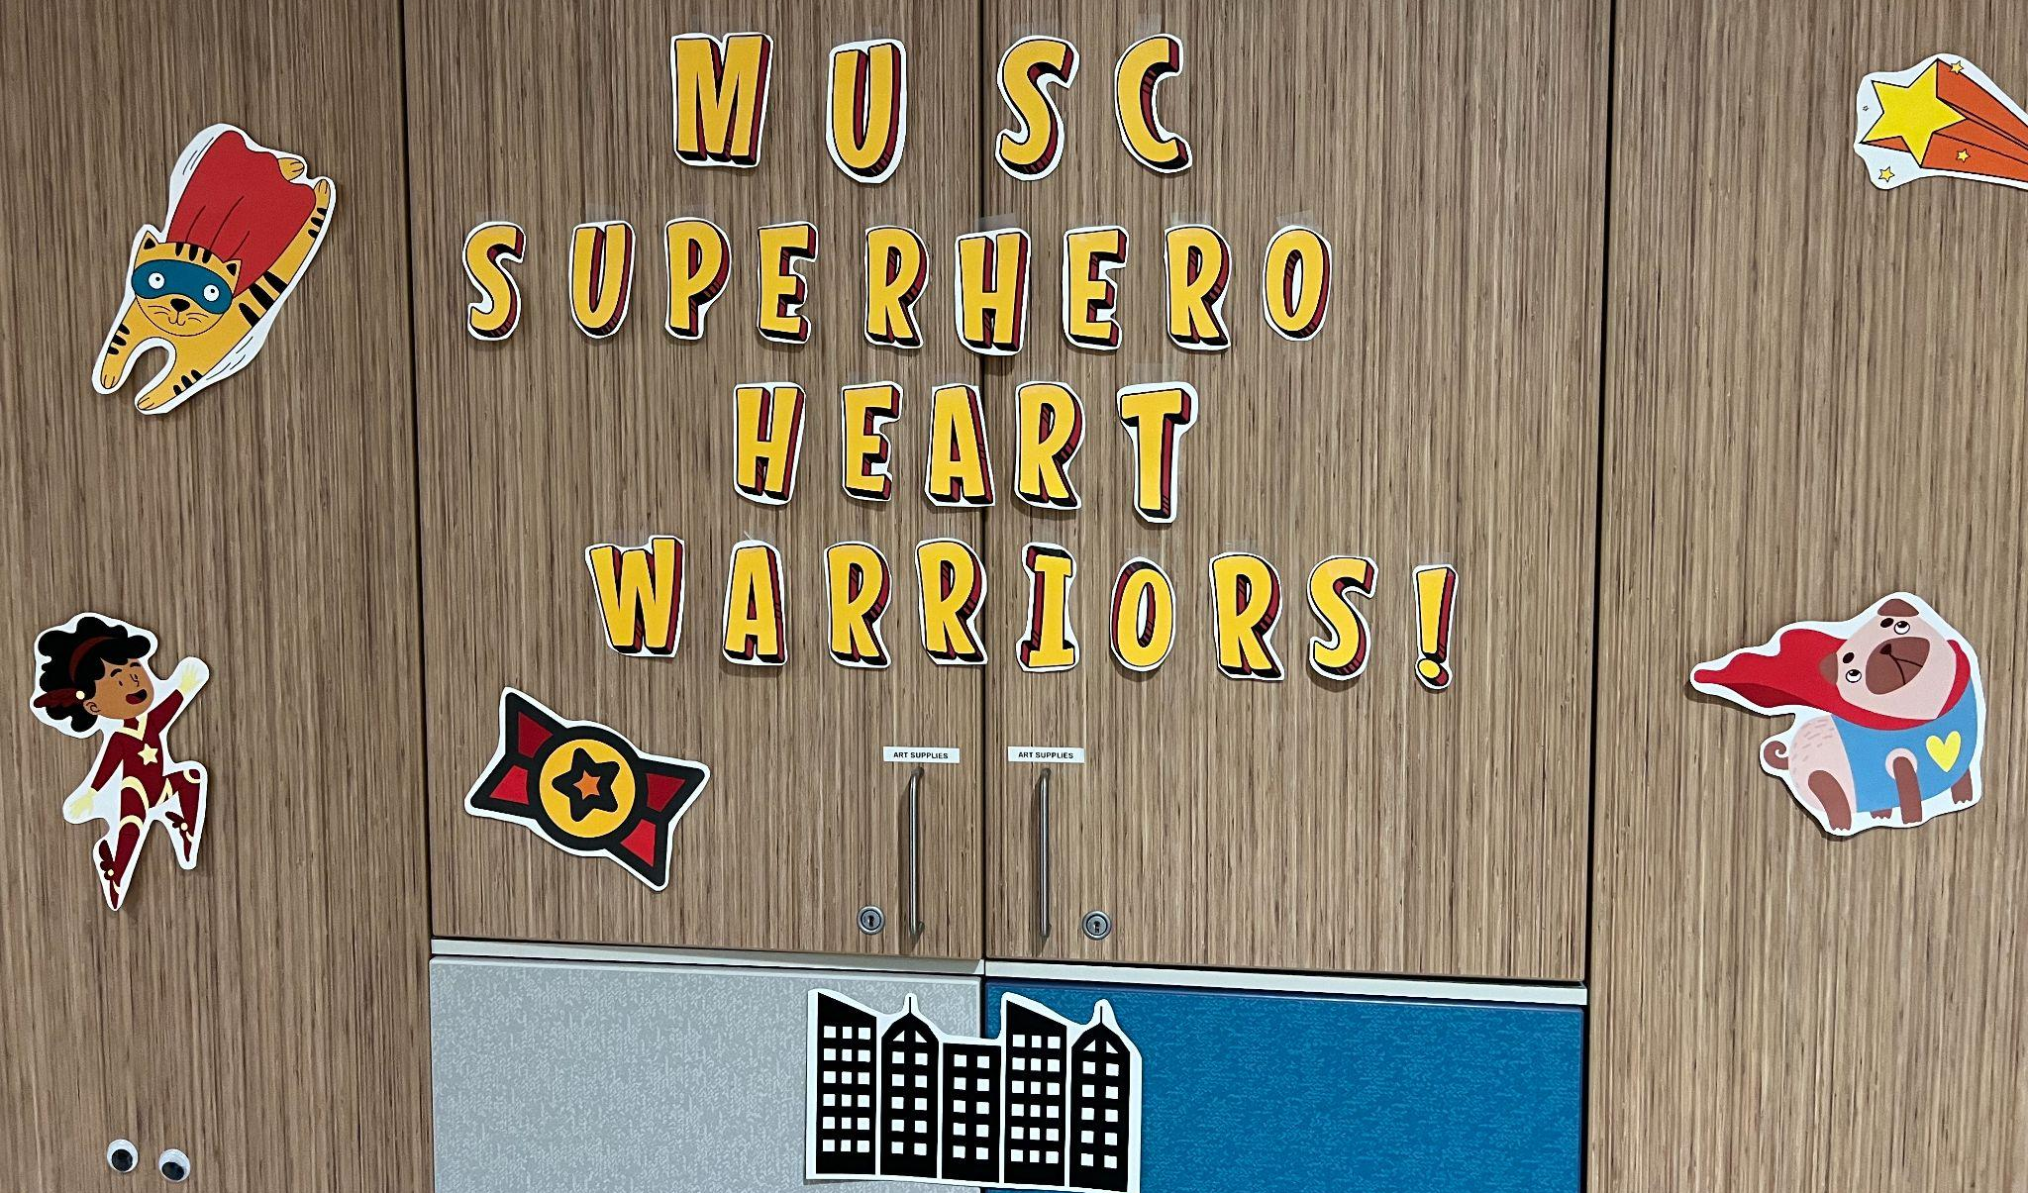
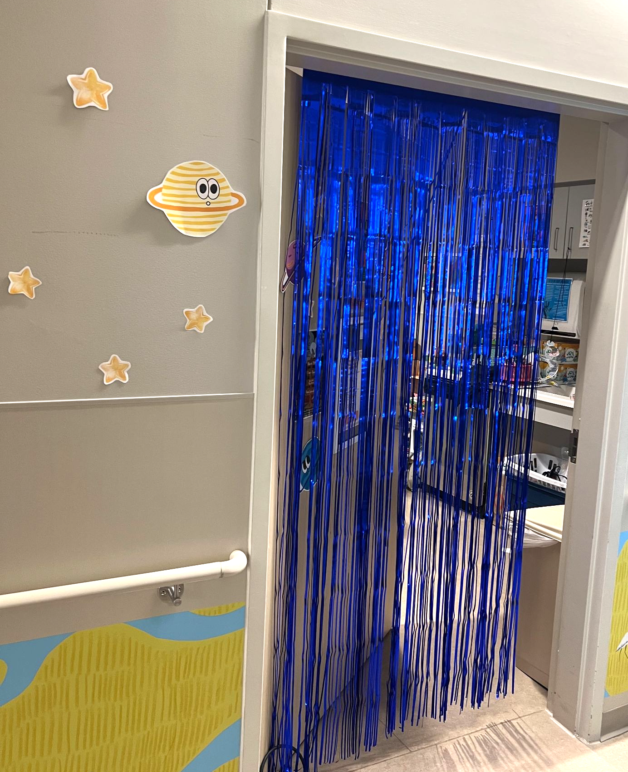
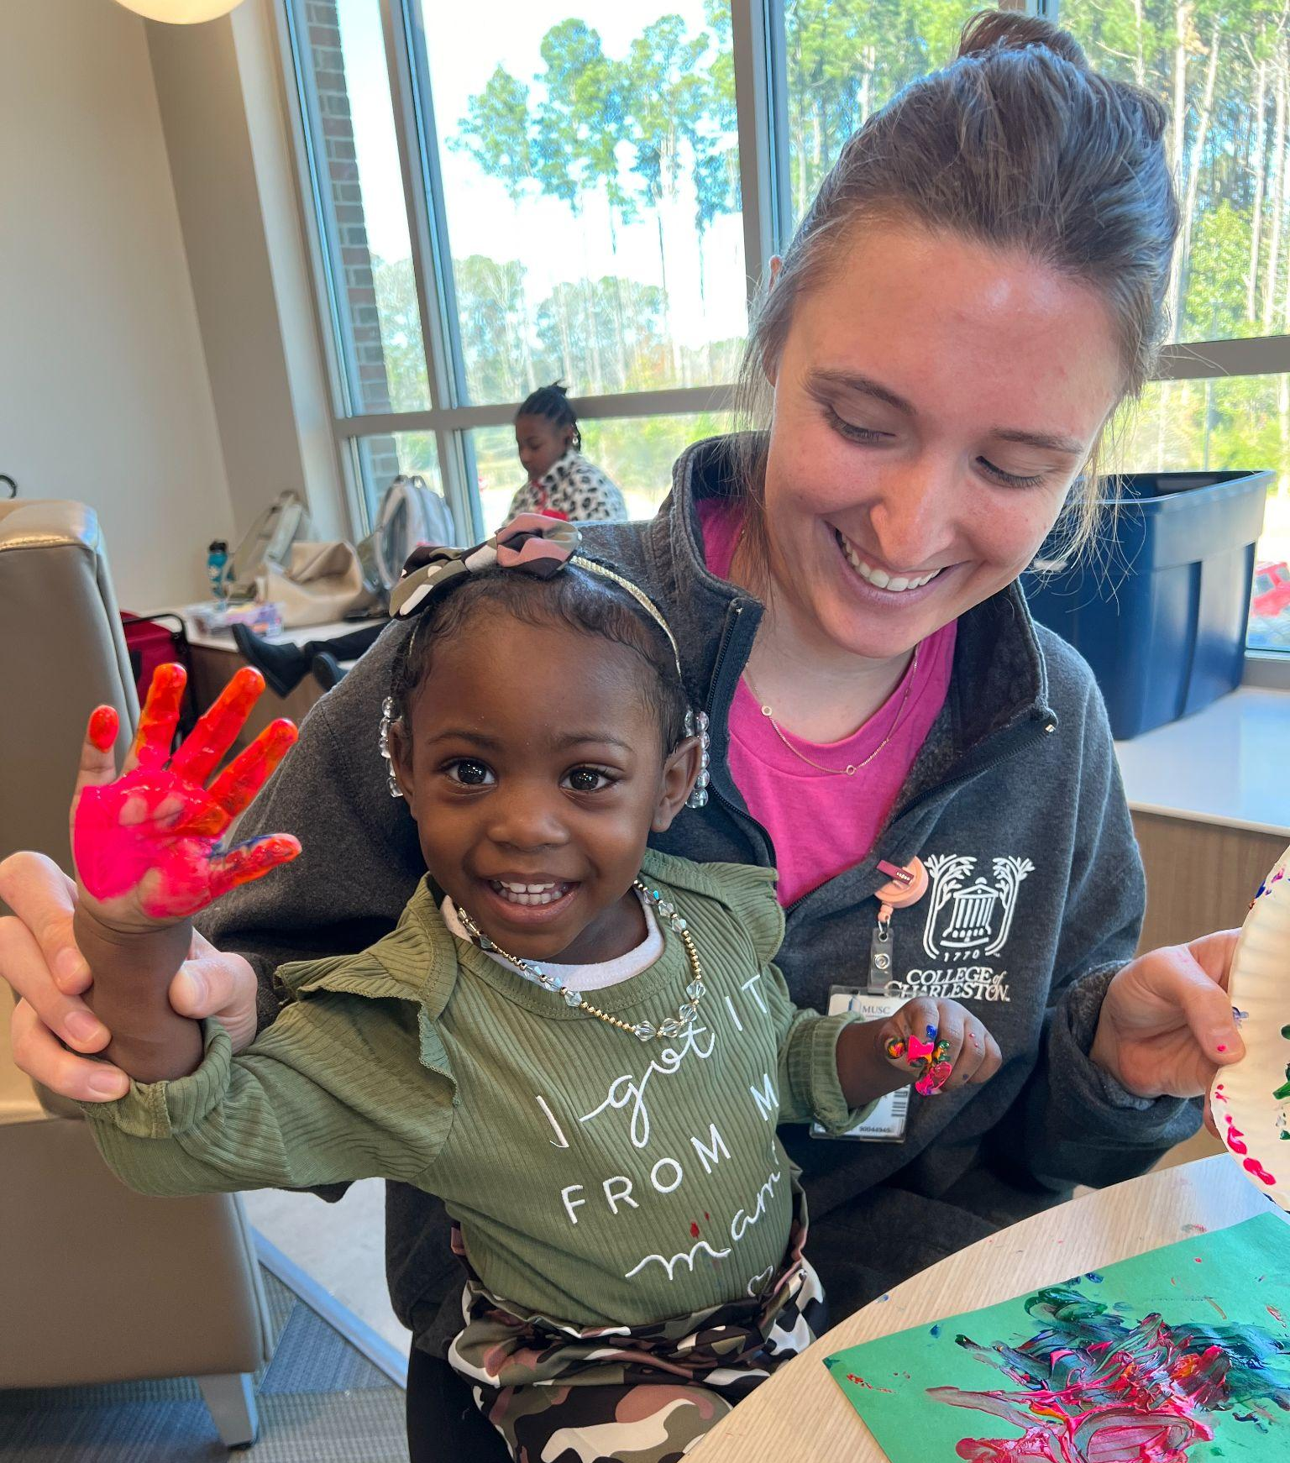
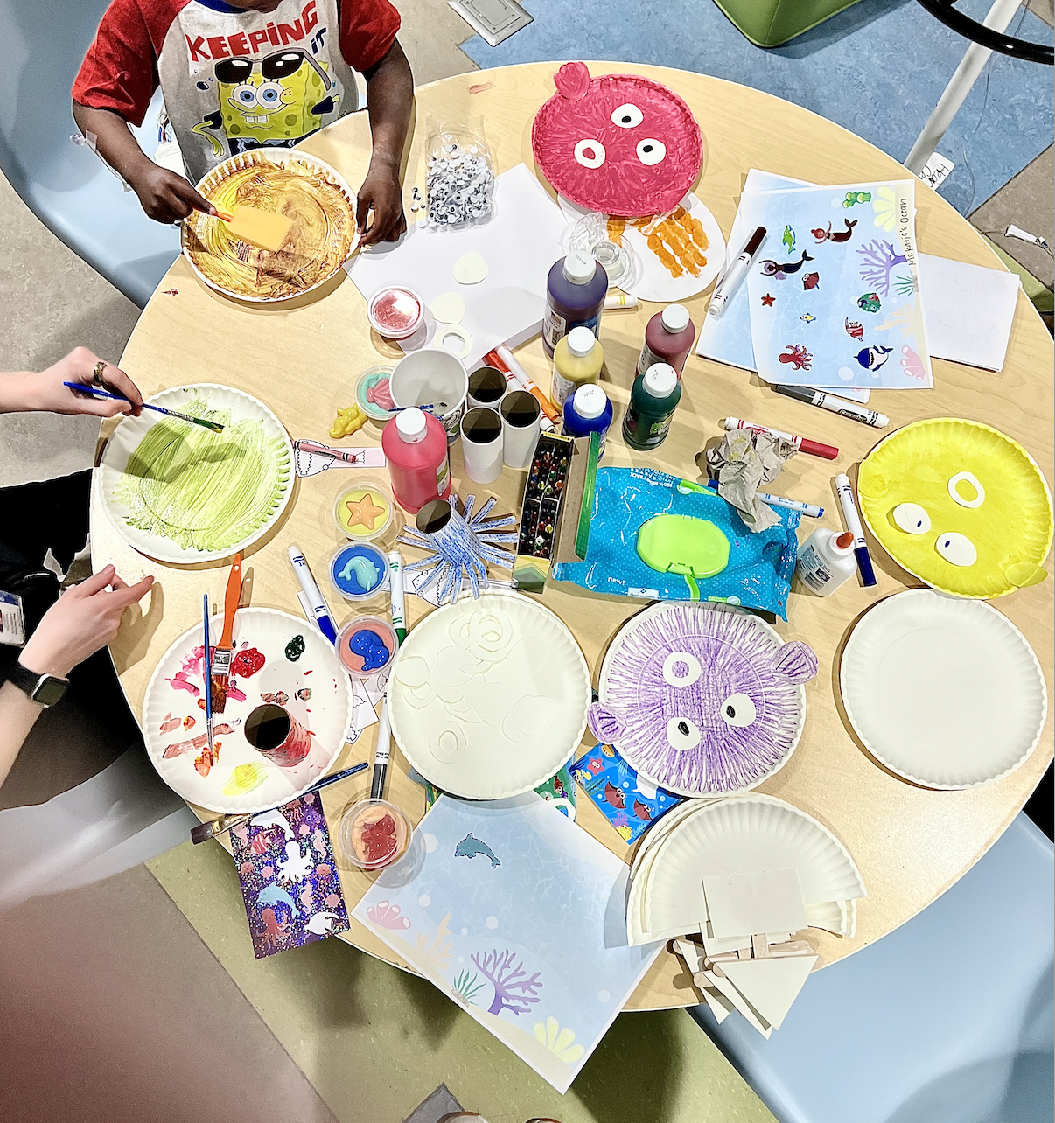
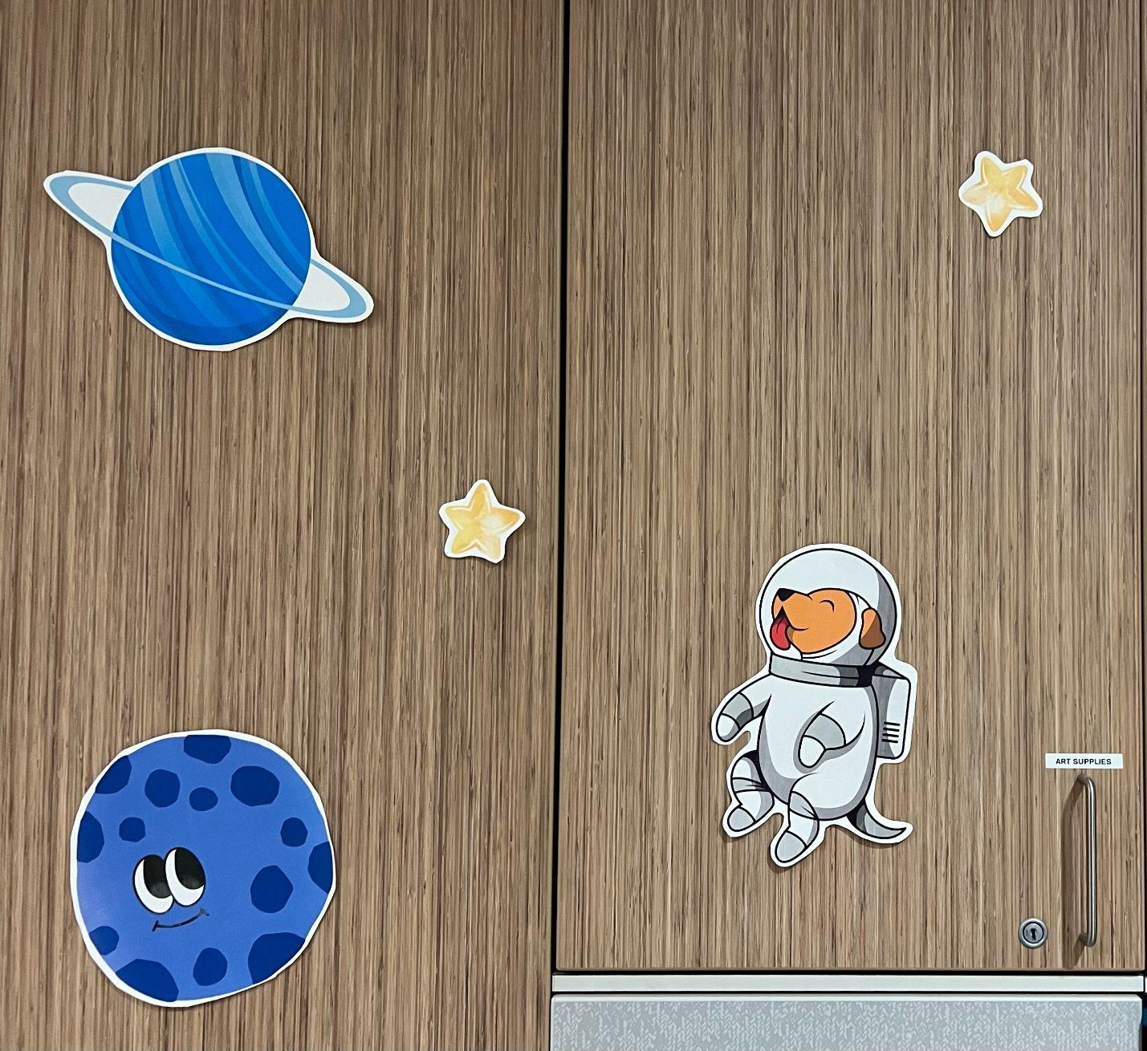
Capstone Experience
6 Biweekly 2 hour camp programs (01/23 - 04/02)
Weekly camp themes
Jungle exploration
Pirates and Princesses
Under the Sea
Summer Camp
Outer Space
Superhero Heart Warriors
Participation in Pre-Existing Camps
SJCH monthly atrium day camps
Summey Medical Pavilion monthly waiting room day camps

Slide 7
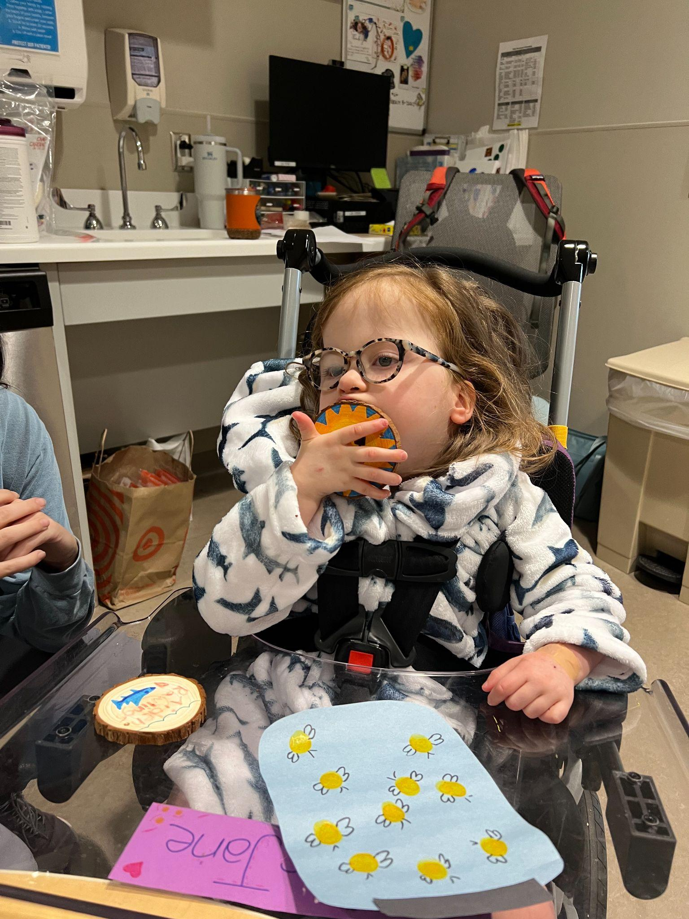
Supporting Framework
Person-Environment-Occupation (PEO) model focusing on the major area of occupation of all children – age-appropriate play.
Person
Occupation
Environment

Slide 8
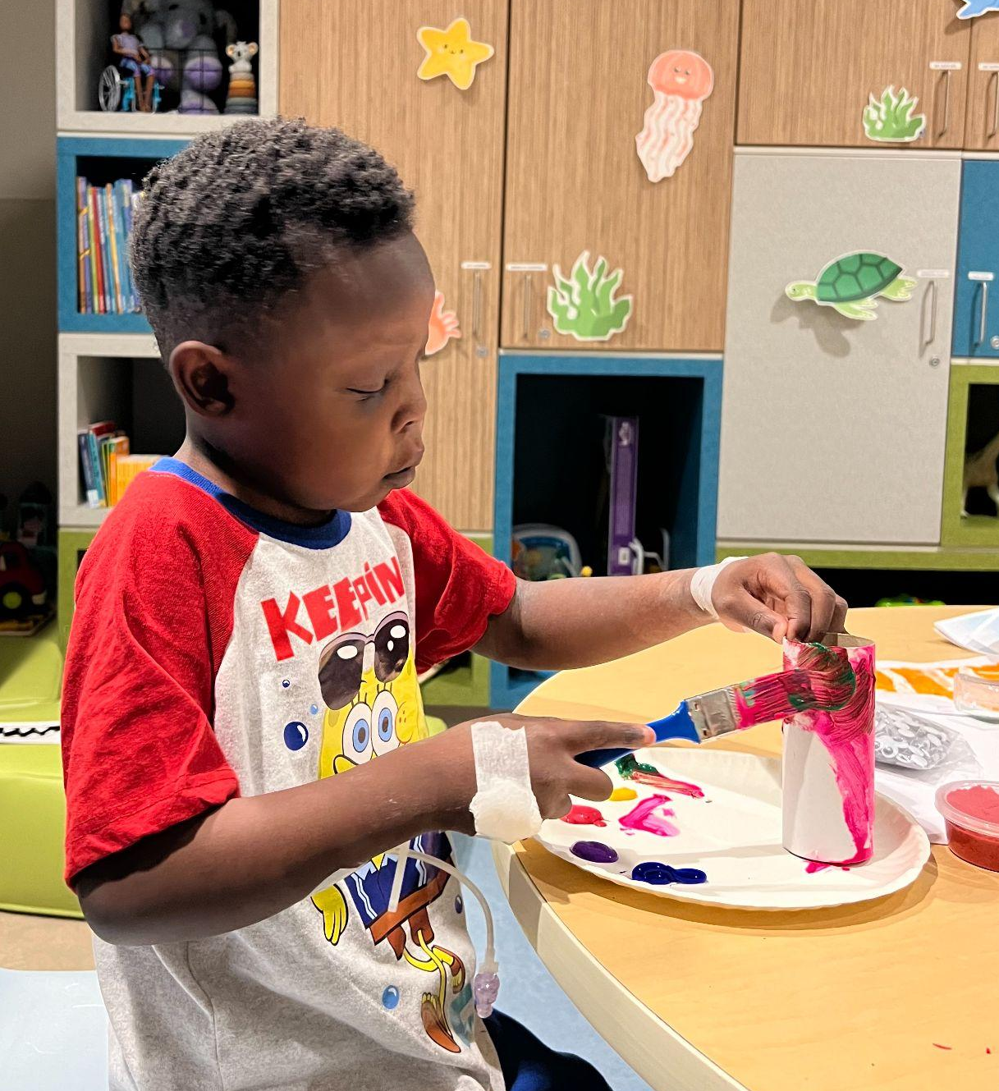
Population/Stakeholders
Camp Rise Above and Shawn Jenkins Children’s Hospital Staff
3 Full-time staff at Camp Rise Above
OT Capstone Student
1 Child Life intern
Outside volunteers
Child Life Specialist and Nurses at Shawn Jenkins Children’s Hospital
Participants and Siblings
Children with congenital heart defects and their siblings ages 2-13 years old
Week | # in person | # on go | total campers | Boy:Girl ratio | In Person Ages
1 | 3 | 10 | 13 | 1:2 | 7, 7,10
2 | 4 | 7 | 11 | 3:1 | 2,7,11,11
3 | 4 | 6 | 10 | 3:1 | 10,7,7,11
4 | 4 | 7 | 11 | 2:2 | 5,7,7,11
5 | 9 | 7 | 16 | 3:6 | 5,6,7,7,8,9,10,12,13
6 | 6 | 10 | 16 | 3:3 | 5,6,7,7,9,10
Stakeholders
SJCH patients/families/staff
Sponsors
Camp Rise Above Staff

Slide 9
Methods
Quality Improvement
Design
Before and After Study n=5
Implementation
6 Biweekly 2 hour camp programs
Data Collection
3 Surveys Used
Staff:
Post Camp Survey
Sustainability Survey
Participants & Caregivers:
Post Camp survey
Observational data
Peer/staff feedback
Surveys used a variety of likert scale, multi-select, true/false, and text box questions
Data Analysis
Mixed Methods and Thematic Data Analysis
Participation in Camp Cardiac eliminated ALL negative emotions patients were experiencing by 100%
100% participants would participate in another camp day
Strengths
6 successful camp days
100% buy in from stakeholders and population
Strong supporting research and data collected
Weaknesses
Limited Parent/Caregiver Feedback
14 week capstone time frame

Slide 10
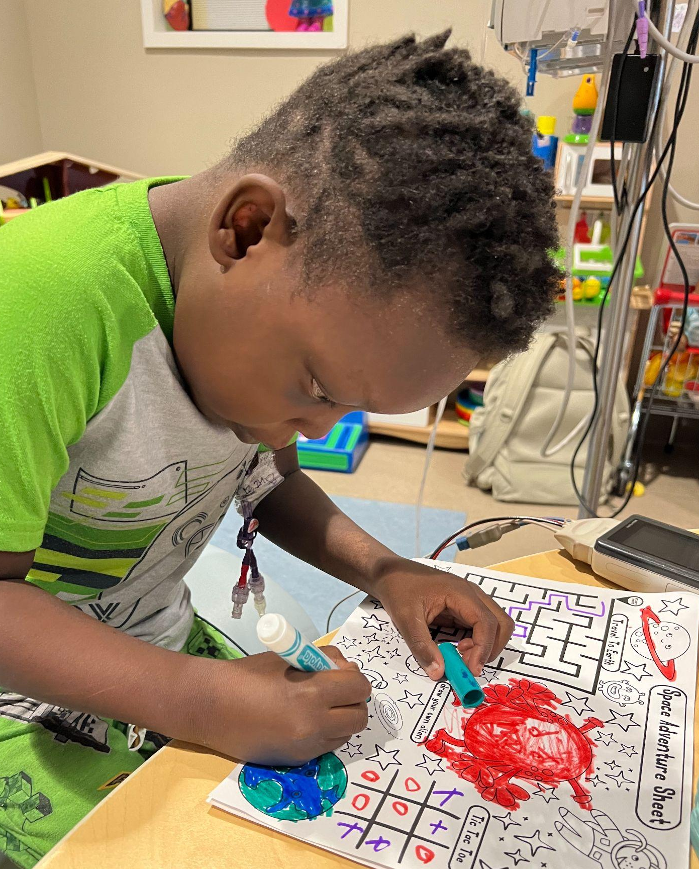
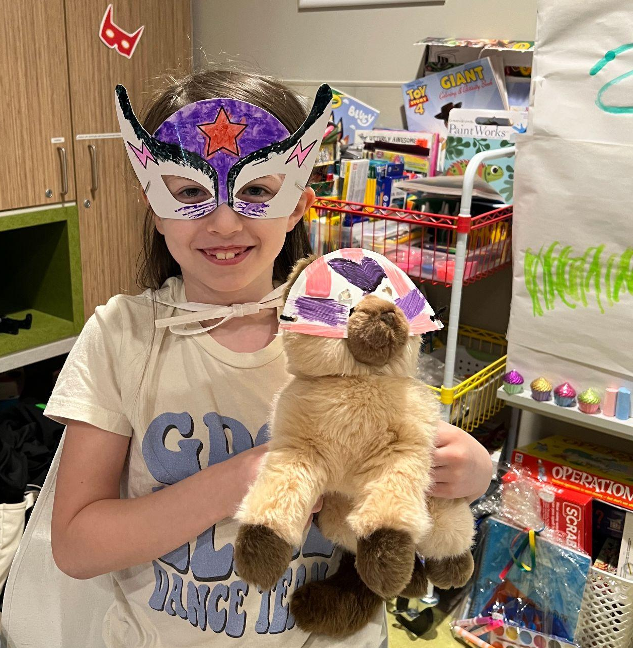
Methods & Measures Used
3 RedCap Surveys Used
Parent/Caregiver Survey (Spanish and English version)
Qualitative and quantitative data
Variety of Likert Scale, multi-select, yes/no, and fill in the blank questions.
Addressing:
Care Received
Child’s Psychosocial state(s)
Needs/Wants in regards to play while in the acute care setting
Camp Cardiac Staff Survey
Qualitative data
Addressing:
Impact of Camp Cardiac
Review of Camp Cardiac
Camp Rise Above Sustainability Survey
Qualitative data
Addressing:
Knowledge
Economic and Financial stability
Implementation and continuation of project

Slide 11
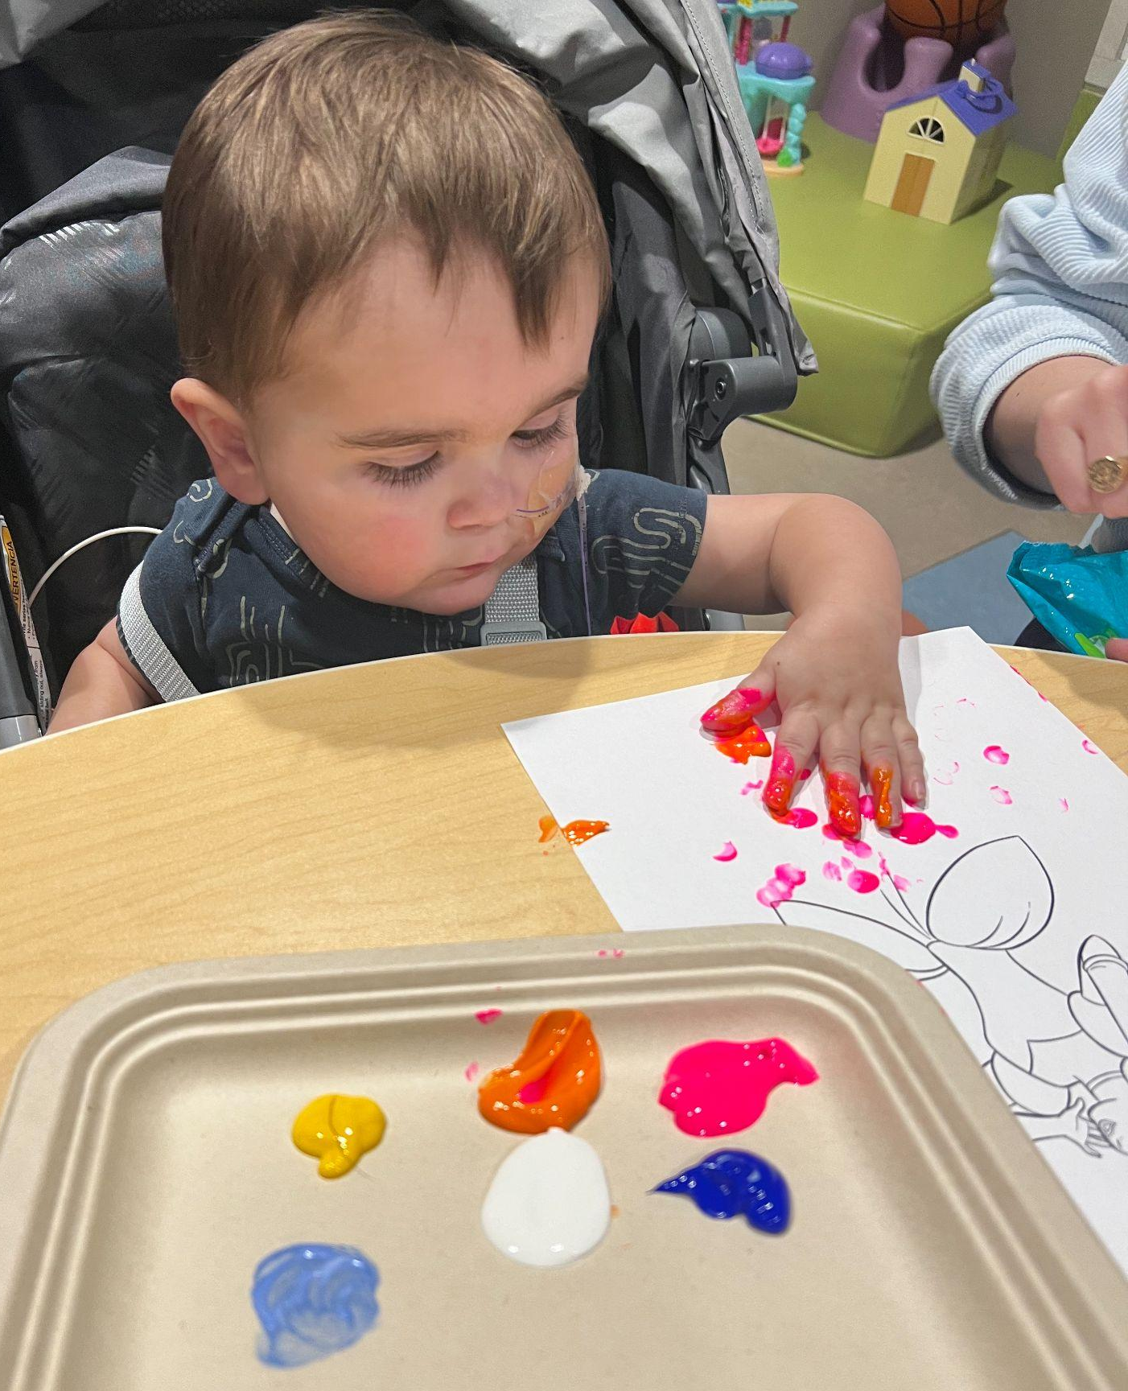
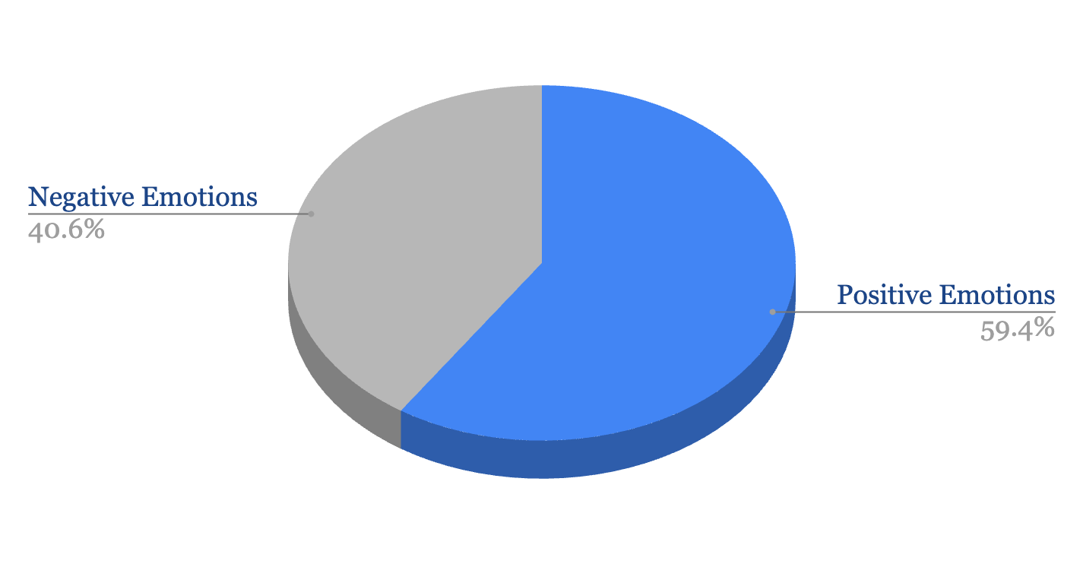
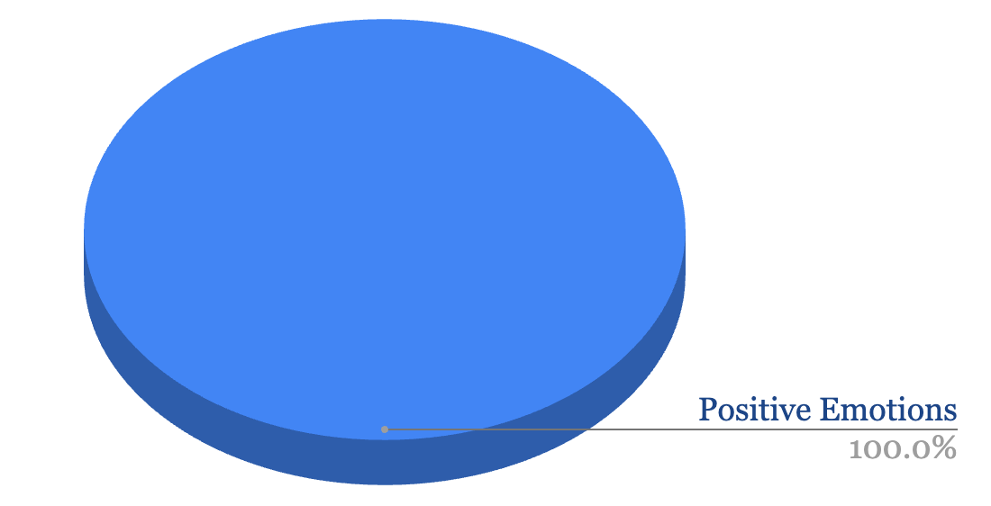
Impact & Key Findings
5 Parents and Caregivers were asked:
“During a normal day in acute care the following characteristics describe my child”
5 Parents and Caregivers were asked:
“After participating in camp cardiac my child was....”
Please note throughout the data analysis slides:
Blue= positive connotation
Grey = negative connotation

Slide 12
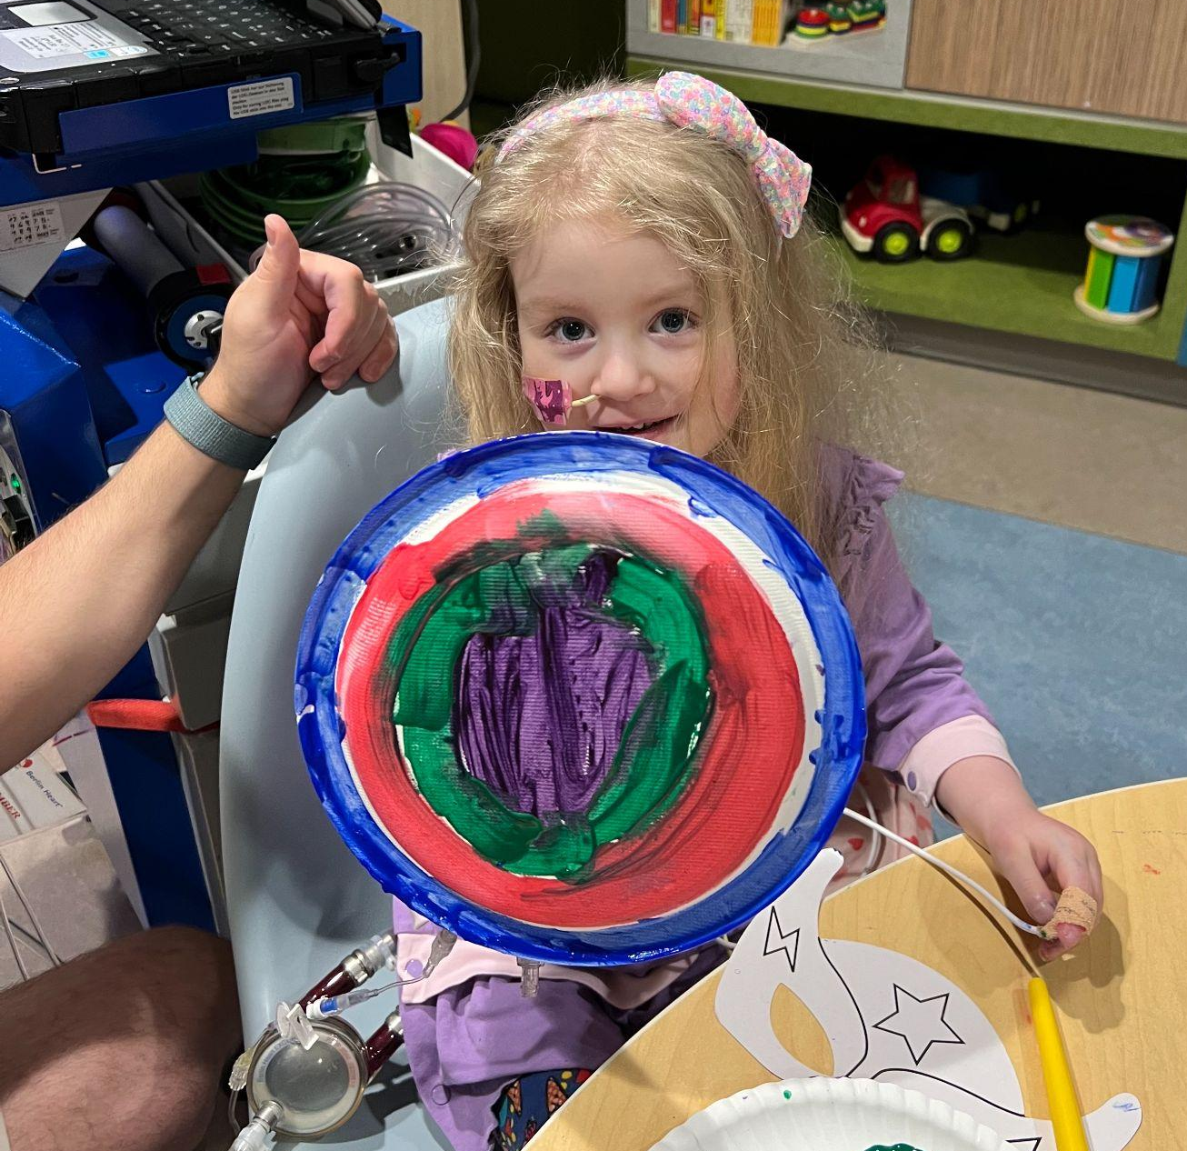
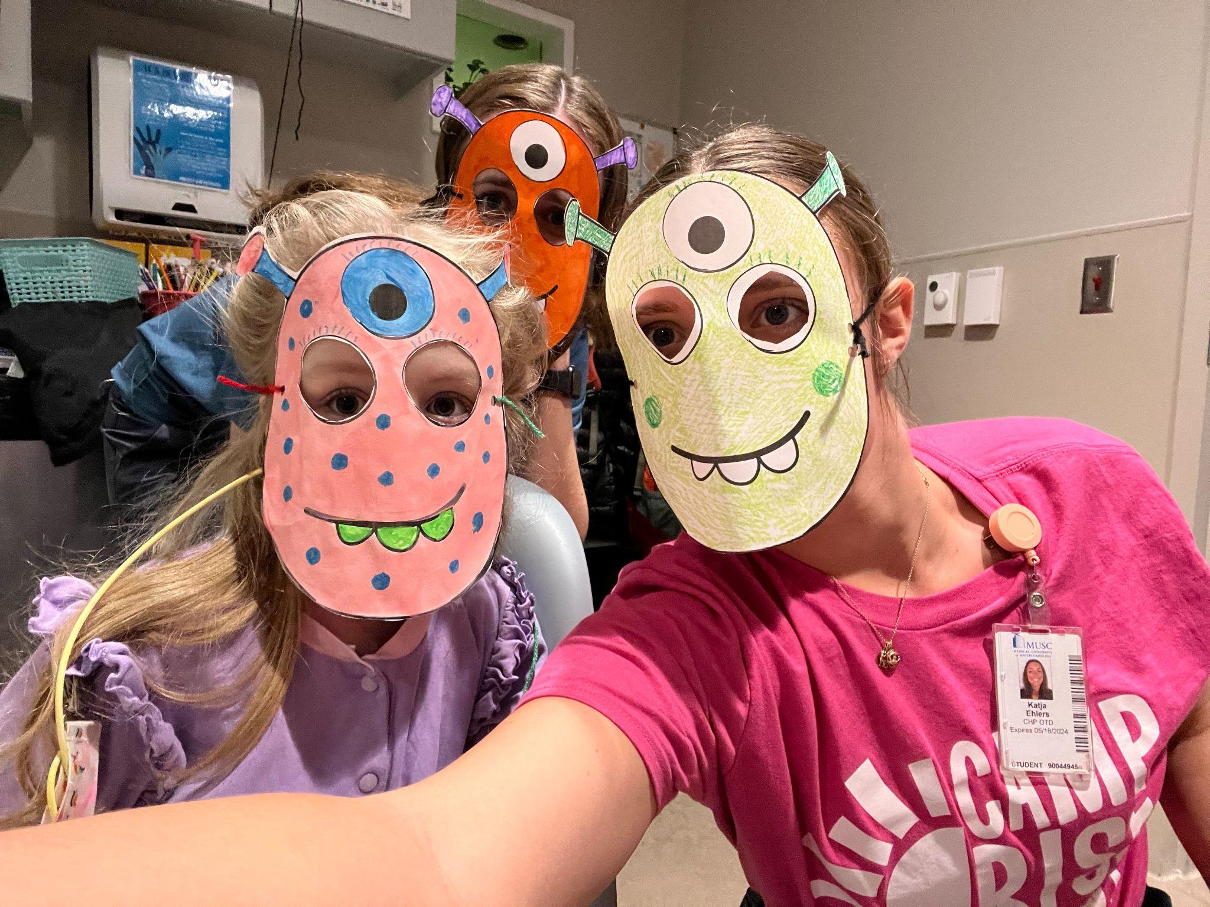
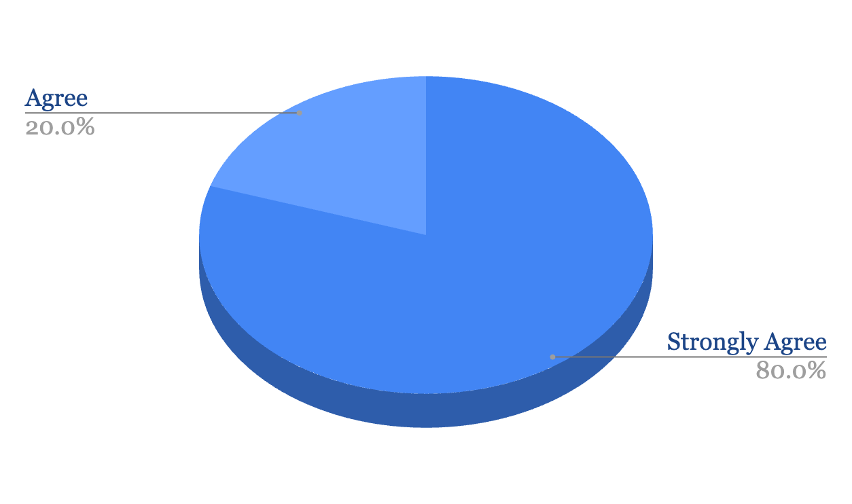
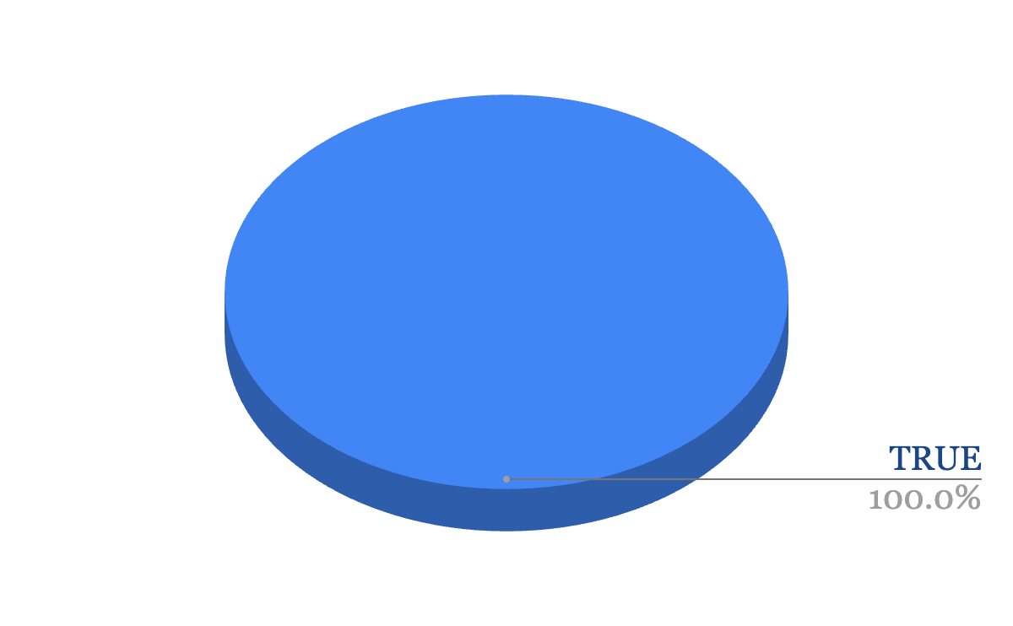
Impact & Key Findings
5 Parents and Caregivers were asked:
“My child expressed excitement in participating in cardiac camp”
5 Parents and Caregivers were asked:
“True or False: My child's mood positively changed after participating in cardiac camp”
5 Parents and Caregivers were asked:
“My child, if present in acute care, would like to participate in another cardiac camp day”
Please note throughout the data analysis slides:
Blue= positive connotation
Grey = negative connotation

Slide 13
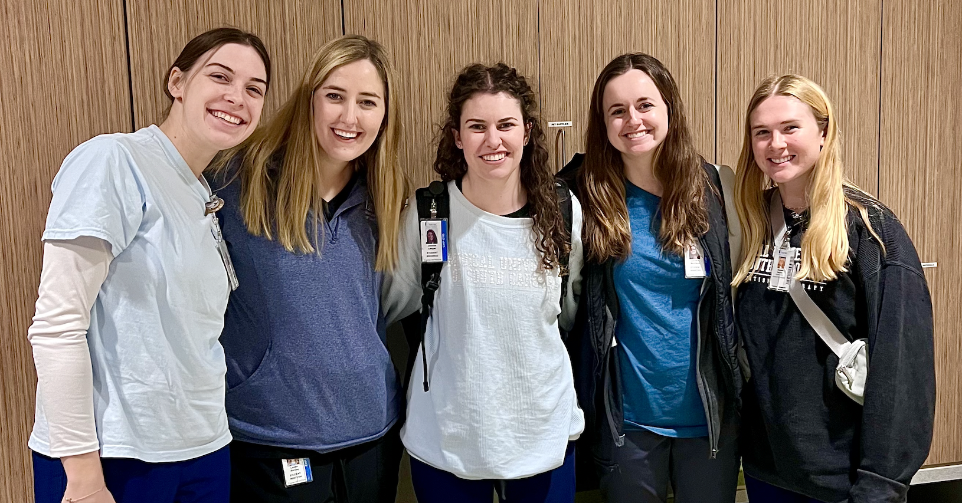
Impact & Key Findings
12 staff participants were asked:
“If you were going to leave a 1-2 sentence google review on Camp Cardiac what would it say?”
“Full of fun, dedicated volunteers, and camp magic!”
“The program and activities set up for the pediatric cardiac patients during their time with the cardiac camps is something I believe the children and caretakers look forward to. It allows them to have fun aside from their daily treatments and medical visits and allows them to be a kid.”
“These camps have been intentional in targeting play, movement, creativity, independence, friendship, and quality of life to the patients in the heart center. Katja has created a resource for CRA to continue using for years to come!”
“It was really neat to connect with the children during my 1 day visit to camp! I could see their eyes light up when they had staff interacting with them. You could tell it made their day brighter. One child did not want to leave us.”
The staff were great and well-prepared to create a fun camp experience for the kids with lots of options for activities.
“Very well thought out and able to be adapted to all ages and needs”
“Provides a great way for the kids and their siblings to have fun, relief for parents, and a little distraction from the scary things!”
“A great way to provide fun for children in the hospital and their siblings!”
Camp Rise Above is a place that children can forget about the hardships and have fun.
“Such a fun camp that provides so much joy to all the families and kids on the cardiac floor!”
“Katja went above and beyond! Each week had a fun theme with very creative crafts fit for kids of all ages and abilities”
“There was a great variety of crafts to engage in! If a kid was not interested in a craft there were fun games that were great for social engagement”

Slide 14
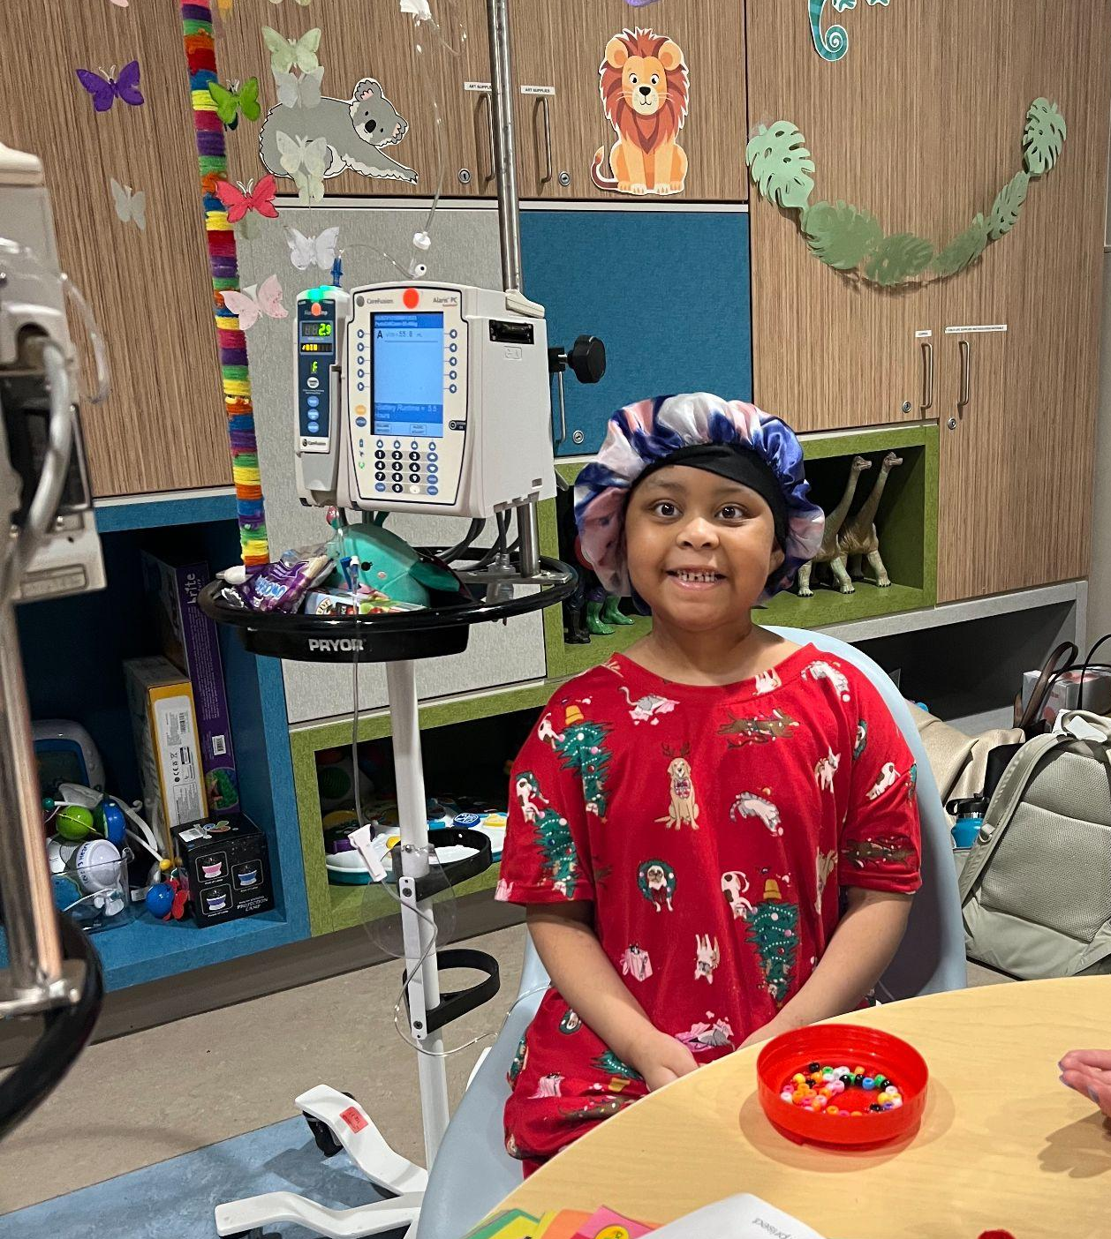
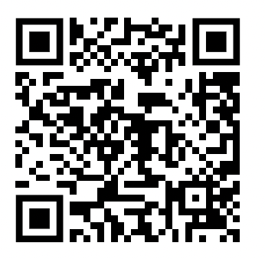
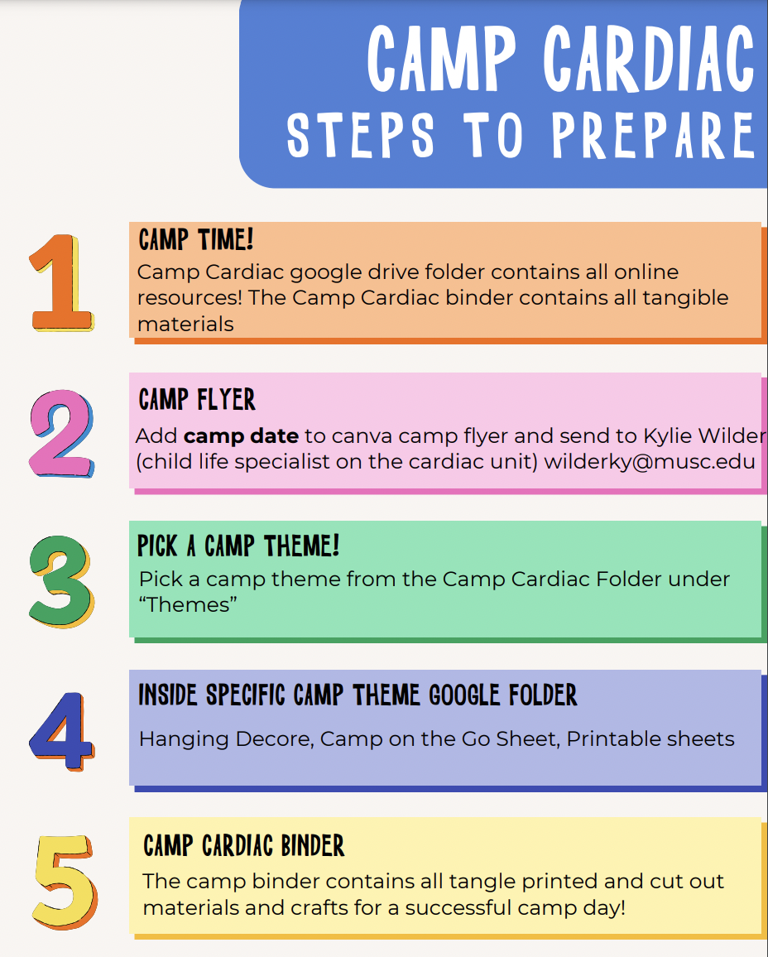
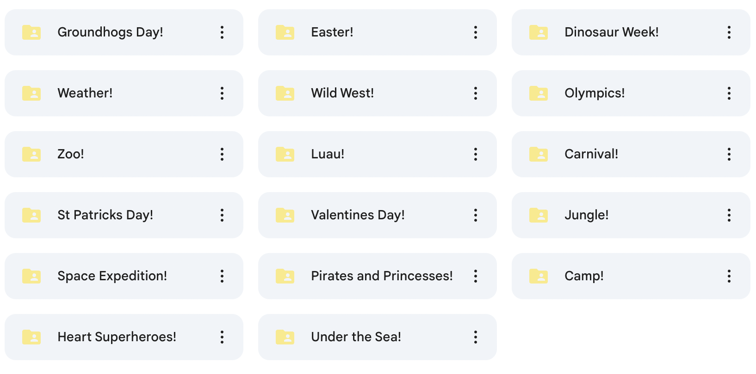
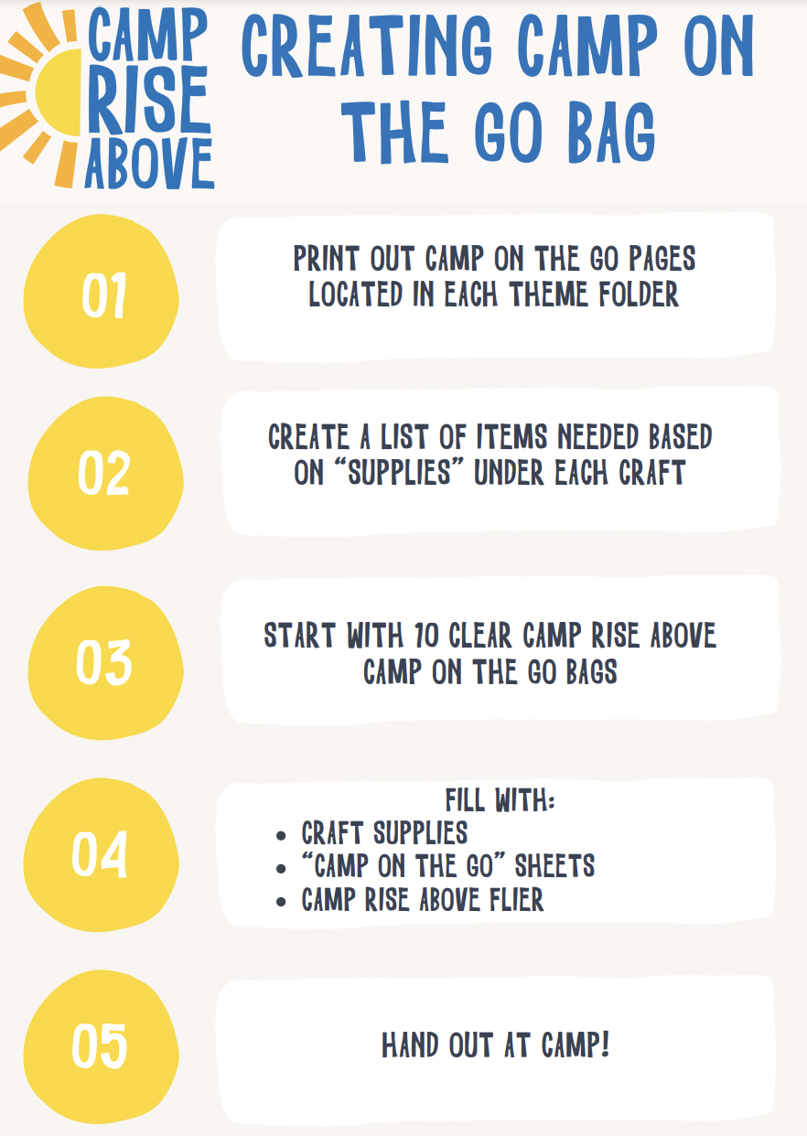
Project Deliverable
Google Drive Folder
17 Pre-Created Camp Day Themes
*Each Theme has material in both English and Spanish*

Slide 15
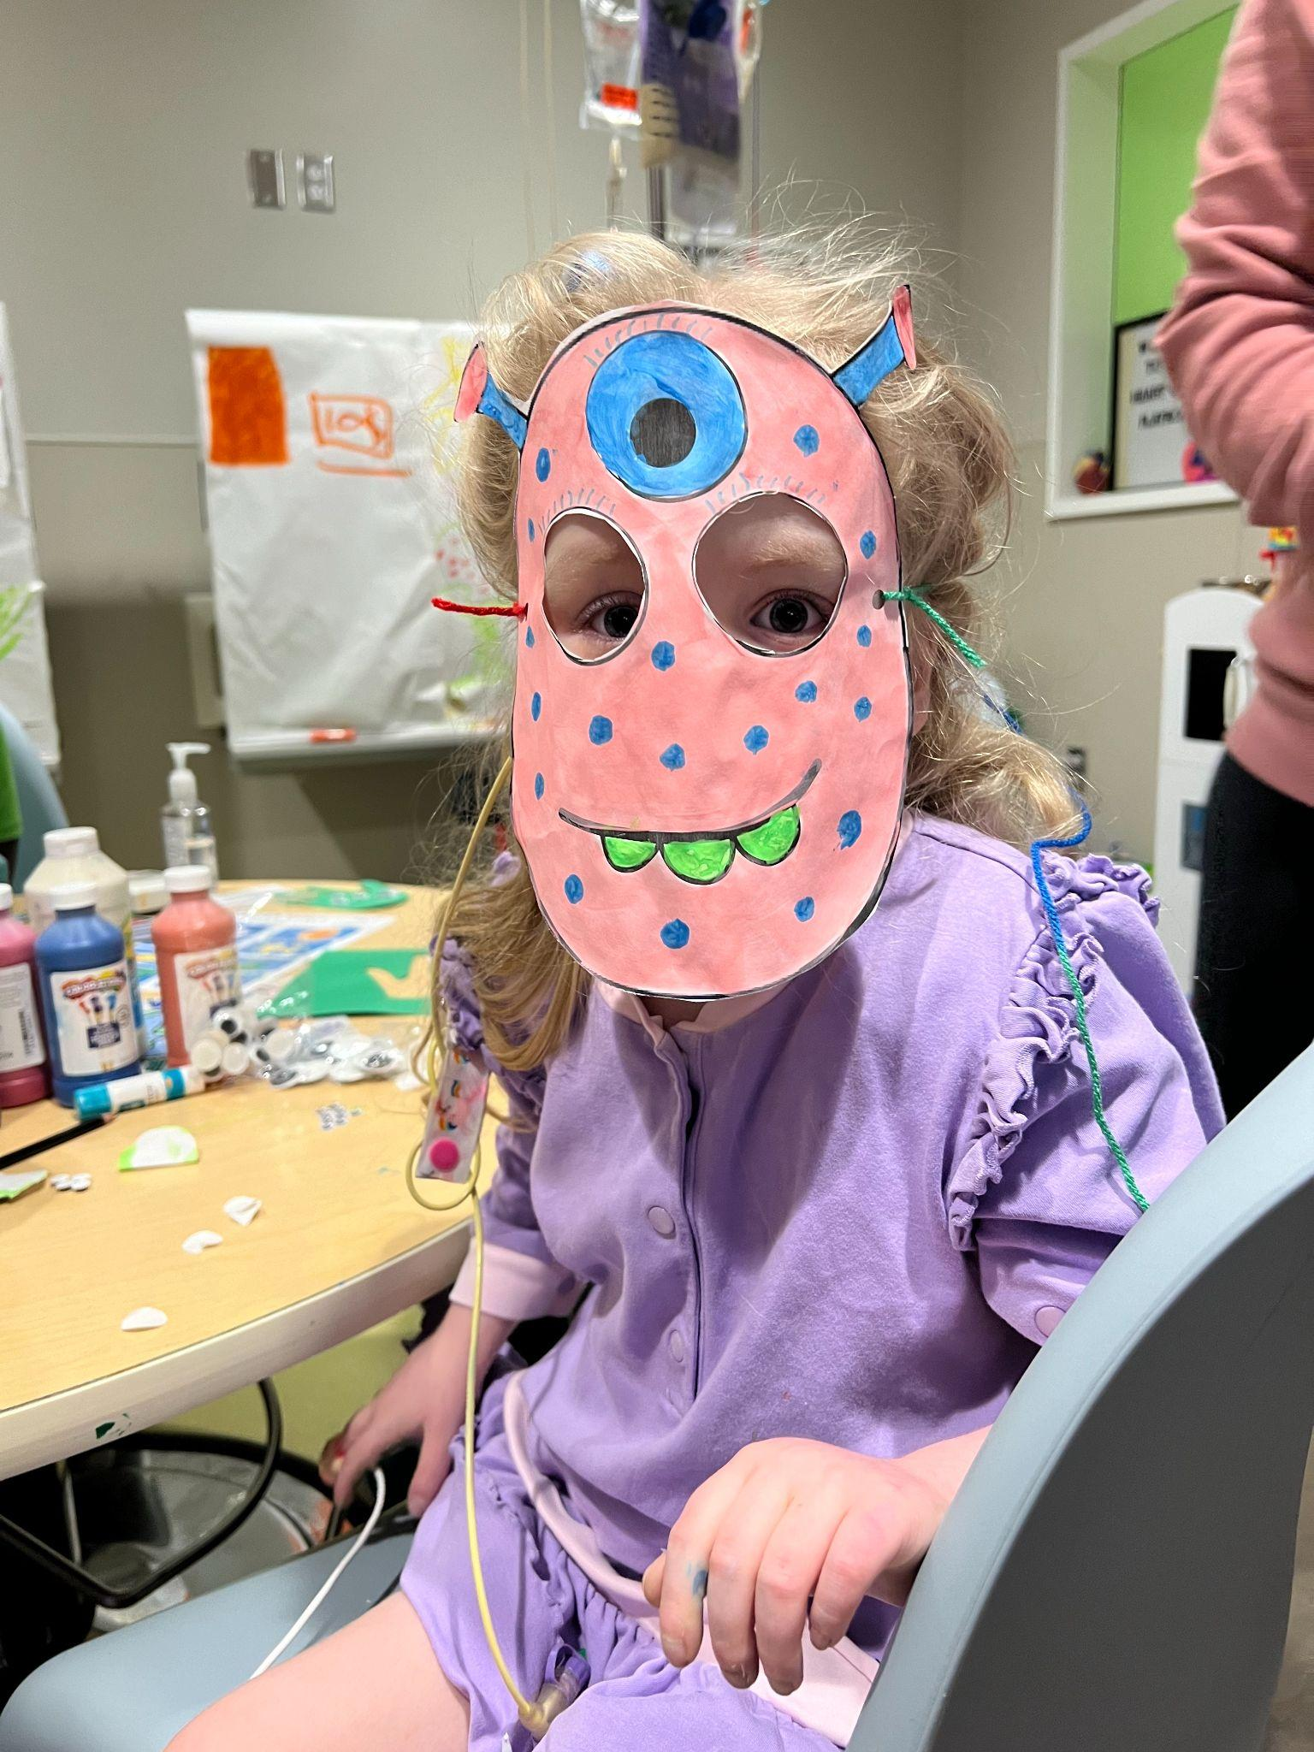
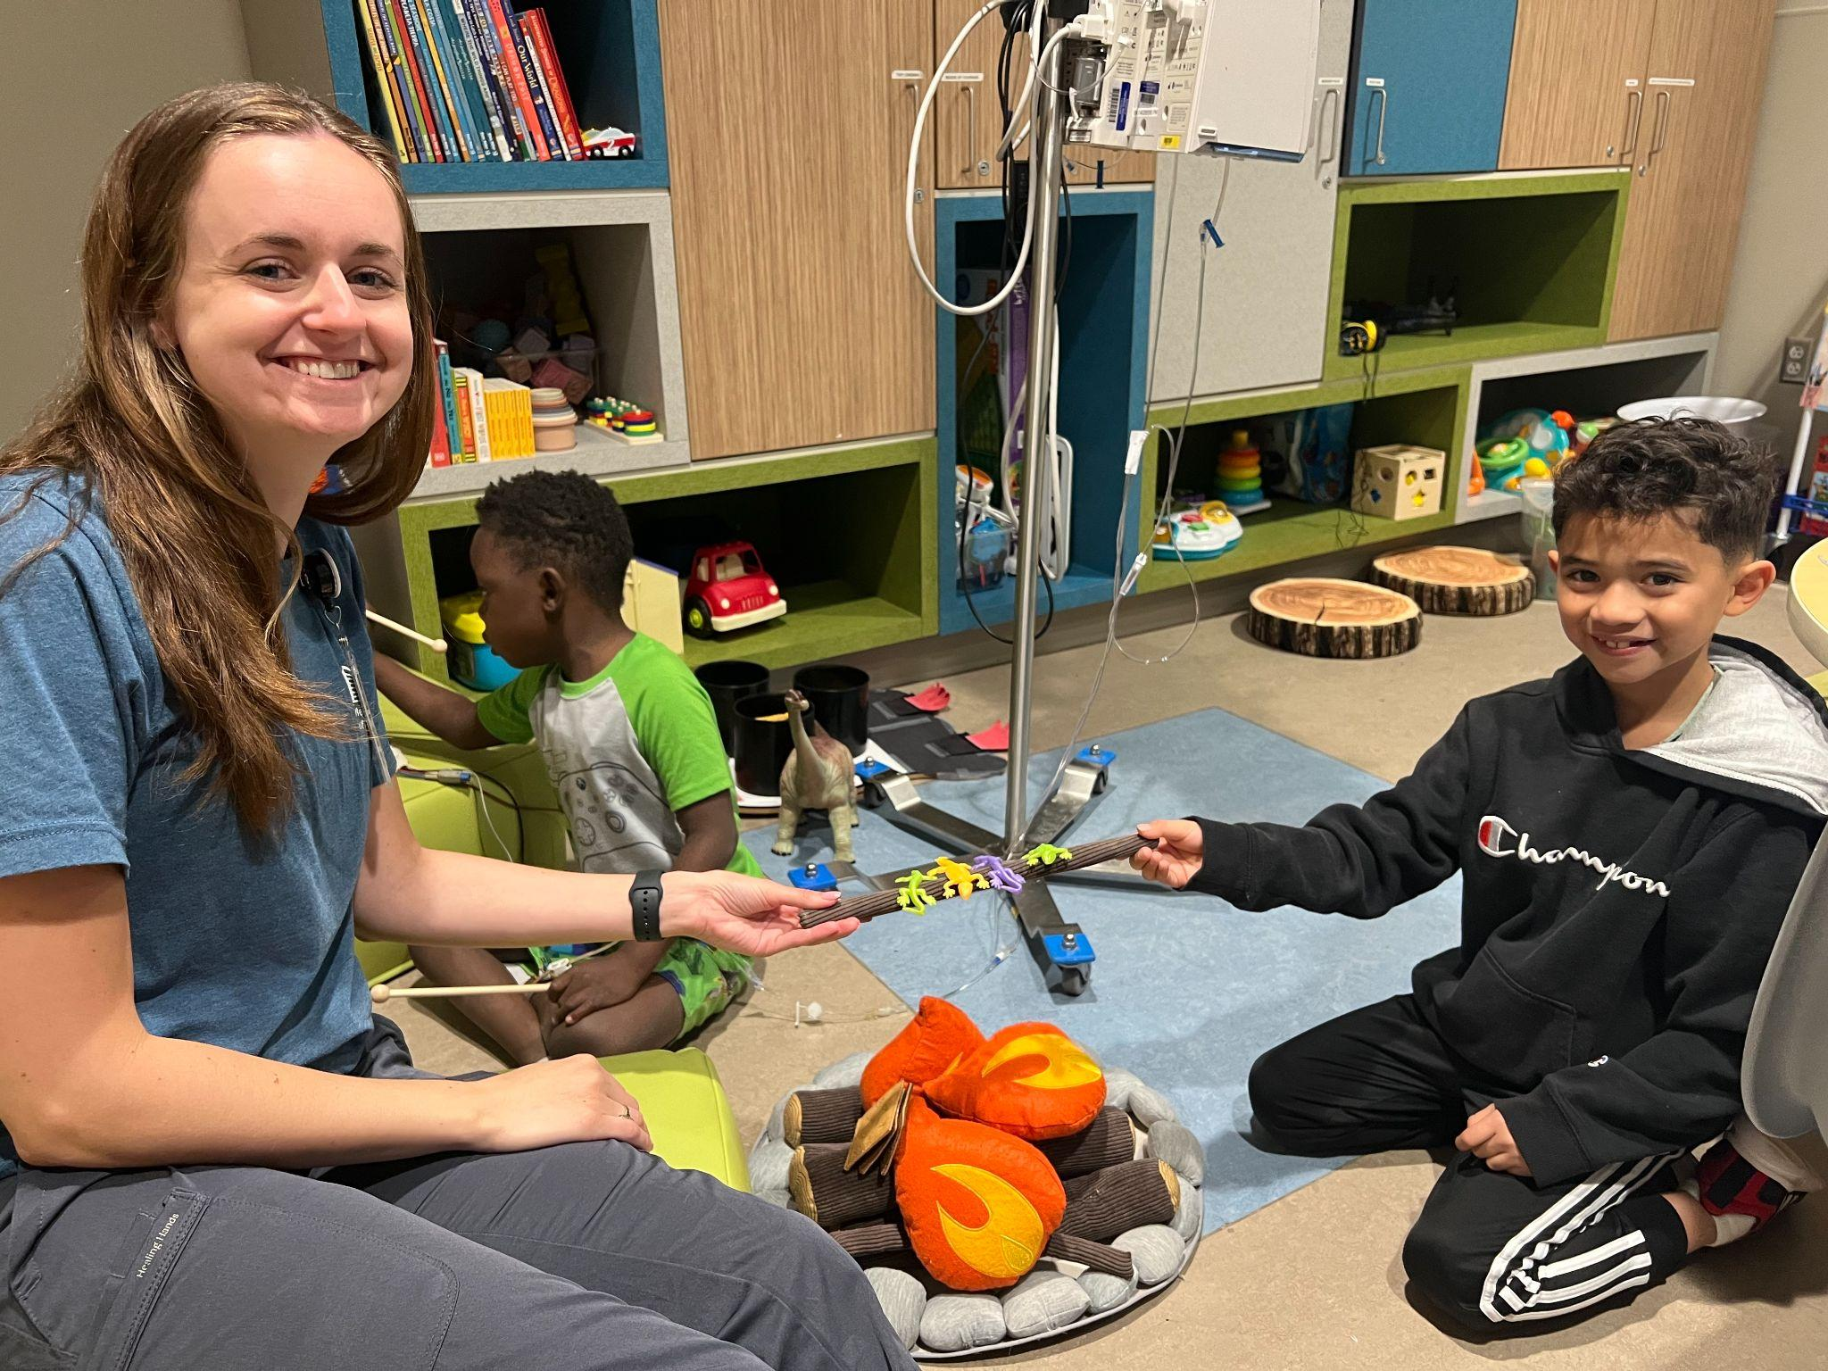
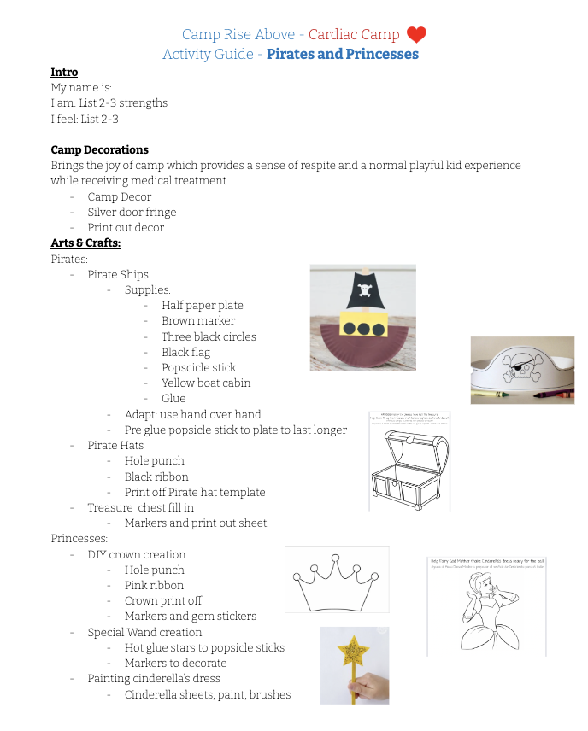
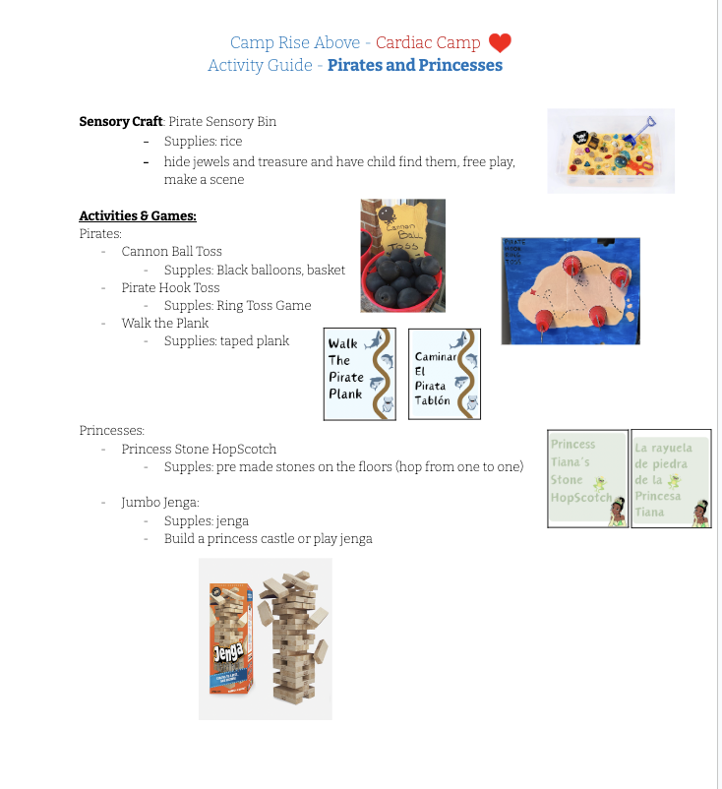
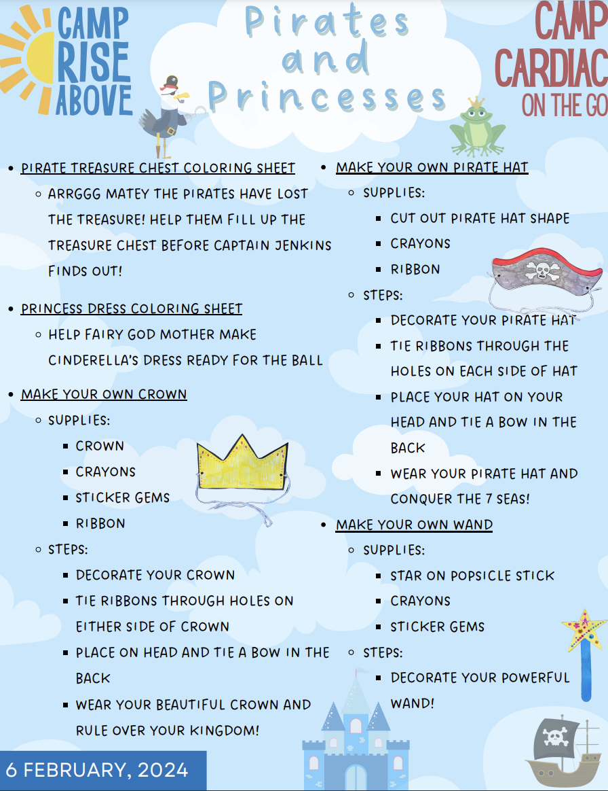
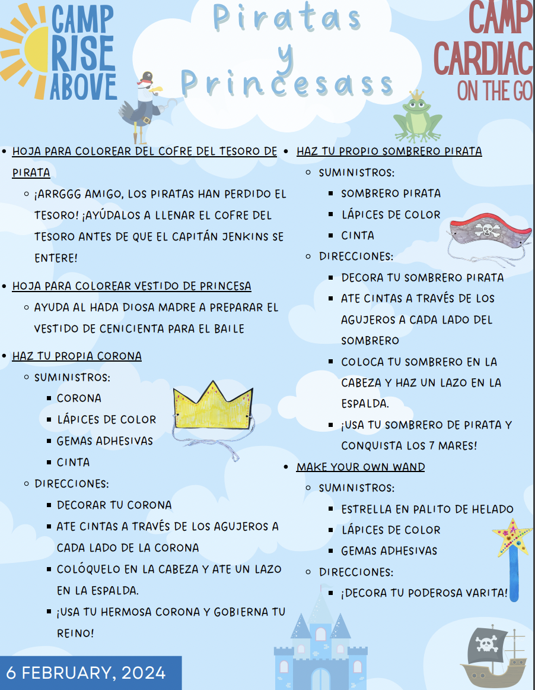
Project Deliverable
Camp Itinerary
Camp On the Go (English and Spanish Version)

Slide 16
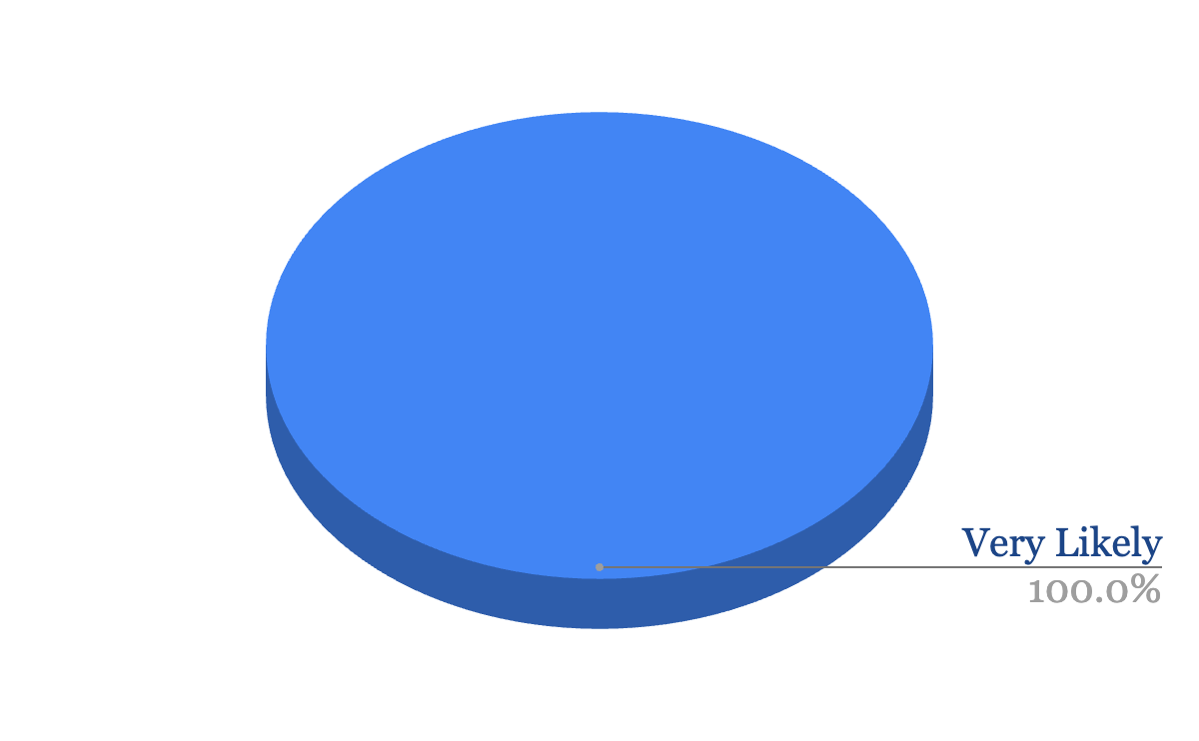
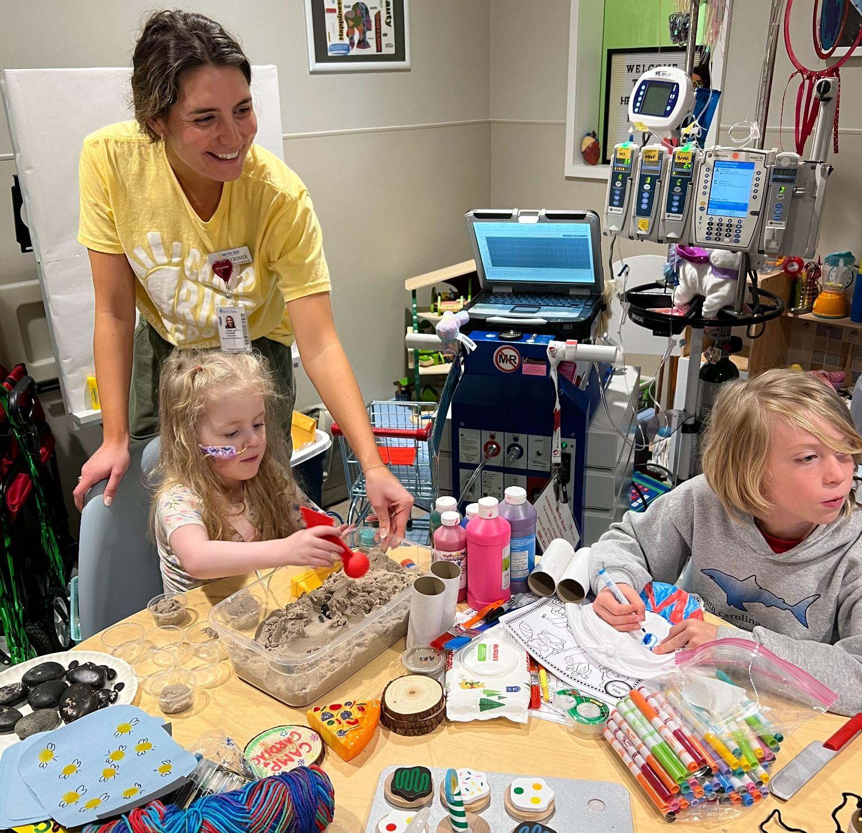
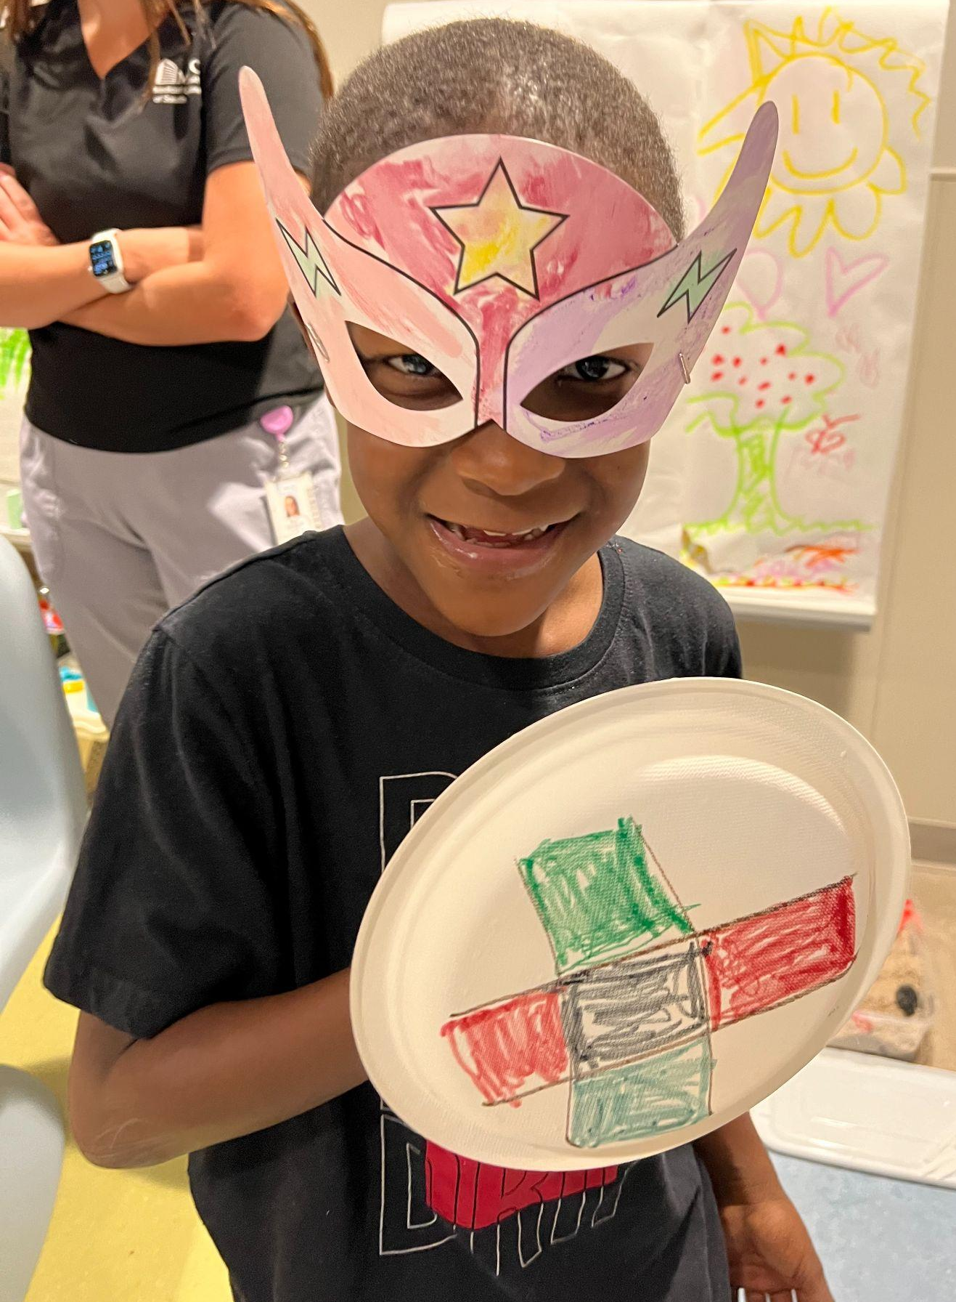
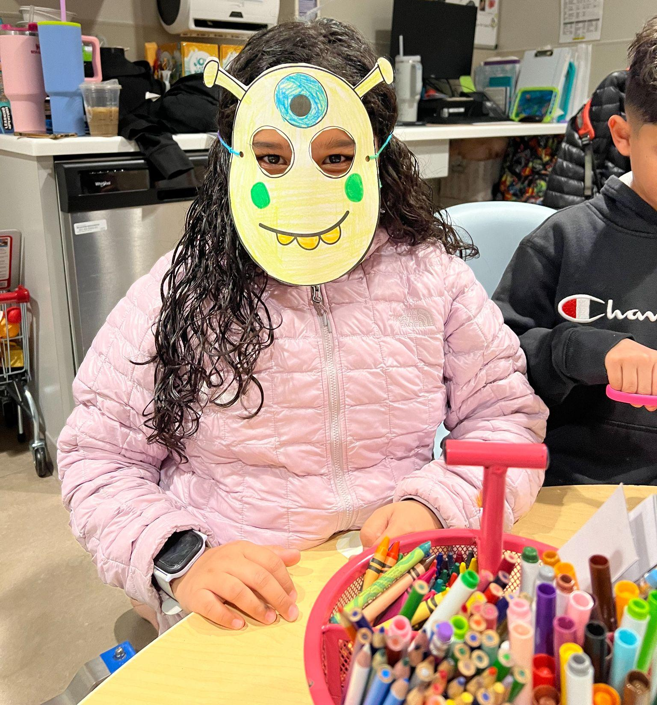
Deliverable Effectiveness
Successful implementation of deliverable at
4 pre-existing hospital camps and 1 Camp Cardiac day
3 Camp Rise Above Staff Members were asked:
“I understand the Camp Cardiac deliverable and feel confident implementing Camp Cardiac independently after the 14 week capstone experience is complete”

Slide 17
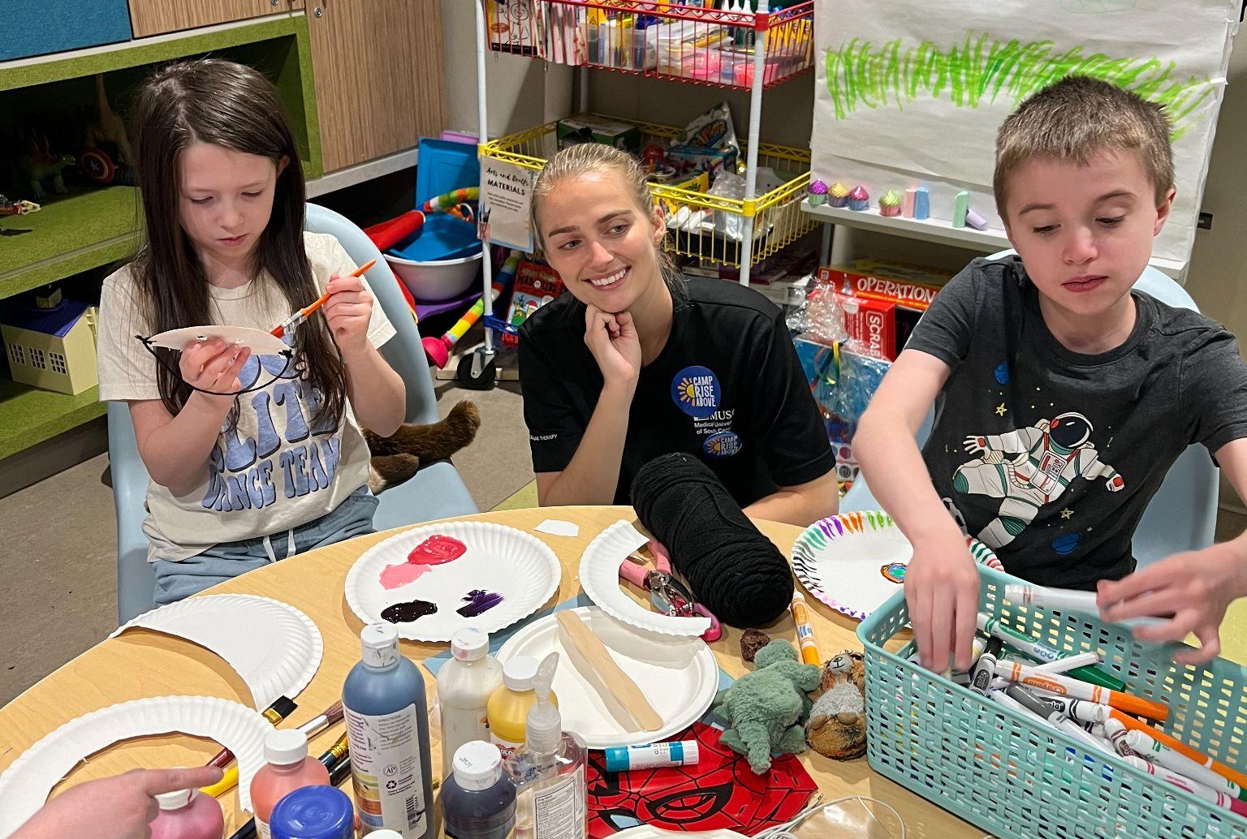
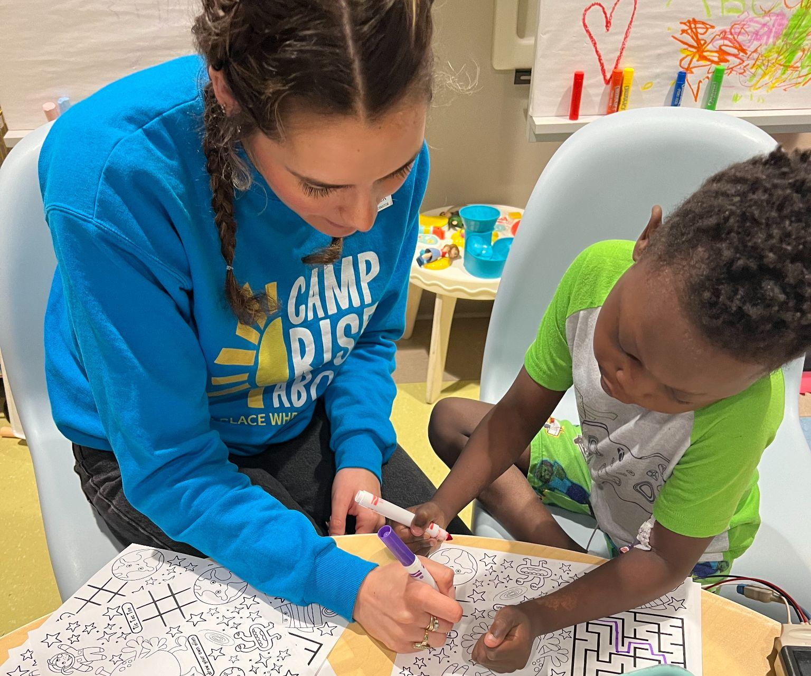
Impact on Occupational Therapy
Occupational therapy understands that there is a direct correlation between purposeful participation in occupations and increased mental health (Cahill, et. al, 2020)
Occupational therapist also understands that play in all forms can come with beneficial qualities
Allowing for children to get access to play outside of just occupational therapy treatments, when they may have medical/physical/mental factors limiting them to participate in self directed play, will help to decrease the burden on occupational therapists, and promote increased wellbeing.

Slide 18
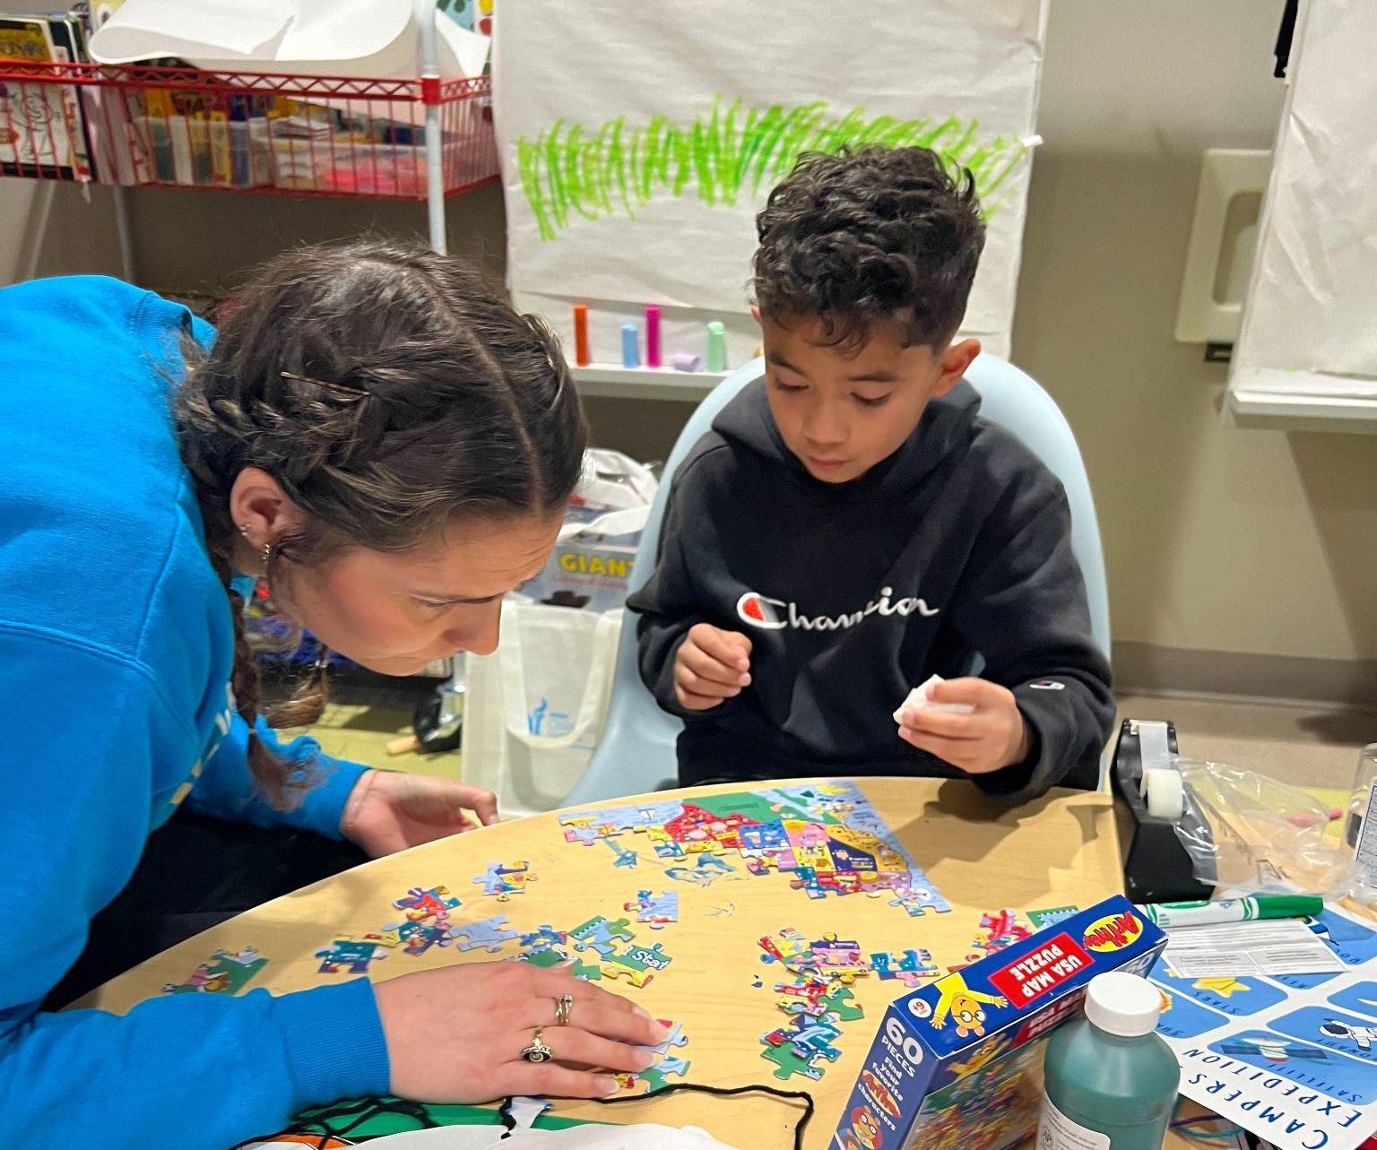
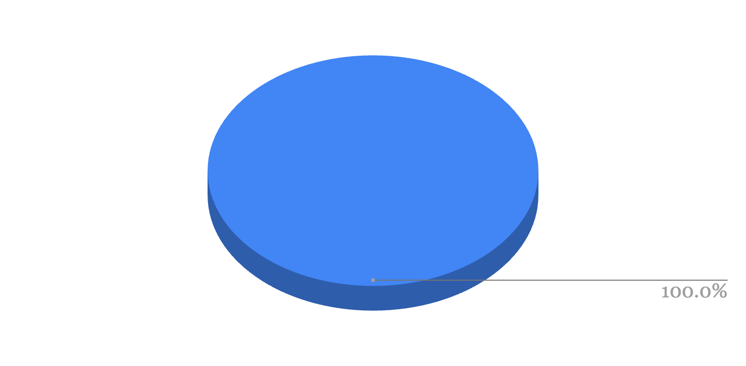
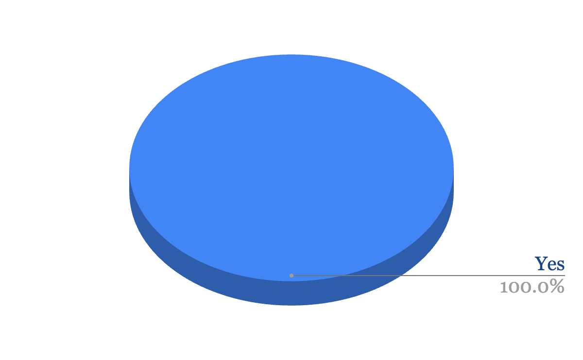
Sustainability
The 3 Camp Rise Above Staff Members were asked the following questions:
“True or False: Does Camp Cardiac align with Camp Rise Above's core values?”
“True or False: My knowledge on the patients and needs of the MUSC Shawn Jenkins Children's Hospital Heart Center have increased throughout this capstone experience”
“Likelihood of Camp Rise Above continuing Camp Cardiac after the 14 week capstone experience is completed”
“In regards to economic and financial sustainability;
Camp Cardiac is....”
As economically and financially sustainable as our other camps
Please note throughout the data analysis slides:
Blue= positive connotation
Grey = negative connotation
Notes:
When looking at sustainability of my project i had a few questions in mind in order to determine if it would be sustainable for CRA to continue. With that being said i asked the 3 full time CRA staff member the following questions.
I asked these questions due to the belief that if it aligns of CRA core values, it is as economic and financially sustainable, and the personal knowledge and connection as increased then the likelihood of my project to continue would increase.
As shown with the results of the data, sustainability of Camp Cardiac is very likely

Slide 19
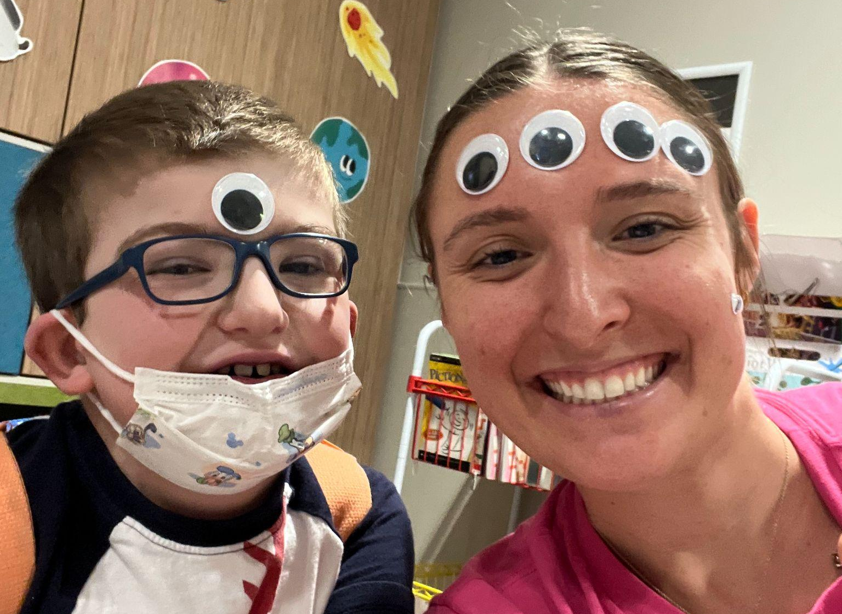
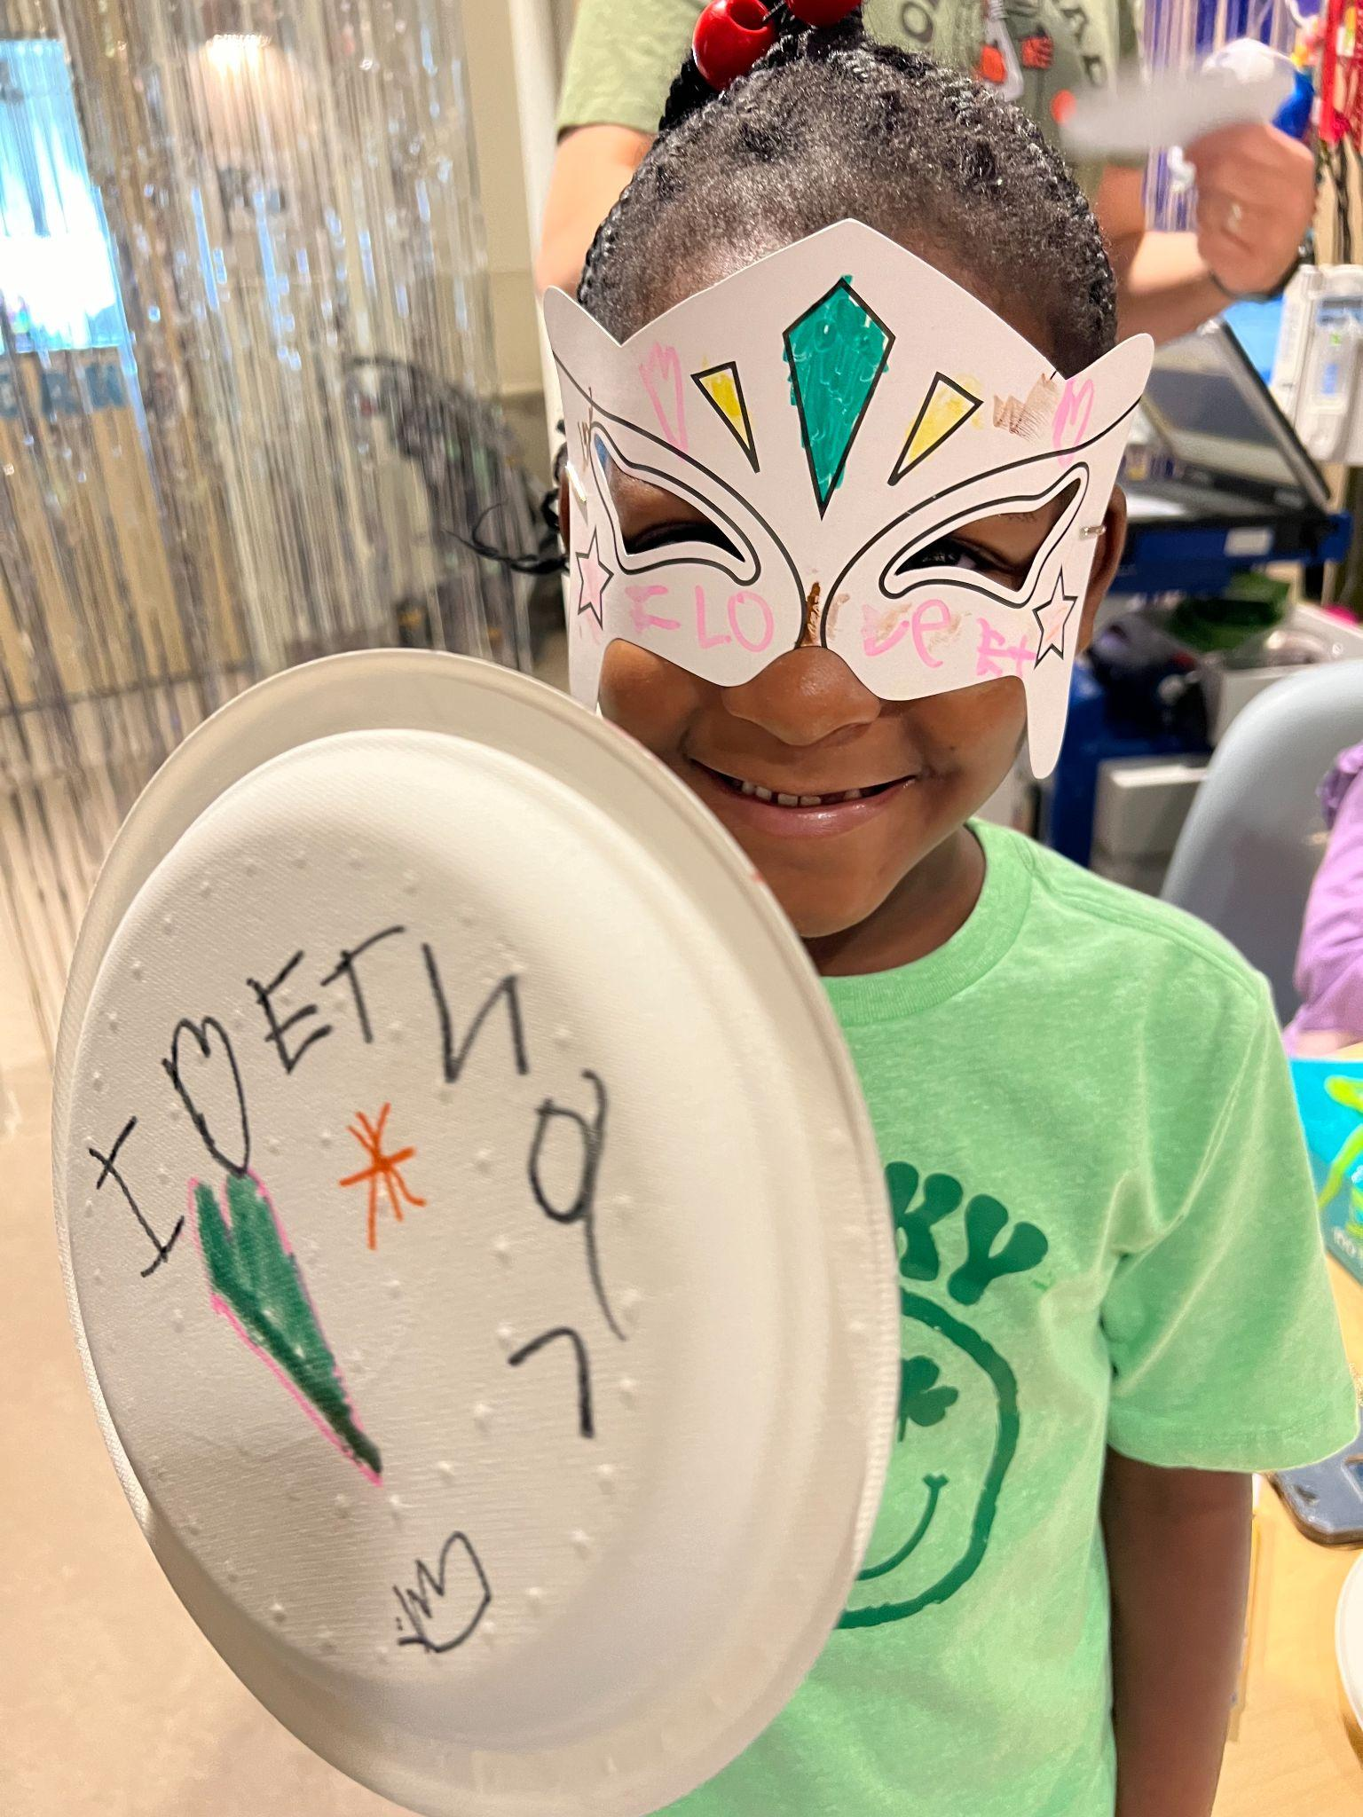
Recommendations
Continued collaboration with SJCH Child Life Specialists
Continue to keep an open line of communication with parents and caregivers
Continue data collection of qualitative and quantitative to continue providing evidence for Camp Rise Above to share with the stakeholders and donors of the organization about the limitless benefits play-based camps in the acute settings can have
Early preparation and planning with Cardiac Camp to ensure smooth camp day implementation

Slide 20
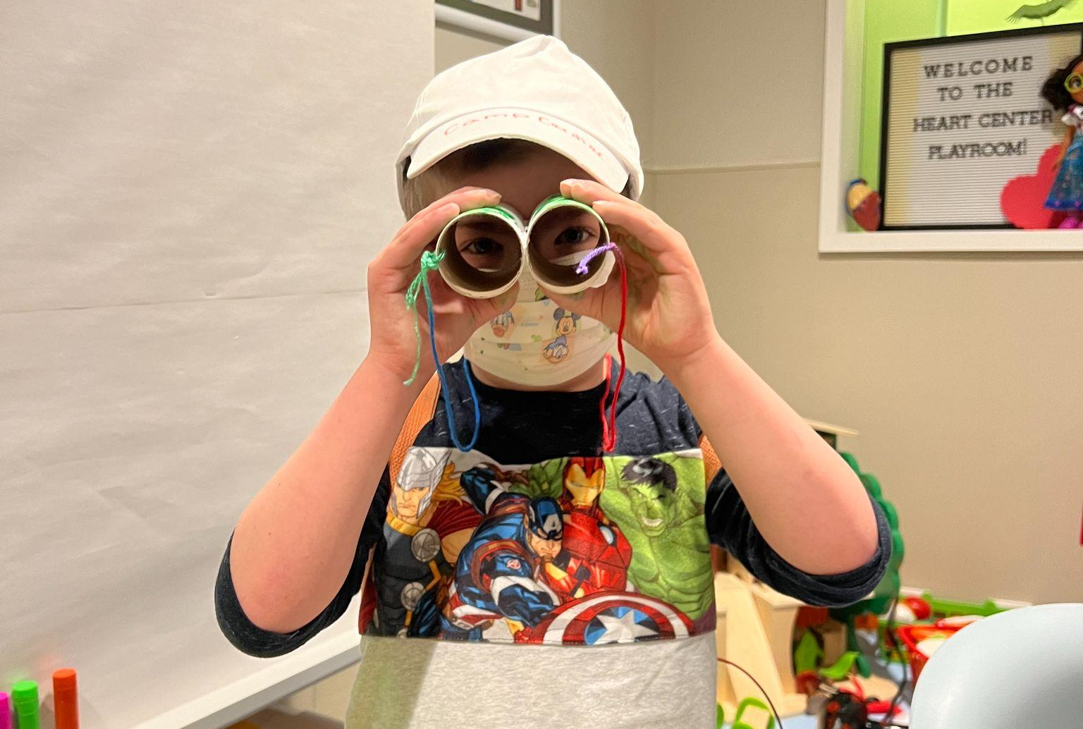
Conclusion
Camp Cardiac was a SUCCESS!
Camp Cardiac served ~ 12 kids per camp day on a 28 unit floor (~42% of unit served biweekly)
Week 5&6 of Camp Cardiac served over 50% of the unit
Participation in Camp Cardiac eliminated ALL negative emotions patients were experiencing by 100%
Camp Cardiac will continued to implemented monthly by Camp Rise Above

Slide 21
Acknowledgements
Dr. Joy Crawford, OTD, OTR/L...................................................................Capstone Faculty Mentor & Coordinator
Erin Ulmer, Executive Camp Director........................................................................................Capstone Site Mentor
Jessica Cromer, Director of Programs.................................................................................Capstone Site Co-Mentor
Allison Carter, Director of Development.............................................................................Capstone Site Co-Mentor
Kylie Wilder, CCLS..............................................................................................................Child Life Specialist at SJCH
Tara Brophy, OTS.......................................................................................................................Peer Review & Feedback
Molly Brinkhoff, OTS…………………………………………....................………...….……Full Time Camp Cardiac Volunteer
Lilly Riley, OTS………………………………………………………………………….…….……Full Time Camp Cardiac Volunteer
Additional Camp Cardiac Volunteers…………………Jen, Ashlyn, Bridget, Caroline, Lauren, Jaeger, Alison, Taylor

Slide 22
References
Cahill, S. M., Egan, B. E., & Seber, J. (2020). “Activity- and Occupation-Based Interventions to
Edelson, J. B., Rossano, J. W., Griffis, H., Quarshie, W. O., Ravishankar, C., O'Connor, M. J., Mascio, C. E., Mercer-Rosa, L., Glatz, A. C., & Lin, K. Y. (2021). Resource Use and Outcomes of Pediatric Congenital Heart Disease Admissions: 2003 to 2016. Journal of the American Heart Association, 10(4), e018286. https://doi.org/10.1161/JAHA.120.018286
Nijhof, S. L., Vinkers, C. H., van Geelen, S. M., Duijff, S. N., Achterberg, E., van der Net, J.,
STS national database. STS. (2018). https://www.sts.org/registries/sts-national-database
Support Mental Health, Positive Behavior, and Social Participation for Children and Youth: A Systematic Review.” The American journal of occupational therapy: official publication of the American Occupational Therapy Association, 74(2), 7402180020p1–7402180020p28. https://doi.org/10.5014/ajot.2020.038687
Veltkamp, R. C., Grootenhuis, M. A., van de Putte, E. M., Hillegers, M., van der Brug, A. W., Wierenga, C. J., Benders, M., Engels, R., van der Ent, C. K., Vanderschuren, L., & Lesscher, H. (2018). “Healthy play, better coping: The importance of play for the development of children in health and disease.” Neuroscience and biobehavioral reviews, 95, 421–429. https://doi.org/10.1016/j.neubiorev.2018.09.024
Williams, R. J., Lu, M., Sleeper, L. A., Blume, E. D., Esteso, P., Fynn-Thompson, F., Vanderpluym, C. J., Urbach, S., & Daly, K. P. (2022). Pediatric heart transplant waiting times in the United States since the 2016 allocation policy change. American journal of transplantation : official journal of the American Society of Transplantation and the American Society of Transplant Surgeons, 22(3), 833–842. https://doi.org/10.1111/ajt.16921

Slide 23
Thank You!
This concludes my doctoral capstone defense presentation.
I invite you to offer feedback and/or ask questions.

Slide 24
