Slide 1
The Development of Intervention Toolkits for Non-Specialized Personnel and Families of Children with Autism Spectrum Disorder in La Paz, Bolivia
Margaret Mahoney, OTDS
Faculty Mentor: Dr. Zesarae Bodie, OTD, MPH, OTR/L
Site Mentor: Dra. Cecilia Uribe
Capstone Site: Child Family Health International
04/24/2024 Occupational Therapy Doctoral Capstone Defense

Slide 2
BACKGROUND AND SIGNIFICANCE
ASD is characterized by difficulty with social communication and repetitive/inflexible behaviors (IDC-11, 2022).
Much of ASD research and interventions have yet to be implemented in Bolivia (CDC, 2014).
PMIs are being heralded as a promising approach for this population (Gillespie-Lynch & Brezis, 2018).
Notes:
PULL POINTS OVER FROM NEEDS ASSESSMENT
-carry over into the home is essential otherwise it is more difficult for any change in behavior
Reduces occupational engagement
Carry over of interventions into the home is crucial
-there are barriers such as geography, low ratio of healthcare personnel to patients, no OTs
Limited resources, lack of therapy services
Children with ASD less access to services
-previous research has shown benefits in PMIs
Reduces barriers to services
Increases confidence in supporting
2)Healthcare providers in Bolivia reported that the majority of parents did not know typical development nor symptoms of ASD.
3)The needs assessment showed that majority of people believed that PMIs could help overcome barriers to access to services. And majority of parents reported that they would feel comfortable using a PMI
3) one healthcare provider in Bolivia even cited “training primary caregivers as co-therapists” as an option for improving options for families of children with ASD

Slide 3
PROJECT PURPOSE AND AIMS
Purpose:
To enhance the occupational engagement and quality of life for children with ASD and their families in La Paz, Bolivia through the creation of toolkits/resources for non-specialized personnel.
Knowledge Acquirement
Cultural/Language
Attunement
Toolkit
Development
Knowledge on health and educational systems in place for children with ASD and their families
Enhance Spanish-speaking abilities and cultural responsiveness within Latin America
Develop and implement toolkits/resources to aid non-specialized personnel and families of children with ASD
Notes:
**Add purpose Through the creation of toolkits for non-specialized personnel (e.g., parents, teachers), the purpose of this QI project is to enhance the occupational engagement and quality of life for children with ASD and their families in La Paz, Bolivia.
Acquire in-depth knowledge on the Bolivian health and educational systems that are currently in place for supporting children with ASD and their families.
Further develop my Spanish-speaking abilities and cultural responsiveness within Latin America.
Engage in the development and implementation of evidence-based toolkits and resources among health and educational personnel to aid non-specialized personnel and families of children with ASD.

Slide 4
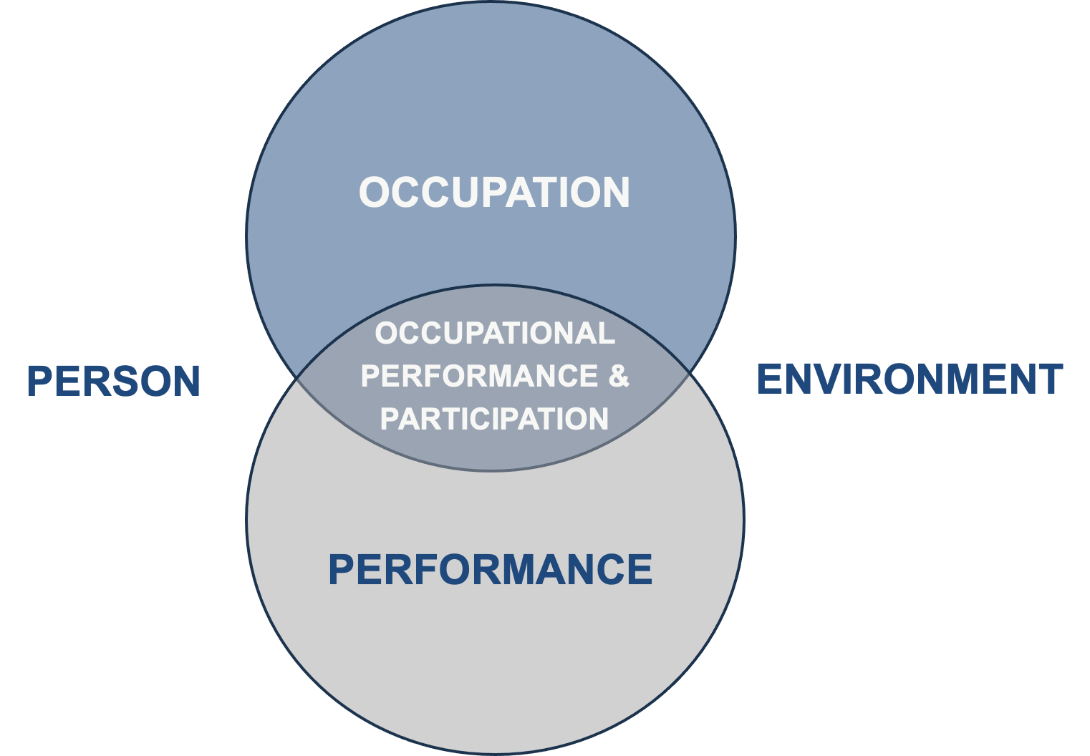
PEOP MODEL
WELL-BEING
QUALITY OF LIFE
Notes:
The interaction between the person and environmental components positively or negatively influences occupational performance
(1) characteristics of the person (including physiological, psychological, motor, sensory/perceptual, cognitive, or spiritual), (2) features of the environment (including cultural, social support, social determinants, and social capital, physical and natural environments, health education and public policy, assistive technology), and (3) characteristics of the activity, task, or role.
Not only impacts child with ASD in terms of their intrinsic traits and environment can determine their performance, but also the families and teachers of children with ASD in terms of how the environment influences their performance in understanding and supporting their child with ASD.

Slide 5
STAKEHOLDERS
OTHER HEALTHCARE PROVIDERS
CHILDREN WITH ASD AND THEIR FAMILIES
PTs
SLPs
Doctors
At clinical sites (Virgen Niña and CEREFE Center)
Shared with other families
06
01
VIRGEN NIÑA AND CEREFE CENTER
CHILD FAMILY HEALTH INTERNATIONAL
Students
OT, autism specialist
Staff
Teachers
Volunteers
05
02
Site mentor
La Paz program
04
03
OT STUDENTS
NC PARTNERS OF THE AMERICAS
At OT programs
Partners with Bolivia
Notes:
-Clinical sites: Virgen Niña and CEREFE Center

Slide 6
METHODS
Quality Improvement
Pre-Toolkit
Design: Cross-sectional mixed-methods
Post-Toolkit
Design: Cross-sectional mixed-methods
Data Collection
Parents (n=5): Pre-survey
Teachers/Therapists: Observations and feedback
Data Analysis
Quantitative data: Descriptive statistics
Qualitative data: Summative content analysis
Data Collection
Healthcare providers at sites (n=5): Post-survey and feedback
Data Analysis
Quantitative data: Descriptive statistics
Qualitative data: Thematic analysis
Notes:
Pre-survey and discussion

Slide 7
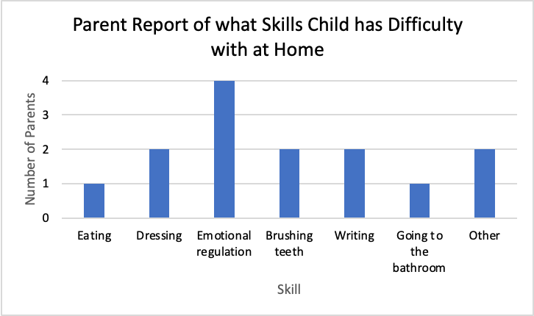
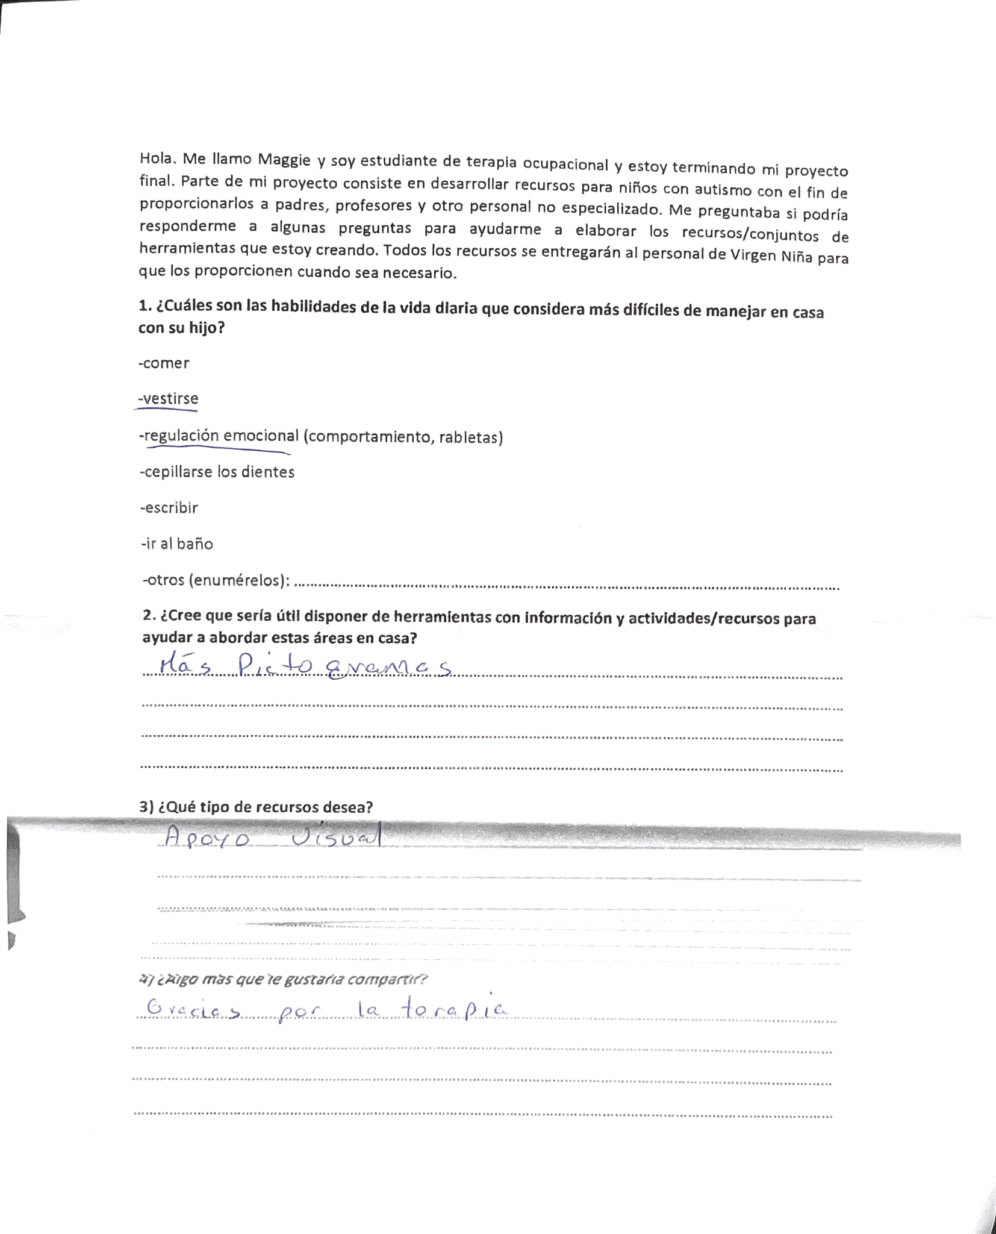
PRE-TOOLKIT SURVEY
Survey administered to parents at therapy sites (n=5)
Virgen Niña and CEREFE Center
*”Other” was “Communication”
Notes:
Post-survey

Slide 8
CAPSTONE EXPERIENCE AND DELIVERABLES
EXPERIENCE
DELIVERABLES
Time at clinical sites
Hospital del Niño
Primary Care Clinic in Bella Vista
Virgen Niña
CEREFE Center
Spanish classes
Cultural activities
Meetings with local and medical coordinator
Healthcare
History and culture
Essay on the healthcare and educational systems in Bolivia and the implications on children with ASD
Toolkits/resources for non-specialized personnel
Zones of Regulation
Brushing Teeth
Food/Feeding
Clothes/Dressing
Resources for the Classroom

Slide 9
TIMELINE OF CAPSTONE EXPERIENCE
WEEK 1 - 4
WEEK 8 - 10
WEEK 11 - 14
Learn about the healthcare system
Develop toolkits/resources
Collect and analyze data
WEEK 4 - 8
WEEK 10 - 11
Learn about the educational system and therapy sites
Implement toolkits/resources
Learn about the history, culture, and language
Notes:
Don’t know if i need this slide?

Slide 10
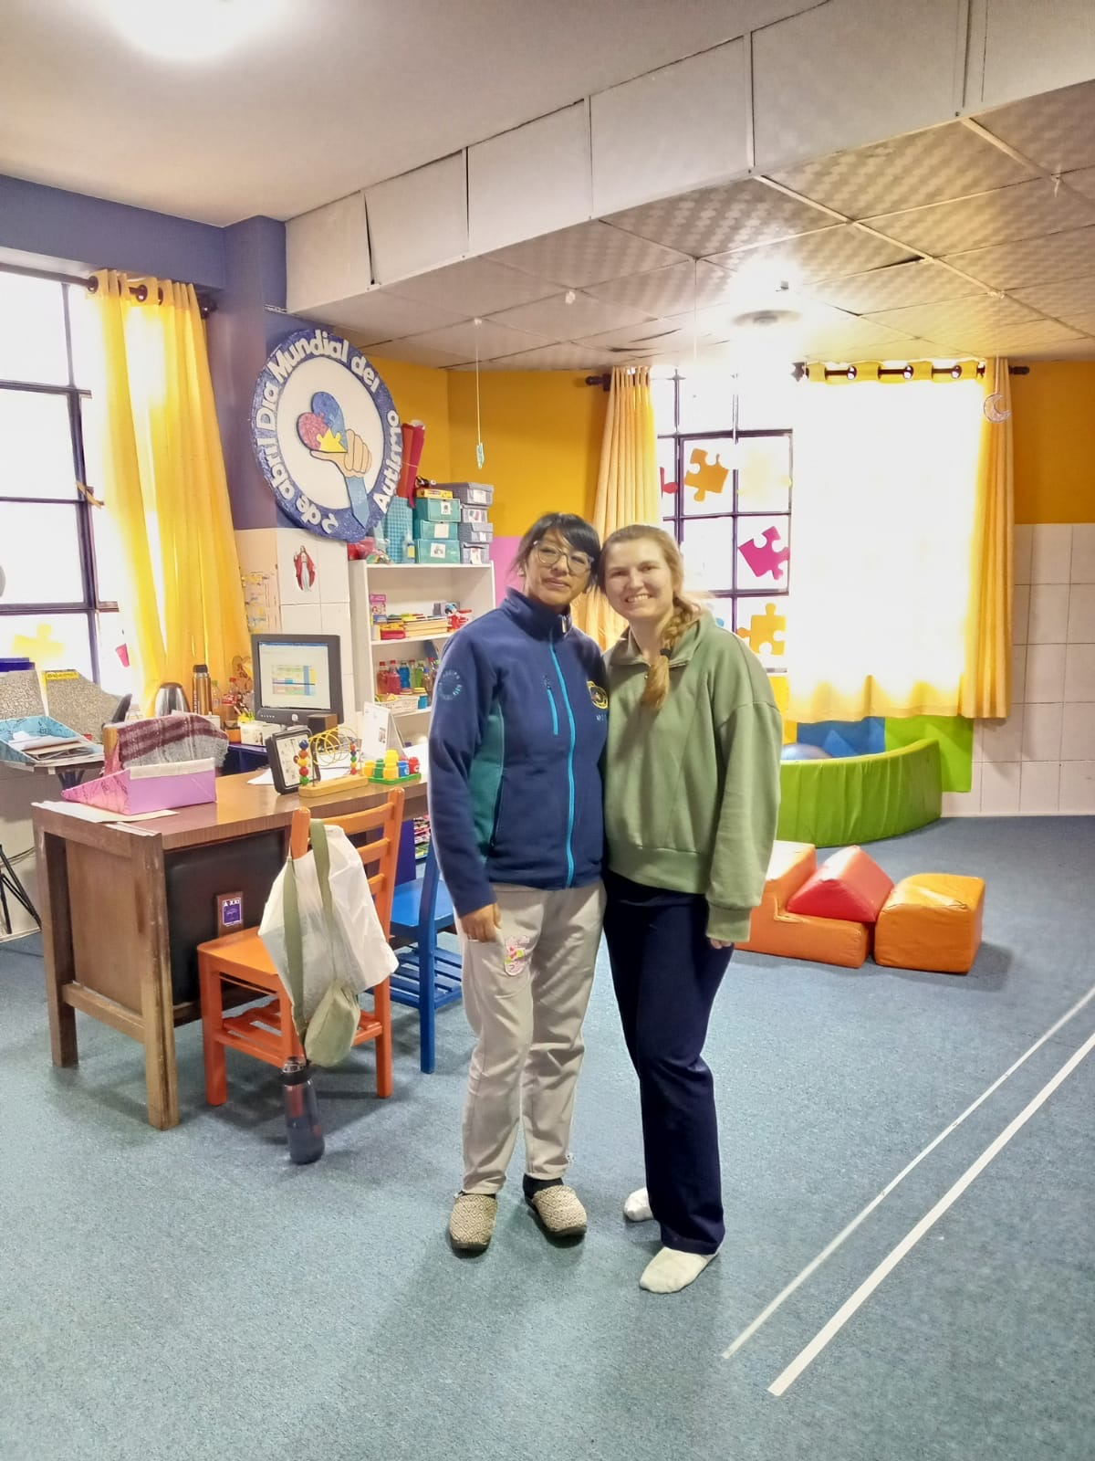
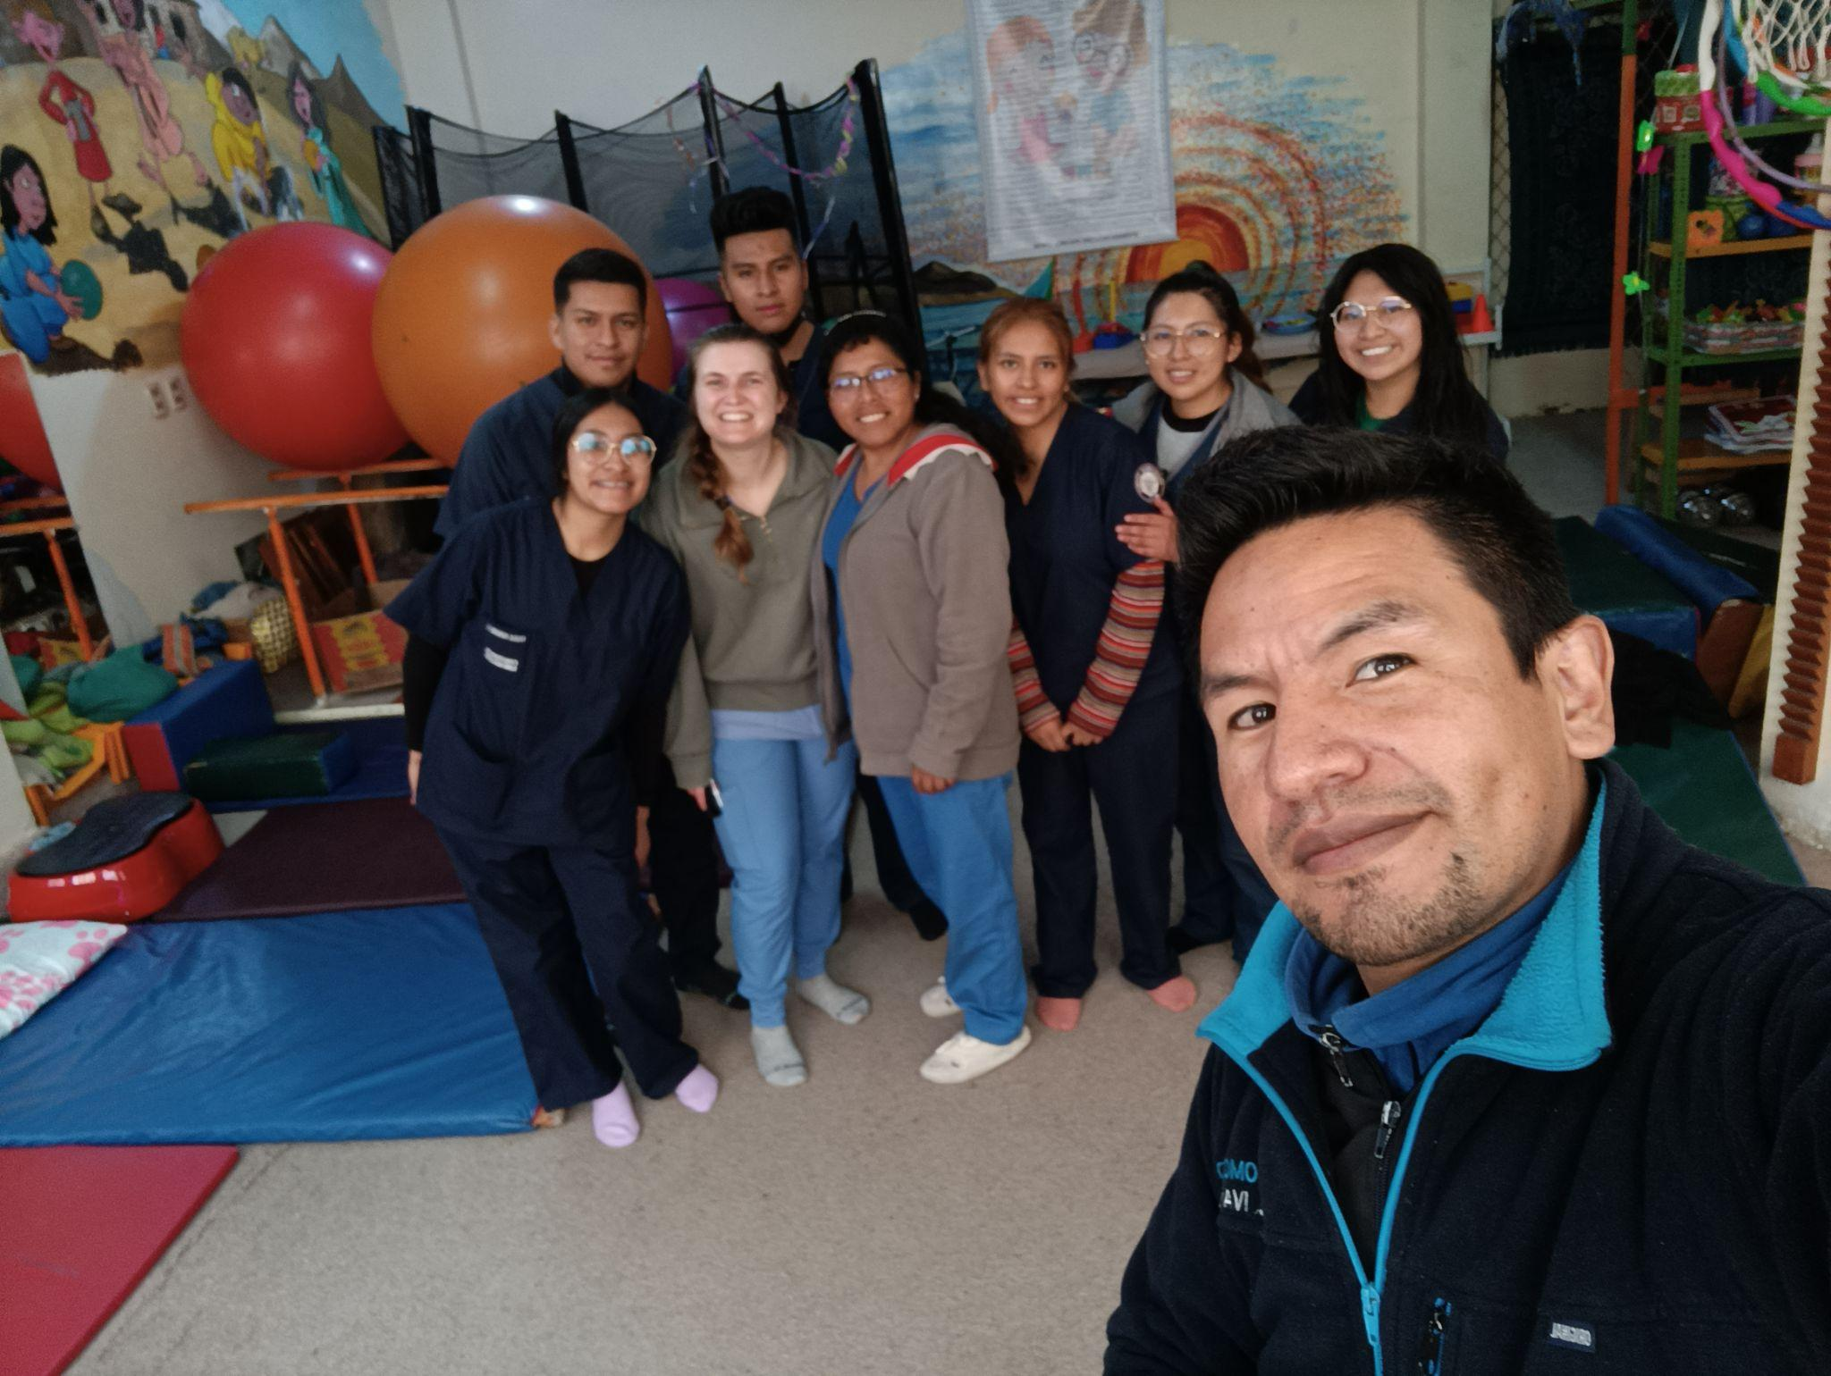
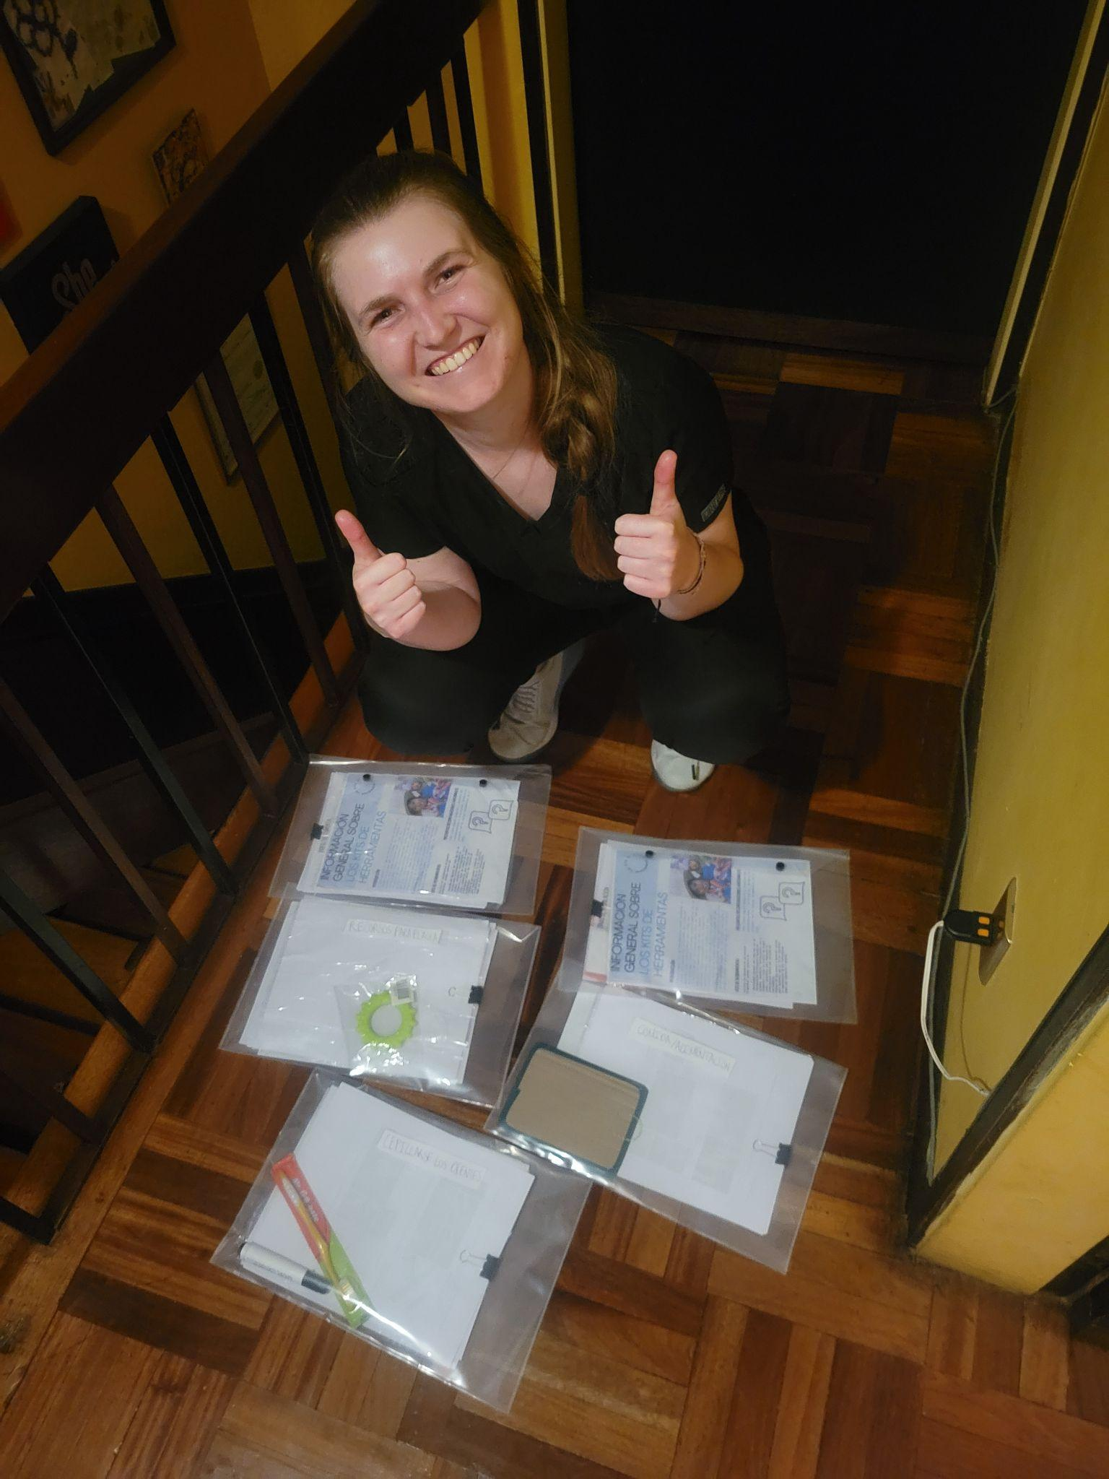
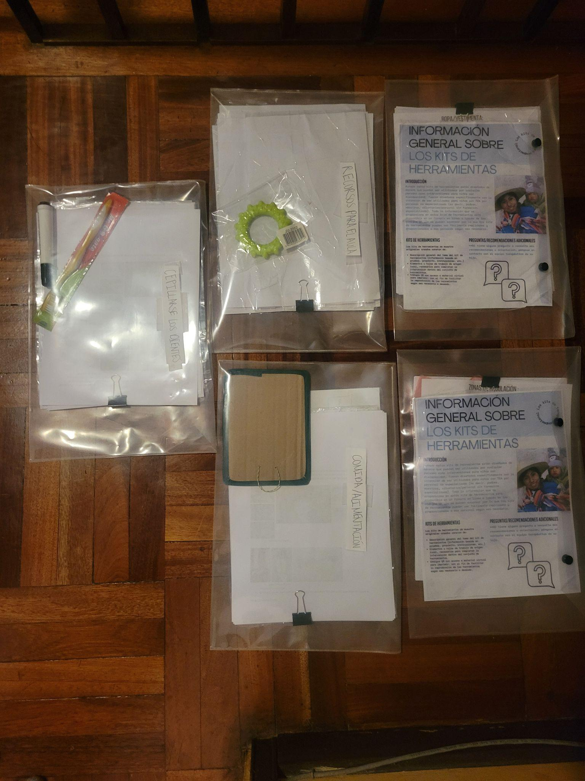
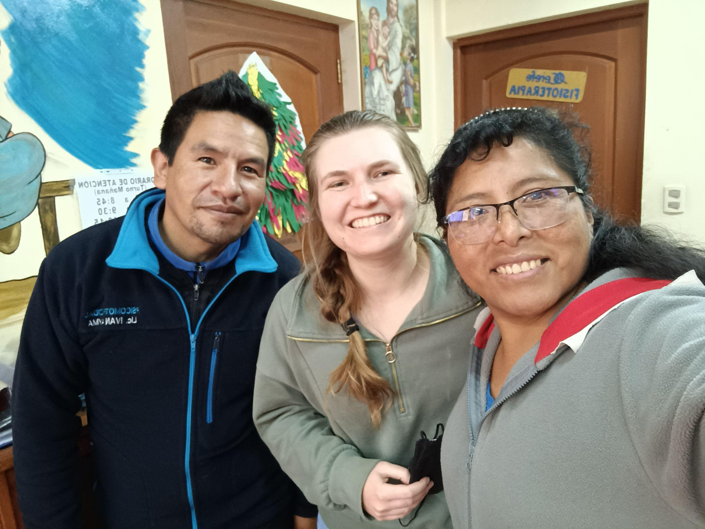

Slide 11
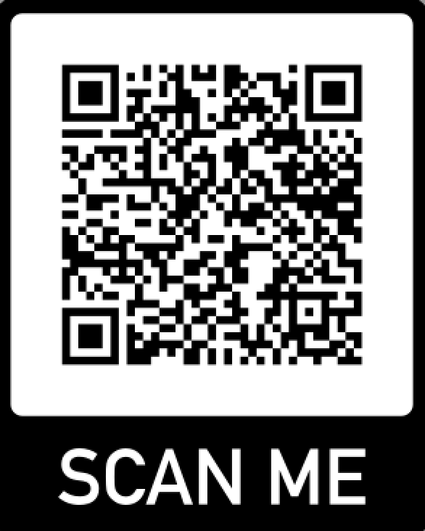
LINK TO ESSAY
Capstone Deliverable

Slide 12
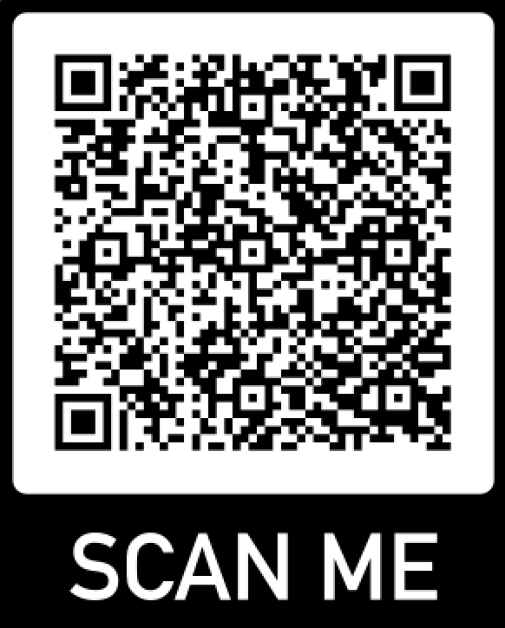
LINK TO TOOLKITS
Capstone Deliverable

Slide 13
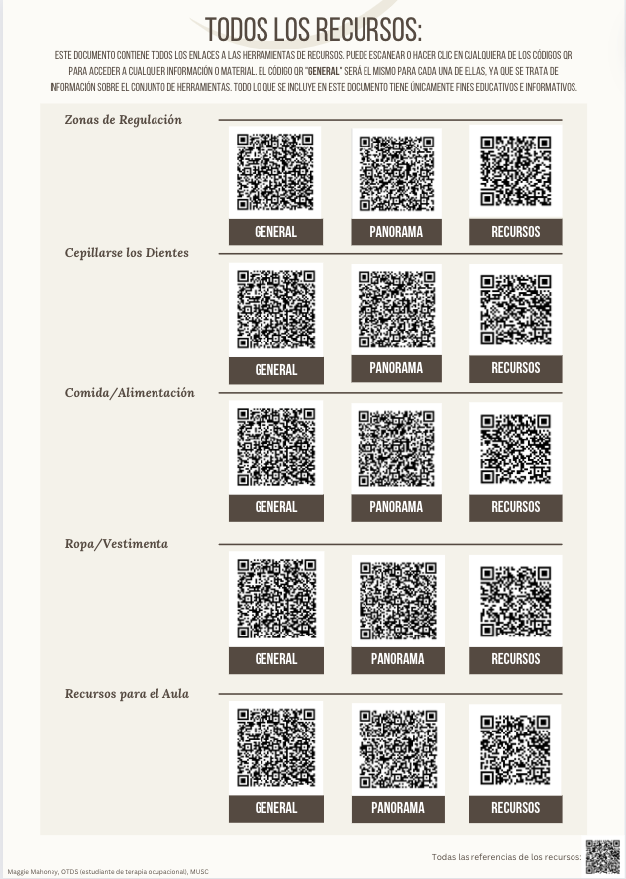
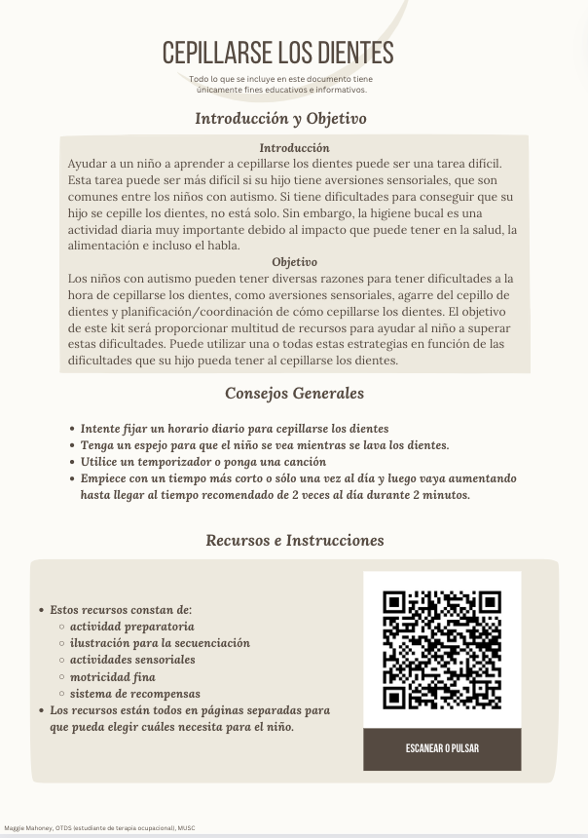
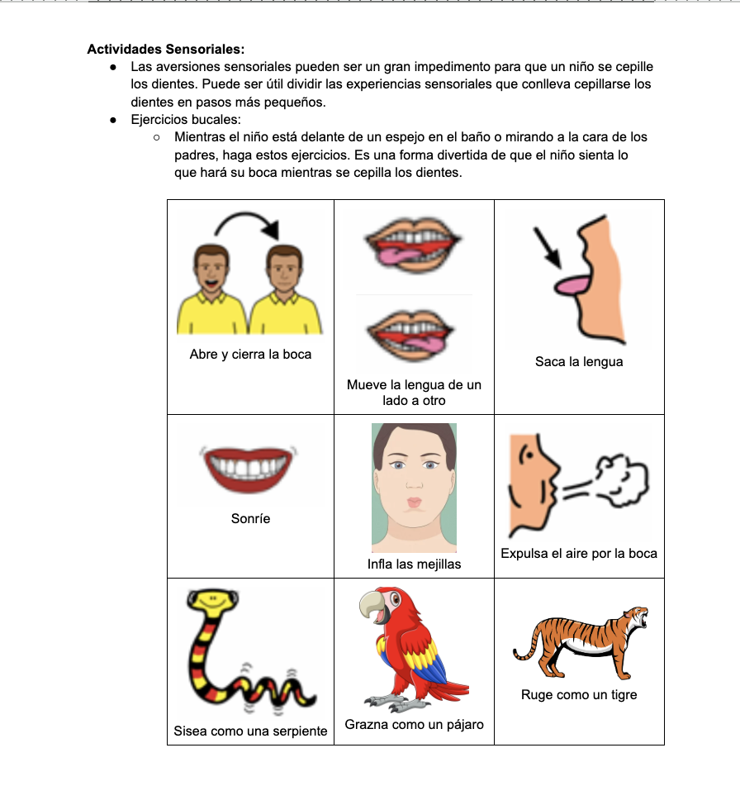

Slide 14
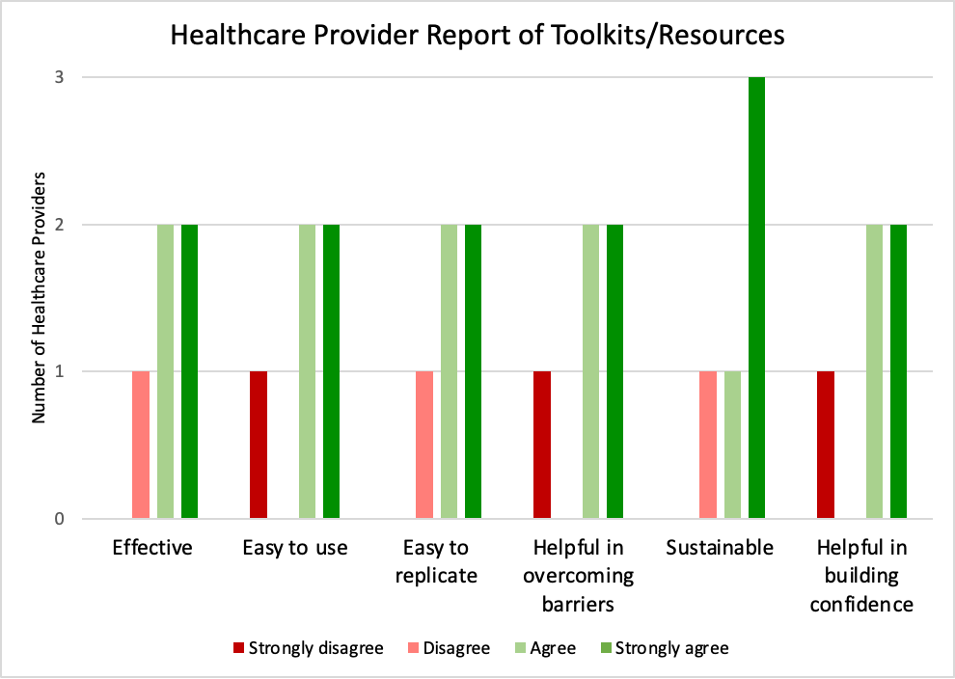
EVALUATION AND EFFECTIVENESS
100%
Ranked the toolkits/resources as helpful/very helpful (n= 5)
100%
Ranked that they are likely/very likely to use and share these toolkits/resources (n=5)

Slide 15
EVALUATION AND EFFECTIVENESS
Thematic Analysis of Open-Ended Responses
General Opinion | “They are practical, easy to understand... very useful.” | “I like the virtual option so that it is easy to replicate”
Possible Obstacles | “may be difficult for some parents to fully understand due to their level of reading comprehension.” | “Difficult to understand for people outside the area, such as parents.”
Areas for Improvement | “In a more didactic and visual way.” “maybe some more pictures to help show what more things would look like.” | “Promote platforms for use”
Notes:
Tie into impact/sustainability
Practical/useful; Easy
Difficulty for parents to understand; Reading comprehension
More didactic and visuals; Find a way to promote platform

Slide 16
STRENGTHS AND LIMITATIONS
Strengths:
Continual ability to update/modify
Improved sustainability
Multiple formats to enhance replicability
Digestible formats with ability to choose specific topics
Limitations:
Small sample size
Short duration of time post-implementation
Unable to survey target population directly
Language and cultural differences

Slide 17
POTENTIAL IMPACTS AND IMPACT ON OT
LOCAL
Support Spanish-speaking population of children with ASD and their families
Provide information to NC Partners of the Americas
GLOBAL
Reduce impacts of barriers related to low SES and lack of therapy services
Improve access to information on ASD to non-specialized personnel
Support education of OT students in Bolivia
Notes:
International Occupational Therapy: addresses community concerns, contributing to sustainable health and well-being.

Slide 18
RECOMMENDATIONS FOR SITE
Share toolkits/resources with non-specialized personnel
Teachers, parents, etc.
Adjust classrooms/therapy spaces based on “Resources for the Classroom” toolkit
Contact for further modifications/suggestions for toolkits
Continue inter-collaboration between therapy sites

Slide 19
CONCLUSION AND FUTURE DIRECTIONS
OUTCOMES:
Successful development and implementation of toolkits/resources at sites
Healthcare providers viewed the toolkits/resources as a useful and effective option for non-specialized personnel
Opportunity to address gaps surrounding access to clinic-based services and availability of OT-based interventions/information
FUTURE DIRECTIONS:
Direct implementation of toolkits/resources among target population
Presentations, videos, etc.
Local use of toolkits/resources
Notes:
Which helps to achieve the purpose of this QI project by improving occupational engagement and QoL for children with ASD and their families

Slide 20
ACKNOWLEDGEMENTS
Faculty Mentor: Dr. Zesarae Bodie and Dr. Patty Coker-Bolt
Site Mentor & Medical Coordinator: Dra. Cecilia Uribe
Site Healthcare Professionals: Dra. Claudia Hernandez, Dra. Veronica Champi, Patricia Claudia, Otilia Yanque, and Valeska Carvajal
Local Coordinator: Gonzalo Claure
Spanish Instructor: Maria Osinaga
Local Tour Guide and Cultural and Conservation Expert: Beto Espinoza
Translator Assistance: Abi Mendoza, Andrés González, and Susan Dempsey
Host Family: Ana Paola Lorberg, Belén Lorberg, and Forest (dog)

Slide 21
REFERENCES
Centers for Disease Control and Prevention. (2014). Prevalence of autism spectrum disorder among children aged 8 years—Autism and Developmental Disabilities Monitoring Network, 11 sites, United States, 2010. Morbidity and Mortality Weekly Report, 63, 1-21. Retrieved from http://www.cdc.gov/mmwr/preview/mmwrhtml/ss6302a1.htm
Gillespie-Lynch, K., & Brezis, R. (2018). Parent-Implemented Interventions Around the Globe. Handbook of Parent-Implemented Interventions for Very Young Children with Autism (pp. 359-383). Springer International Publishing. 10.1007/978-3-319-90994-3_22
ICD-11 for Mortality and Morbidity Statistics. (2022). 6A02 Autism Spectrum Disorder. International Classification of Disease. https://icd.who.int/browse11/l-m/en#/http%253a%252f%252fid.who.int%252ficd%252fentity%252f437815624

Slide 22
THANKS!
Let me know if you have any questions!

