Slide 1
JUNTOS PODEMOS (TOGETHER WE CAN): A RESOURCE PLATFORM FOR SPECIAL EDUCATION TEACHERS IN LATIN AMERICA
Susan Dempsey, OTS
MUSC faculty mentor: Cristina Smith, OTD, OTR/L
Capstone site: FNE International
Capstone site mentors: Michael Cipoletti and Alyssa Hopun
Grant Sponsorship: MUSC Center for Global Health

Slide 2
Background and Literature Review
Background:
There is a high number of individuals in the world living with disabilities, an estimated 1 billion+ people worldwide. Out of that number the majority live in low- and middle- income countries (LMICs) (Saran et al., 2019).
Literature:
There is a gap in research addressing disabilities and care in impoverished settings (van der Mark et al., 2017).
There is a lack of research on teacher programs and how they impact teachers, schools, and children (Delkamiller et al., 2016).
Gap:
There is a need for easier access to teacher programs and more research on these topics in LMICs.

Slide 3
Building Blocks
Alcanzando Alturas Nuevas
Melissa Turpin, OTD, OTR/L
Modules: Universal Design for Learning and General Disability Knowledge, Classroom Behavior, and Neuromuscular System
Results: Increased knowledge and decreased self-perceived confidence
Creciendo Juntos
Kate Griffin, OTD, OTR/L
Modules: Sensory Processing
Results: Teachers reported increased knowledge of sensory processing

Slide 4
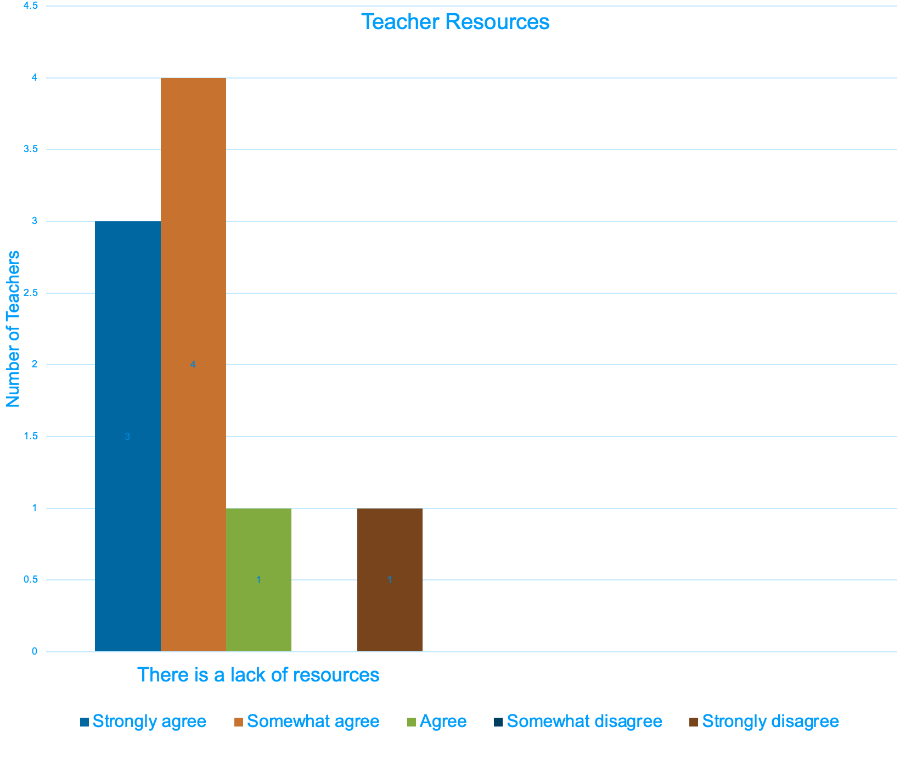
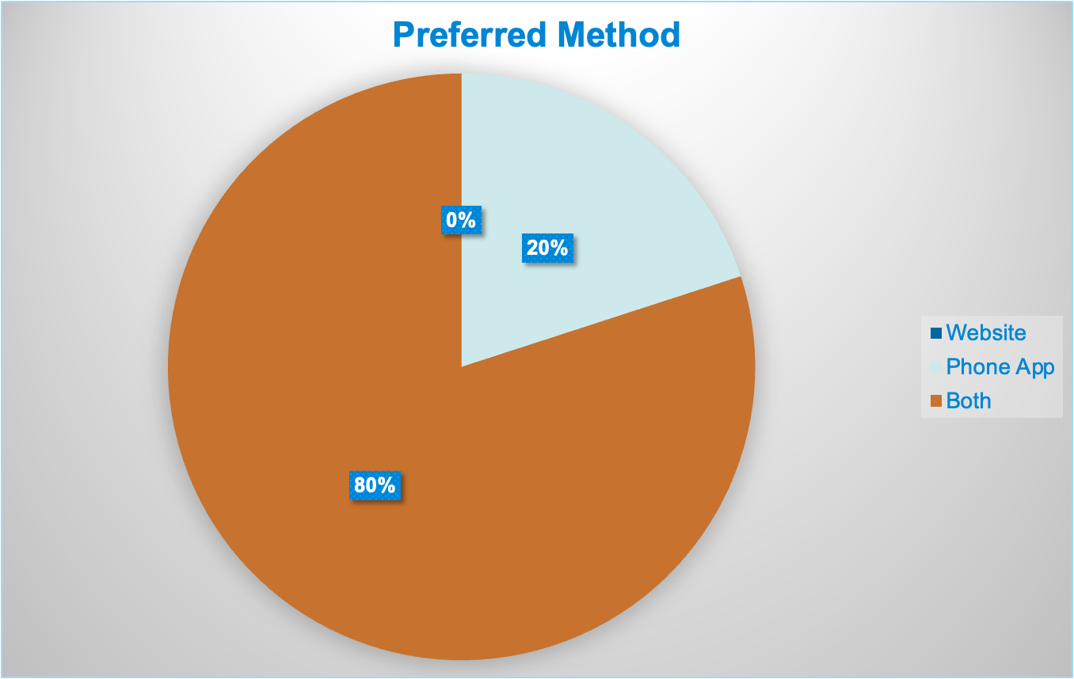
Needs Assessment 2022
Participants from Niño Feliz in Nicaragua and Nueva Vida in Guatemala
Majority of teachers agreed there is a lack of resources and agreed they would like to have more access to educational resources
Majority of the responses indicated they would like to have access to resources on an app and website

Slide 5
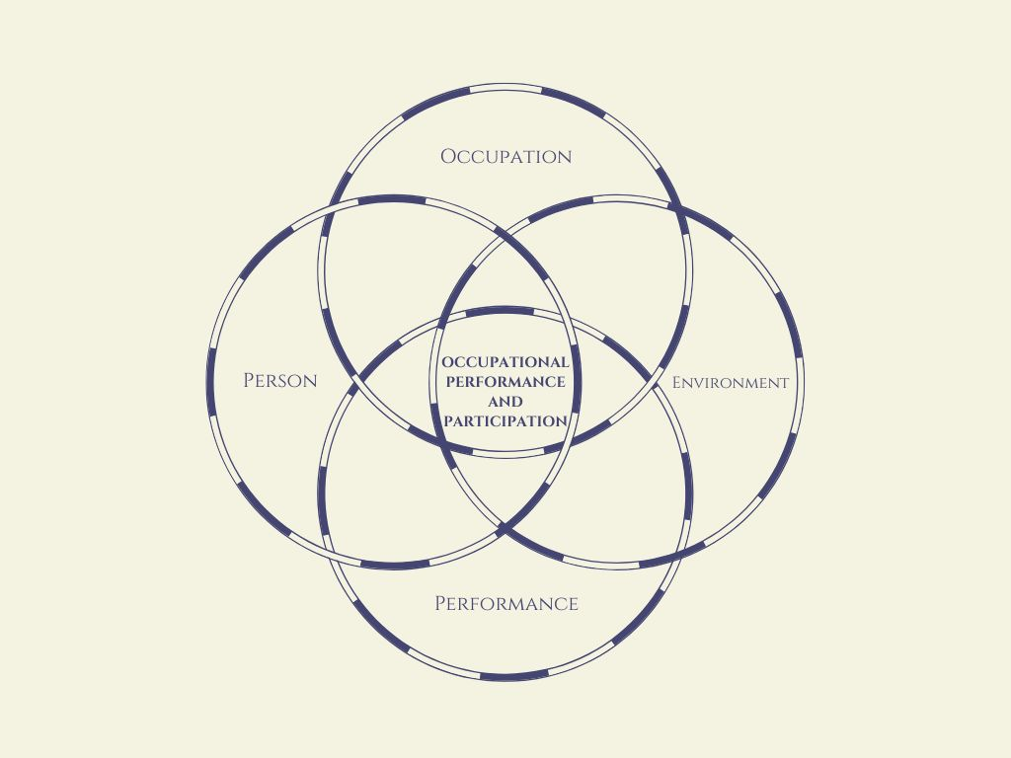
Supporting Framework
Person- Environment- Occupation- Performance method (PEOP) to maximize teacher performance in their occupation as special education teachers.
PEOP emphasizes a holistic approach that will keep in mind the needs of the teachers to do their jobs to the best of their abilities, which in this case included access to resources.
Notes:
Extrinsic peop factor- Tools

Slide 6
Project Aims and Purposes
The purpose of this project was to address the problem of limited access to resources that teachers in Nicaragua and other LMICs face.
Aim 1: Apply the leadership and communication skills needed for international collaboration.
Aim 2: To develop sustainable platforms for teachers to access learning modules across Latin America through partnership with FNE International.
Aim 3: To act as an advocate to ensure resource access for teachers in Low- Middle- Income Countries through partnership with FNE International.
Notes:
**check

Slide 7
Stakeholders
Staff, board members, & community partners of FNE International
Teachers and students of Niño Feliz and Nueva Vida
Patients and families receiving care through Salud Para Todos Los Niños (SPTLN) medical brigade
Physicians and students working with SPTLN
International Autism Outreach Project (IAOP)
OT students

Slide 8
Capstone Experience
Prework
Talked with teachers and OTs
Worked on app development
Compiled resources
Shadowing
Niño Feliz
FNE International community projects (library and farm)
Volunteering
Salud Para Todos Los Niños medical brigade
Aided individual with disabilities
Other capstone projects
Research
Reviewed literature
Continuing education courses
Listened to podcasts (school OT and culture)
App development
Collaborating
FNEI, SPTLN, & IAOP
Niño Feliz School
Nueva Vida School
MUSC Center for Global Health
MUSC OTD students

Slide 9
Timeline
January
Researched app development
Started app development
Talked with professionals
Compiled resources
March
Added more app content
Edited content
Contacted other schools
Prepared for presentation
February
Added content to the app
Created evaluation tool
Visited sites in Nicaragua
Disseminated deliverable
Completed evaluation
April
Analyzed data
Finalized presentation

Slide 10
Time in Nicaragua- SPTLN
Doctors, nurses, a prosthetist, and a physical therapist
3 clinic days in two locations
Treating children/young adults with special needs
Therapy gym for the 2nd and 3rd day with the SPTLN Brigade
Home visit with SPTLN for child with CP

Slide 11
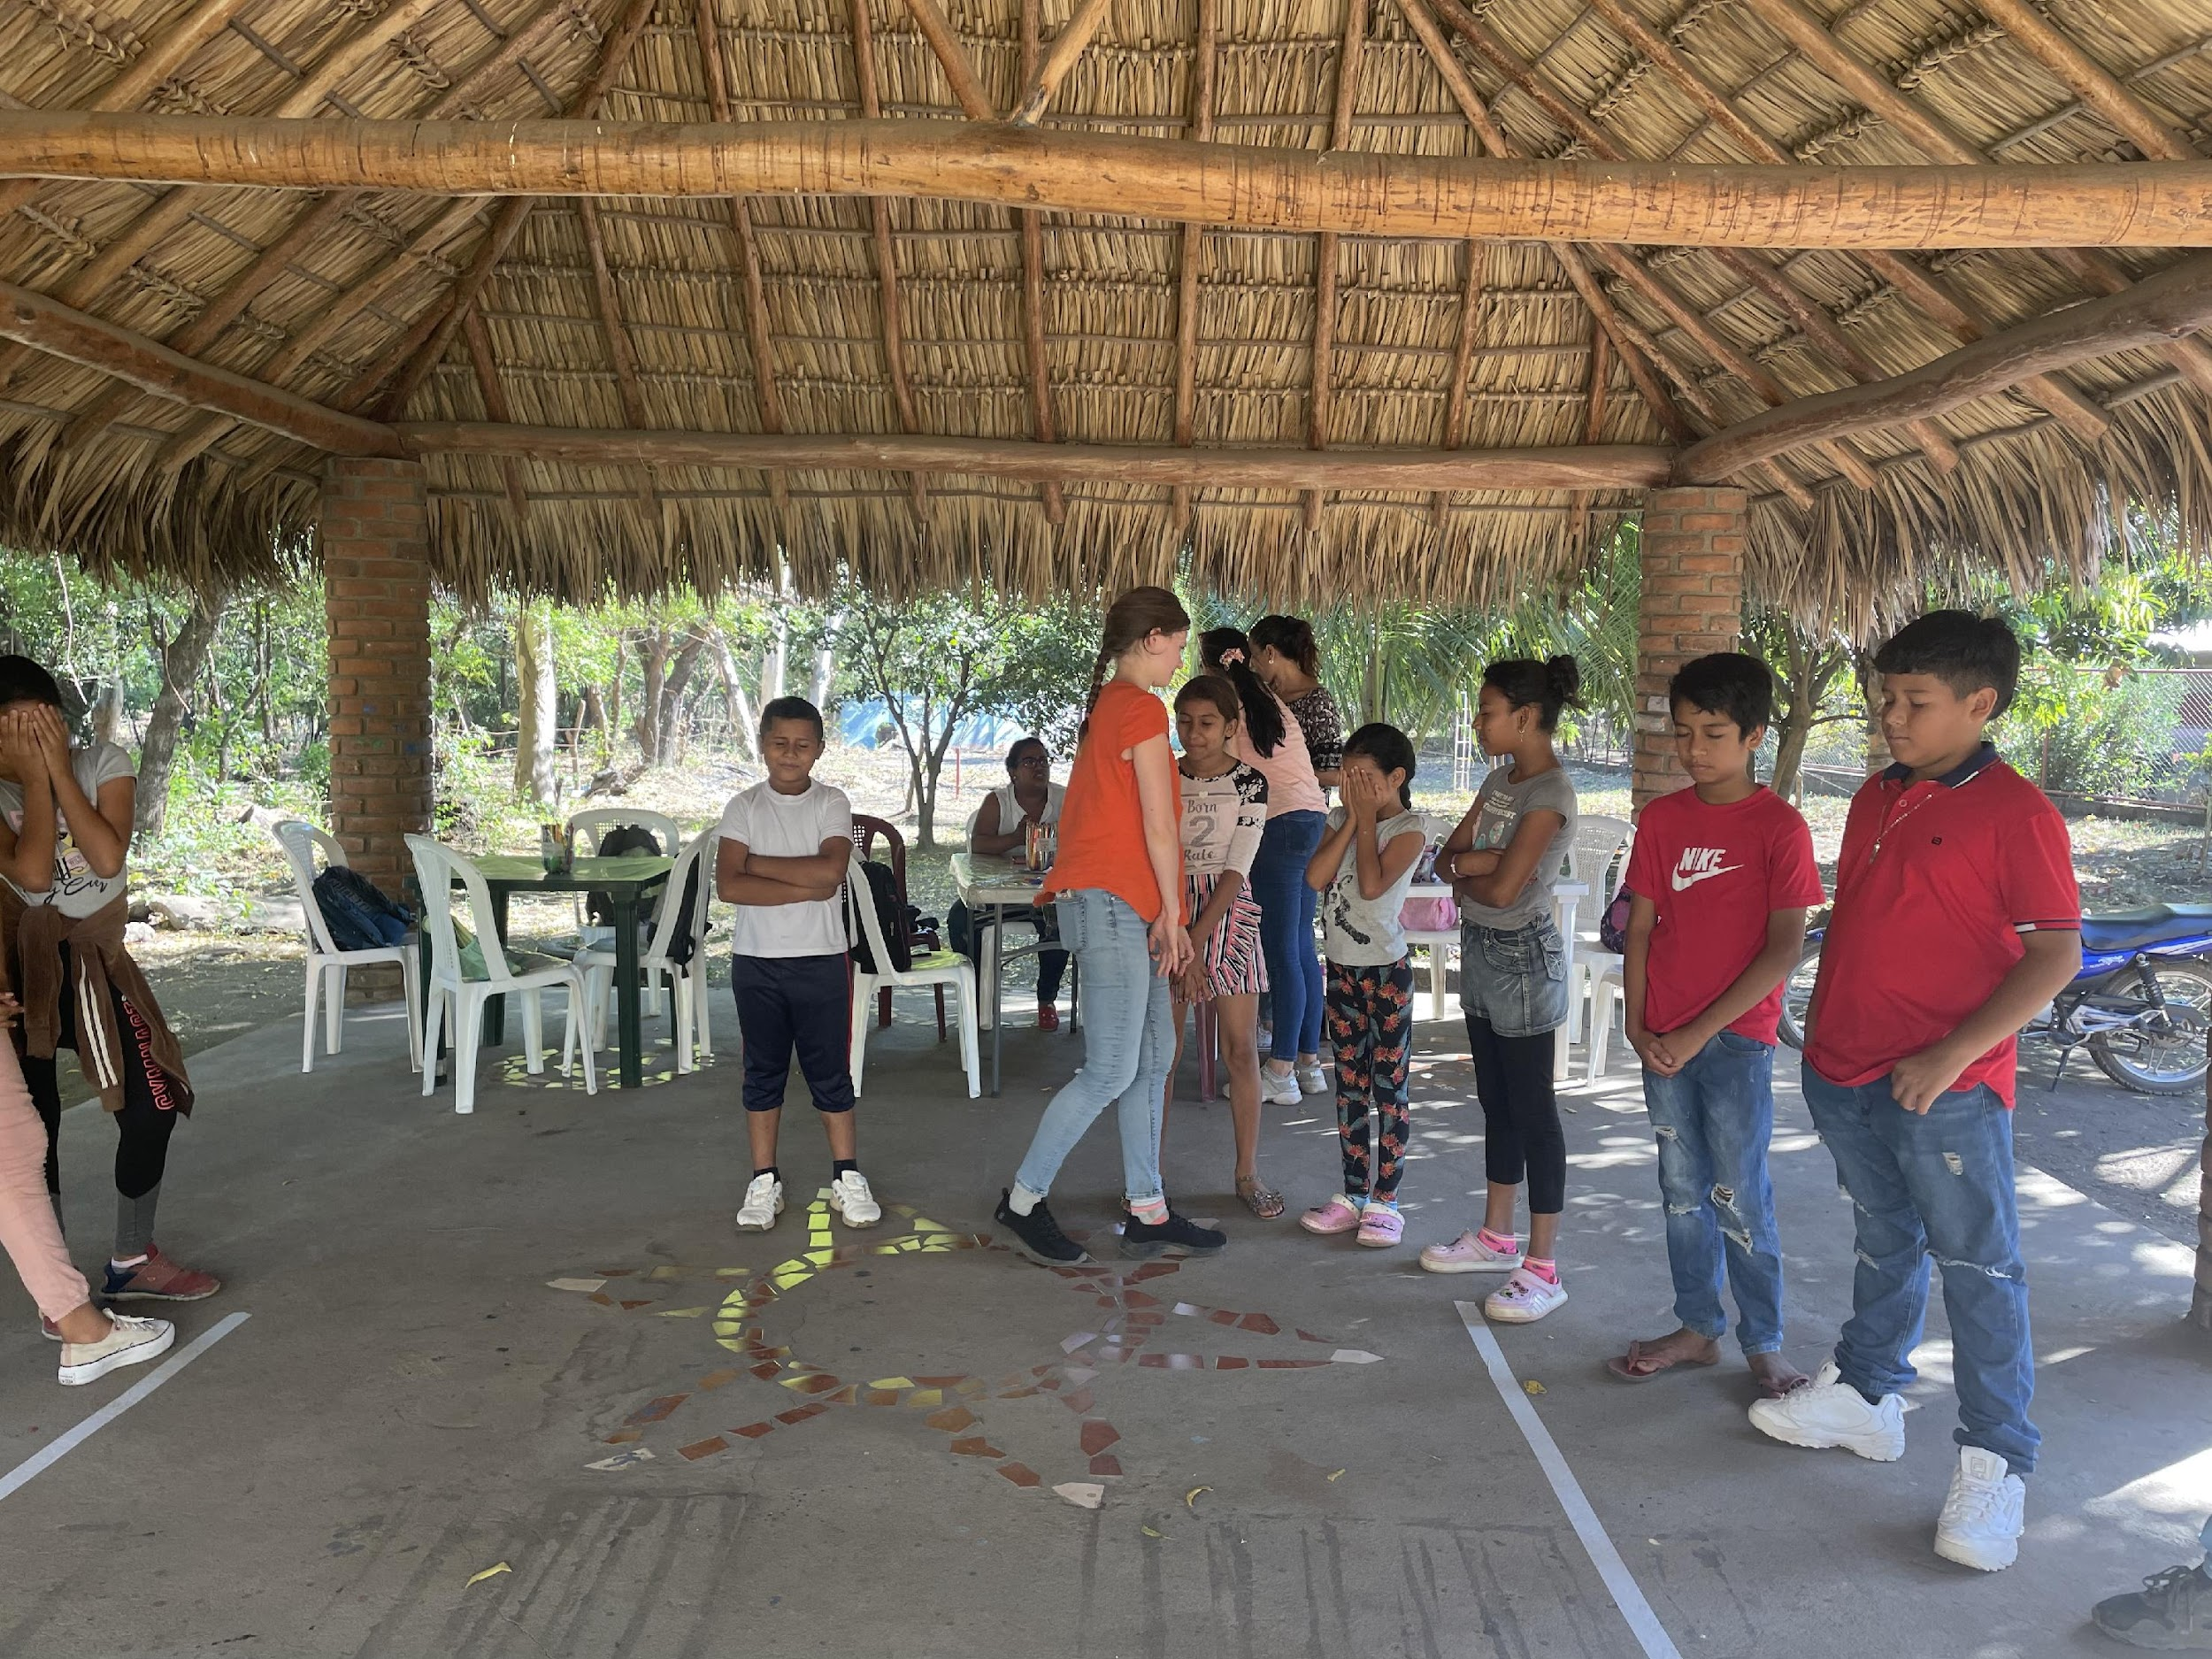
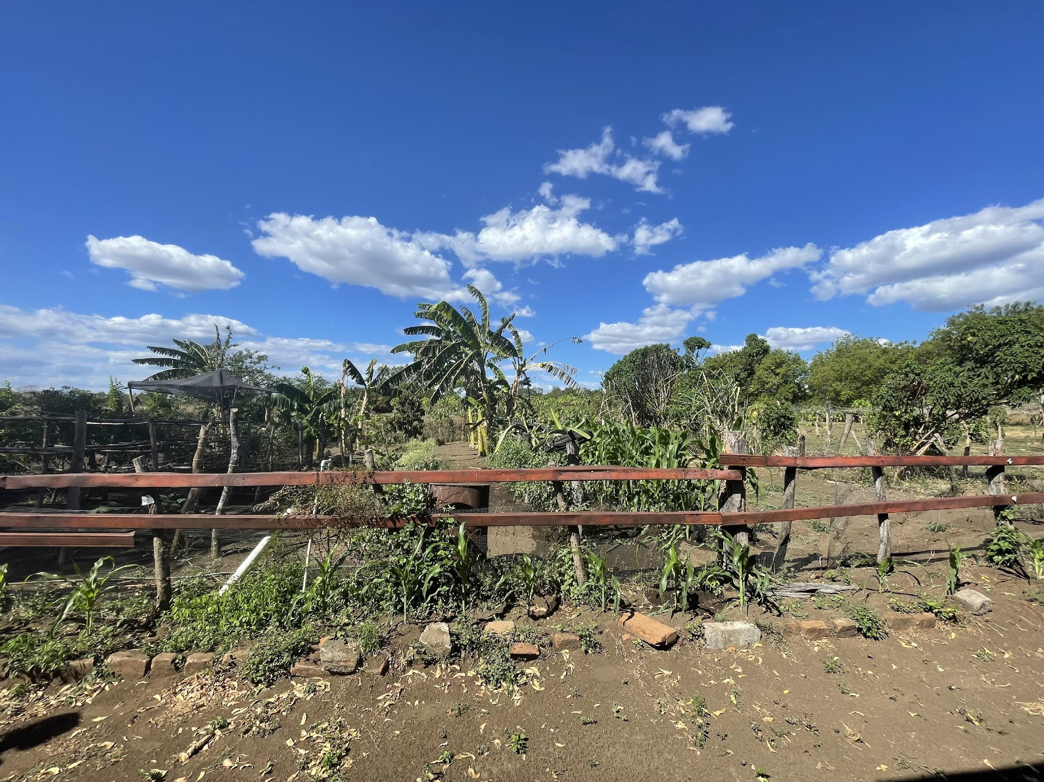
Time in Nicaragua- other FNEI projects
Visit to FNEI farm project
After school program for children at the library
After school English class at the library

Slide 12
The Schools
Schools that provided feedback
Niño Feliz
Chichigalpa, Nicaragua
5 classrooms + Skills workshop
Sensory garden
Offer school transportation
Nueva Vida
Santa María de Jesús, Guatemala
OT, PT, SLP
K-6th grade
Community
Early intervention
Family support groups
Community education
Notes:
List of classes

Slide 13
Methods
Quality Improvement
Mixed Methods: collection of qualitative and quantitative
In-person workshop at Niño Feliz: set-up of application
Survey (N=11)
Satisfaction, perception of access, frequency of use, likes/dislikes of application features
Focus group
General comments, future changes, useful tools and resources
Virtual communication with Nueva Vida:
Survey (N=2)
Satisfaction, perception of access, frequency of use, likes/dislikes of application features, and general comments

Slide 14
Deliverable- Online Platform
Created a Progressive Web App (PWA) that can be added to the phone home screen free of charge (Apple and Android)
English and Spanish version
It can also be accessed via a computer with the format of a desktop screen
Contains content from former/current MUSC PPOTD and OTD student projects
Resources for teachers that work with children with special needs

Slide 15
The App Development Process
Juntos Podemos
Editing/Translating
Editing content
Font sizes
Layout
Translating into Spanish or English
4
Creating/Adding Content
Compiling resources
Creating handouts
Creating special features
Loading content onto app
3
Layout/Design
Splash-screen
Color/pictures
Organization
2
Research
Researching software
Comparing products
Experimenting with different functions
1
Notes:
Testing as well

Slide 16
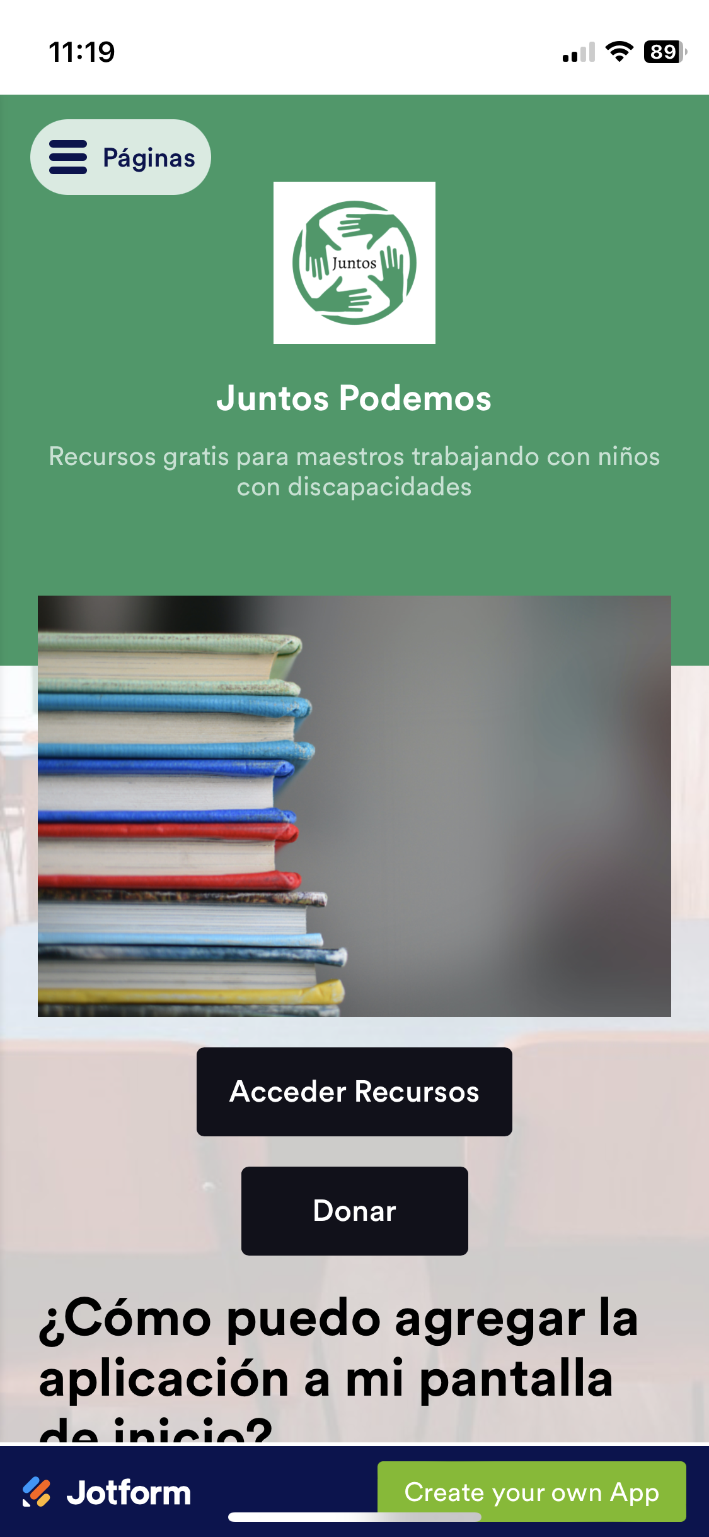
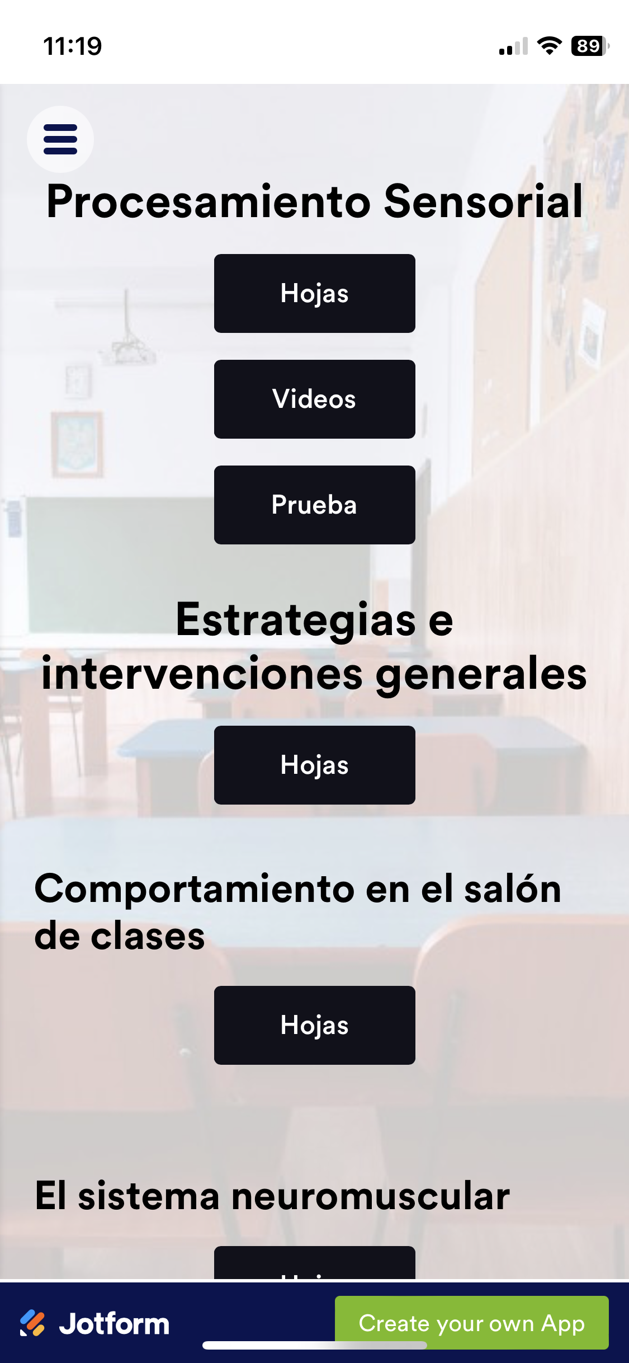
Deliverable
Splash-screen
Home page
Table of content
Notes:
https://app.jotform.com/240147354774156

Slide 17
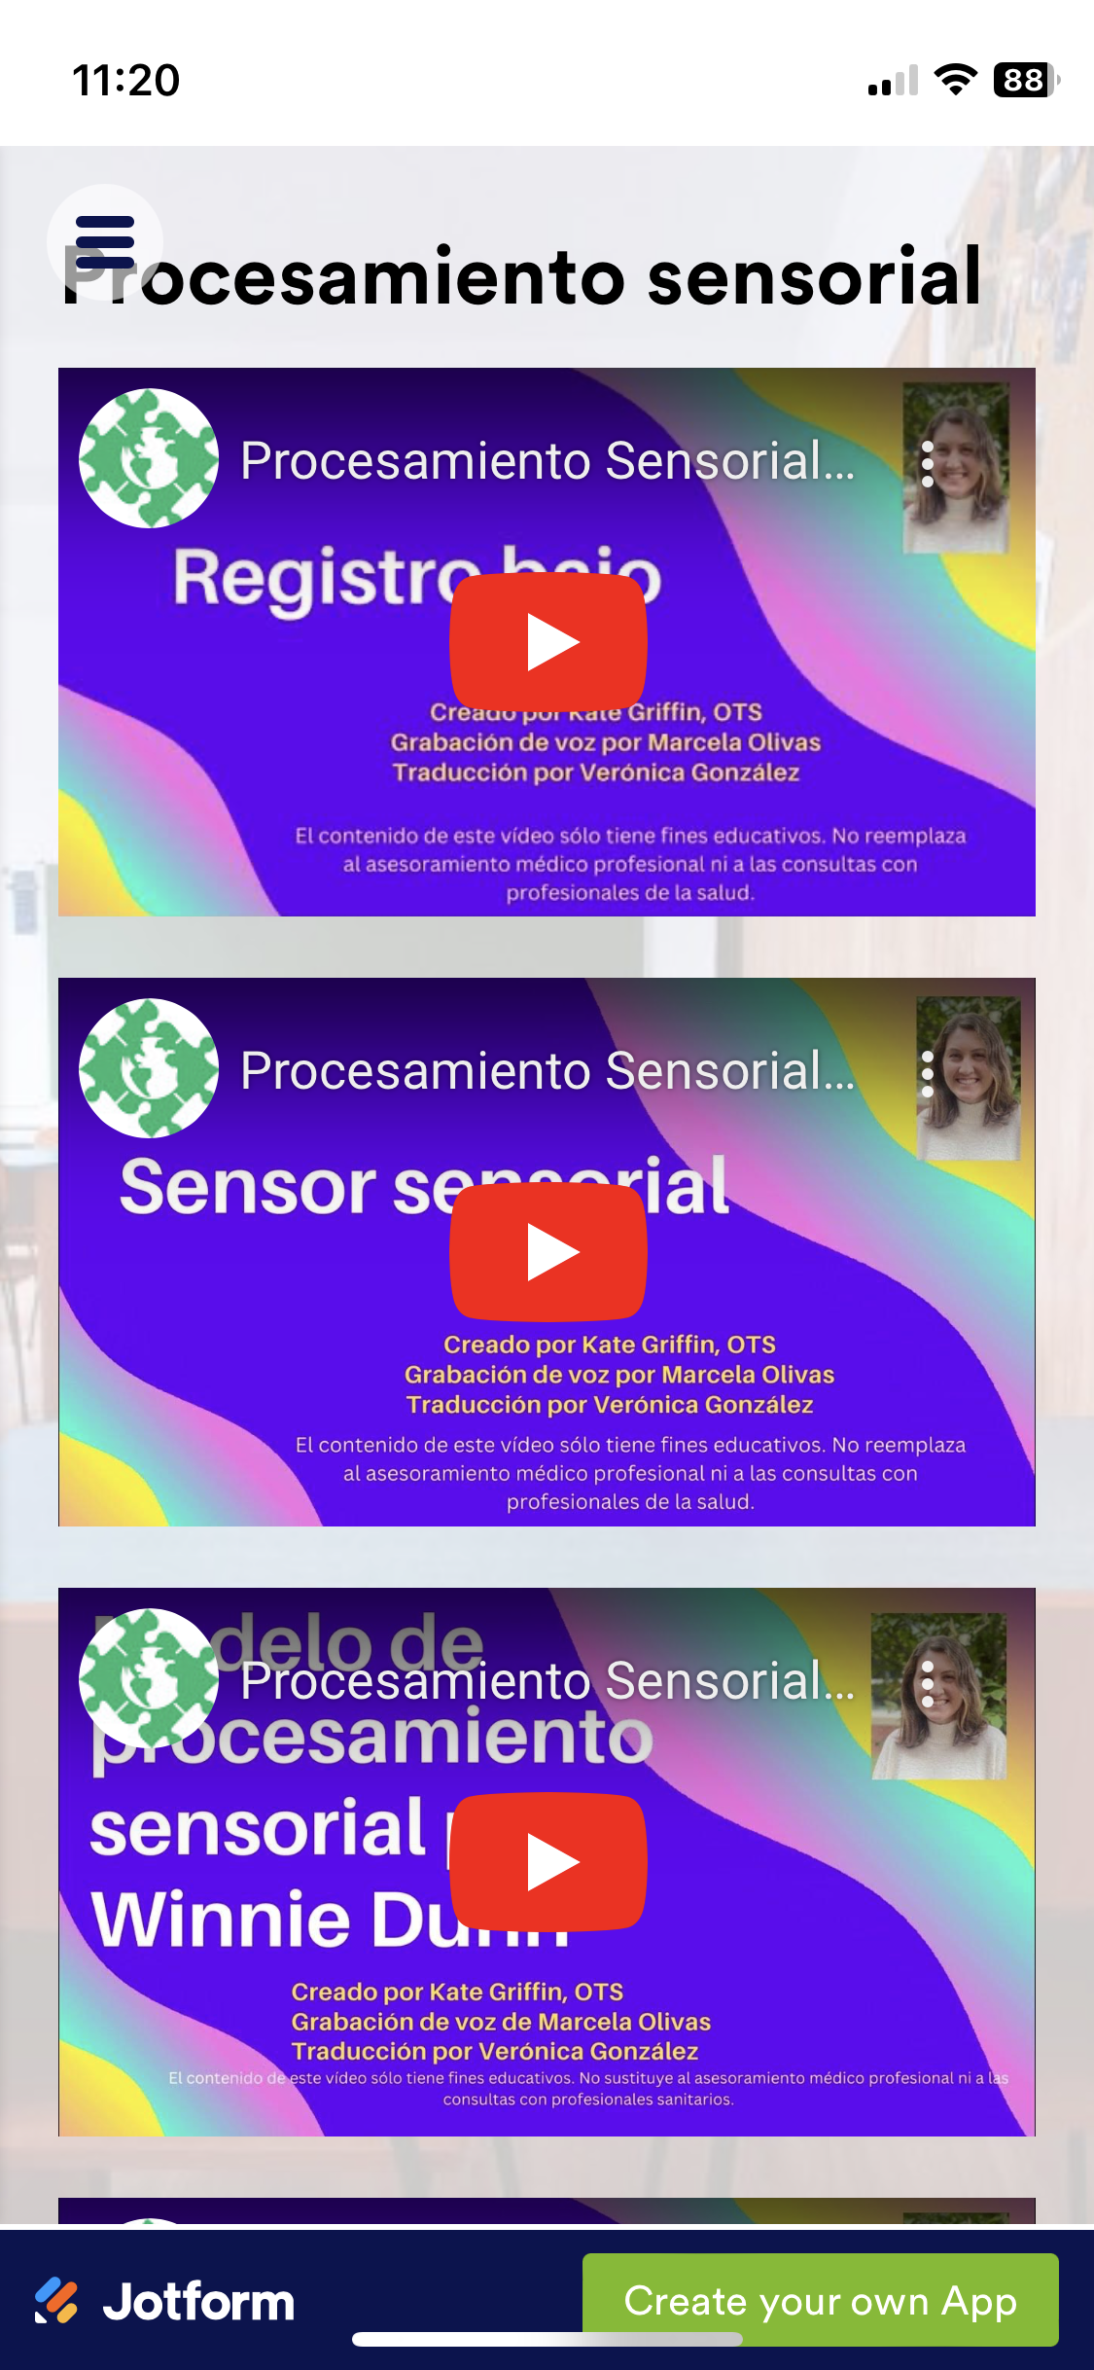
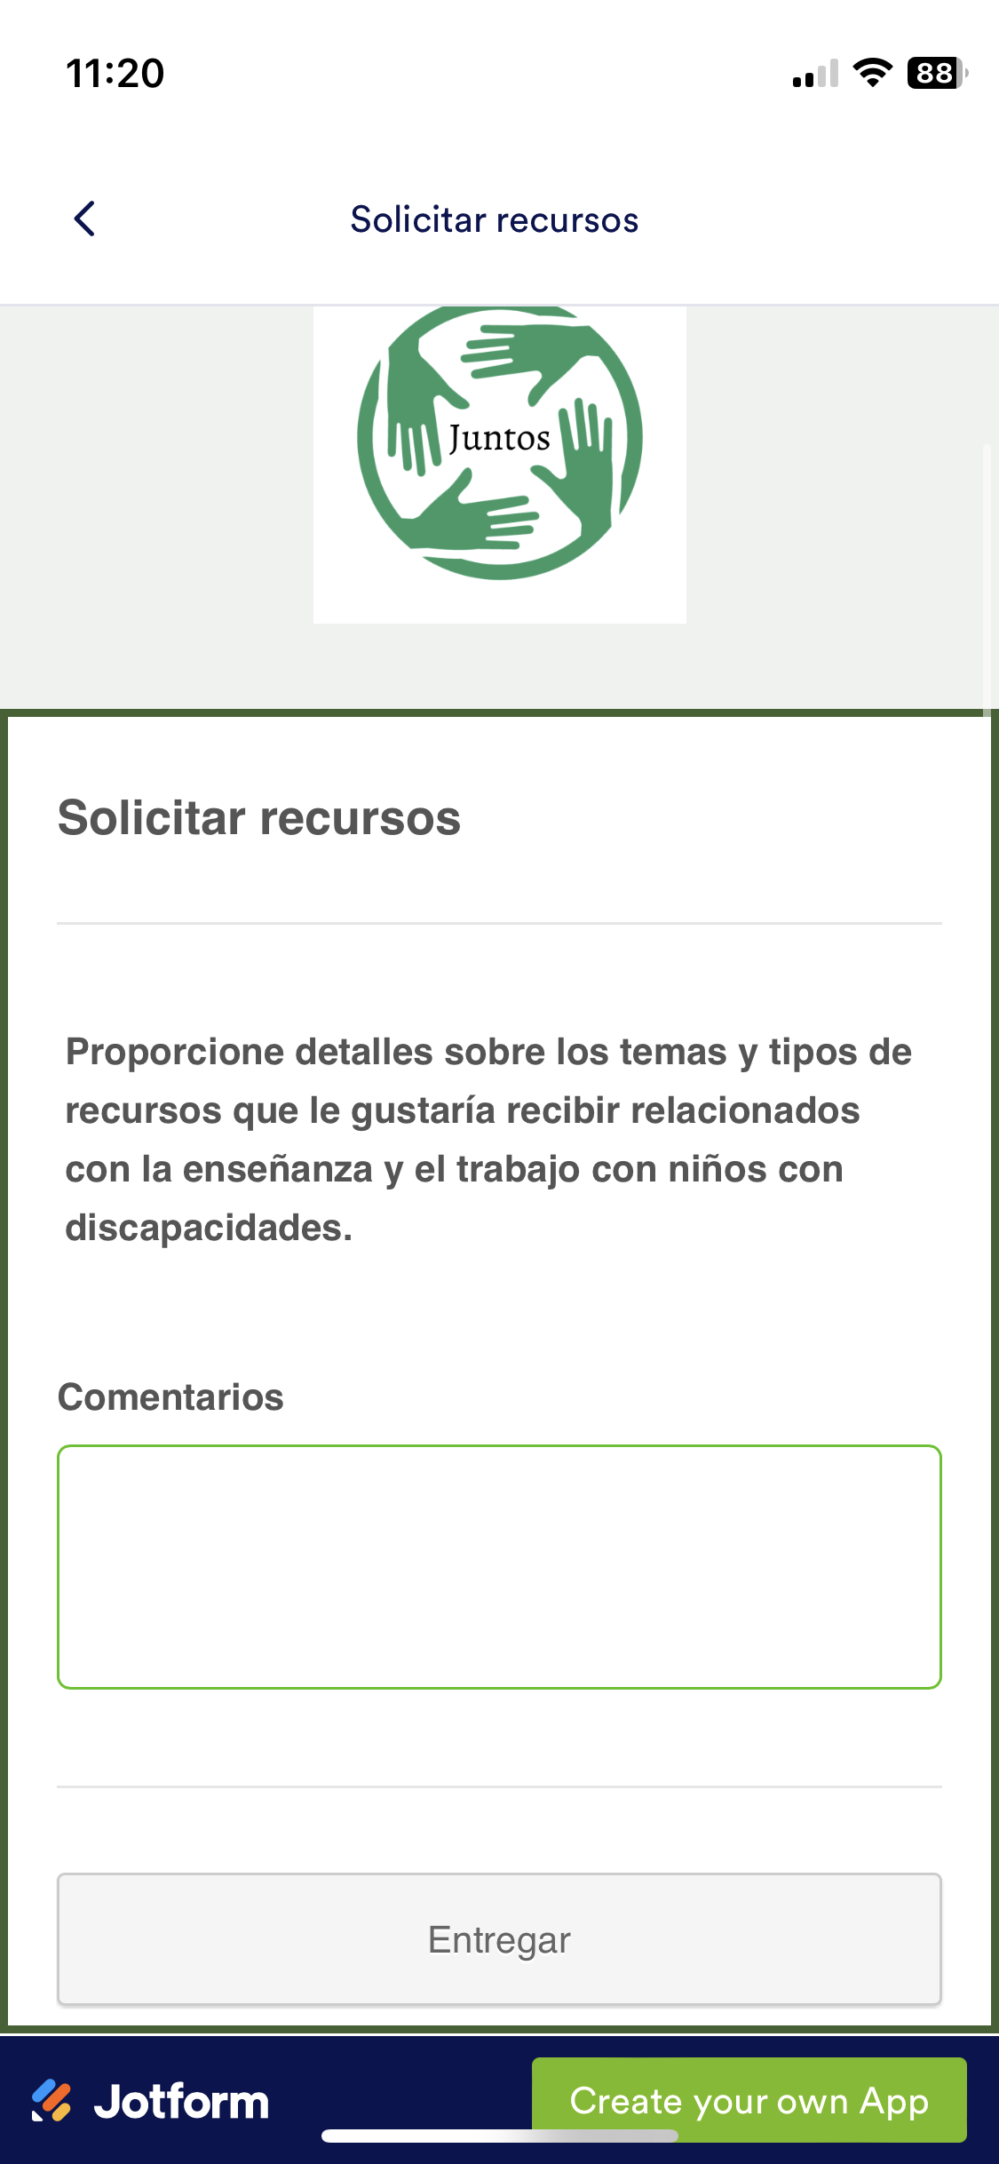
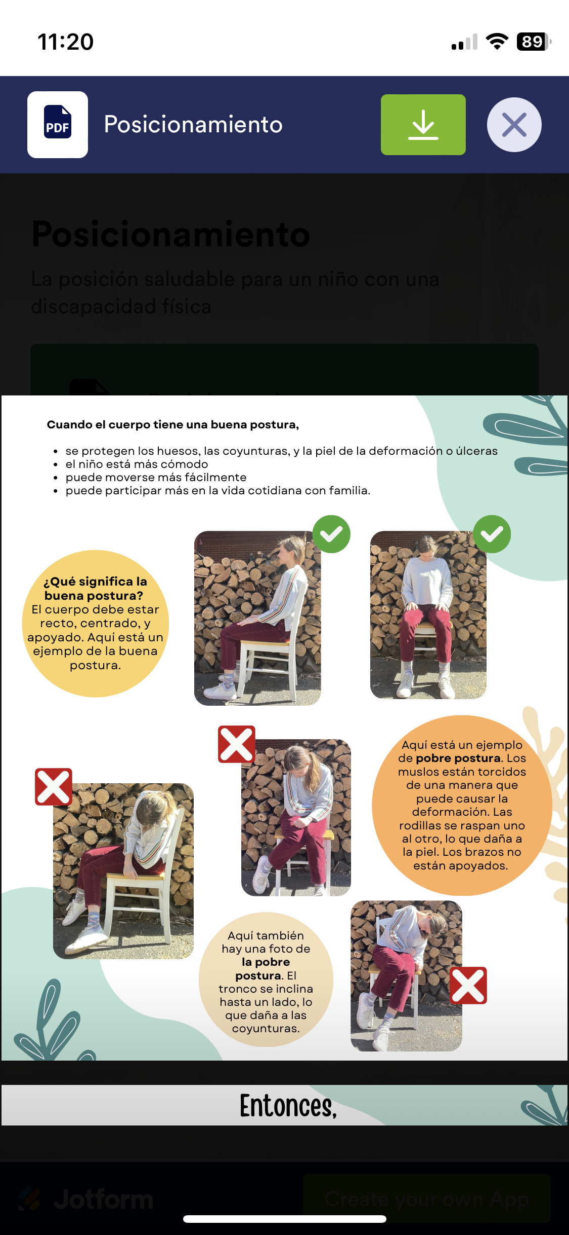
Deliverable
Sensory Processing Videos
Form to request resources
Downloadable PDF

Slide 18
Sustainability
The app was built using a free version of an app building site, no fees are currently involved
The app is self-sustaining and uploading content is easy
Created accounts related to the app and shared it with FNEI staff
Compiled videos and handout information for future reference
Created how to video on app and quiz editing functions
Opportunity for continued collaboration with OTD projects

Slide 19
Evaluation
In-person workshop at Niño Feliz
Introduction of app
Helped troubleshoot the set-up
Gave time to assess the app
Administered survey
Conducted focus group

Slide 20
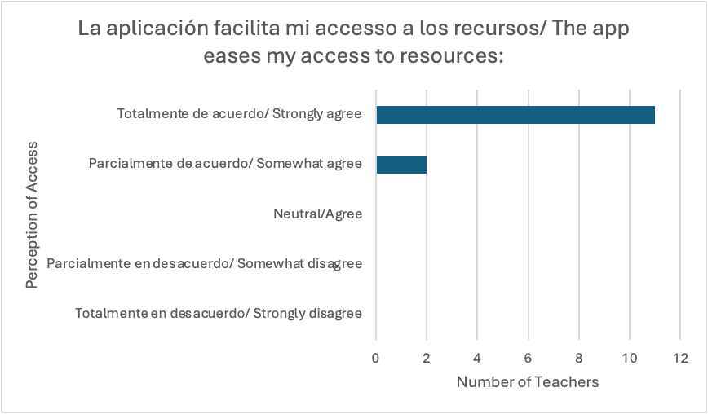
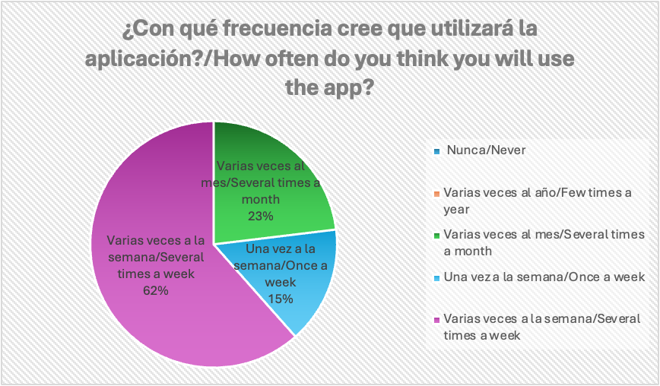
Results
Participants: special education teachers
N=13 (Niño Feliz =11, Nueva Vida =2)
Notes:
Quantitative

Slide 21
Results continued…
Average
Lowest satisfaction score: 8
Highest satisfaction score: 10

Slide 22
Results continued…
Thematic analysis revealed:
Desire for more strategies to be applied to the application.
For behavioral management and general strategies organized by diagnosis
Would like more videos on the application
For activities and stretches, especially for children with mobility issues
Teachers voiced that the application was easy to understand/navigate
Suggested the application would be a great tool for parents to have access to
Notes:
Thematic analysis

Slide 23
Strengths and Limitations
Strengths
- Quantitative and qualitative data
- Continued relationship with FNEI, teachers, school administrators
- Stakeholder satisfaction
- Access to housing, transportation, interpreters, and approval for level 3 travel
- Working with established NGO and experienced medical brigade
- Spanish language skills and cultural humility
Limitations
- Technology issues (limited fast internet, differing Android phones, limited app development knowledge)
- Limited time in person (3 school visits)
- Trip planning around medical brigade and differing school schedule
- Level 3 safety approval needed for travel
- Cultural and language differences
Notes:
List tech issues
(start in february)

Slide 24
Stakeholder Feedback
“The work you have done here will have a long term impact at Niño Feliz and the fact that your work will be available widely makes it all the more impactful. This capstone will be a major building block as we continue to develop resources in the space! Incredible work!”
Director of FNEI
“You did a great job on this resource..sent them to my staff to perk their interest and encourage them to look further into the resources you have provided.”
Occupational therapist in Guatemala
Teacher at Niño Feliz
“Muy buena la aplicación”

Slide 25
Potential Impact
Current
Growing relationship between FNEI and MUSC
In-person visit to Niño Feliz allows us to share information with future students
Making past resources more easily accessible
Adding new resources
Future
Continue to add content for teachers
Spread the resource to other schools around Latin America
Add features to educate and aid parents

Slide 26
Recommendations for FNEI
Collect resources from various teams that can be added to the platform
Continue to gain feedback from the Niño Feliz staff to help inform future projects
With future projects continue to encourage small surveys and interactive forms of data collection
Continue collaboration with upcoming MUSC OTD Student Projects to meet the needs of the LMIC’s (two scheduled for Spring 2025)

Slide 27
Conclusion
The purpose of this project was to address the problem of limited access to resources that teachers in Nicaragua and other LMICs face:
Collaboration: I applied the leadership and communication skills needed for international collaboration.
Develop: I successfully developed a sustainable platforms for teachers to access learning modules across Latin America through partnership with FNE International.
Advocate: I acted as an advocate to ensure resource access for teachers in Low- Middle- Income Countries through partnership with FNE International.
Impact on OT: I continued the partnership to facilitate more opportunities for OTs and OT students to be involved in work overseas and increased awareness of OT and teacher collaboration abroad.

Slide 28
Acknowledgments
Thank you to everyone who helped me along the way during this project.
MUSC Faculty Advisory: Cristina Reyes Smith, OTD, OTR/L
FNEI Capstone Site Mentors: Michael Cipoletti and Alyssa Hopun
Translator: Vero Gonzalez
Capstone Coordinator: Joy Crawford, OTD, MSRS, OTR/L
Content contributors/experts: Melissa Turpin, OTD, OTR/L, CTP, Kate Griffin, OTD, OTR/L, Michaella Tran, OTD, OTR/L, & Grace Price, OTDS
Stakeholders: FNEI, Niño Feliz, SPTLN, Nueva Vida, and IAOP
Travel Grant: MUSC Center for Global Health
FNEI staff and partners for all their help with transportation and Spanish interpreting
All those who contributed by reviewing the application

Slide 29
References
Delkamiller, J., Swain, K. D., Ritzman, M. J., & Leader-Janssen, E. M. (2016). Evaluating a special education training programme in Nicaragua. International Journal of Disability, Development, and Education, 63(3), 322–333. Abingdon: Routledge.
Saran, A., White, H., & Kuper, H. (2019). PROTOCOL: Effectiveness of interventions for people with disabilities in low- and middle-income countries—an evidence and gap map. Campbell Systematic Review, 15(1-2). Wiley.
van der Mark, E. J., Conradie, I., Dedding, C. W. M., & Broerse, J. E. W. (2017). How poverty shapes caring for a disabled child: a narrative literature review. Journal of International Development, 29(8), 1187–1206.

Slide 30
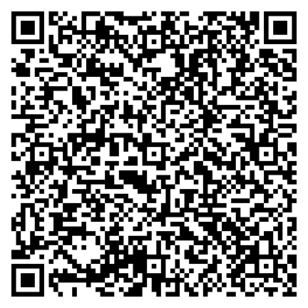
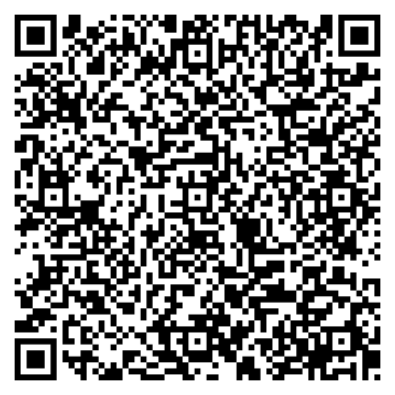
Thank you!
Any questions?
Spanish
English

