Slide 1
Interprofessional Collaboration to Evaluate Health Disparities in the Utilization of Therapy Services for Children with Down Syndrome
Ashlyn Jackson McKeehan, OTS
Faculty Mentor: Dr. Cristina Reyes Smith
Capstone Site: MUSC Down Syndrome Clinic
Medical University of South Carolina

Slide 2
Background and Significance:
Down syndrome (DS) affects 1 in 700 births in the United States (CDC, 2023)
Per DS guidelines, therapy services (OT, PT, and SLP) should be implemented throughout development as early as possible (Bull et al., 2022)
Disparities in healthcare services and outcomes for children with DS have been reported:
Life expectancy and infant mortality between races (de Graaf et al., 2017; Kucik et al., 2013)
Lower health outcomes due to socioeconomic status (Arrango et al., 2018)
Negative healthcare experiences for minorities and non-English speaking families (Chung et al., 2023; Krell et al., 2022)
25% of DS population travels >2 hours to get to specialty clinics (Joslyn et al., 2020)
There is limited research around access to care in the Down syndrome population
Lack of research on utilization of therapy services for children with DS
Notes:
Down syndrome affects 1 in 700 births in the United States
According to the American Academy of Pediatrics guidelines for children with Down syndrome, therapy services (OT, PT, and SLP) should be implemented throughout development
Access to therapy services can be difficult for children with DS due to geographic location, language barriers, socioeconomic status, and parents’ education levels
Disparities exist in access to healthcare services
Race
Life expectancy
SES and language barriers
Lower health outcomes and more negative healthcare experiences
Geographic location
25% of DS population travels >2 hours to get to specialty clinics
There is little research around health disparities in the Down syndrome population
Lack of research on utilization of therapy services for children with Down syndrome

Slide 3
Research data is needed about access to therapy services for children with
Down syndrome based on:
Sex
Race/Ethnicity
Age
Gap/Identified Need
Notes:
Because of this limited research, the gap/identified need was…

Slide 4
Purpose
To provide research evidence to propose the need to address health disparities to access therapy services for children with Down syndrome
To analyze current research and identify disparities faced by children with Down syndrome in utilization of rehabilitation services for sex, race, and age
To enhance the knowledge and understanding of health disparities for families of children with Down syndrome for the interprofessional team at the MUSC Down Syndrome Clinic

Slide 5
AIMS
Research
Disseminate
Community
Use Medicaid data to research utilization of therapy services for children with Down syndrome
Get involved with the Down syndrome community to understand barriers that they might face in accessing health services
Present results to MUSC Down Syndrome Clinic and develop manuscript to report the data related to utilization of therapy services for children with Down syndrome

Slide 6
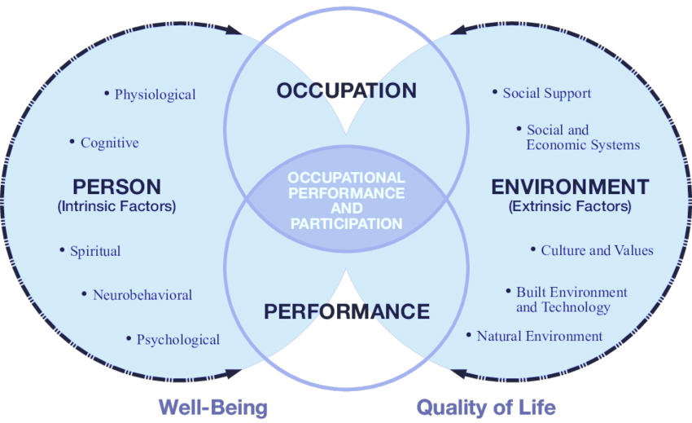
Supporting Framework: Person-Environment-Occupation Performance (PEOP) Model
https://www.researchgate.net/figure/The-Person-Environment-Occupation-Performance-model-PEOP_fig4_254841074
Notes:
https://www.researchgate.net/figure/The-Person-Environment-Occupation-Performance-model-PEOP_fig4_254841074
Green Care: a Conceptual Framework. A Report of the Working Group on the Health Benefits of Green Care – Figure 5

Slide 7
Research Framework
Aday & Andersen, 1974
Notes:
The project uses the Person-Environment-Occupation-Performance Model (PEOP) and the Framework for the Study of Access to Medical Care to look at the utilization of health services and the enabling factors and the barriers of the person and their environment to see how the person can reach their full occupational performance.
By looking at the utilization of health services, this project will depict the lack of access to medical care for children with Down syndrome.

Slide 8
Capstone Experience
MUSC Down Syndrome Clinic
Interprofessional clinic for annual/biannual check up visits
Shadow opportunities at different settings for children with Down syndrome
EI, NICU, outpatient pediatrics, cardiac floor
Interviews with families of children with Down syndrome
Community Immersive Events
Adaptive dance programs
Bitty and Beau’s Coffee Shop
Gigi’s Playhouse Down Syndrome 5K Run – Cancelled due to weather
Medicaid Data Health Services Research Analysis with Dr. Sara Knox
Notes:
MUSC Down Syndrome Clinic
An interprofessional “one-stop shop” clinic
Annual or biannual visits
Evaluations to check development
Referrals to any discipline they need
Annual visits for age 6 and up, biannual visits for under 6
Evaluations to look at development progress
Referrals to OT, SLP, PT if they need it, any specialty services, like ophthalmology or audiology if they need it

Slide 9
Population and Stakeholders
Population
Medicaid beneficiaries
Down syndrome diagnosis
Stakeholders
MUSC Down Syndrome Clinic clinicians
21 and under
Received outpatient services
from 2016 to 2018
Down syndrome community
Health professional community

Slide 10
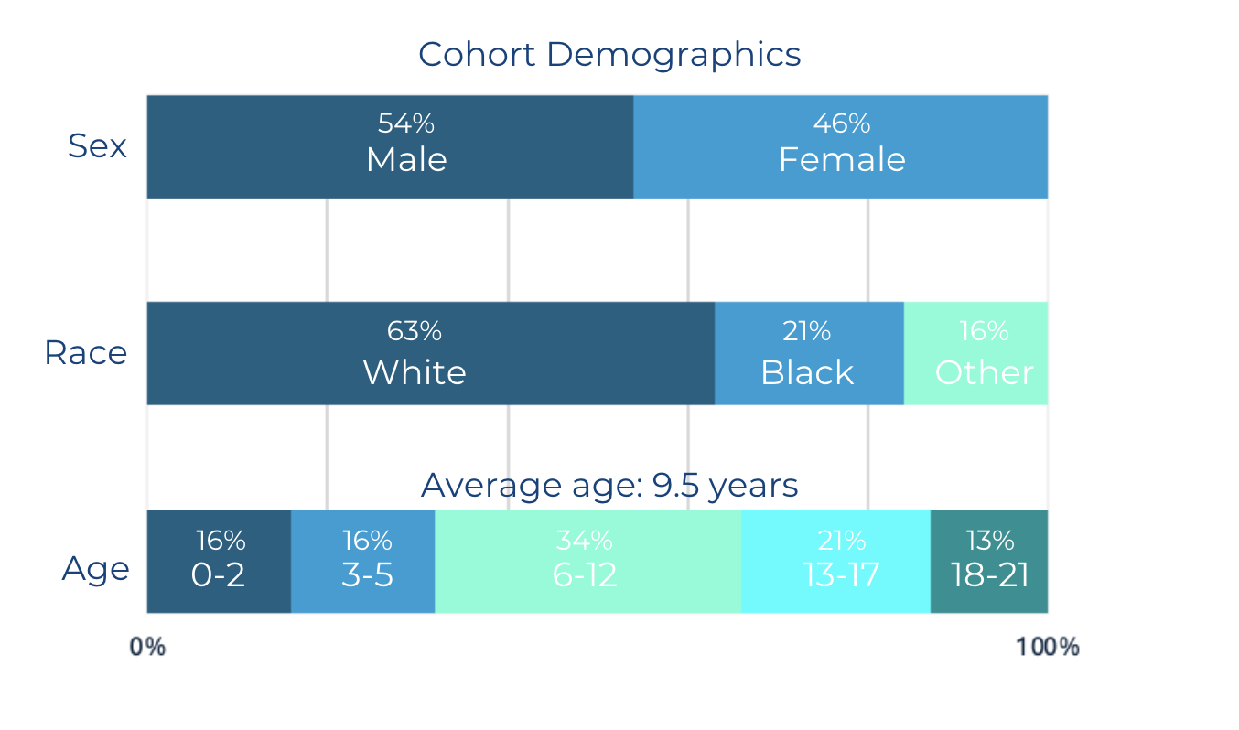
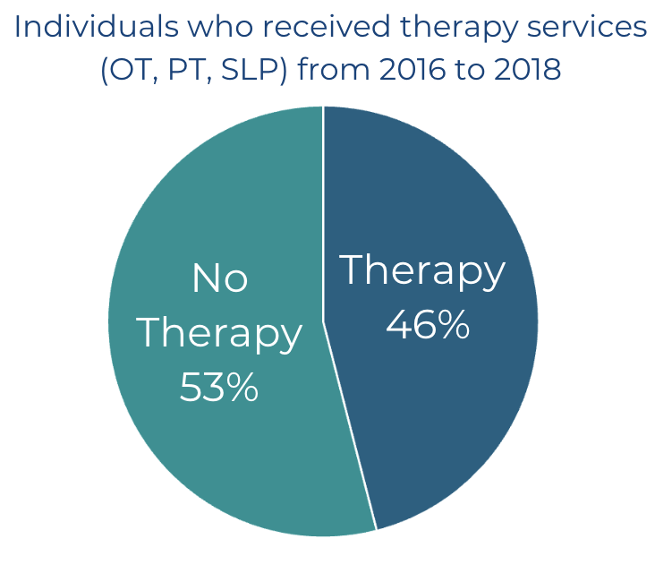
Medicaid Data Research Methods
Capstone project type:
Health Services Research with MUSC IRB approval
Quantitative
Data collected from IBM Watson Market Scan Medicaid Database for outpatient claims from 2016 to 2018
Medicaid Beneficiary Cohort (n=17,813)
Down syndrome diagnosis
21 years old and under
Strengths
Large, representative sample similar to DS population
Access to cohort ICD-10 Codes, CPT Billing Codes, etc.
Weaknesses
Data did not include detailed demographic information (i.e. SES, geographic location, severity of dx, etc.)
Data included some incomplete and duplicate records

Slide 11
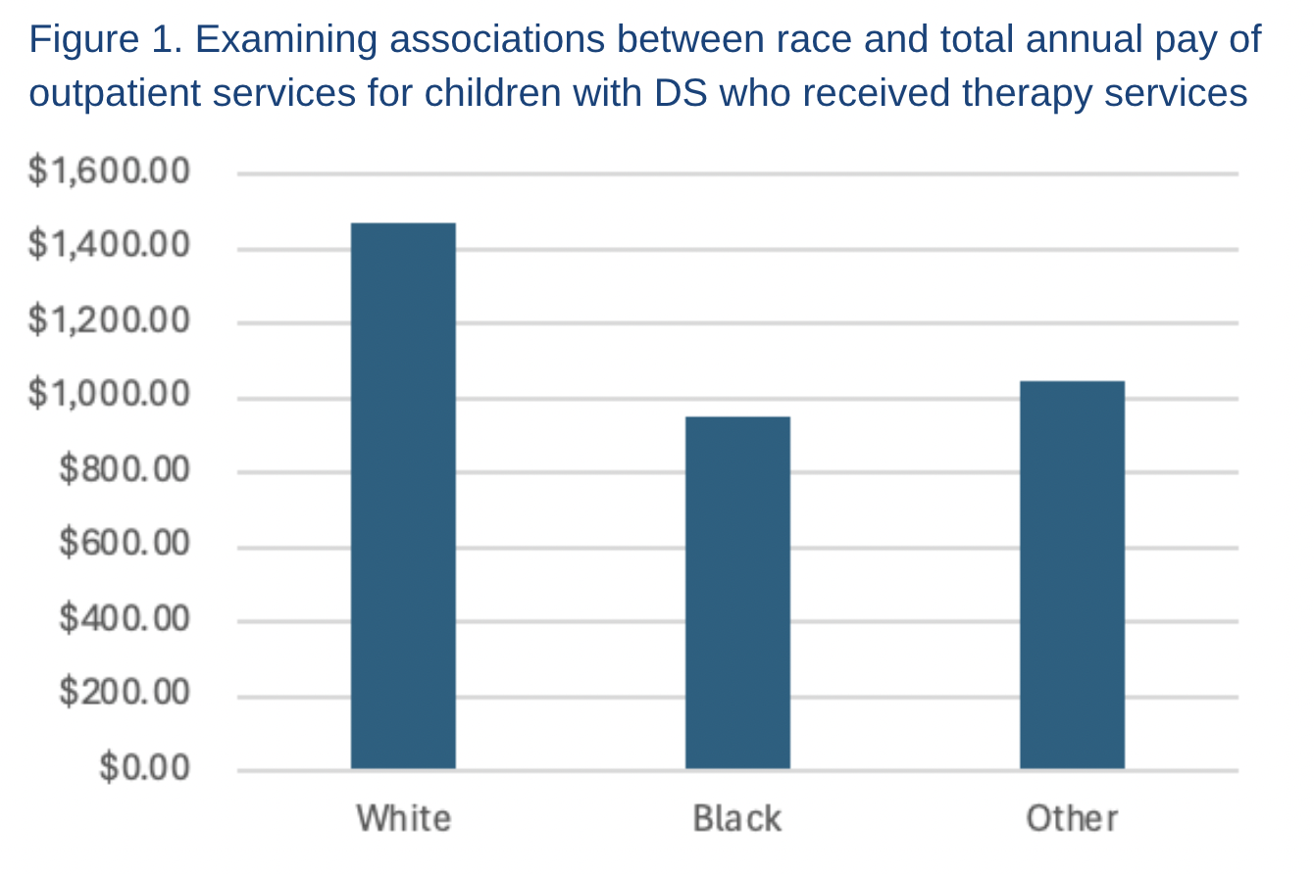
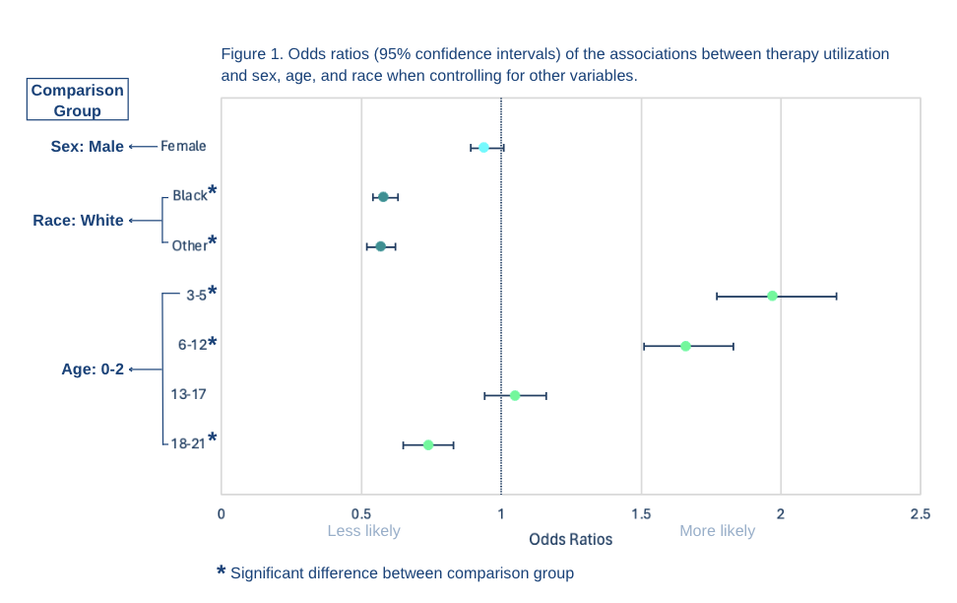
Medicaid Data Research Results
Significant differences:
Total annual payment for outpatient services between races
Includes therapy, medical visits, labs, etc.
Therapy utilization (OT, PT, SLP) between different races and ages
Individuals of minority races are almost half as likely to receive therapy services than White individuals
Infants and toddlers with DS are less likely to receive early outpatient therapy services when compared to later in a child’s life
No significant difference in therapy utilization (OT, PT, SLP) between sexes
2.
Notes:
This study found that disparities do exist among children with DS in the utilization of therapy services based on race and age
Individuals of minority races are almost half as likely to use therapy services than White individuals.
Children with DS also are less likely to receive early outpatient services when compared to later in a child’s life.

Slide 12
Project Deliverables
Presentation of research results to the MUSC Down Syndrome Clinic clinicians
Manuscript submitted to journal for publication
Notes:
Capstone Experience & Project Deliverable (describe elements of the capstone experience. Timeline graph with details of the experience, or description is acceptable)
Describe your project deliverable. (Identify when and how it was delivered. If the deliverable is a paper/article, describe when,
and where you plan to submit)
Identify the impact and/or potential impact of your project/deliverable
Address the sustainability of your project/deliverable
Overall Impact- Current and anticipated future impacts
Proposed measures, or actual measures, utilized to assess project/deliverable effectiveness
Recommendations –suggest next steps for the capstone site

Slide 13
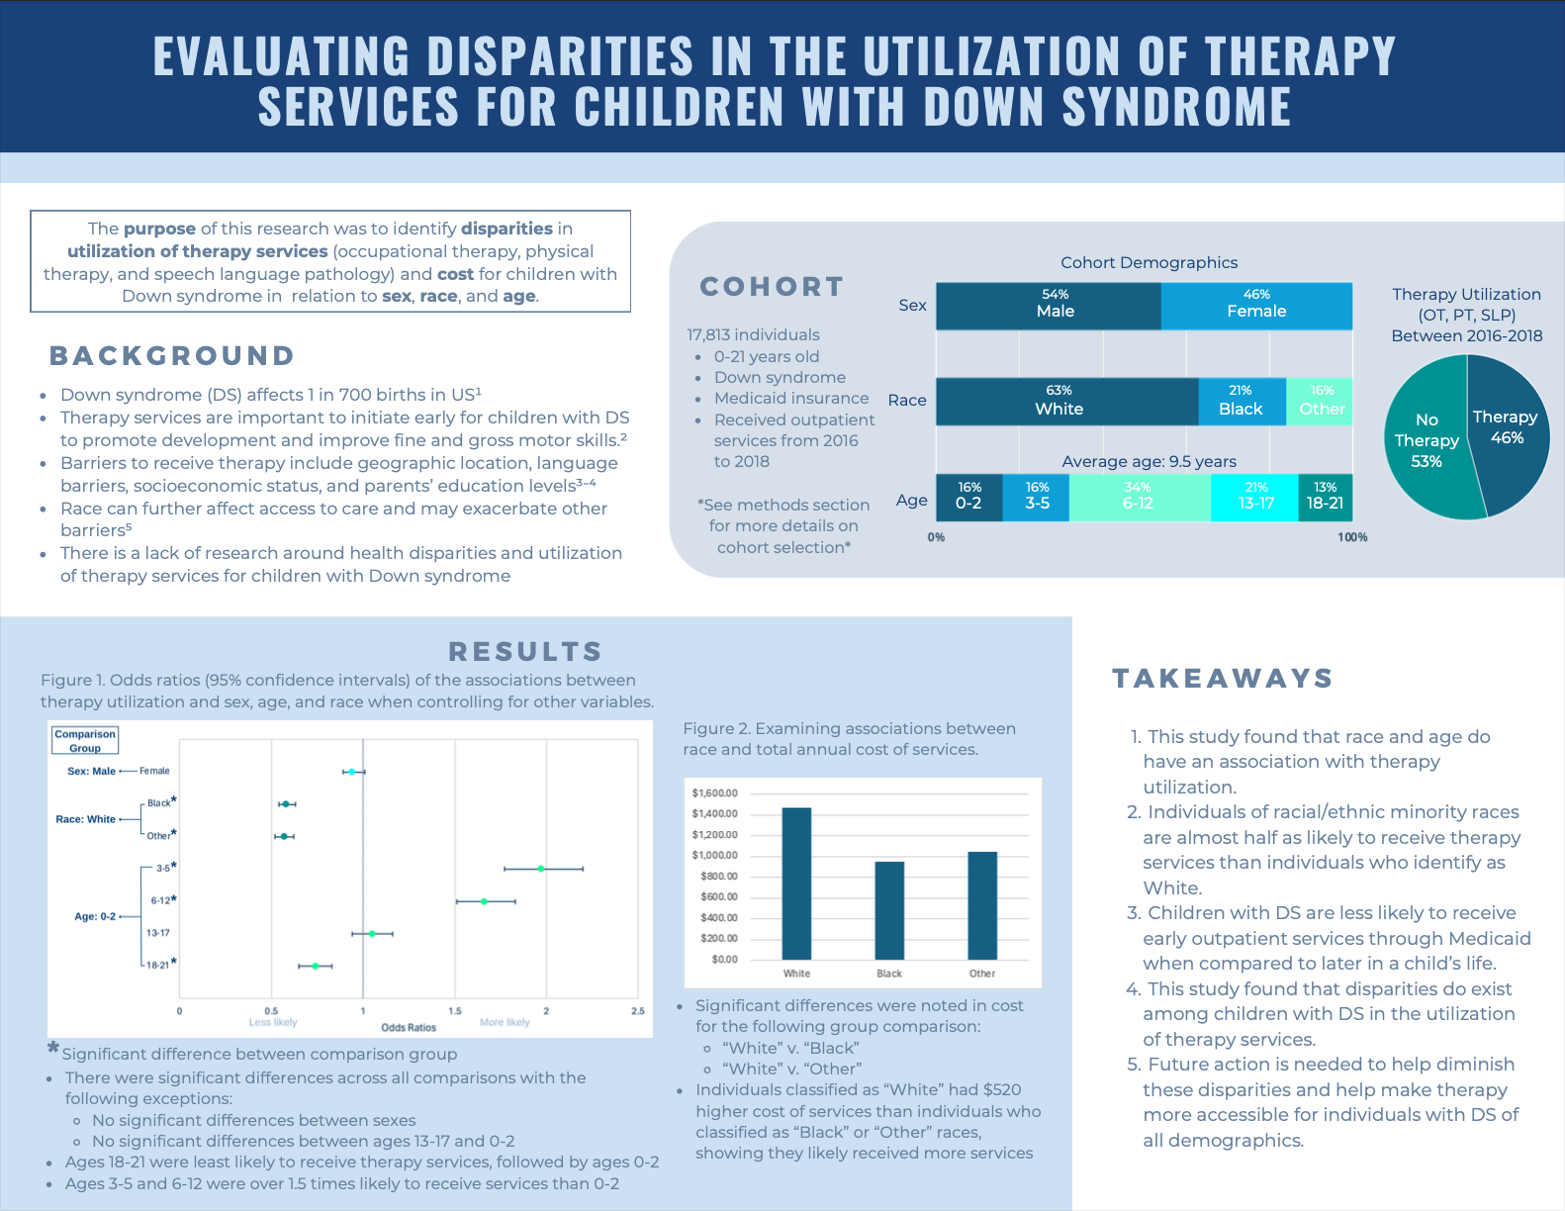
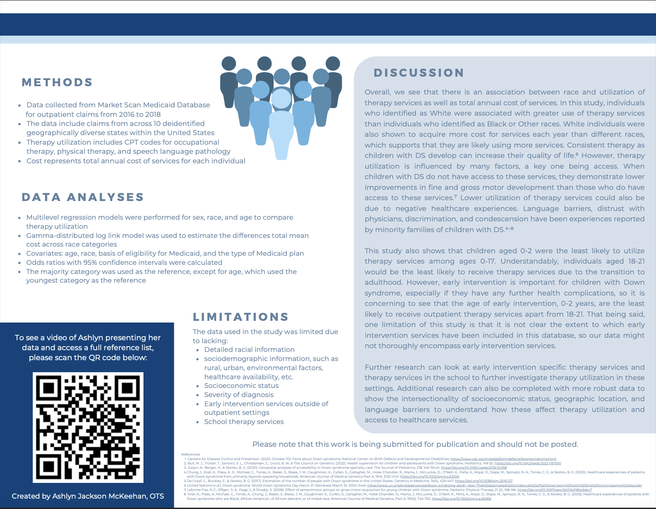
Project Deliverable - Presentation
Research flyer presented to the MUSC Down Syndrome Clinic interprofessional clinician team

Slide 14
Evaluation Plan
Capstone Outcomes:
Measures of Project and Deliverable Effectiveness
Qualitative and Quantitative
During the Capstone Experience:
Self-evaluation REDCap survey completed every month to track progress
Evaluation of Deliverable Effectiveness:
REDCap Survey after presentation of research to MUSC Down Syndrome Clinic
n= 11 clinicians
8 different professions
OT, PT, SLP, NP, MD, Social Work, School Psychology, ENT
Experience working with children with DS ranged from <1 year to 25 years

Slide 15
Project Deliverable Evaluation
Statement | Strongly disagree | Disagree | Neither agree nor disagree | Agree | Strongly Agree
The results were presented in a clear and concise way. | 0 | 0 | 0 | 2 | 9
Prior to the presentation, I knew that race had an impact on healthcare utilization. | 0 | 0 | 1 | 4 | 6
This research helped me learn more about disparities faced by children with DS. | 0 | 0 | 0 | 1 | 10
These research results are supported by current research articles that I know of. | 0 | 3 | 2 | 5 | 1
This research is important for helping to eliminate health disparities faced by children with DS. | 0 | 0 | 0 | 1 | 10

Slide 16
Analysis and Take-Aways from Feedback
The majority agreed they were aware about race impacting healthcare utilization.
All (100%) learned about disparities faced by children with Down Syndrome through the presentation.
About half of the respondents knew about current research that supports these results
Indicates the need for more research
All (100%) agreed that this research is important to help eliminate disparities.
The most surprising takeaway mentioned by respondents:
“The low percentage of children 0-2 that were not receiving therapy services compared to 3-17”
Over 80% responses mentioned this
“The racial difference was expected, but almost half is a huge discrepancy between groups”
“Similarities of Black and Other data compared to White individuals”
$520 annual payment difference between races – “Had no idea it was that much, money puts it into perspective”

Slide 17
Sustainability and Recommendations
Sustainability
Cleaned Medicaid data available to continue research in different areas of health disparities
Manuscript developed for publication in a journal to educate a broad audience of different health professions on the disparities experienced by children with DS
Results presented to the MUSC Down Syndrome Clinic to promote further research and action towards creating accessible services for children with DS
Future Recommendations
Future research is needed to explore underlying reasons for the disparities found in this study for children with DS and other pediatric conditions
Future action needed to create more accessible services for children with DS
Raise awareness, revise policies, and implement targeted strategies
Notes:
Raise awareness, revise policies, and implement targeted strategies to improve access to therapy services and specialty clinics; address continuum of care from the NICU to make the pipeline from labor and delivery to early intervention and ongoing therapy services for this and other at risk populations

Slide 18
Anticipated overall impact:
Potential impact on the discipline of OT:
Encourage further research on health disparities in the Down syndrome population and the overall population as well
Help make clinicians aware of difficulties faced by children of different races
Promote change to create more accessible therapy services for children with DS
Increased awareness of disparities that exist among the Down syndrome population in access to and utilization of therapy services
Encourage clinicians to start building more access to therapy services
Encourage further research on the impact of OT in the Down syndrome community
Notes:
Further research can be completed with the Medicaid data that I used and these results will hopefully spur more therapists to do research on health disparities
Increased awareness of disparities that exist among the Down syndrome population in access to and utilization of therapy services
Encouragement for further research and further action to help children with Down syndrome get better access to therapy services, specifically those of minority races

Slide 19
Conclusion
The results of the research completed for this capstone indicate that disparities are present in therapy utilization and Medicaid payment based on race and age
MUSC Down Syndrome Clinic clinicians agreed that:
The research results educated them more about disparities faced by children with DS
This research is important to help eliminate disparities for children with DS
This research will aim to prompt action from clinicians and policy makers:
To help decrease the disparities faced by children with DS and other at-risk pediatric populations
To help make therapy services more accessible for children with DS of all demographics and across stages of development

Slide 20
Acknowledgements
Thank you to everyone on my capstone team:
Ashley Saunders, OTR/L Capstone Site Mentor
Dr. Sara Knox, PT, DPT, PhD Health Services Research Expert
Dr. Roxanna Bendixen, PhD, OTR/L, FAOTA Research Team Member
Dr. Christina Pelatti, PhD, CCC-SLP Research Team Member
Dr. Elizabeth Crawford OTD, MSRS, OTR/L Capstone Coordinator
MUSC Down Syndrome Clinic Clinicians
You have all helped me immensely in meaningful ways, and I could not have done my capstone project without you!!

Slide 21
References
Aday, L. A., & Andersen, R. (1974). A framework for the study of access to medical care. Health Services Research, 9(3), 208–220.
Arango, P. S., Aparicio, A., & Tenorio, M. (2018). Developmental trajectories of children with Down syndrome by socio-economic status: the case of Latin America. Journal of Intellectual Disability Research : JIDR, 62(9), 759–774. https://doi.org/10.1111/jir.12516
Bull, M. J., Trotter, T., Santoro, S. L., Christensen, C., Grout, R. W, & The Council on Genetics. (2022). Health supervision for children and adolescents with Down syndrome. Pediatrics, 149(5). https://doi.org/10.1542/peds.2022-057010
Centers for Disease Control and Prevention. (2023, October 10). Facts about Down syndrome. National Center on Birth Defects and Developmental Disabilities. https://www.cdc.gov/ncbddd/birthdefects/downsyndrome.html
Chung, J., Krell, K., Pless, A. Jr., Michael, C., Torres, A., Baker, S., Blake, J. M., Caughman, K., Cullen, S., Gallagher, M., Hoke-Chandler, R., Maina, J., McLuckie, D., O'Neill, K., Peña, A., Royal, D., Slape, M., Spinazzi, N. A., Torres, C. G., & Skotko, B. G. (2023). Healthcare experiences of patients with Down syndrome from primarily Spanish-speaking households. American Journal of Medical Genetics Part A, 191A, 2132–2141. https://doi.org/10.1002/ajmg.a.63250

Slide 22
References
Joslyn, N., Berger, H., & Skotko, B. G. (2020). Geospatial analyses of accessibility to Down syndrome specialty care. The Journal of Pediatrics, 218, 146-150.e1. https://doi.org/10.1016/j.jpeds.2019.10.058
Krell, K., Pless, A., Michael, C., Torres, A., Chung, J., Baker, S., Blake, J. M., Caughman, K., Cullen, S., Gallagher, M., Hoke-Chandler, R., Maina, J., McLuckie, D., O'Neill, K., Peña, A., Royal, D., Slape, M., Spinazzi, N. A., Torres, C. G., & Skotko, B. G. (2023). Healthcare experiences of patients with Down syndrome who are Black, African American, of African descent, or of mixed race. American Journal of Medical Genetics, Part A, 191(3), 742-752. https://doi.org/10.1002/ajmg.a.63069
Kucik, J. E., Shin, M., Siffel, C., Marengo, L., & Correa, A. (2015). Trends in survival among children with Down syndrome in 10 regions of the United States. Pediatrics, 131(1), e27-e36. https://doi.org/10.1542/peds.2012-1616

Slide 23
Thank you!
This concludes my doctoral capstone defense presentation.
I invite you to offer feedback or ask questions.

