Slide 1
Tier One Tools: Improving Educators’ Understanding of the Multi-Tiered System of Supports Within the School System Including a Case Example Briggs Elementary School – Florence One Schools
Maclaine Hanvey, OTDS
Dr. Rebecca Campbell, OTD, OTR/L, IBCLC
Dr. Kelly McGloon, PhD, OTR/L

Slide 2
Background
When using the Multi-tiered System of Supports (MTSS), around 80% of students are expected to meet district and state standards (Ohl et al., 2013).
In a Kindergarten readiness Fine Motor (FM) assessment, 31% of K-5 students scored below 75% demonstrating a lack of age-appropriate FM skills. After administering Tier One interventions for 15 weeks, >1% of students scored below 75% on the post-assessment (Campbell, 2022).
Research shows that there is a gap in education or professional development on proper MTSS implementation for teachers (Berkeley, et. al, 2020).

Slide 3
Purpose
The purpose of this project is to develop Occupational Therapy-based, Tier One interventions that can be utilized by teachers in K-5 classrooms while also providing an MTSS referral resource to be used at a school and district level.

Slide 4
Population and Stakeholders: Briggs Elementary
2 Kindergarten inclusion classrooms
43 K-5 students
Teachers & assistants
Stakeholders
District employees
Students
Parents
Interventionists and therapists

Slide 5
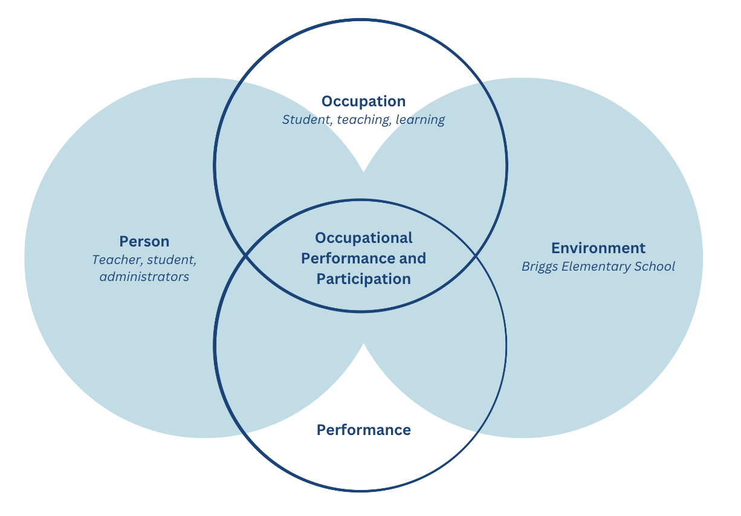
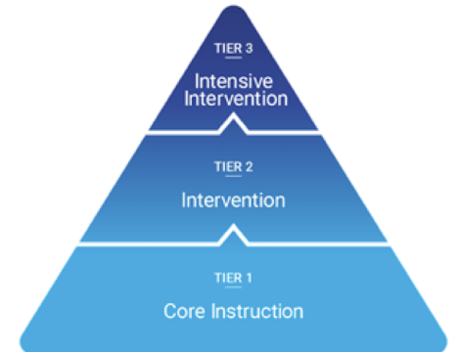
Foundational Frameworks
Primary Framework: Person-Environment-Occupation-Performance Model (PEOP)
Secondary Framework: Multi-Tiered Support System (MTSS)

Slide 6
Capstone Experience: Briggs Elementary
Gain an in-depth understanding of therapy delivery models.
Observation of school-based OT sessions in both individual and inclusion classroom settings.
Research and discussions with interventionists.
Acquire professional skills necessary for educating an interprofessional team.
Interacted with a variety of professionals including teachers, administration, and interventionists.
Held meeting regarding deliverables in multiple settings.

Slide 7
Capstone Experiences
Observed therapists and interventionists at 3 school levels to develop appropriate MTSS referral guidelines.
Observed and developed age-appropriate interventions to lead within classrooms.
Worked interprofessionally to advocate for OT at a Tier One level while meeting school-specific needs, resulting in adapting original plans.

Slide 8
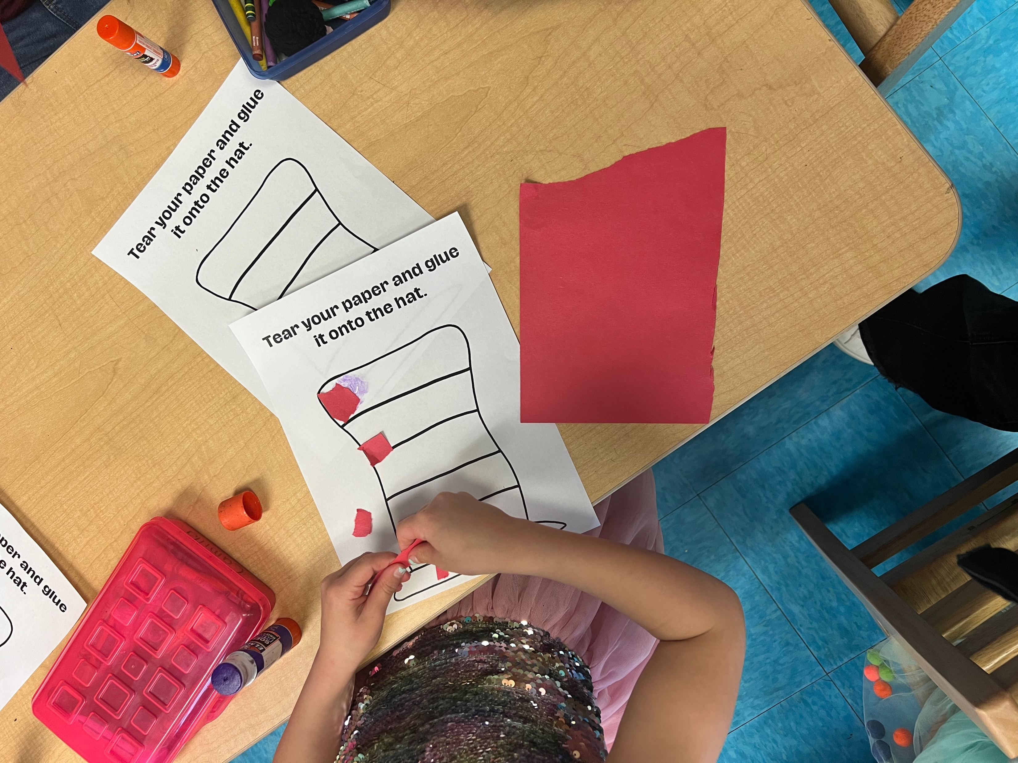
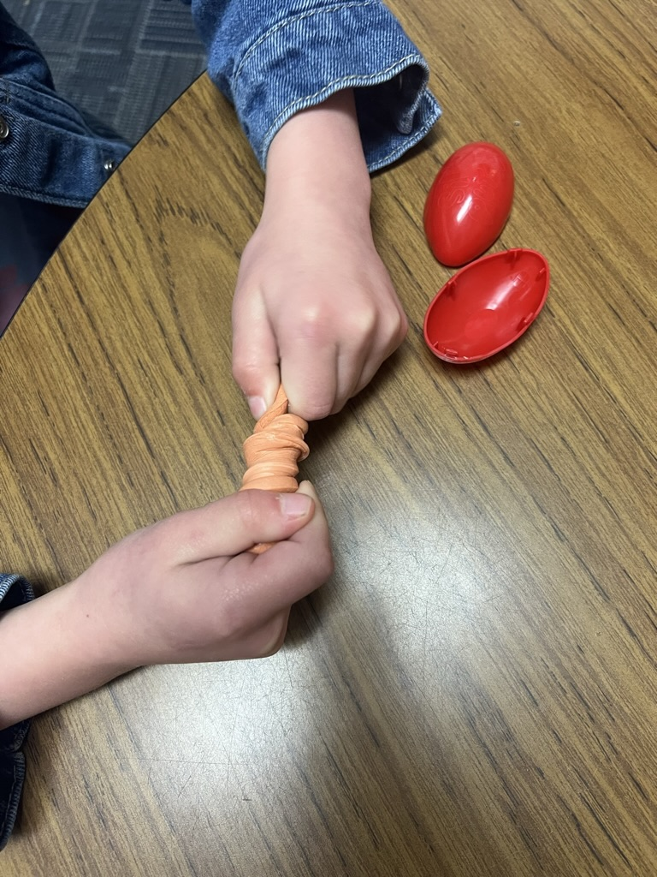
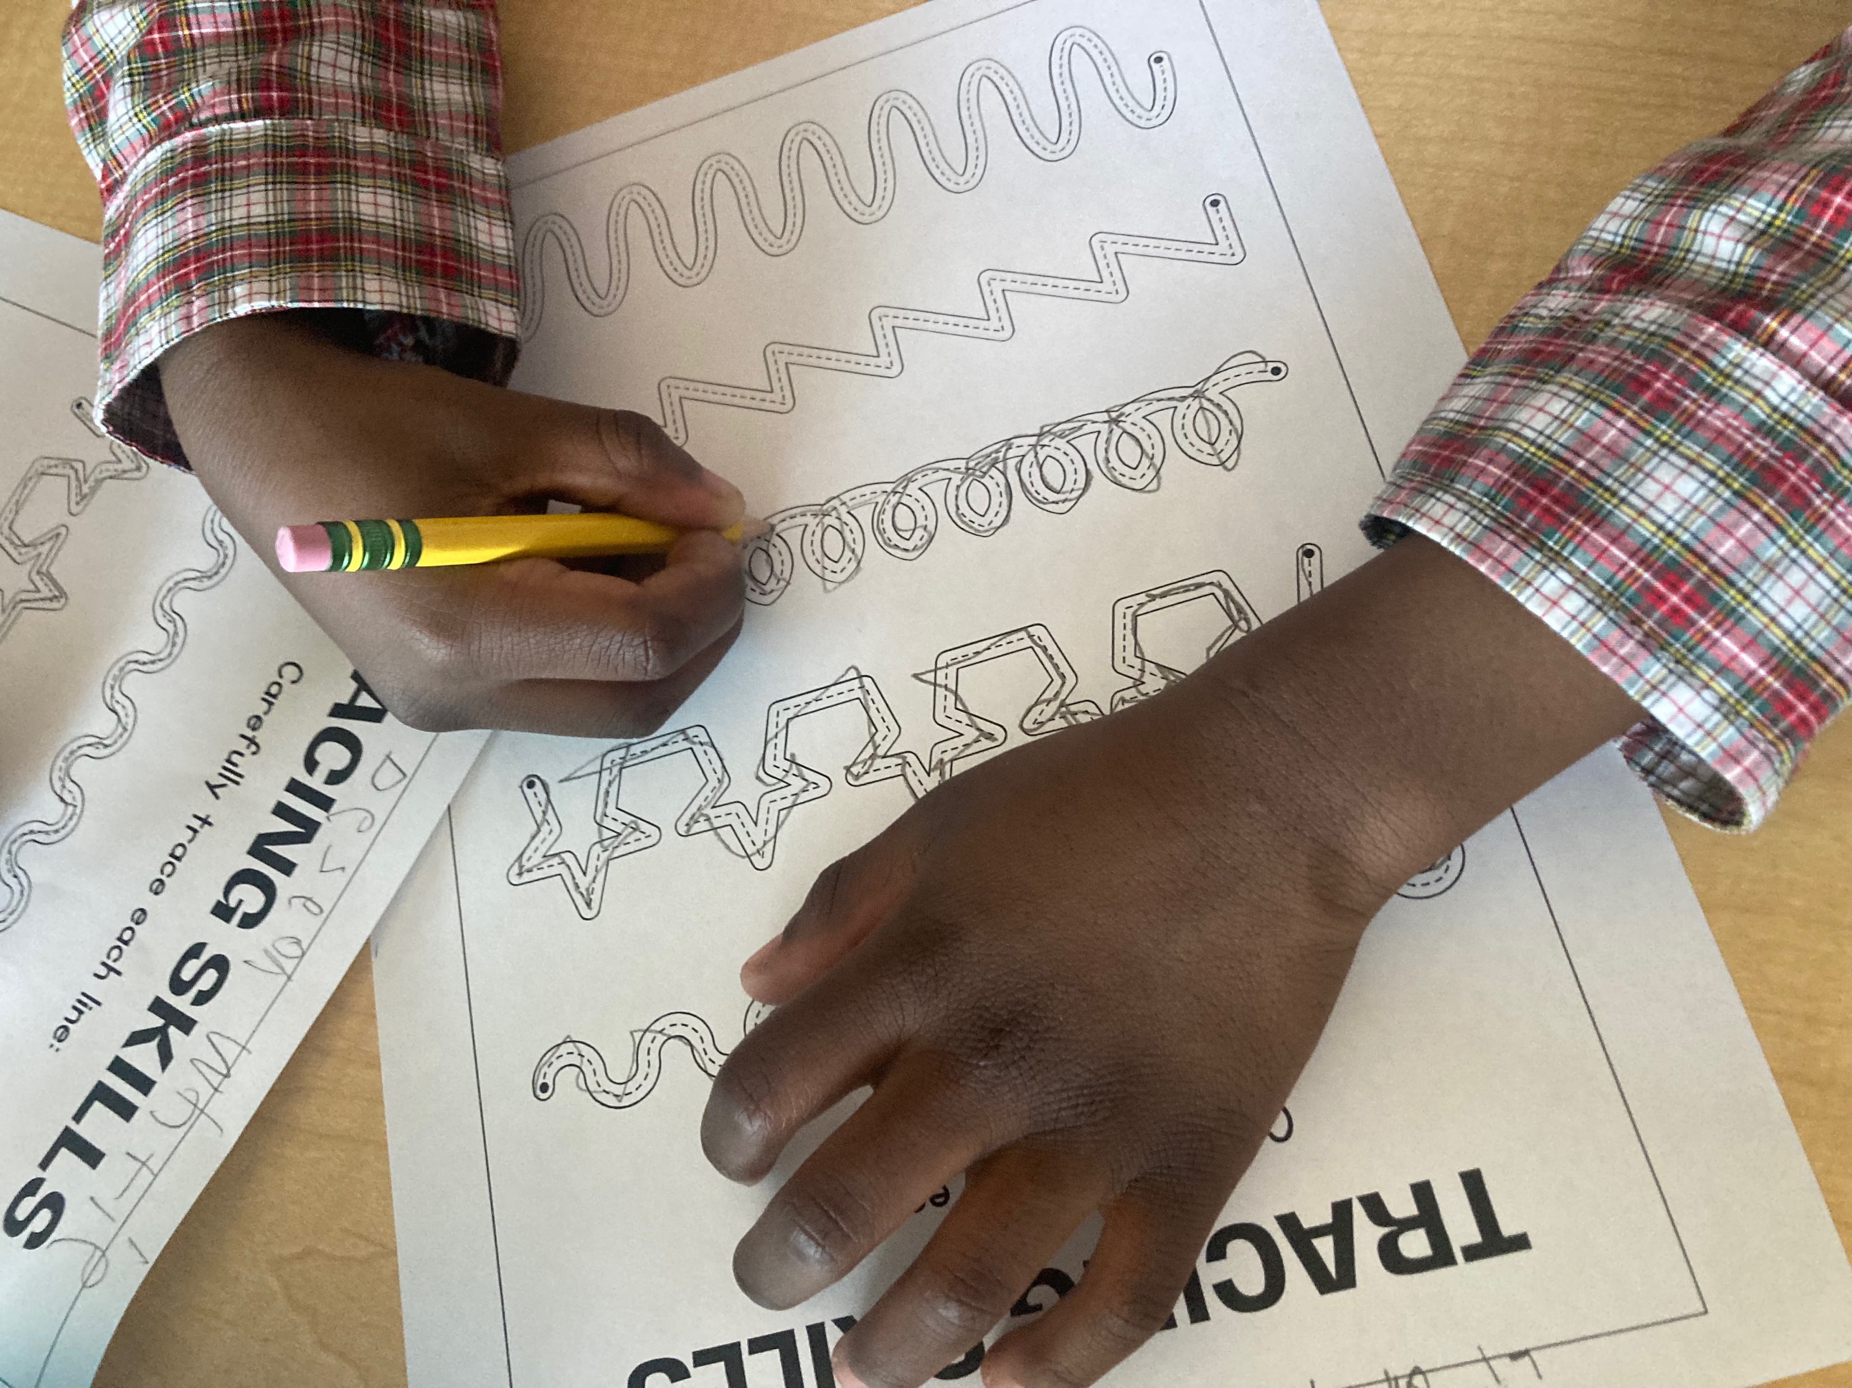
Capstone Deliverables
Observation
Development
Implementation

Slide 9
Deliverable: Methods and Data
Quality Improvement
Tier One Education
MTSS Education
Evaluation Methods
RedCap Surveys
Live, In-person Feedback

Slide 10
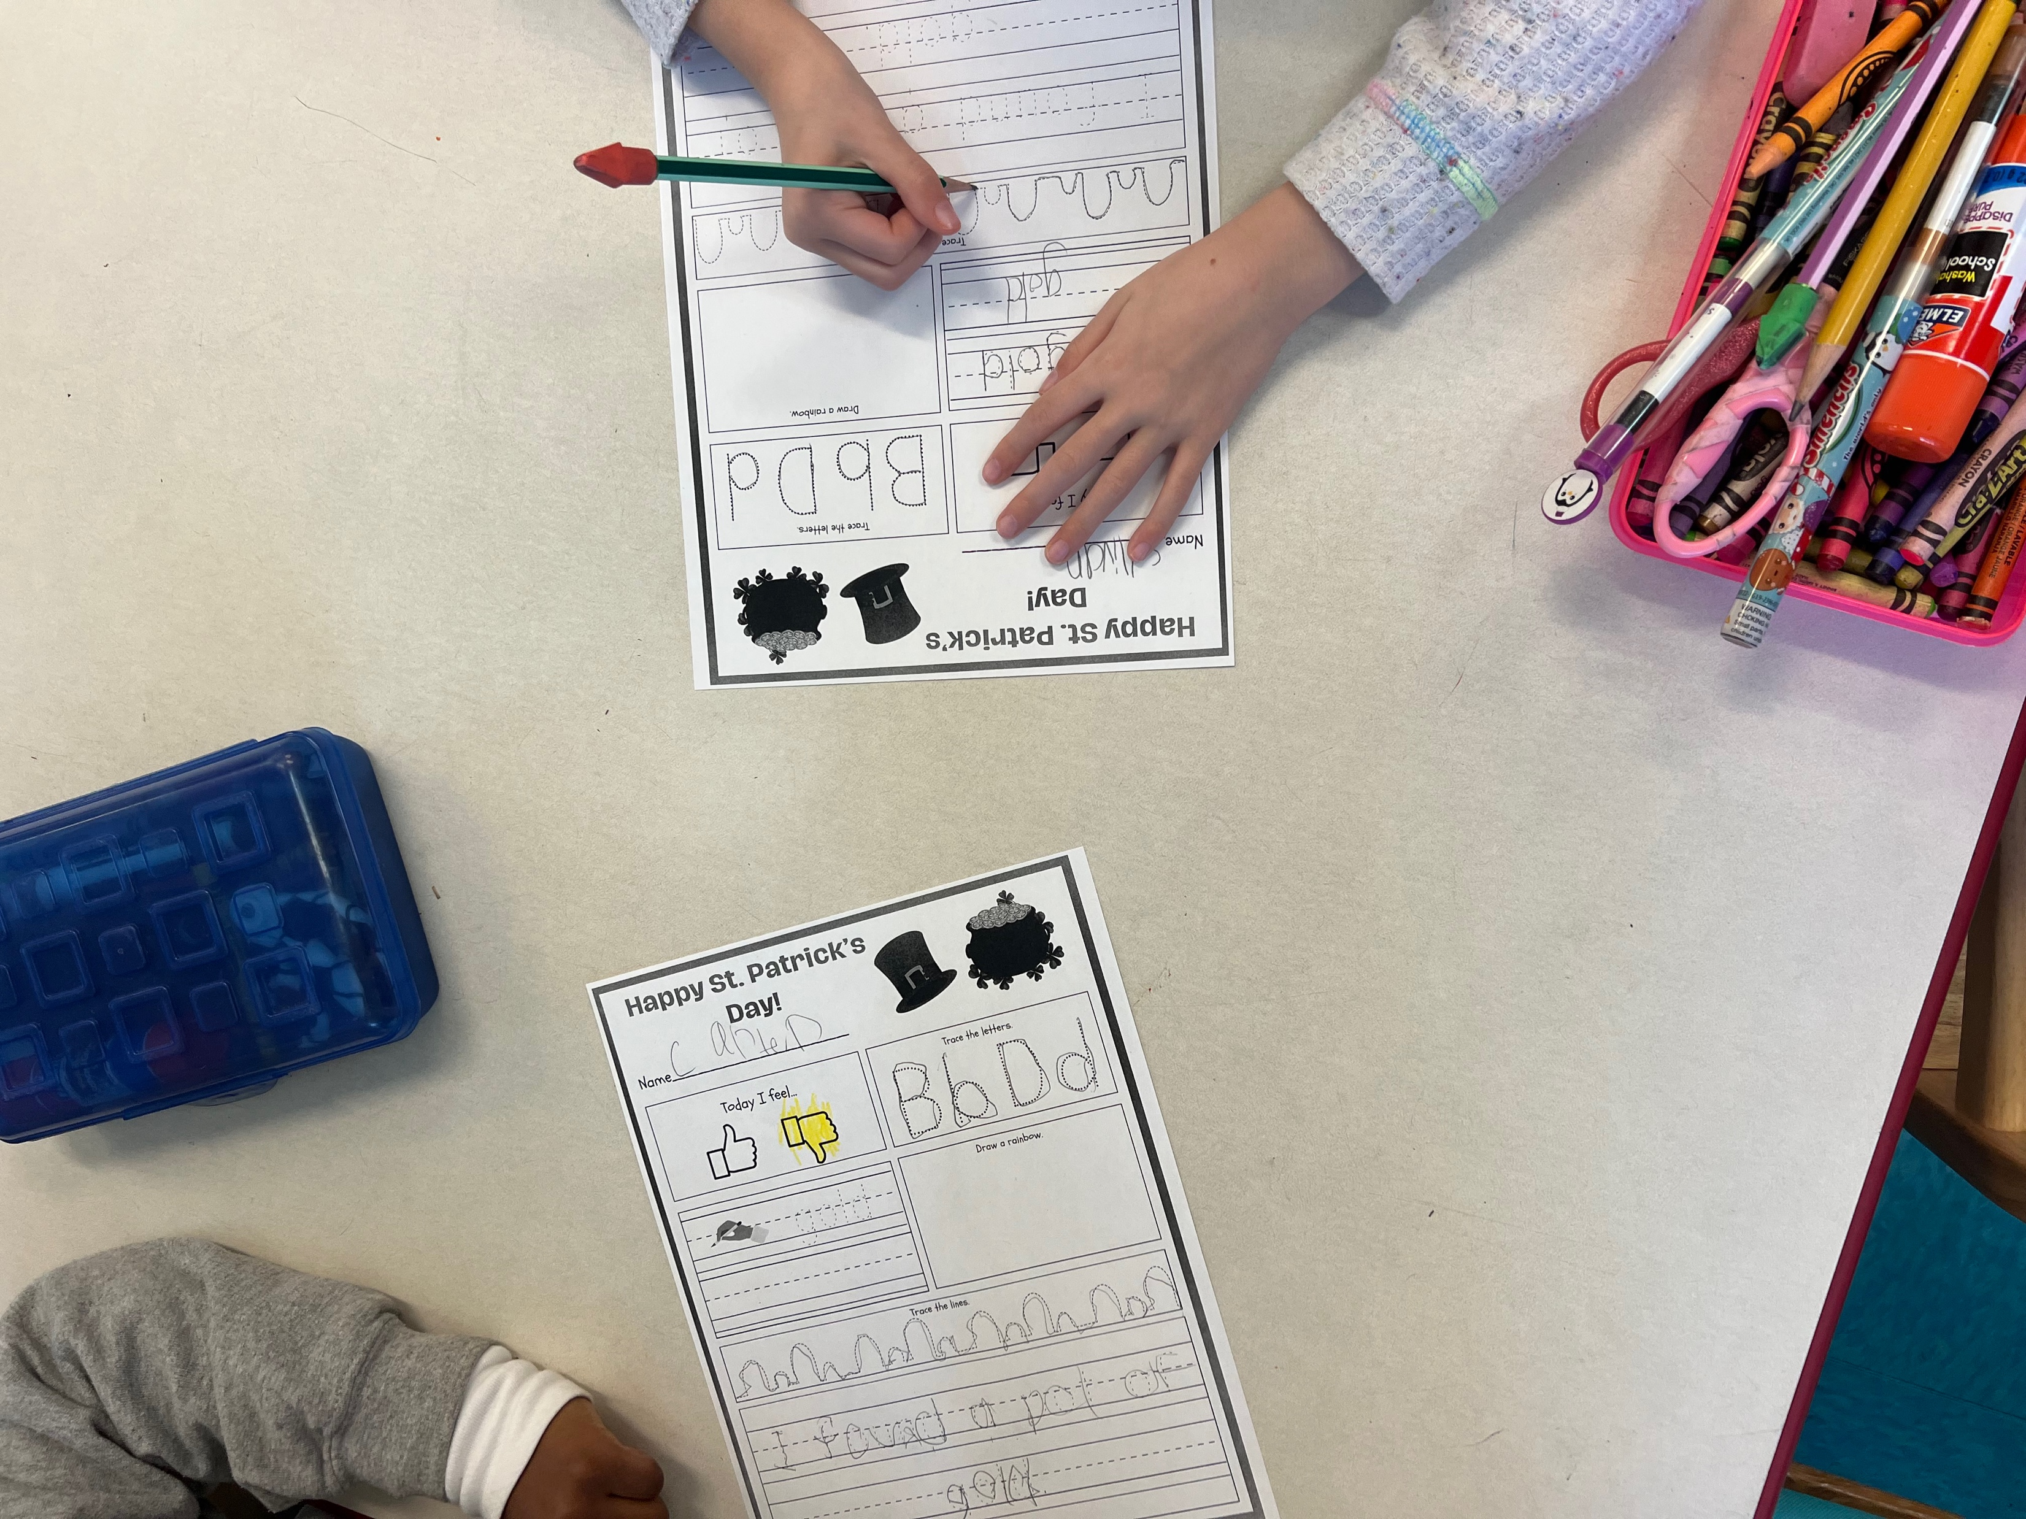
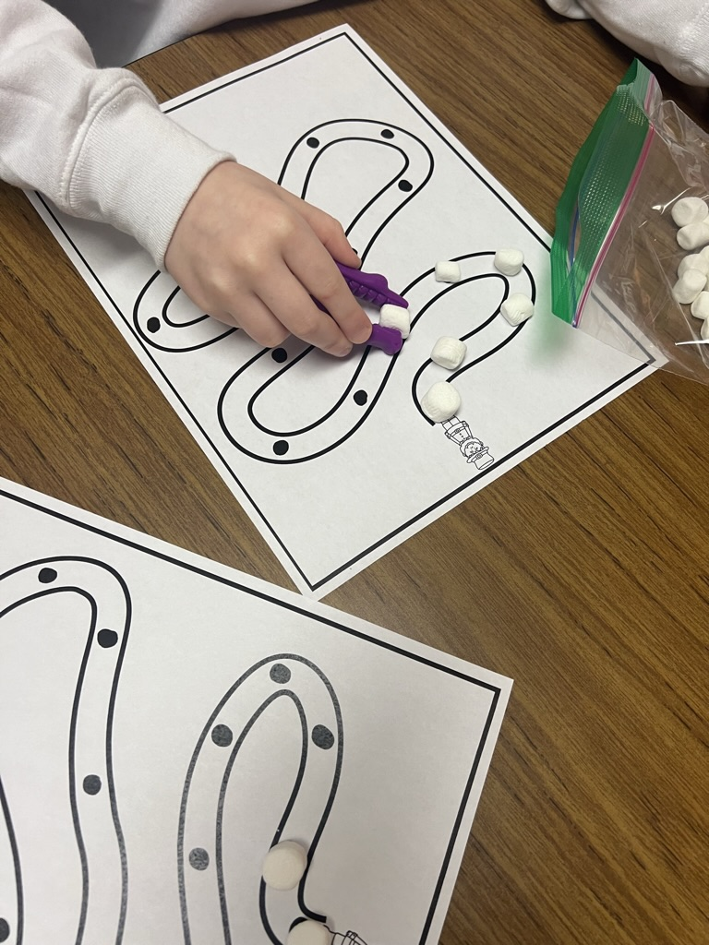
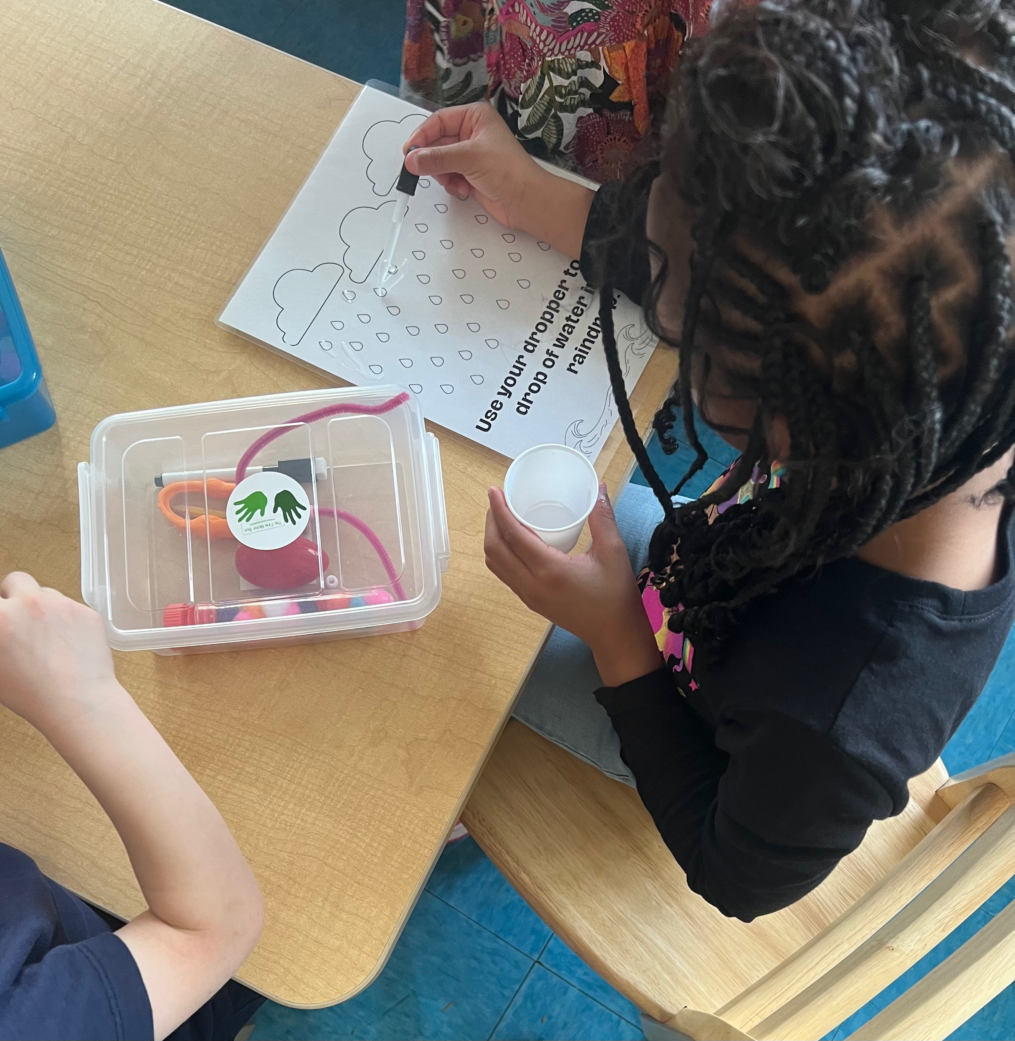
Project Deliverable: Tier One Interventions
30 interventions consisting of fine motor, visual motor,
and sensory-motor activities.
3-4 activities completed in the classroom over a 30
minute session.

Slide 11
Project Deliverable: MTSS Educational Resource
Referral Overview
Overview of MTSS guidelines and support systems.
Provided specific support staff and referral guidelines for each tier.
District-specific referral resource
Addendum to previously established referral document.
Provided OT-specific examples of concerns/behaviors teachers may see in their classrooms.

Slide 12
Tier One Intervention Measured Effectiveness
*Teachers and assistants were surveyed after each week of interventions with a 91% response rate over 3 weeks.

Slide 13
MTSS Referral Measure of Effectiveness
“I appreciate the clarity of the resources. They give good suggestions of behaviors to look for in the classroom.”

Slide 14
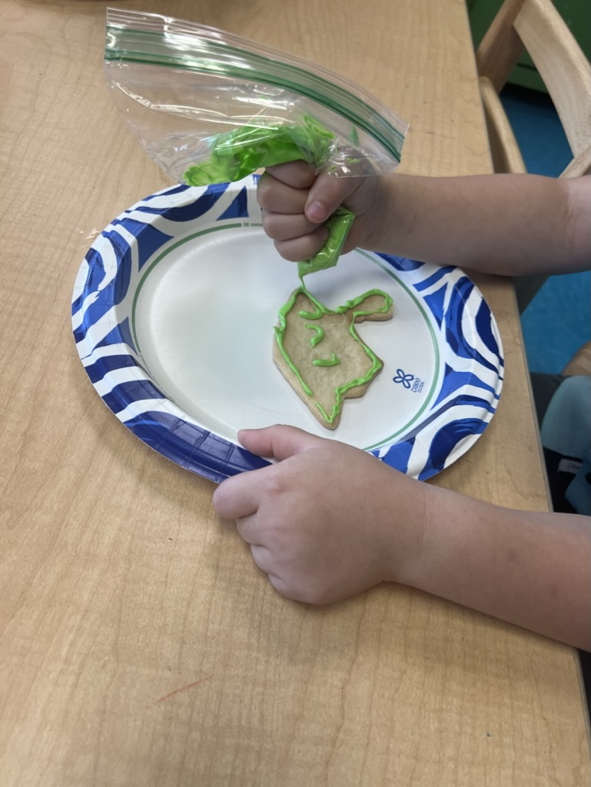
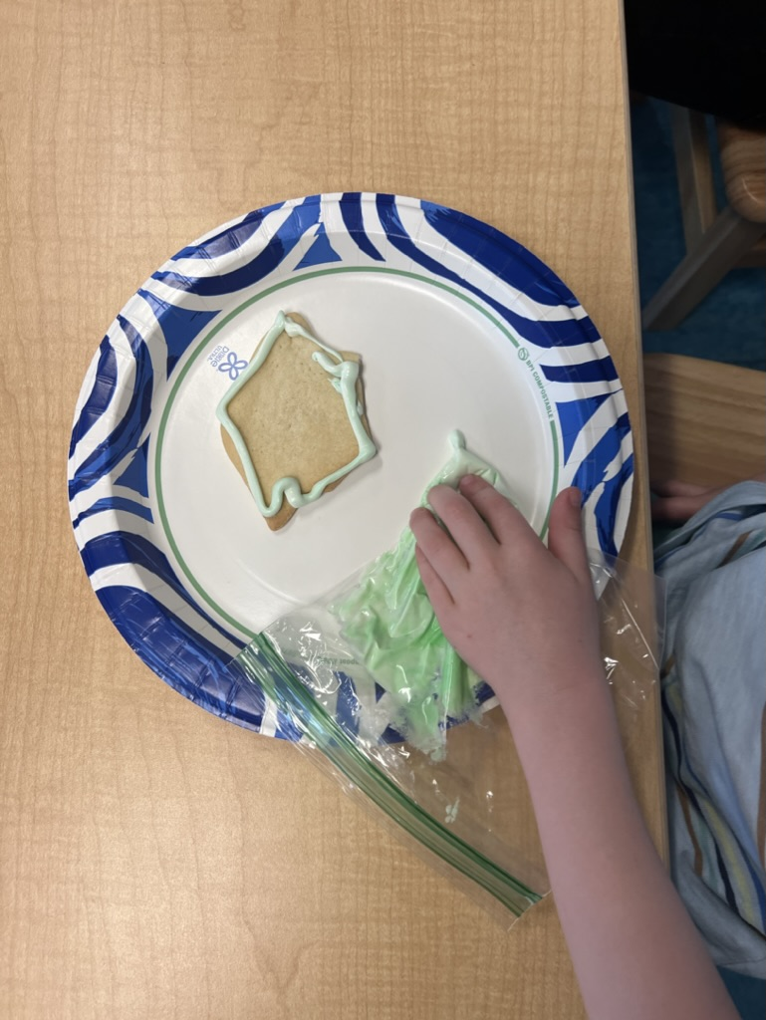
Outcomes and Impact
Teachers were provided with both OT-specific referral recommendations and interventions to address the fine motor, visual motor, and sensory concerns and demonstrated the ability to implement interventions within their classrooms.

Slide 15
Sustainability & Future Recommendations
Tier One interventions were provided to teachers on the school’s Google Drive for continuous access with future recommendations to expand the resources to multiple grade levels.
Teachers demonstrated buy-in after in-class demonstrations and discussing post-assessment results.
Next steps would include parent/guardian buy-in.

Slide 16
References
Berkeley, S., Scanlon, D., Bailey, T. R., Sutton, J. C., & Sacco, D. M. (2020). A Snapshot of RTI Implementation a Decade Later: New Picture, Same Story. Journal of learning disabilities, 53(5), 332-342. https://doi.org/10.1177/0022219420915867
Campbell, Rebecca Derrick, "Finessing Fine Motor Skills: Implementing a Parent Education Module and the Use of a Fine Motor Box to Address Fine Motor Skills and Fine Motor Delays in Elementary Age Children" (2022). Post-Professional Occupational Therapy Doctorate - Innovations in OT Symposium: Transforming Possibilities into Practice. 5. https://medica-musc.researchcommons.org/muscotd-ppotd/5
Ohl, A. M., Graze, H., Weber, K., Kenny, S., Salvatore, C., & Wagreich, S. (2013). Effectiveness of a 10-week tier-1 response to intervention program in improving fine motor and visual-motor skills in general education kindergarten students. The American journal of occupational therapy, 67(5), 507-514. https://doi.org/10.5014/ajot.2013.008110
Zylstra, S. E., & Pfeiffer, B. (2016). Effectiveness of a Handwriting Intervention With At-Risk Kindergarteners. The American journal of occupational therapy, 70(3), 7003220020p7003220021-7003220020p7003220028. https://doi.org/10.5014/ajot.2016.018820

Slide 17
Acknowledgements
Capstone Mentor: Dr. Rebecca Campbell, OTD, OTR/L, IBCLC
Faculty Mentor: Kelly McGloon, PhD, OTR/L
Peer Review and Feedback: Jaeger Parsons, OTDS
Special Thanks to Mrs. Varney, Mrs. Russell, Mrs. Wainwright and the faculty and staff at Briggs Elementary School. Additional thanks to the School District of Oconee County for their participation and help.

