Slide 1
Access and Awareness of Reused Durable Medical Equipment (DME) and Adaptive Equipment (AE) Through Inventory System Development and Community Resource Distribution
John Joseph Guerriero IV, OTDS
Faculty Mentor: Scott Hutchison, OTD, OTR/L
Site Mentor: Sarah Gassman Wilbanks, OTR/L

Slide 2
Background & Significance:
Accessibility seems to be the highest barrier in equipment acquisition playing a significant role in an individual’s ability to engage within their community. (Wang, 2012)
According to Martinez et al, 2021, results of this study indicate that out of 1,157 DME requests 43% of individuals had private or federal insurance coverage. This highlights a disparity in insurance coverage compared to the volume of DME requests (Martinez et al, 2021).
In Ordway et al., 2020, the discussion of potential waste created with ineffective equipment recommending practices is highlighted. This is the first source that refers to charitable equipment reuse and redistribution programs as a possible solution (Ordway et al., 2020).
Identified Need:
Develop cost-effective alternatives for equipment acquisition for under/uninsured individuals.
Increase access and awareness of existing community resources for reused DME and AE among clinicians to promote appropriate reused equipment referrals among vulnerable populations.

Slide 3
Project Purpose and Objectives
Purpose
To develop an Inventory System in collaboration with PHC Home Health and DME to enhance an existing reused equipment program (Jean's Fund). In addition, create and present an In-service for Reused Equipment Community Resources targeted at therapists within the Charleston area to increase awareness of reused equipment referral options for vulnerable and underserved populations throughout the Charleston area.
SA 1: Gain in-depth knowledge of Adaptive Equipment and Durable Medical Equipment distribution methods and how they can be utilized to maximize patient outcomes.
SA 2: Enhance Interprofessional skills to improve communication and effectiveness in a team settings. (Community Resource Allocation)
Supporting Framework: Person-Environment-Occupation-Performance Model (PEOP)

Slide 4
Overview of Jean's Fund
Jean’s Fund is a non-profit 501C3 that stores and redistributes reused Durable Medical Equipment (DME) and Adaptive Equipment (AE) to vulnerable populations within PHC’s client base (Home Health).
Jean's Fund is a clinician driven storage facility located in Hanahan, SC.
The location is ideal for Home Health therapists to access and redistribute equipment throughout their day to appropriate patient populations.
Pic. #1: Jean's Fund Entrance

Slide 5
Population & Stakeholders
Patients/Caregivers (Charleston Community)
PHC Home Health patients
Therapists, Healthcare Clinicians, and Healthcare Support Staff (Charleston Community)
PHC (Home Health & DME)
MUSC (Acute Care) (OT Department)
The Villages (SNF) - Summerville
Roper Rehab (Acute Rehab.) - Downtown Charleston
Other Clinicians around the Charleston Area.

Slide 6
Methods
This capstone project was a quality improvement project utilizing a descriptive study design
Informal In-person/Phone Interviews:
PHC Home Health: OT (1), PT (1), SLP (1), MSW (1)
PHC DME: Warehouse Manager (1), ATP (2)
PHC Patients: (3)
Community Resources: Accessibility, SCATP, Operation Home, Hope Repairs
Initial Jean's Fund Inventory Assessment Surveys (2) [Therapists]
Reused Equipment Toolkit In-service Feedback Forms (40) [Therapists, Nurses, and Support Healthcare Professionals]
Strengths:
Supportive Capstone Mentors (access to resources on/off site)
Interprofessional communication opportunities across institutions
Access to other clinicians outside of PHC to broaden Reused Equipment Toolkit dissemination.
Weakness:
Difficulty aligning schedules for observation of DME warehouse requiring project redesign
Rework of initial capstone timeline due to adaptations in deliverables causing scheduling interruptions
Not enough time to reach more clinicians with the Reused Equipment Toolkit.

Slide 7
Initial Survey Results
(n=2) Occupational Therapist (1) Physical Therapist (1) - utilized Jean's Fund prior to Capstone Project
Pre-Inventory System Survey (n=2)
Most Utilized Equipment Type: Bathroom Equipment
What equipment would you like to see more of in Jean's Fund?
OT Requested Equipment
Bedside commodes
Tub Transfer Benches
Shower Chair
PT Requested Equipment
Lift Equipment
Hospital Beds
Rolling Walkers
Rollators
Question | Participant #1 | Participant #2
On a scale from 1 –10, what would you rate the organization of Jean's Fund, prior to this project? | 2 | 10
Approximately how long did it take you to find your desired equipment, prior to the organization system? | -10 min. | ~3 min.

Slide 8
Initial Survey Results (cont...)
Post-Inventory System Survey (n=1)
Therapist tested the difference between:
Donation Form Type A (Short Answer) & Type B (Multiple Choice)
Question | Participant #1
Between Donation Form Type A & Type B, which Donation Form do you prefer? | Type A
On a scale of 1 - 10, How would you rate the organization system of Jean's Fund? | 10
Approximately how long did it take you to find your desired equipment, after the organization system? | ~2 min.
On a scale of 1 - 10, How would you rate the QR code donation system? | 10
On a scale of 1 - 10, How would you rate instructions for 'Condition' rating? | 10
On a scale of 1 - 10, How would you rate instructions for tagging equipment? | 7

Slide 9
Interview Testimonials
"Once DME is taken off of the delivery truck, it is considered "Used Equipment" and due to liability most places aren't willing to deal with used equipment." - Carla Adams, MSW
"This patient is a perfect candidate for Jean's Fund because by the time her insurance deems her eligible (5-year rule regarding DME) for a new rollator, it may be too late for her." - Sarah Gassman Wilbanks, OTR/L
"I just evaluated a patient who received the wrong equipment from the VA, and she doesn't know what to do with it. Do you think she would be willing to donate it to Jean's Fund?" - Faith Carraway COTA/L
"Reused low vision and hearing assistive technology is very hard to get your hands on. It is so specialized that once people are done using it, the equipment is either thrown out or sold." - Ryan Locklear OTR/L, CLVT

Slide 10
Deliverables
Experience
Deliverables
Created a cost-effective, easy-to-access, and shareable online inventory system using Google Forms, Sheets, and Drive.
Developed a Reused Inventory Toolkit (Presentation) to assist anyone interested in creating their own Reused Equipment Closet
Provided In-Services for PHC (Home Health), The Villages (SNF), MUSC – OT Department (Acute Care), Roper Rehab. (Acute Rehab.) on Reused DME and AE Community Resource Awareness
Observe Administrative Staff, MSW, OT, PT, SLP in a Home Health setting to better understand patient environments, equipment referral, and equipment education processes.
Observe PHC DME Staff to better understand industry standards for DME/AE Storage, Sanitization, and Processing
Organize and reshape Jean's Fund to become self-sustainable.

Slide 11
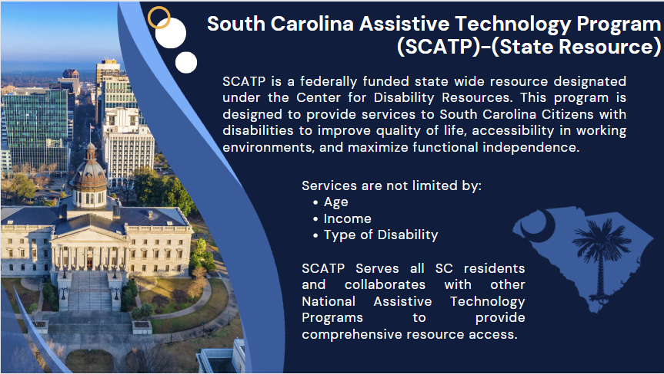
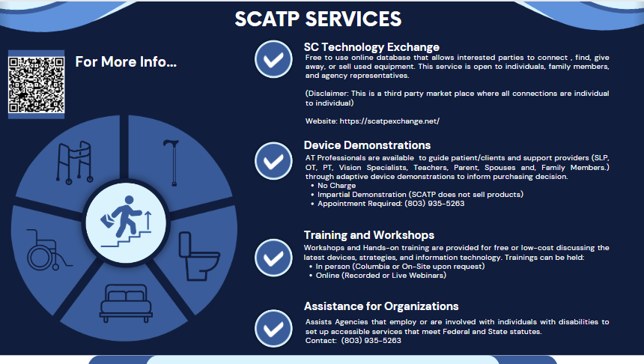
Reused Equipment Inventory Toolkit (Community Resources)

Slide 12
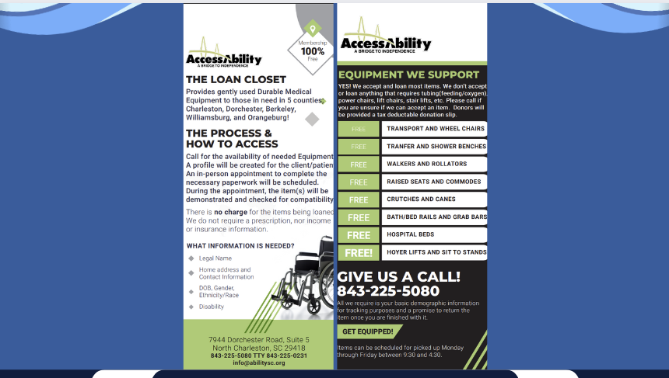
Reused Equipment Inventory Toolkit (Community Resources)

Slide 13
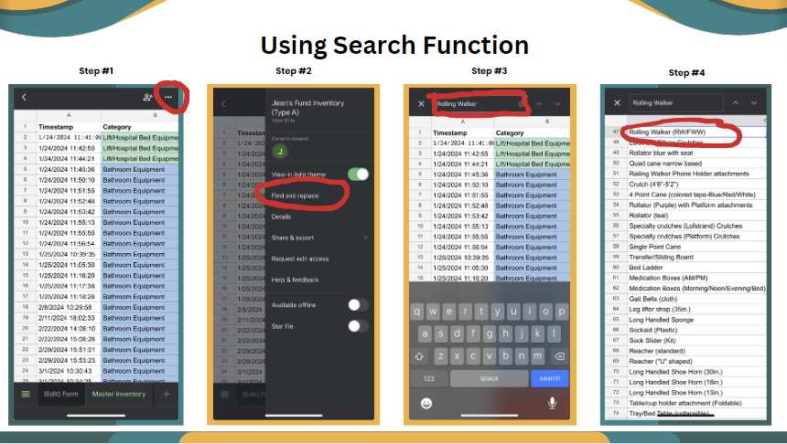
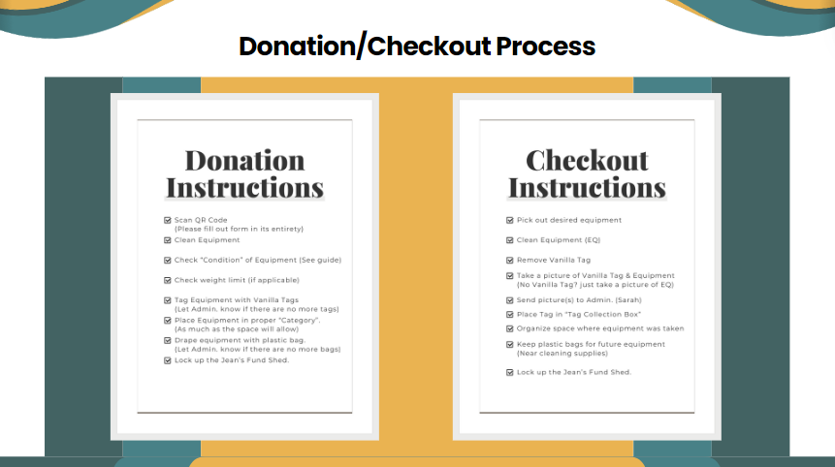
Reused Equipment Inventory Toolkit (Inventory System)

Slide 14
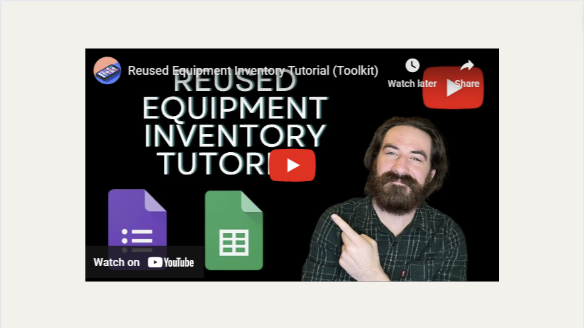
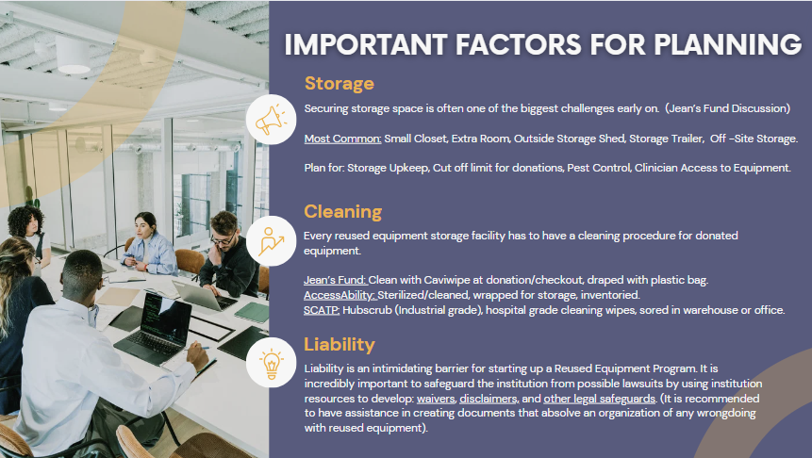
Reused Equipment Inventory Toolkit (Inventory System)

Slide 15
Reused Equipment Inventory Toolkit (Templates)
Reused Equipment Inventory Google Template Links:
Form: https://docs.google.com/forms/d/18iNYplLMms--gaGHu3KmK3D0JqE3blXM0G5LzDaoZis/copy
Sheets: https://docs.google.com/spreadsheets/d/1-nUzY_TIFfTkwmkQ4r1ac2UvyCFOA2Vu4hWXnOUVsyg/copy

Slide 16
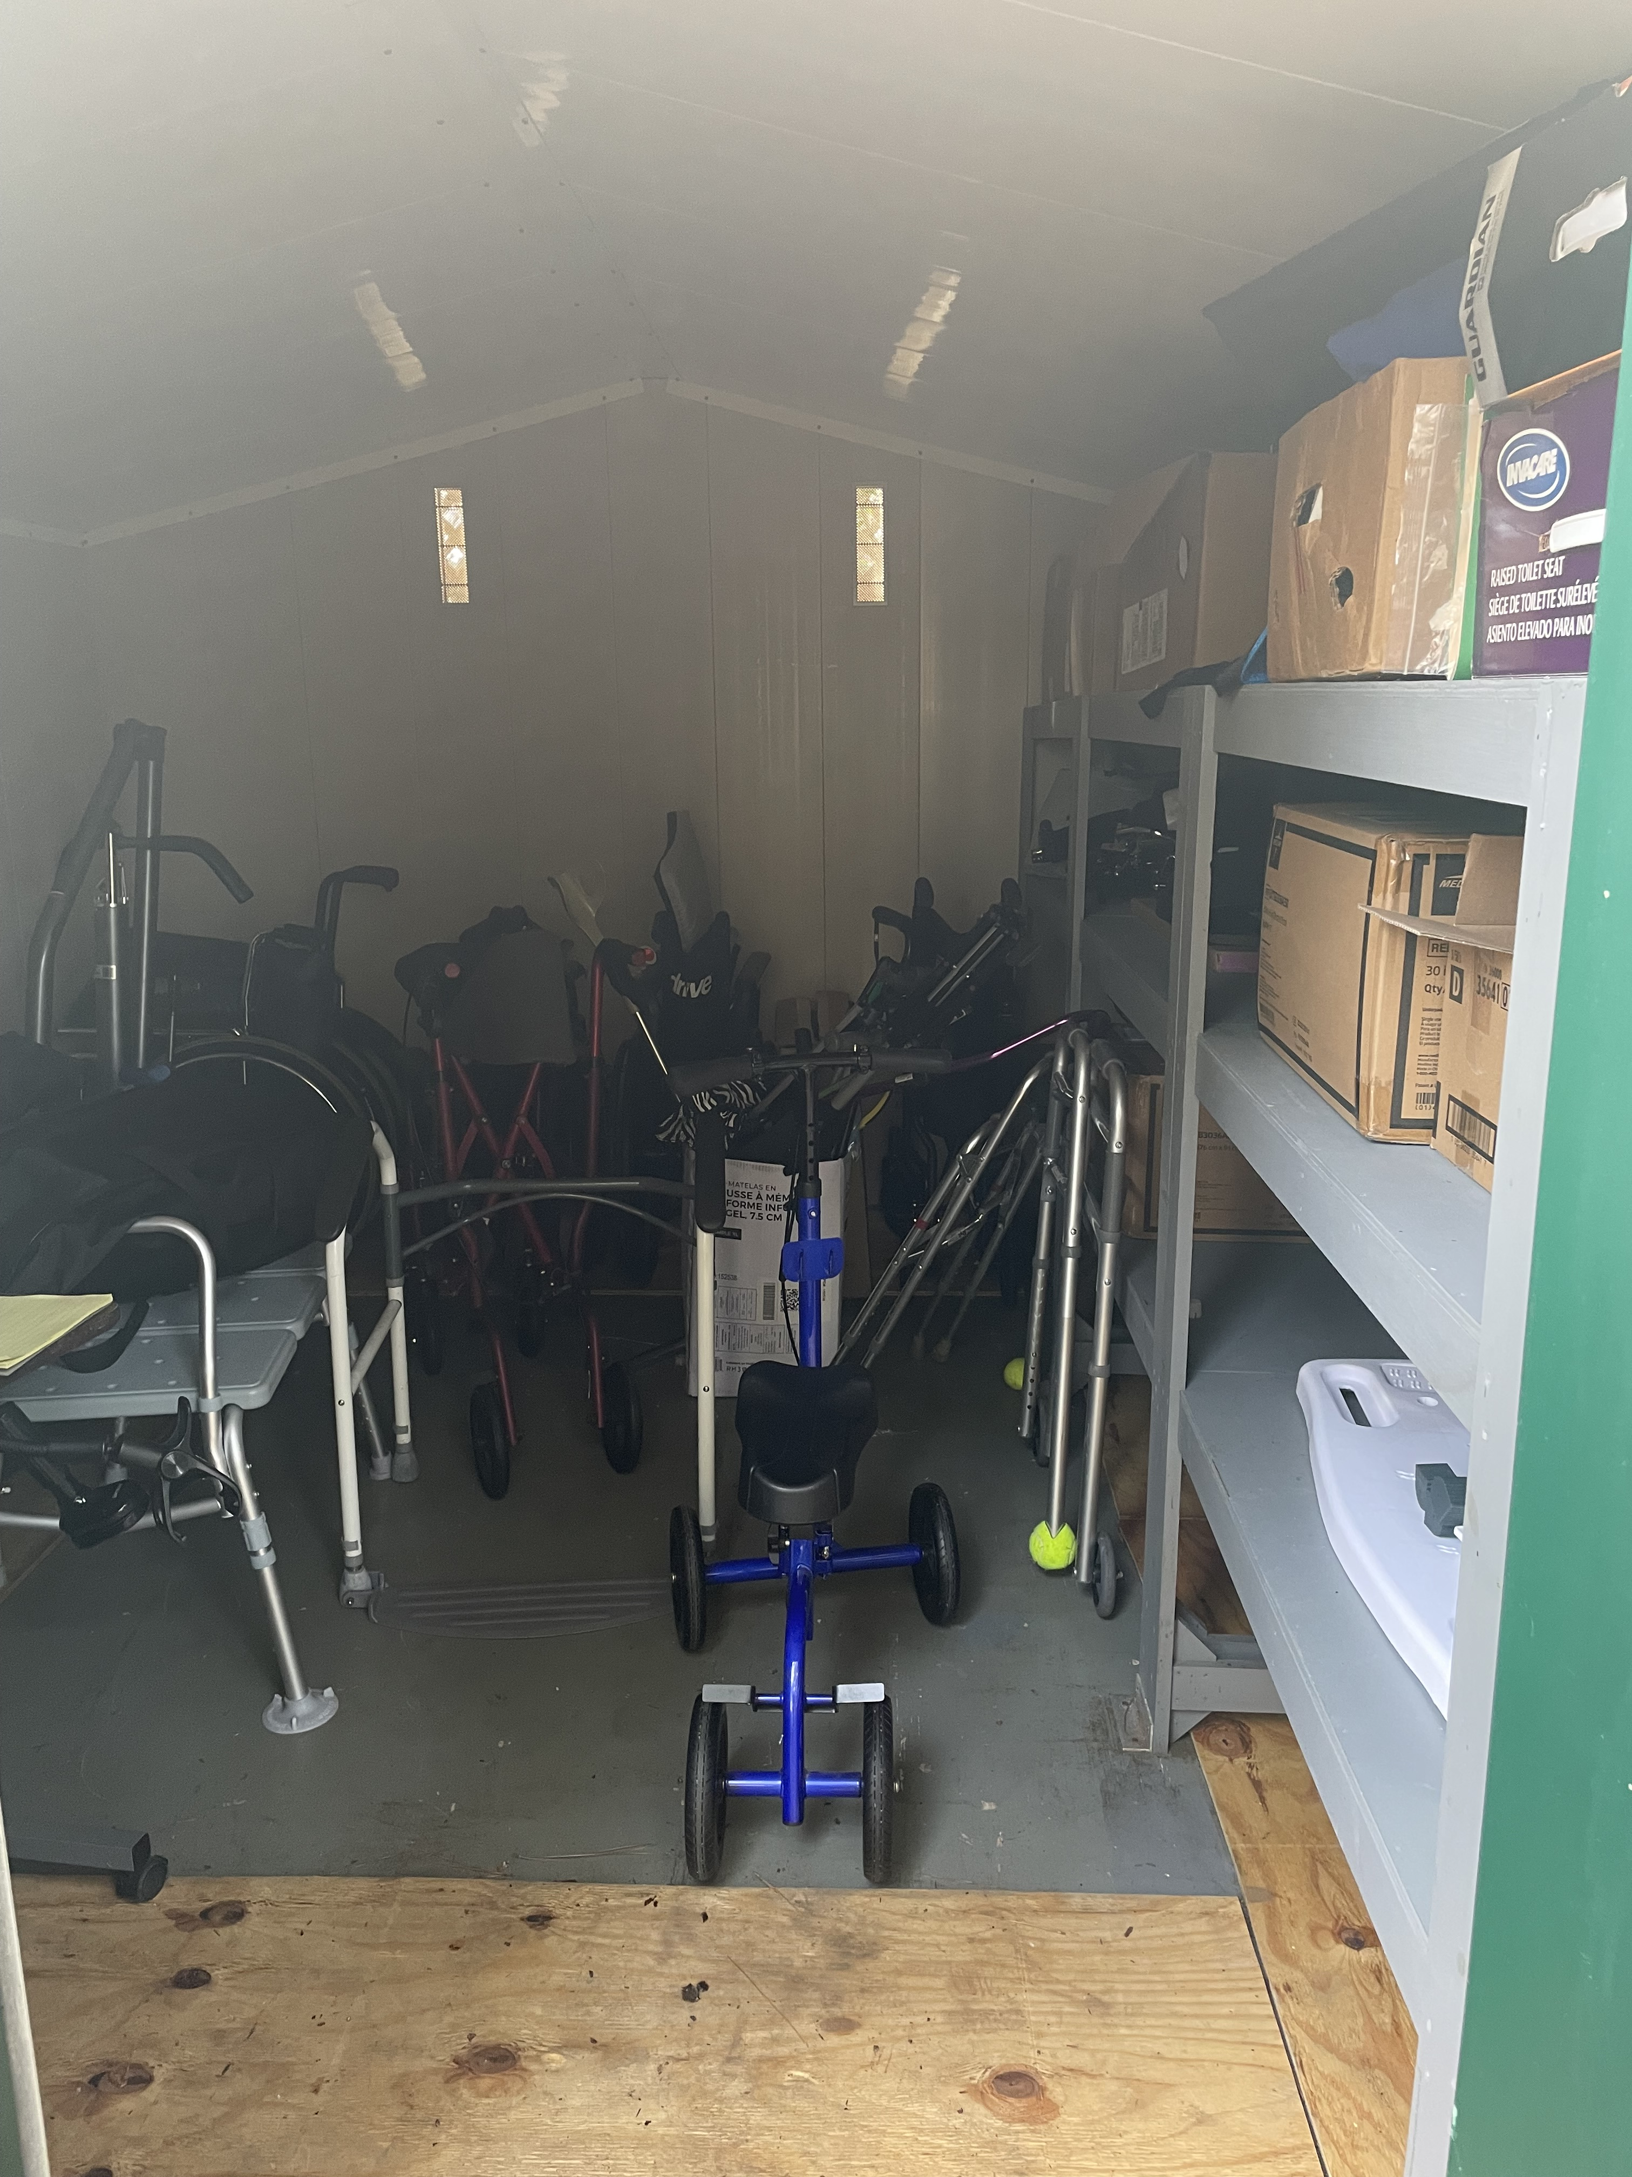
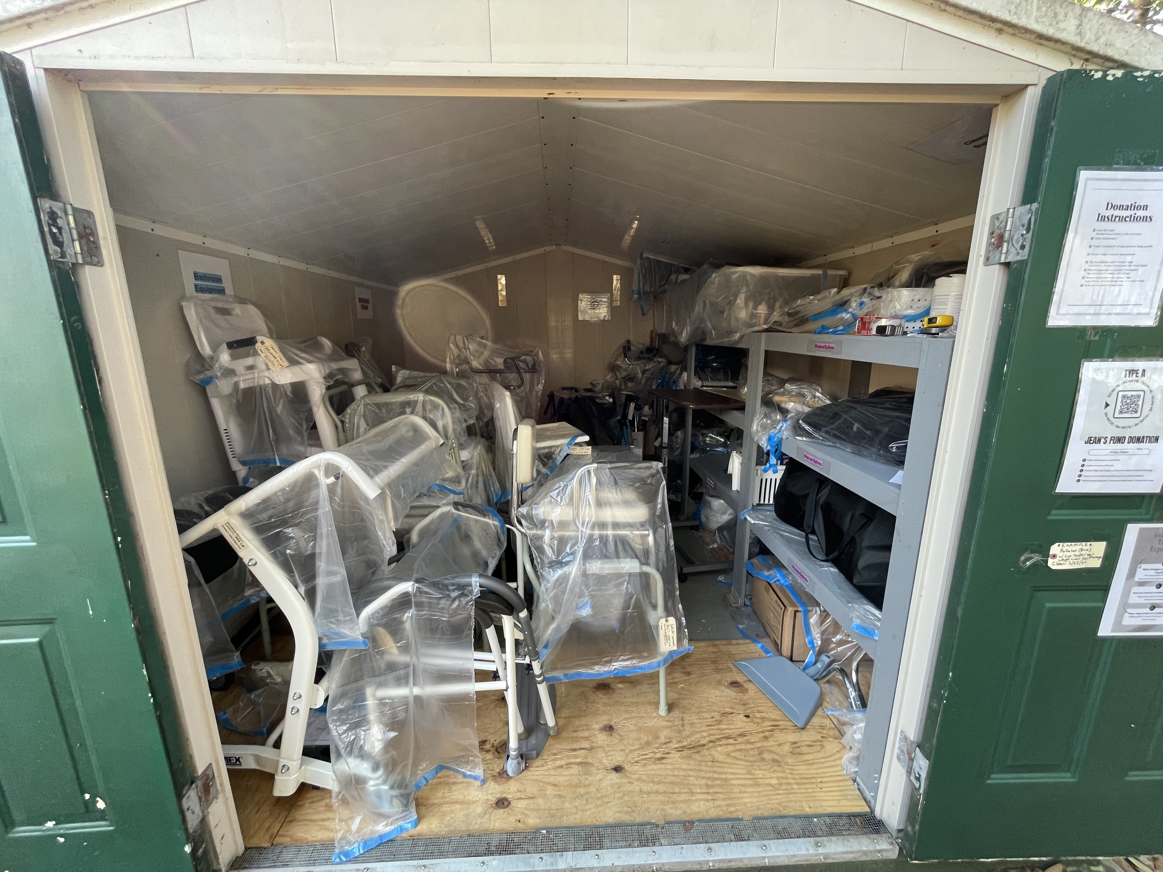
Jean's Fund Before & After
Pic. #2: Jean's Fund (Before)
Pic. #3: Jean's Fund (After)

Slide 17
Jean's Fund Donation Data

Slide 18
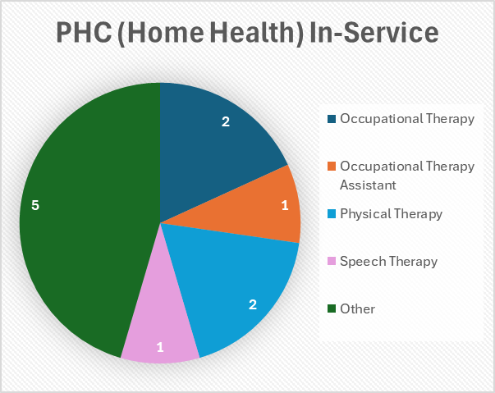
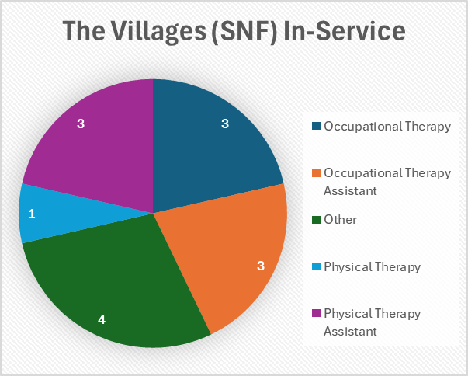
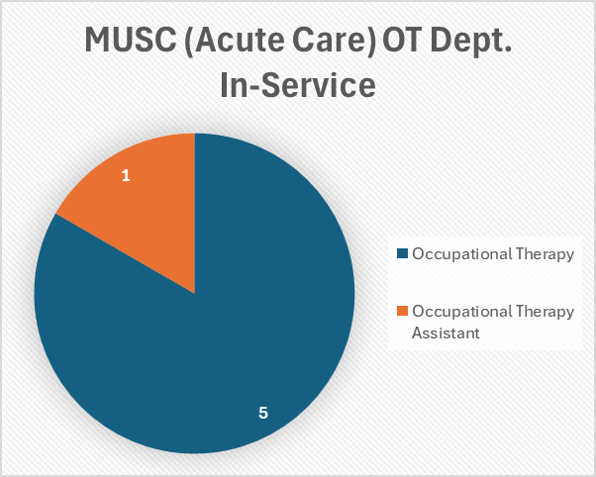
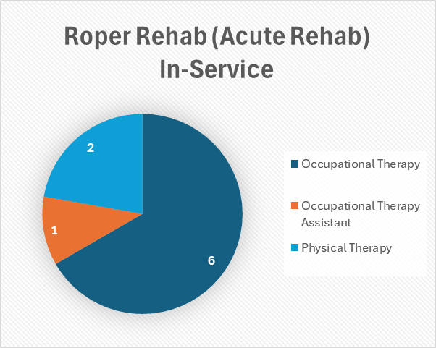
Reused Equipment Inventory Toolkit In-service
"Other" Healthcare Professions:
Restorative Aid (2)
Rehab. Assistant (1)
Social Services Director (1)
Registered Nurse (1)
Admin. Assistant (4)

Slide 19
Reused Equipment Inventory Toolkit In-service

Slide 20
In-service Feedback Results

Slide 21
Potential Impact
Increase referrals and awareness of existing reused DME and AE Community Resources for vulnerable under/uninsured populations.
Increase interprofessional communication among healthcare disciplines across systems to provide more options for vulnerable populations.
Provide clinicians with a "Beginner's Guide" to creating their own basic Reused DME/AE "Closet".
Overall, decrease DME and AE medical waste.

Slide 22
Conclusion
The Reused Equipment Inventory Toolkit was well-received among PHC and the Charleston Therapy Community (The Villages, MUSC, Roper Rehab.)
Inventory System implementation at Jean's Fund was well-received and highly utilized by PHC therapists.
This QI project is a small step towards increasing awareness and access to reused DME and AE resources in Charleston and South Carolina.
Further research and quality improvement projects will continue to benefit local and statewide reused equipment resources, reaching a broader patient population and providing access to desperately needed equipment.

Slide 23
Acknowledgements
I want to thank my Capstone Site Mentor Mrs. Sarah Gassman Wilbanks OTR/L and all of the PHC Home Health/DME Staff for their continuous support throughout the ups and downs of this project.
I want to thank Dr. Scott Hutchison for always being available and willing to provide insight and encouragement through challenging aspects of this project.
I want to thank my Capstone Group for their kind words and comradery
I would not be here without my lovely wife, Anne Marie Guerriero as she was my stabilizing force that kept me on my feet all the way to the end.

Slide 24
References
Disability impacts ALL of US. (2020). Centers for Disease Control and Prevention. https://www.cdc.gov/ncbddd/disabilityandhealth/infographic-disability-impacts-all.html#
Lin, S. C., & Gold, R. S. (2018). Assistive technology needs, functional difficulties, and services utilization and coordination of children with developmental disabilities in the United States. Assistive Technology, 30(2), 100-106. https://doi.org/10.1080/10400435.2016.1265023
Martinez, C. I., Sanchez, A. N., Stampas, A., Woo, J., & Verduzco-Gutierrez, M. (2021). Demographics and durable medical equipment needs of persons with disabilities in a charitable rehabilitation clinic. American Journal of Physical Medicine &amp; Rehabilitation, 100(3), 288-291. https://doi.org/10.1097/PHM.0000000000001553
Oliver, Melissa, MS, OTR/L. (2018). Assistive technology in polytrauma rehabilitation. Physical Medicine and Rehabilitation Clinics of North America, 30(1), 217-259. https://doi.org/10.1016/j.pmr.2018.08.002
Ordway, A., Pitonyak, J. S., & Johnson, K. L. (2020). Durable medical equipment reuse and recycling: Uncovering hidden opportunities for reducing medical waste. Disability and Rehabilitation: Assistive Technology, 15(1), 21-28. https://doi.org/10.1080/17483107.2018.1508516
Wang, B. (2012). Medical equipment maintenance. Springer International Publishing. https://doi.org/10.1007/978-3-031-01655-4
AccessAbility (n.d.). Medical Equipment. Retrieved March 12, 2024, from https://www.abilitysc.org/medical-equipment/
University Of South Carolina School of Medicine Columbia (n.d.). Services: Assistive Technology. Retrieved March 12, 2024, from https://sc.edu/study/colleges_schools/medicine/centers_and_institutes_new/center_for_disability_resources/assistive_technology/services/index.php
Operation Home (n.d.). Operation Home: Home. Health. Hope. Retrieved March 12, 2024, from https://operationhome.org/
Hope Repair (n.d.). Hope Repair. Hope Repair: Safe, Dry & Warm Sharing The Gospel. Retrieved March 12, 2024, from https://www.hope-repair.org/
REDCap at SCTR is supported by the National Center for Advancing Translational Sciences of the National Institutes of Health under Grant Number UL1 TR001450.
[Think Media]. (2021, December 30). How to Make Your First YouTube Video (START to FINISH) 🚀 [Video]. YouTube. https://youtu.be/bKvfzxtadL8?si=ZSfcfI1egnJ53Q6A
[Sheets Help]. (2022, September 7). Consolidate Data From Multiple Sheets 📝 With ONE FORMULA Using Google Sheets [Video]. YouTube. https://youtu.be/z_nOHcBAcx4?si=bphTTXwFg2Agu-QD
[The Computer Lab]. (2019, October 3). Use Google Forms to Auto Fill Google Sheets with Data [Video]. YouTube. https://youtu.be/jxqlkxRO5Aw?si=1L2MVmA6u1qLdUIi
[Ashley N Cameron]. (2021, January 18). Conditional Formatting Based on Another Cells Values – Google Sheets [Video]. YouTube. https://youtu.be/2X1ahr8So3s?si=TK1rYXnE2FE6om6N
[Joli Boucher]. (2019, February 4). Sort Responses from Google Forms to Google Sheets Tabs [Video]. YouTube. https://youtu.be/xOXyeFHGkpw?si=ahT9a9C0eTTWsien
Google. (2024). Google Forms. Retrieved from https://docs.google.com/forms/d/13GZcOL-wZcT3R4okeT8RaIHPRY-dygERjbDXy47BNhU/edit
Google. (2024). Google Sheets. Retrieved from https://docs.google.com/spreadsheets/d/1ZorwvEk-SzJ4Dv83mzbAV78aIrfaYnCkOFzPwlL80Dw/edit#gid=1386260244
Baum, C. M., Christiansen, C. H., & Bass, J. D. (2015). The Person-Environment-Occupation- Performance (PEOP) model. In C. H. Christiansen, C. M. Baum, & J. D. Bass (Eds.), Occupational therapy: Performance, participation, and well-being (4th ed., pp. 49-56). Thorofare, NJ: SLACK Incorporated.

Slide 25
Thank You! Questions?

