Slide 1



The Forgotten Occupation in Stroke Rehabilitation: Use of Keyform Mapping to Address Sleep Disturbance
& Student Research Therapist Experience
Erin Elenz, OTS; Michell Woodbury PhD, OTR/L
Notes:
Title page
- add stroke recovery center logo

Slide 2
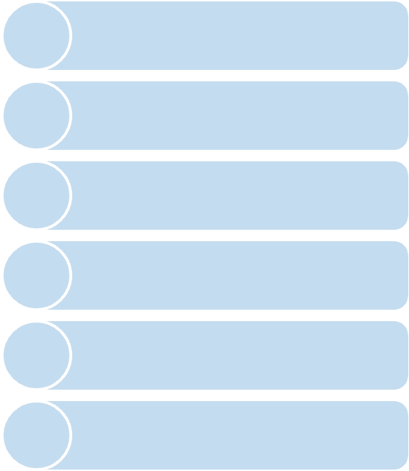





}
Project Background
Sleep disturbances are estimated to affect over 50% of patients throughout the post-stroke phases (Jeffers et al., 2023).
Sleep disturbances negatively affect recovery and rehabilitation and increase the possibility of mortality or reoccurring stroke (Väyrynen et al., 2014).
Identified Need
Direct need for precise assessment tools to effectively guide therapeutic sleep interventions across various practice settings.
Management should begin in the acute phases and continue through the chronic phase of stroke to positively influence recovery and rehabilitation outcomes (Hasan et al., 2021; Frange et al., 2023)
Comprehensive assessment and management of sleep disturbances is rare; due to a lack of expensive and inaccessible resources, assessment tools, and fragmented care (Brown et al., 2019).
Allied healthcare professionals are necessary to increase screening and implement interventions in combination with routine medical care (Fulk et al., 2020).
Notes:
Project Background
Sleep disturbances/disorders- a set of conditions that present with interruptions in normal healthy sleep patterns (Karna et al., 2023). These disturbances involve poor or lack of quality and quantity of sleep.
1) Sleep disturbances are a prevalent and pervasive consequence of stroke that is estimated to affect over 50% of patients throughout the post-stroke phases (Jeffers et al., 2023).
2) Sleep disturbances negatively affect recovery and rehabilitation and increase the possibility of mortality or reoccurring stroke (Väyrynen et al., 2014).
3) It is crucial to begin management of sleep disturbances in the acute phases and through the chronic phase of stroke to positively influence functional recovery and rehabilitation outcomes (Hasan et al., 2021; Frange et al., 2023)
4) But, comprehensive assessment and management of sleep disturbances is rare and is thought to be due to a lack of expensive and inaccessible resources, pointed tools, and fragmented care (Brown et al., 2019).
5) It is imperative to recruit allied healthcare professionals to screen and implement interventions in combination with routine medical care (Fulk et al., 2020).
Project Need:
This project directly addresses the need for the creation of precise assessment tools to effectively guide therapy interventions across various settings, complementing existing therapy practices.

Slide 3
Purpose:
Stakeholders:
Develop a keyform map that effectively models the concept of sleep disturbance in stroke survivors
  Stroke Survivors
  OT Clinicians, Students, and Researchers
Aim 1:
Aim 2:
Aim 3:
Gather quantitative data from at least 50 stroke patients using a sleep disturbance questionnaire
Conduct 5 qualitative interviews to understand stroke patients' subjective experiences of sleep disturbance
Utilize Rasch analysis to create a keyform map to display the interplay between a patient's ability level and the severity of their symptoms
Notes:
Project purpose:
- Develop a keyform map that effectively models the concept of sleep disturbance in stroke survivors
(thus effecting our identified stakeholders: stroek survivors and OT clinicians, students, and researchers)
Project Aims:
- To carryout this purpose, I have identified 3 distinct aims:
1) Gather quantitative data from at least 50 stroke patients using a sleep disturbance questionnaire
2) Conduct 5 qualitative interviews to understand stroke patients' subjective experiences of sleep disturbance
3) Utilize Rasch analysis to create a keyform map to understand the intricate interplay between a patient's ability level and the severity of their symptoms

Slide 4
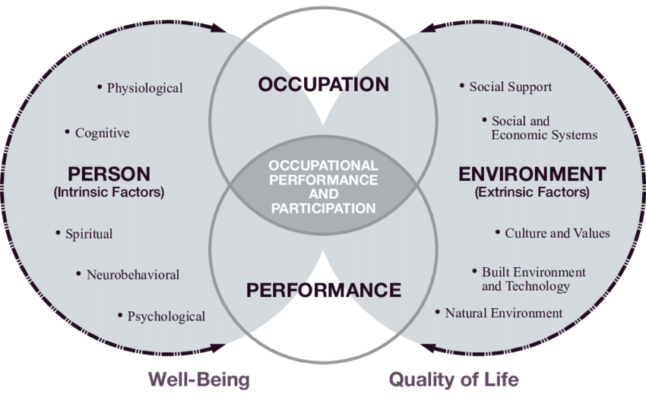
Supporting Framework:
Person-Environment-Occupation-Performance (PEOP) Model
PEOP for OT Sleep Interventions:
  Person: reducing the impact of bodily function on sleep
  Environment: fostering an environment conducive to sleep
  Occupation: restructuring daily activities and routines
(Ho & Siu, 2018)
(Baun et al., 2015
Notes:
supporting framework
Person-Environment-Occupation-Performace Model (PEOP):
- Modified PEOP model proposed for OTs targeting sleep
- Relates the PEOP framework to sleep through viewing:
1) Person: reducing the impact of bodily function on sleep
2)Environment: fostering an environment conducive to sleep
3) Occupation: restructuring daily activities and routines

Slide 5
Project Methods:
Research project: Sub-analysis of data collected from 2 parent studies
Study Design:
Inclusion Criteria:
  >21 years of age
  >3 months post-stroke
  English as primary language
  Able to participate in study protocol despite motor, language, or cognitive impairment
MDS:
Enhanced Study Recruitment for Stroke Survivors through Longitudinal Data Collection in Multiple Domains” (MDS, IRB # Pro00119024)
COGT:
Cognitive and Psychosocial Factors Contributing to Stroke Telerehabilitation Response (CogT, IRB # PRO122798)
Participants:
Qualitative Data Collection: Participants interviewed from the COGT study via Zoom platform; audio was transcribed
Quantitative Data Collection: Participants from COGT and MDS completed the Sleep Disturbance questionnaire; data recorded in a secure database (RedCap)
Procedure:
Notes:
Methods
- study design: This is a sub-analysis of existing data collected during two parent studies. The first was titled “Cognitive and Psychosocial Factors Contributing to Stroke Telerehabilitation Response” (CogT, IRB # PRO122798) and “Enhanced Study Recruitment for Stroke Survivors through Longitudinal Data Collection in Multiple Domains” (MDS, IRB # Pro00119024). In addition, interviews were conducted, and responses were collected from participants in the COGT study. All procedures described were conducted in accordance with the IRB-approved protocols.
- participants: For both parent studies, participants were recruited from a database (The RESTORE registry, IRB# Pro00037803) containing information from ~900 stroke survivors who have given consent to be contacted for research studies. Participants were included if they were >21 years of age, >3 months post-stroke, had English as their primary language, and were able to participate in the study’s protocol despite motor, language, or cognitive impairment. We sought to include individuals of all races, ethnic groups, and genders.
- procedure: Interested potential participants met with a study team member either via a videoconference connection (Doxy.me, COGT) or in-person (MDS) to obtain Informed Consent. Once all consent was obtained, a trained study therapist administered a battery of assessments including the Patient Reported Outcomes Measurement Information System (PROMIS) Sleep Questionnaire. Data was recorded and stored in a HIPPA compliant database (RedCap). In addition, The PI of the sub-study (Predoctoral Trainee: Elenz), an IRB-approved student-therapist team member for both parent studies, administered qualitative interviews to n=5 participants in the COGT study. These interviews were conducted via a videoconference connection (HIPAA-compliant Zoom call). Audio was recorded and transcribed. The interview

Slide 6
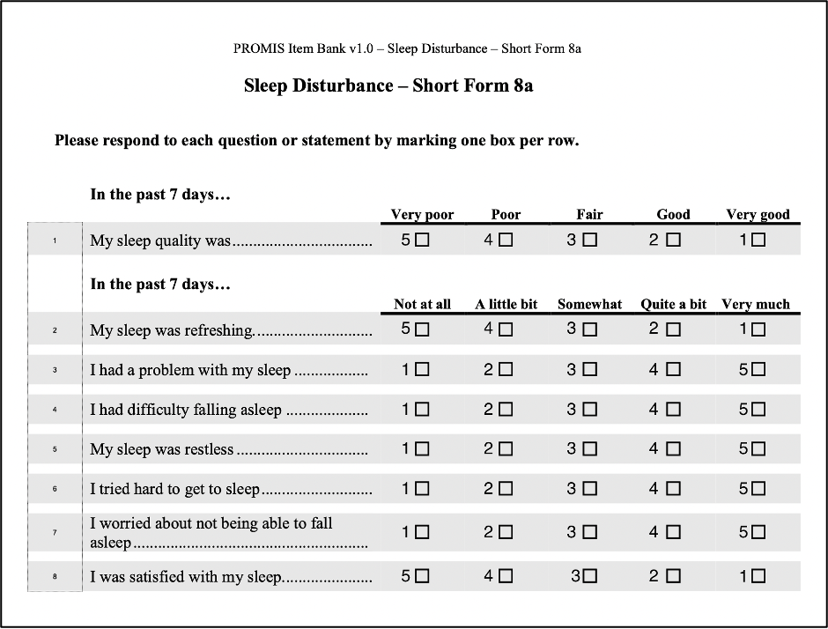
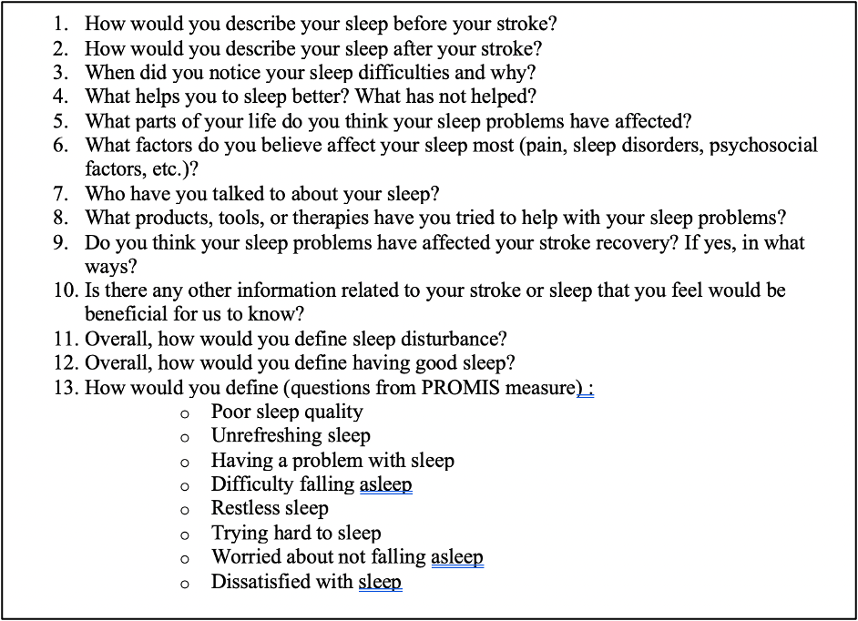
Project Methods:
PROMIS Sleep Disturbance Questionnaire
Sleep Disturbance Interview Questions
Notes:
Methods
PROMIS SD Questionnaire:
- 8 questions
- gathers participants perceptions of their sleep quality, satisfaction, and difficulties
- likert scale, then interpreted as values, scored 1-5
- lowest score 8, highest score 40
- higher score indicates increased levels of sleep disturbance
SD Interview Questions:
- 13 questions
- gathers insight into participants' perceptions of their: sleep patterns before and after stroke, including difficulties, impact on life, attempted interventions, and broader understanding of sleep disturbance factors

Slide 7
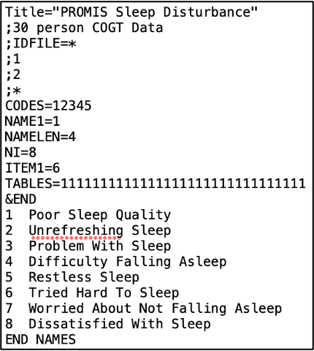
Data Analysis:
Qualitative :
Quantitative:
  Thematic Analysis
  Standardized Methods
    Sleep Disturbance Level based on Health Measures T-cut score charts
  Rasch Analysis
    Statistical analysis using Item Response Theory
    Compare participant's ability level vs. item severity or difficulty
    Provides a deeper understanding of assessment results and proposed use
Notes:
Data Analysis
- Sleep disturbance level: calculated by running the data through the health measures scoring website to get the t-scores and using the score cut off points to determine the level
- rasch analysis: a statistical analysis that utilizes item response theory to better understand and utilize the outcome measure by comparing the participants ability level, to the item severity or difficulty
- qual data

Slide 8
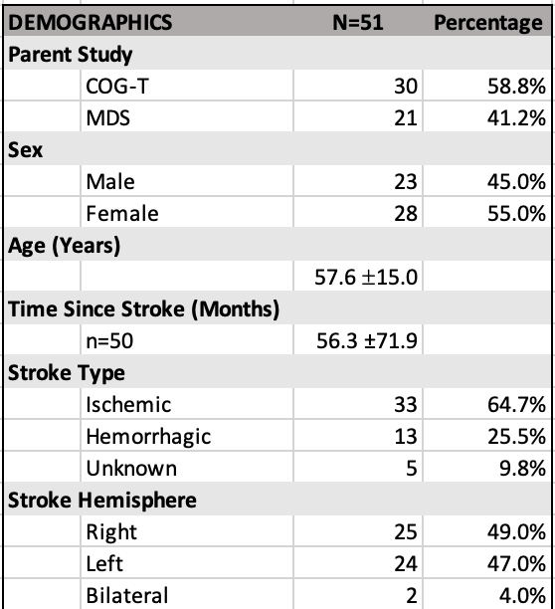
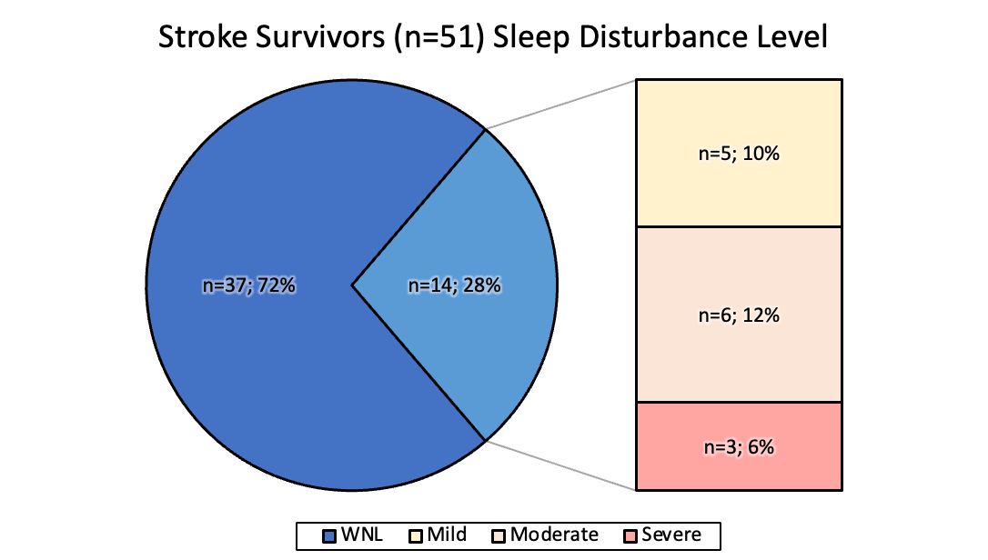
Results - Demographics & Scoring
Table 1
Sleep Disturbance Level
Notes:
Results
- participants (demographics)
Results (quan data)
- standard scores and such (pie chart)

Slide 9

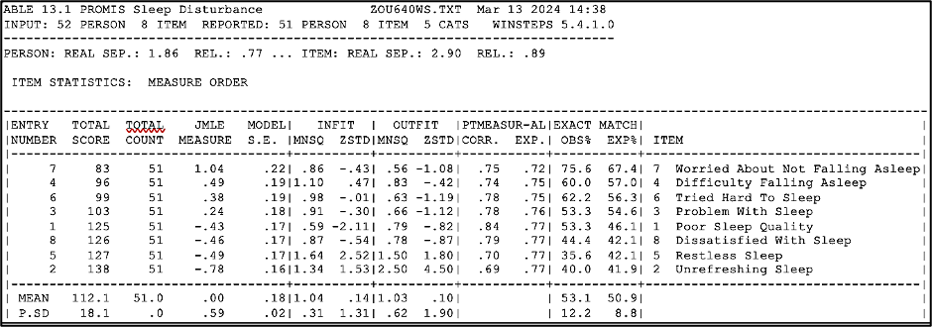

Results - Rasch Analysis
Item Hierarchy :
  Orders items on a continuum of severity
  A higher score on a less severe symptom is less distressing
  A higher score on a more severe symptom is more distressing
Notes:
Results (quan data)
- item hierarchy: orders items on a continuum of severity wit the last severe sleep disturbance behavior being at the bottom and the most severe sleep disturbance behavior being at the top of the continuum

Slide 10
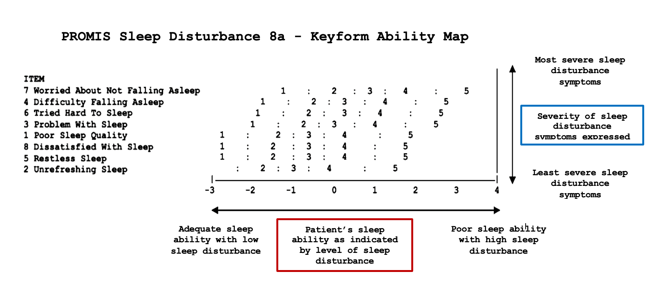

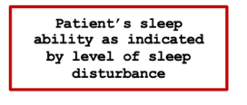
Results/Deliverable - Keyform Map
Notes:
Results (quan data)
- keyform picture
- keyform description

Slide 11
Keyform Map Examples:
WNL SD47 - Score: 13/40
Moderate SD 49 - Score: 35/40
Expected Scores:
Expected Scores:
Score of 1 or 2 on more severe items
Scores of 2-4 on the less severe items
Average score of 4 on all items
Mild SD 32 - Score: 27/40
Severe SD 18 - Score: 38/40
Expected Scores:
Expected Scores:
Score between 1 to 3 on more severe items
Scores between 3-5 on the less severe items
Score of 4 or 5 on all items

Slide 12






Results - Qualitative Data (n=5)
Overall Themes:
100% recognized sleep changes right after stroke in the acute hospital setting
100% recognized these disturbances as a problem after returning to their home environment
80% were provided/recommended medication as the primary treatment for their SD
100% stated the need for non-pharmaceutical intervention
80% reported feeling helpless in addressing their sleep disturbances
Notes:
Results (qual data)

Slide 13
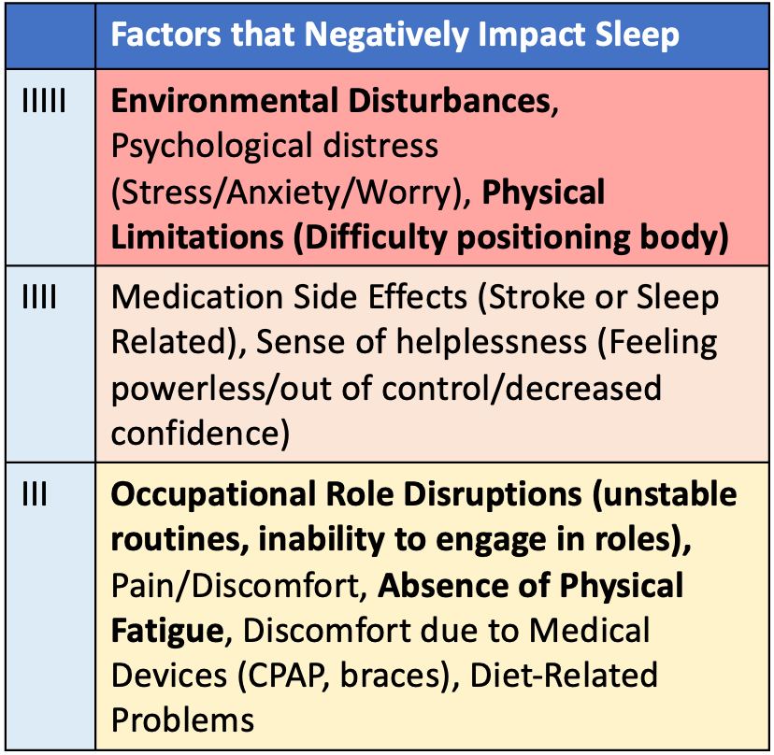
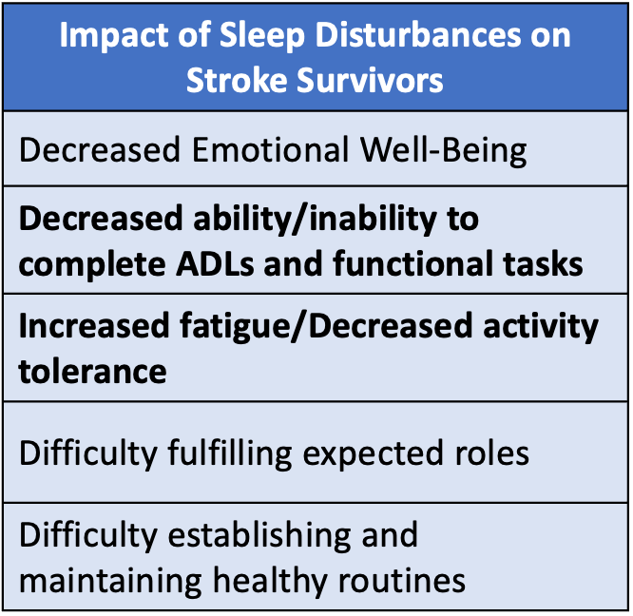
Results - Qualitative Data (n=5)
Overall Themes:
LLow Sleep Ability/Higher SD
Notes:
Results (qual data)

Slide 14
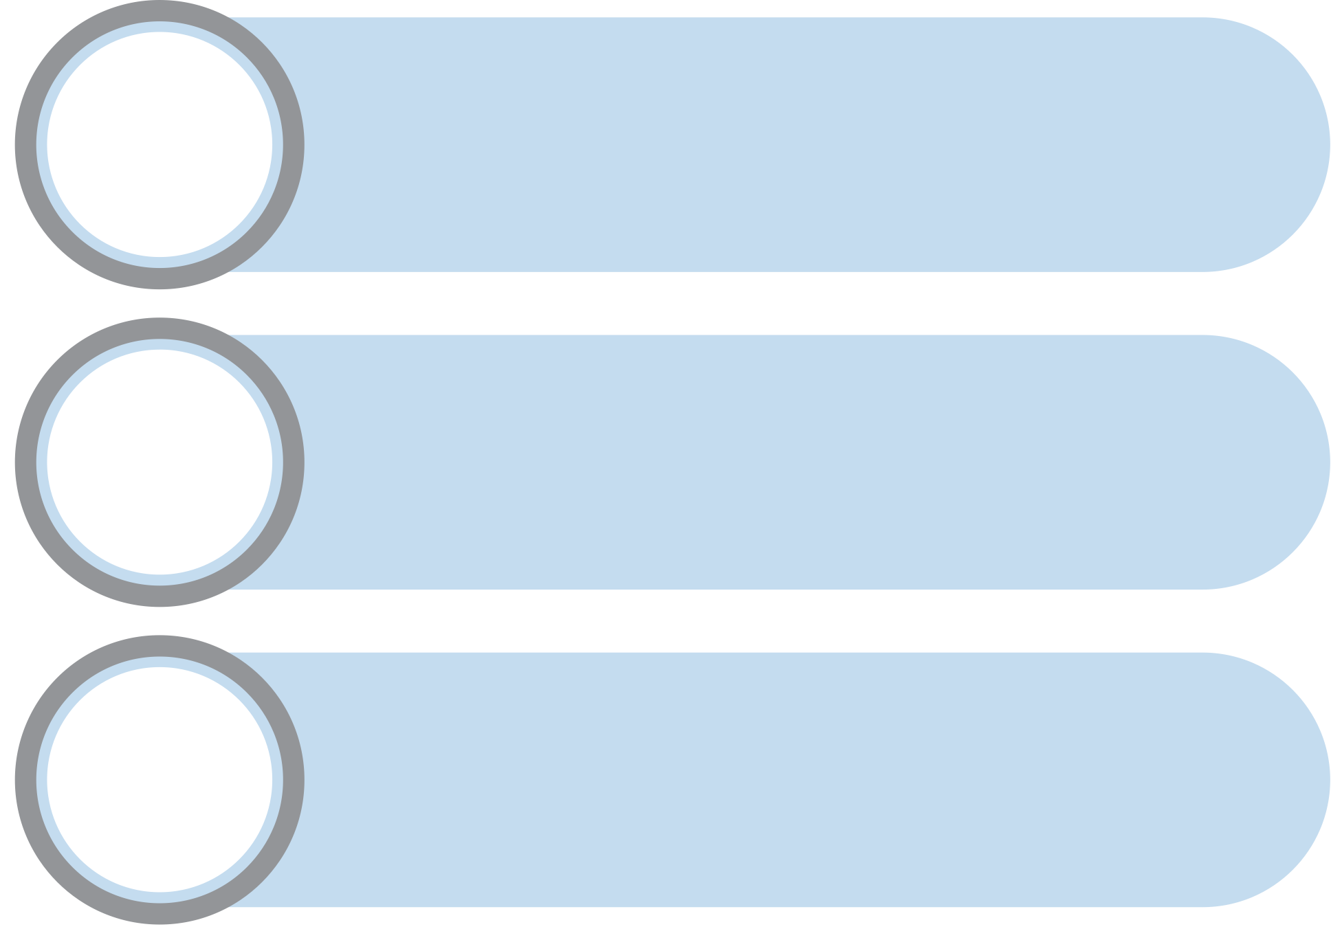
Results - Qualitative Data (n=5)
PROMIS Sleep Disturbance Themes Per Item:
1
Poor Sleep Quality
Restless Sleep
Time spent trying to sleep vs. restful sleep achieved; disrupted sleep; feelings of disappointment
5
Environmental disturbances; tossing and turning; light sleep
Unrefreshing Sleep
Trying Hard to Sleep
2
Decreased activity tolerance; feeling moody/sluggish/miserable/less confident; difficulty getting started
6
No comfort zone in your mind; not physically exhausted; racing thoughts; needing to dull your senses
Having a Problem with Sleep
Worried About Not Falling Asleep
3
Identifiable disturbances that build up (i.e. pain, discomfort, trouble positioning, inability to relax)
7
Use of distraction to avoid sleep; increased awareness but feeling out of control; anxiety
Difficulty Falling Asleep
Dissatisfied with Sleep
4
Emotional difficulties; physical discomfort; long time between laying down and falling asleep
8
Cannot get enough sleep; feeling the need to make up for it during the day
Notes:
Results (qual data)
- thematic analysis
- overall inputs
- 8 questions

Slide 15
Discussion - Case Study: SD 16
Qualitative Information:
  Disrupted routines, with minimal daytime activity
  Fosters animals
  Currently attempting to incorporate exercise into routine
  Struggles to initiate activity in the morning
  Watches TV to delay bedtime
  Nighttime self-care routine delayed until exhaustion
  Takes 3-4 hours to fall asleep, wakes up shortly after
  Perceives sleep as light and shallow
SD Level: Moderate 31/40
Participant Background:
55 y.o. Female, L ischemic stroke, diagnosed sleep apnea with poor adherence to CPAP mask, mild aphasia and cognitive deficits, and minimal physical impairments
Notes:
Case study - Proposed Keyform Use
Participant background: 55 y.o. Female, L ischemic stroke, diagnosed sleep apnea with poor adherence to CPAP mask, mild aphasia, and cognitive deficits
qual info: disrupted routines (not working) with little daytime activity, fosters animals, watches tv at night to avoid going to bed, only begins nighttime routine once exhausted and wakes back up, lays in bed for hours without falling asleep, difficulty initiating activity in morning, constantly feeling like she sleeps lightly/not deep, been trying to start exercising
SD Level: SD 16, Moderate 31/40
Kayform Specific Info:
Use of Keyform:
Proposed Interventions:

Slide 16
Discussion - Case Study: SD 16
SD Level: Moderate 31/40
Proposed Interventions:
  Difficulty falling asleep: stimulus control (time spent in bed trying to sleep, etc.), environmental modifications (ex. pets outside of room), set strict bedtime and wake-up times, sleep hygiene
  Tried hard to sleep: address and restructure nighttime routines, provide exercise recommendations and timing, identify stress-relieving and calming activities
Kayform Observations:
  Score of 5 on items 4 and 6
Notes:
Case study - Proposed Keyform Use
Participant background: 55 y.o. Female, L ischemic stroke, diagnosed sleep apnea with poor adherence to CPAP mask, mild aphasia, and cognitive deficits
qual info: disrupted routines (not working) with little daytime activity, fosters animals, watches tv at night to avoid going to bed, only begins nighttime routine once exhausted and wakes back up, lays in bed for hours without falling asleep, difficulty initiating activity in morning, constantly feeling like she sleeps lightly/not deep, been trying to start exercising
SD Level: SD 16, Moderate 31/40
Kayform Specific Info:
Use of Keyform:
Proposed Interventions:

Slide 17
Discussion:
1
2
3
A keyform map was created from the PROMIS sleep disturbance data and the qualitative data assisted with the interpretation and proposed use of the model.
Project results agree with current literature:
  SD is common, yet remains inadequately addressed and managed
  Stroke survivors are searching for personalized, non-pharmacological, SD interventions
Based on the qualitative data, each PROMIS sleep disturbance item delineated distinct issues that OTs can offer targeted interventions for that is within our scope of practice
Notes:
Discussion
-impact of project
Recap purpose:
Agree with lit
-a lot of them struggle with sleep dis
- not a lot of people are getting proper care
- need for non-pharm tx
promise SD to guide intervention:
- each item of the SD described different problems that we as OTs provide intervention for

Slide 18
Conclusion:
Current Impact:
Next Steps for Site:
Future Impact:
Introduction of a novel tool for OTs and other clinicians in stroke rehabilitation to address SD, potentially improving patient care and outcomes in the clinical and research settings.
  Creation of an intervention manual for addressing SDs in stroke survivors based on keyform map items
  Increase sample size to determine stroke-specific levels of sleep disturbance
Establishing a new standard in OT practice and rehabilitation standards, leading to sustained improvements in stroke patient care and improved patient outcomes
Strengths:
Limitations:
  Innovative approach to addressing SD
  Project was conducted in a research setting following appropriate guidelines
  Utilized mixed methods to ensure stroke survivor input and collaboration
  Small sample size
  Scores may be affected by participants’ cognitive or communication/language deficits
  Multiple research therapists administered questionnaires
Notes:
Future implications
- activity or interventions manual based on the SD items
& Sustainability
- talk about dissemination through a publication

Slide 19
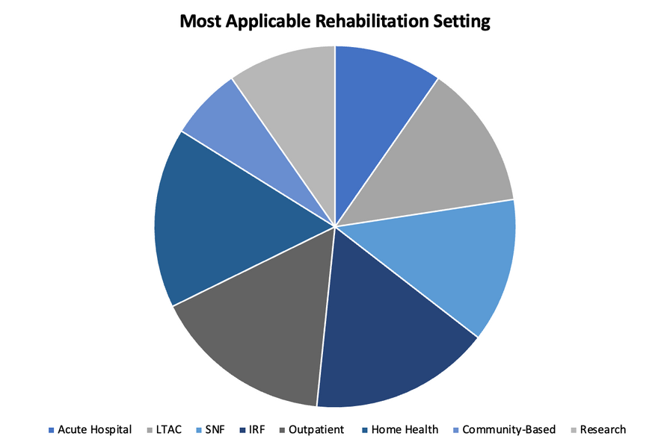
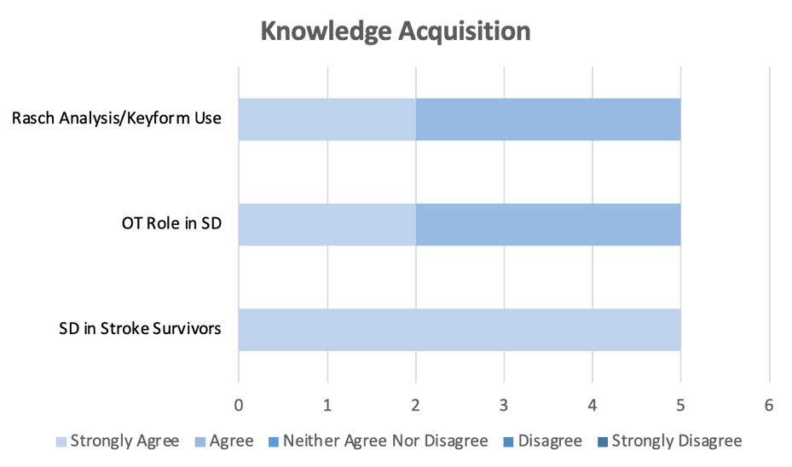
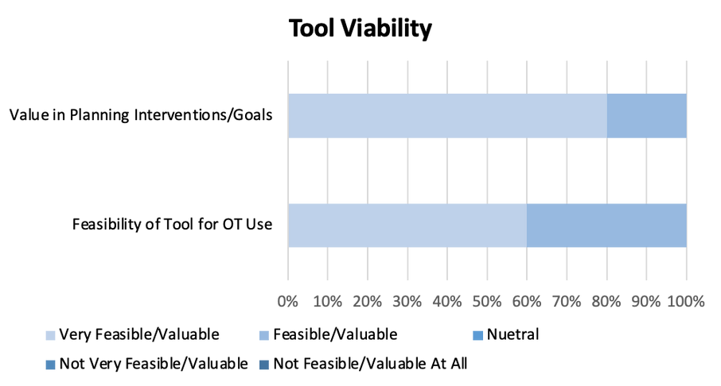
Sustainability:
  Dissemination of project paper and tool to applicable, open-access journals (Student Journal of Occupational Therapy)
  Project continuation through future capstone students
  Introduce project tool to future job sites/facilities for implementation
Project Evaluation Results:
n=5 including OT Clinicians & Students (n=3, n=2)
Notes:
Project Eval Methods & results
- Formative: sleep data questionnaires, qual interviews, feedback from site mentor
- summative: final paper, feedback from OTs and sleep researchers, capstone peers

Slide 20

Student Research Therapist Experience
Notes:
capstone experience title page

Slide 21
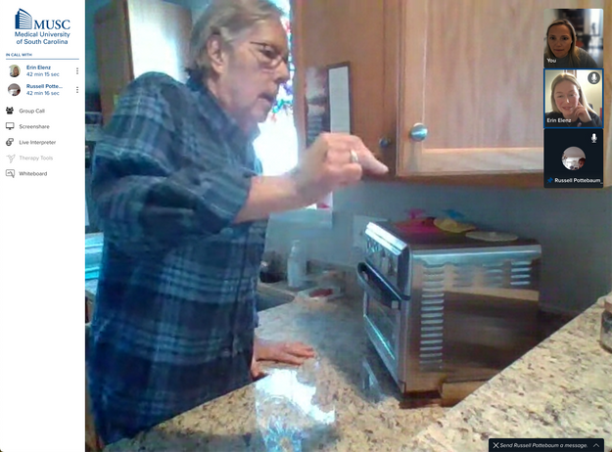
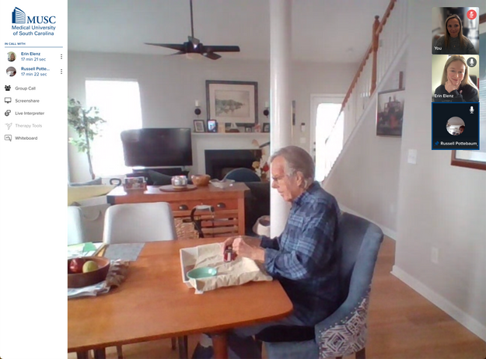
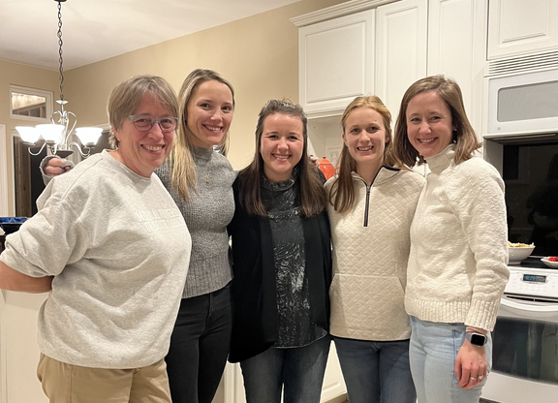
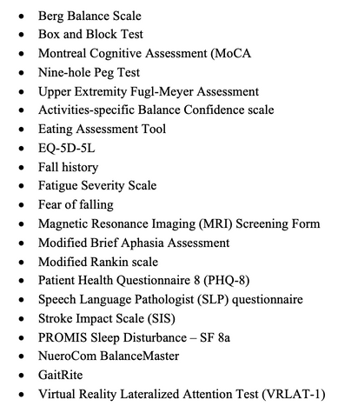
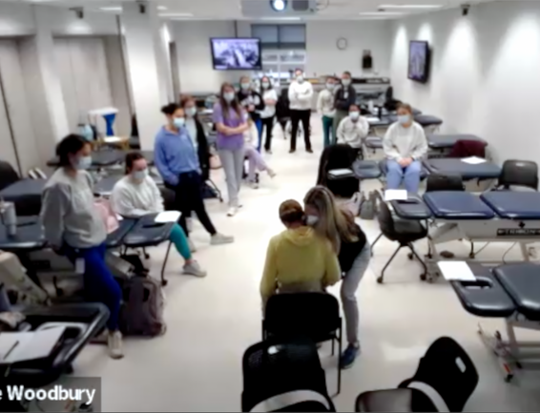
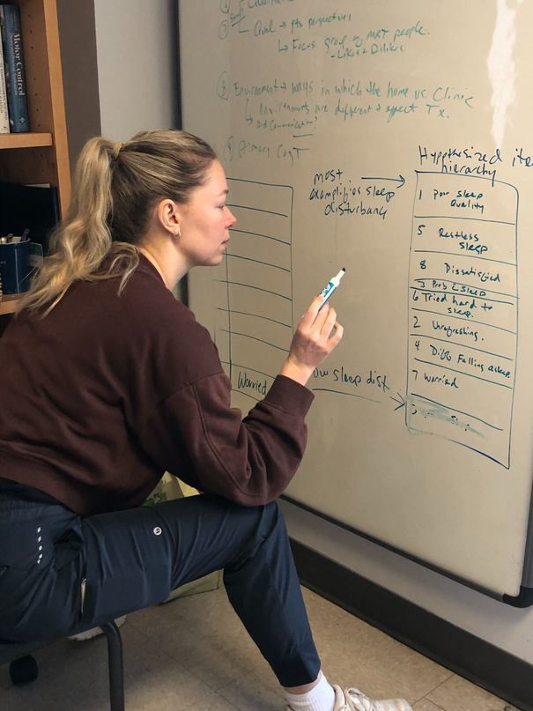
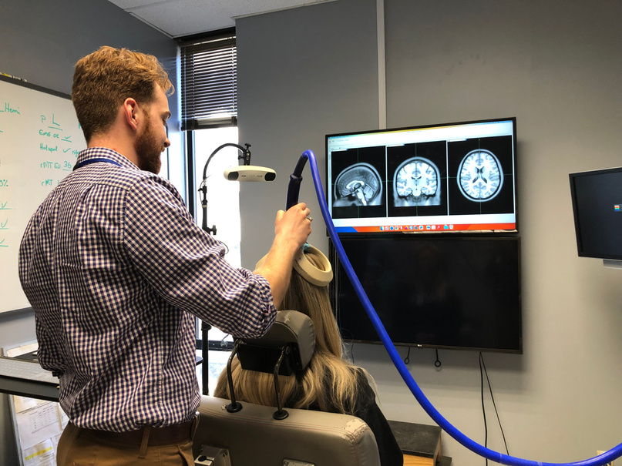
Student Research Therapist Experience:
Measurement-Based Stroke Tele-Occupational Therapy to Improve Community and Home Activity Performance
  Enrollment of participants (5)
    Questionnaires and assessments
    Goal setting
    Actigraph set-up
  Planning and providing telerehab interventions
    Using Fugl Meyer UE Assessment Keyform & Activity Manual
    CO-OP Approach
    Task practice
  Documentation and inputting data
  Post Assessments
Additional Experiences:
  Telerehab Team Member
  MDS - Study Staff
  Stroke Bootcamp Course - Teaching Assistant
  Attended Grant Proposal Presentation
  Experience with Research Technology (TMS, NueroCom, Actigraph watch)
Notes:
experience overview
- MBT study

Slide 22
Acknowledgements
Faculty Mentor and Capstone Site Mentor --- Michelle Woodbury PhD, OTR/L
Telerehab Team and Capstone Co-mentors --- Michelle Woodbury PhD, OTR/L; Kelly Rishe MSOT, OTR/L; Jul Laura MSOT, OTR/L; Patricia Finetto MSOT, OTR/L & Stephanie Garner MScOT, OTR/L, CSRS
Capstone Team --- Katelyn Feeny OTS & Audrey Hartis OTS
Capstone Coordinator --- Joy Crawford OTD, MSRS, OTR/L
Notes:
Acknowledgments

Slide 23
References
Baum, C. M., Christiansen, C. H., & Bass, J. D. (2015). The Person-Environment-Occupation- Performance (PEOP) model. In C. H. Christiansen, C. M. Baum, & J. D. Bass (Eds.), Occupational therapy: Performance, participation, and well-being (4th ed., pp. 49-56). Thorofare, NJ: SLACK Incorporated.
Brown, D. L., Jiang, X., Li, C., Case, E., Sozener, C. B., Chervin, R. D., & Lisabeth, L. D. (2019). Sleep apnea screening is uncommon after stroke. Sleep Med, 59, 90-93. https://doi.org/10.1016/j.sleep.2018.09.009
Frange, C., Murray, B. J., & Coelho, F. M. S. (2023). The Importance of Sleep for Successful Neurorehabilitation after Stroke. Sleep science (Sao Paulo, Brazil), 16(3), e335–e343. https://doi.org/10.1055/s-0043-1772805
Fulk, G. D., Boyne, P., Hauger, M., Ghosh, R., Romano, S., Thomas, J., Slutzky, A., & Klingman, K. (2020). The Impact of Sleep Disorders on Functional Recovery and Participation Following Stroke: A Systematic Review and Meta- Analysis. Neurorehabilitation and neural repair, 34(11), 1050–1061. https://doi.org/10.1177/1545968320962501
Hasan, F., Gordon, C., Wu, D., Huang, H. C., Yuliana, L. T., Susatia, B., Marta, O. F. D., & Chiu, H. Y. (2021). Dynamic Prevalence of Sleep Disorders Following Stroke or Transient Ischemic Attack: Systematic Review and Meta-Analysis. Stroke, 52(2), 655- 663. https://doi.org/10.1161/STROKEAHA.120.029847
Ho, E. C. M., & Siu, A. M. H. (2018). Occupational Therapy Practice in Sleep Management: A Review of Conceptual Models and Research Evidence. Occupational therapy international, 2018, 8637498. https://doi.org/10.1155/2018/8637498
Jeffers, M. S., Pittman, A. C., Kendzerska, T., Corbett, D., Hayward, K. S., & Chen, Y. (2023). Self-reported sleep disturbances among people who have had a stroke: a cross-sectional analysis. CMAJ : Canadian Medical Association journal = journal de l'Association medicale canadienne, 195(10), E354–E362. https://doi.org/10.1503/cmaj.221063
Väyrynen, K., Kortelainen, K., Numminen, H., Miettinen, K., Keso, A., Tenhunen, M., Huhtala, H., & Himanen, S.-L. (2014). Screening Sleep Disordered Breathing in Stroke Unit. Sleep Disorders, 2014, 317615. https://doi.org/10.1155/2014/317615
Notes:
references

Slide 24
THANK YOU!
I INVITE YOU TO OFFER FEEDBACK & ASK QUESTIONS
Notes:
end page
- insert QR code

