Slide 1
Creating Mental Health Resources for Veterans and Caregivers at the Charleston Fisher House
Ashley Edwards, OTDS
Faculty Mentor: Scott Hutchison, OTD, OTR/L
Site Mentor: Erik Zielinski

Slide 2
Overview of the Fisher House
The Charleston Fisher House serves families and caregivers of veterans admitted to a non-local Veterans Administration (VA) hospital and provides free lodging, food staples, a kitchen, and laundry services ​(Friends of Fisher House Charleston, 2022)​
There are 16 private rooms
5,790 guests have stayed at the Charleston Fisher House since it opened in 2018 (Anderson, 2024)
https://www.va.gov/charleston-health-care/programs/fisher-house/
Notes:
Guests must live more than 50 miles from VA or other downtown hospital
"Family is good medicine" motto

Slide 3
Background and Significance
Caring for a loved one can add significant stress to a caregiver, especially if they have financial obligations, other dependents, or must plan for long-term care (Adelman et al., 2014)
There are limited mental health supports at the Charleston Fisher House for families caring for a veteran being treated at the hospital (Zielinski, 2022)
Identified Need:
Resources for different approaches to improve mental health and reduce stress
Education to increase knowledge on ways to improve mental health
Notes:
approximately 27,000 people stay at a fisher house yearly

Slide 4
Project Purpose and AIMS
Purpose
To improve the mental health of guests staying at the Fisher House through evidence-based practice interventions
AIM 1
To develop a sustainable, evidence-based toolkit to decrease stress and improve mental health in Fisher House guests
AIM 2
To obtain knowledge on evidence-based practices relating to mental health and gain experience educating others and creating resources

Slide 5
Supporting Framework
The Person-Environment-Occupation-Performance (PEOP) Model
Occupation: caring for the veteran, potential career
Person: spirituality, stress levels, physical and mental health illnesses
Environment: staying at the Fisher House or VA hospital and preparing to go home, social factors
Occupational Performance and Participation
Performance is influenced based on enablers and hindrances from self and environment
Well-Being
Quality of Life
Notes:
Person: Intrinsic factors such as spirituality, cognition, psychological state, physiological state, etc.
Environment: extrinsic factors such as culture, social support, home environment, etc.
The person and environment influence each other to complete the desired occupation
Top-down model
Include an example of a guest

Slide 6
Population/ Stakeholders
Veterans and their loved ones
Family members or caregivers are at least 18 years old, though some minors come with parents
Guests are mainly from South Carolina and Georgia
Staff, volunteers, and the Charleston Friends of the Fisher House Board
9 full-time staff members

Slide 7
Methods
The capstone was MUSC IRB approved as a quality improvement project
15 veterans and 21 caregivers completed the initial survey January-February 2024
Interviewed 5 caregivers and 1 veteran
Guests filled out surveys after each educational class
A survey was available with the mindfulness craft box
Strengths:
Supportive staff, good advertising for activities, access to supplies, time to talk to guests and know them on a personal level
Weaknesses:
High turnover and individual schedules made classes difficult to schedule
Unable to get enough guests together to do a support group
Notes:
Interviewed guests and asked about life satisfaction, mood, MH strategies they've tried, and wanted to learn, and their experience at the FH

Slide 8
Initial Survey Results
81% of caregivers are spouses or partners
76% of guests stay 1-3 days
Initial mental health: (based on reporting "some of the time” or more)
58% of caregivers (33% veterans) felt stressed during their stay
40% of caregivers (39% veterans) felt anxious
35% of caregivers (27% veterans) felt overwhelmed
30% of caregivers (20% veterans) felt depressed
Most helpful resources at the Fisher House prior to project implementation:
Having food provided (78%)
Support from staff (67%)
Support from others (47%)
Journal in room (35%)

Slide 9
Types of Resources Requested (n=36 individuals)
Number of Guests

Slide 10
Mental Health Topics Requested (n=36 individuals)
Number of Guests
Notes:
Suicide awareness has several resources from VA, and I put a blurb on CSP handout about it

Slide 11
Deliverables
Toolkit included:
5 mental health handouts, 2 Fisher House requested handouts
Signs of Anxiety, Depression, and PTSD and Holistic Ways to Help
Time Management and Productivity
Stress Management
Sleep Hygiene
Positive Affirmations, Mantras, and Mindfulness
VA Caregiver Support Program and Caregiving Resources
Decedent Information
Guidebook with ideas for educational classes, activities, and other information
Notes:
Anecdote: a woman came and told me she applied and learned she could be paid as a caregiver through VA CSP handout

Slide 12
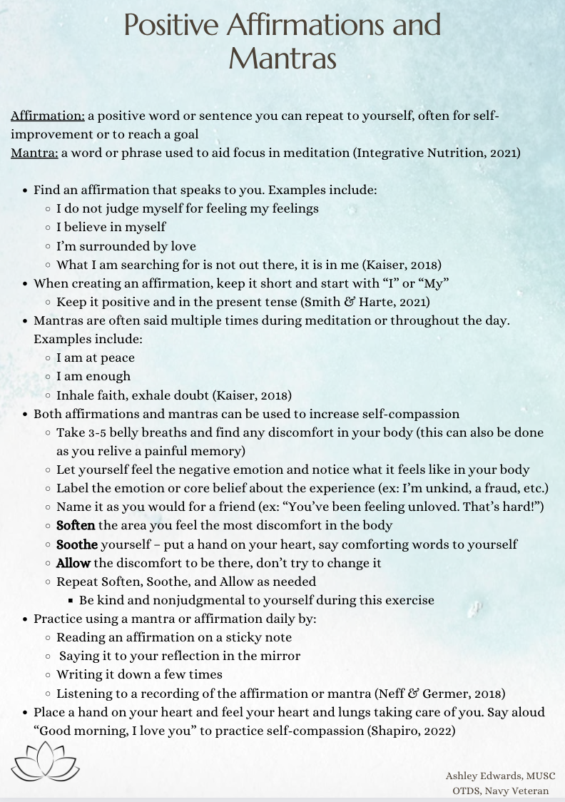
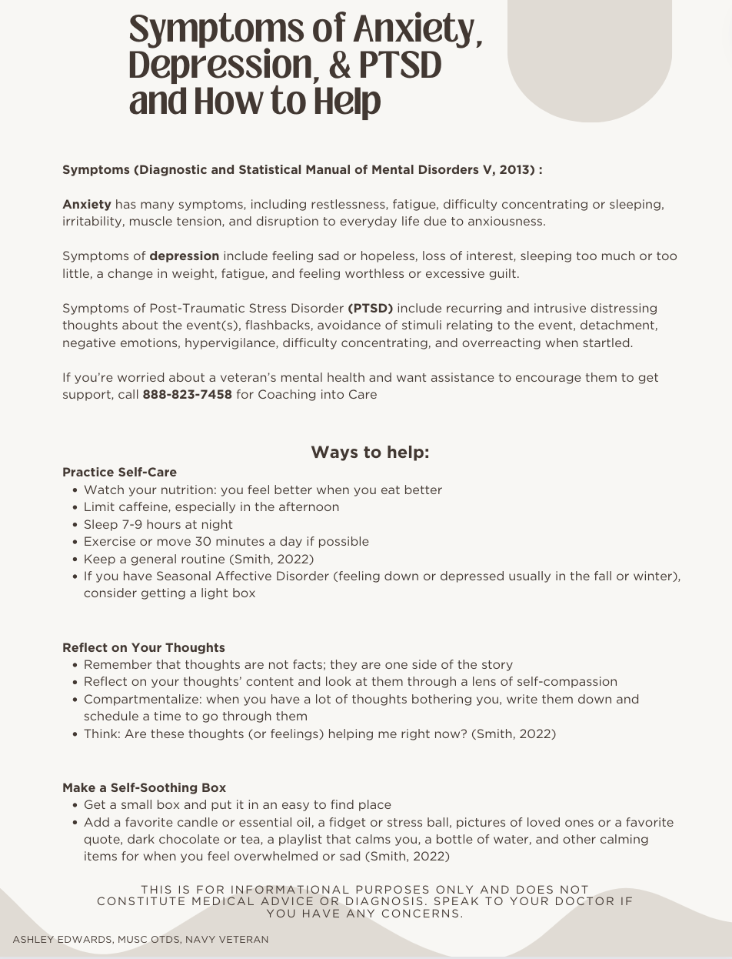
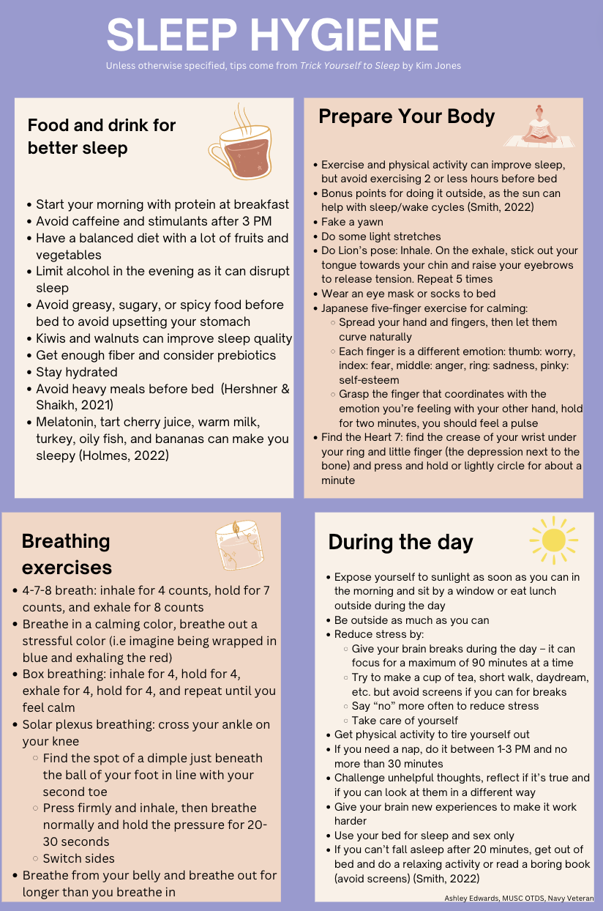
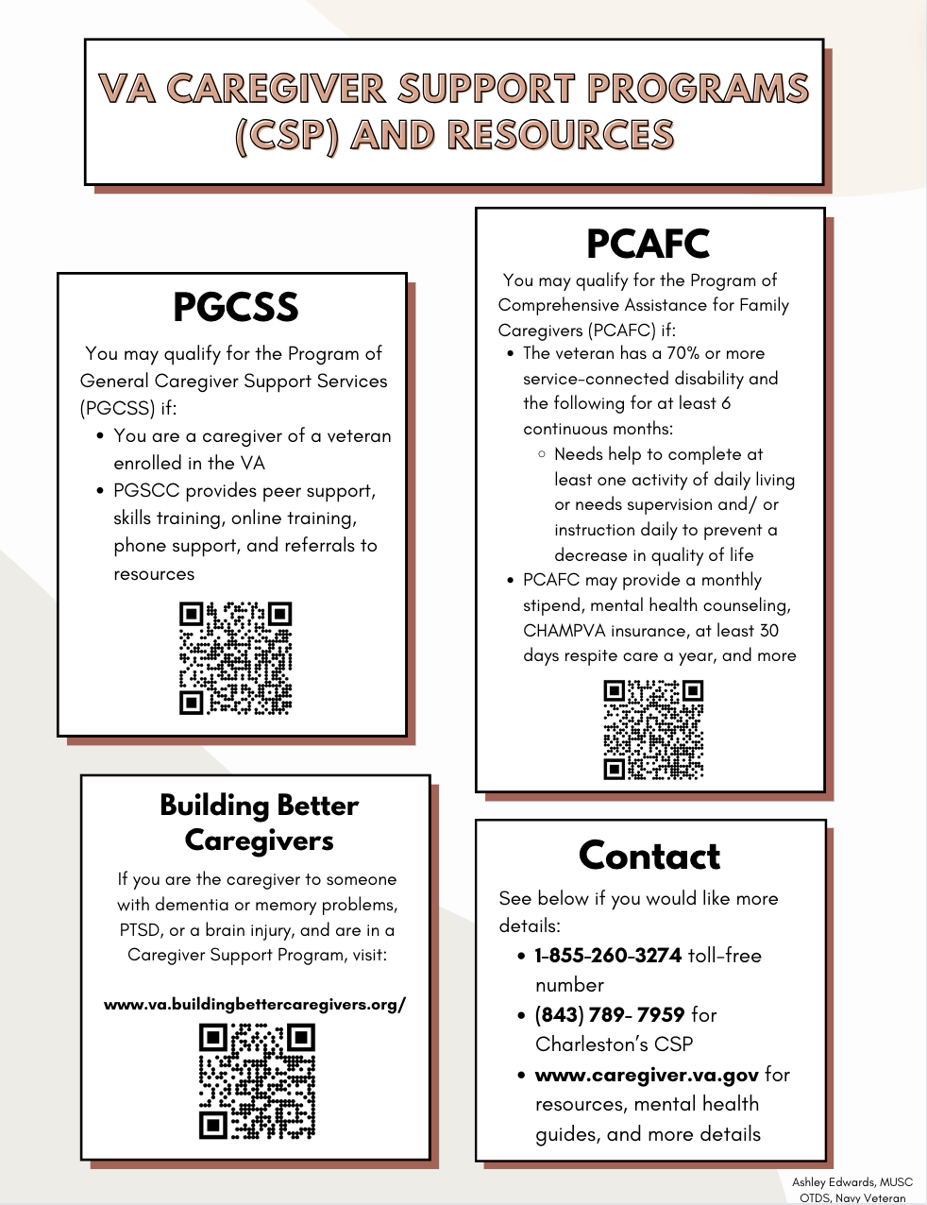
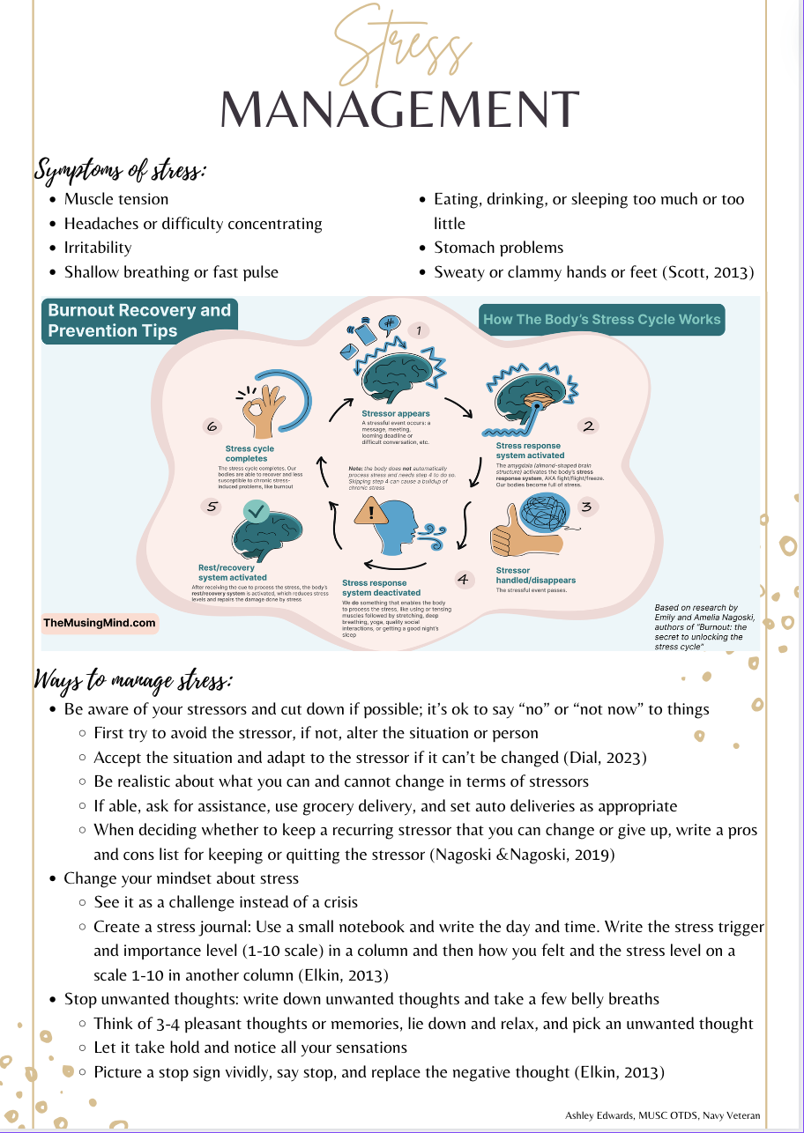
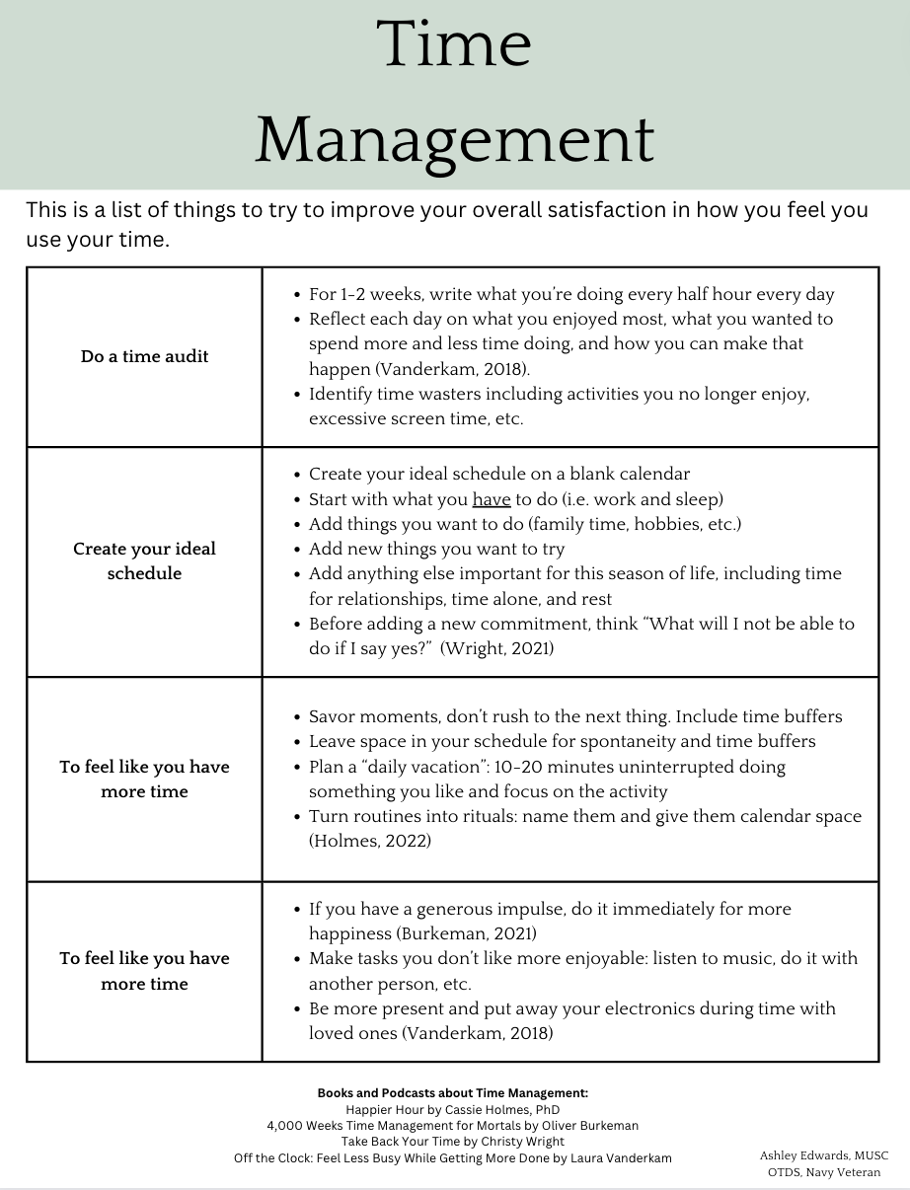
Notes:
Decedent: for when veteran dies, FH gives bereavement basket
Sleep hygiene and time management I had to print more of
Each handout is 3 pages 2 of info, one with sources and additional books, sites, or podcasts

Slide 13
Mental Health Classes
Three classes were taught to guests:
Anxiety, depression, PTSD and holistic ways to help
Time management and productivity
Stress management
Each class was 15-30 minutes, based on guests' participation
Started with a mindfulness activity
Reviewed handout
Class discussion about how to apply techniques and recognize bodily sensations of stress or discomfort
88% of attendees reported they would use the information most days or daily
88% of attendees reported the mindfulness activity was helpful
Notes:
Mindfulness activities such as deep breathing, mindfully eating, etc.
Classes were taught at different times of day (one earlier morning, one around 10 AM, one in the evening)
Handout, group sharing, and information all scored the same for most helpful part of class

Slide 14
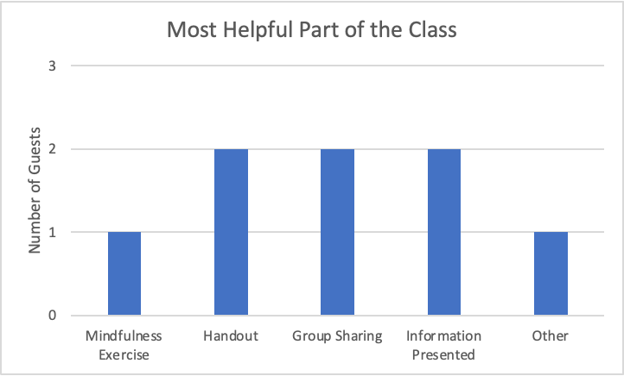
Educational Class Results (n=8)
Notes:
** explain no one disagreed though there was an option

Slide 15
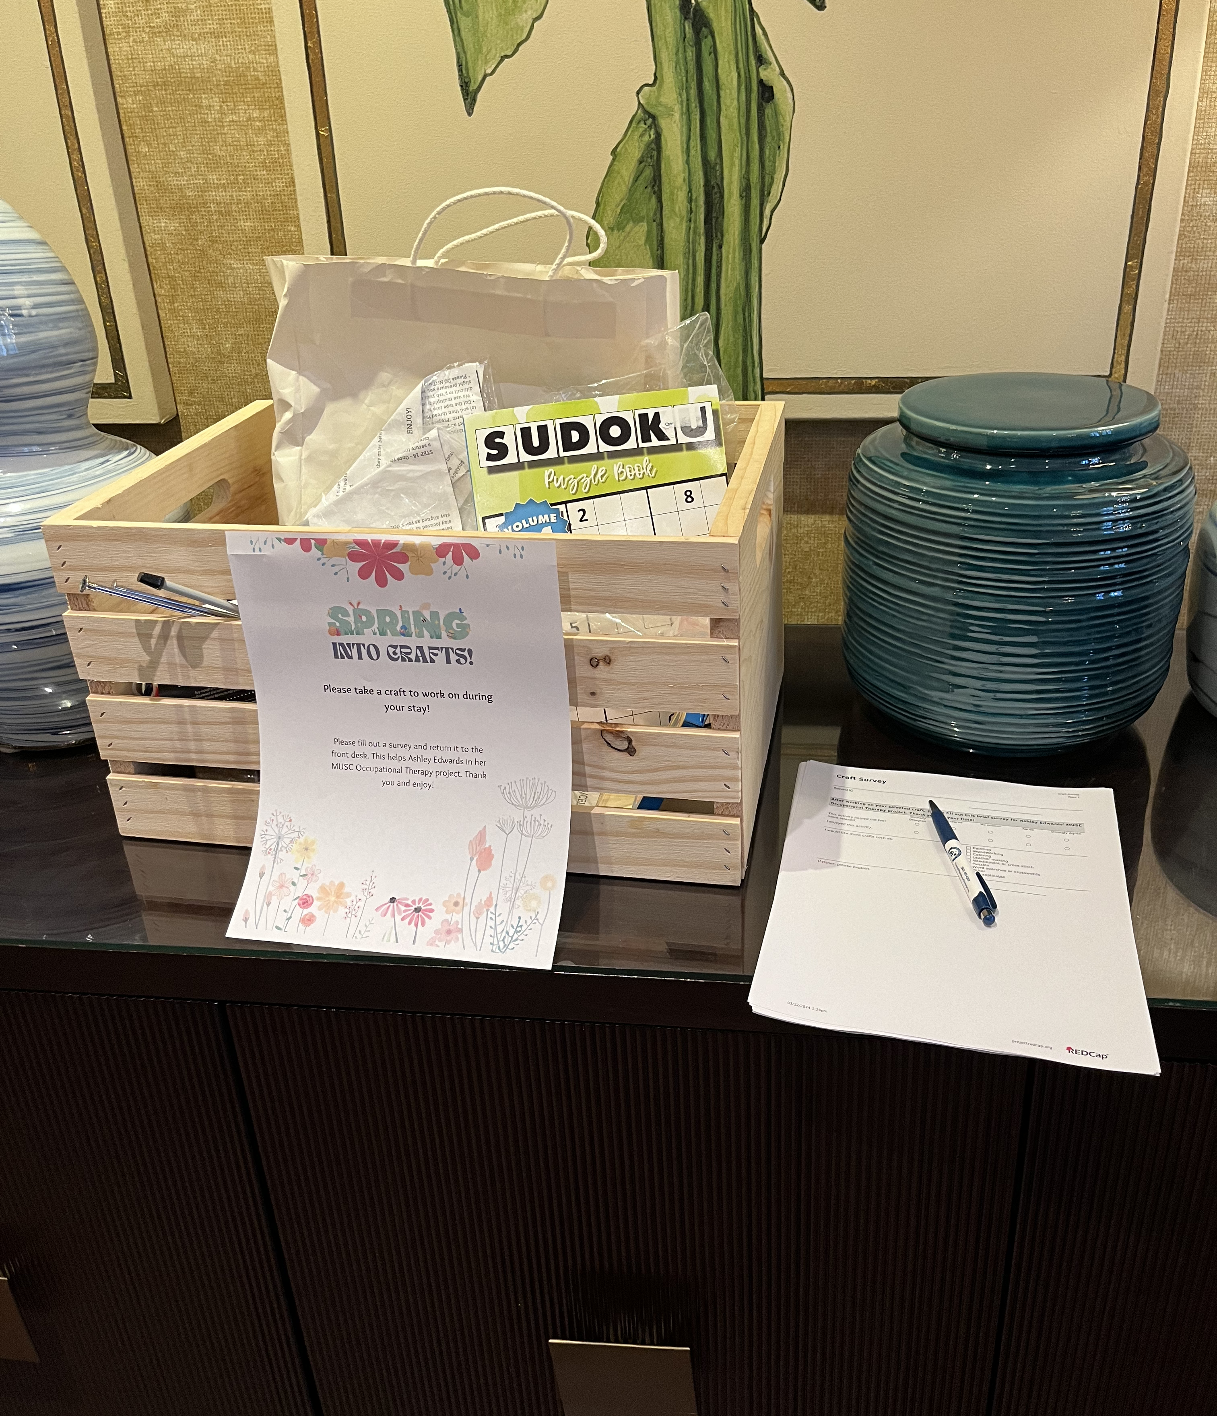
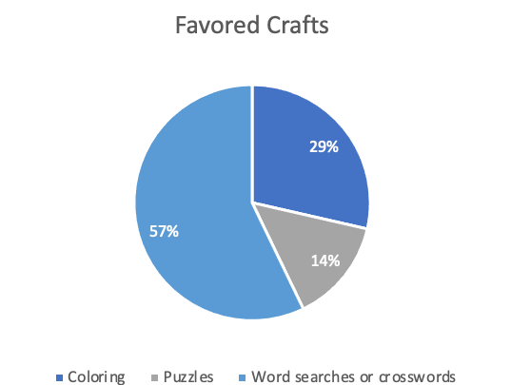
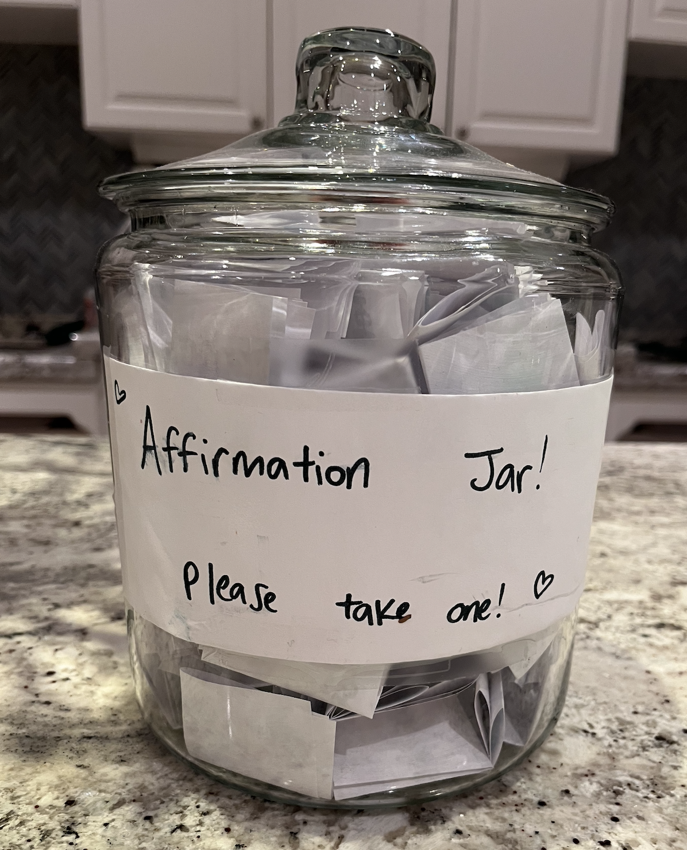
Craft Box Data
n=4
100% of participants agreed or strongly agreed that they enjoyed the activities and felt more relaxed
Notes:
Box included crosswords, word searches and sudokus, painting activities, leatherworking and wood working, crocheting, and cross-stitch
Anecdote: people said they used the affirmation jar daily (3 people)

Slide 16
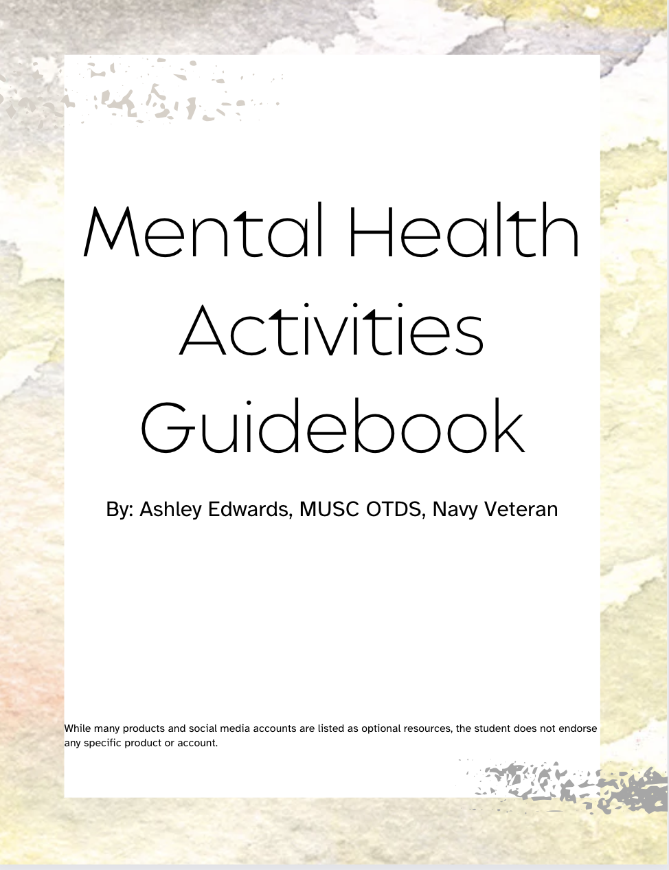
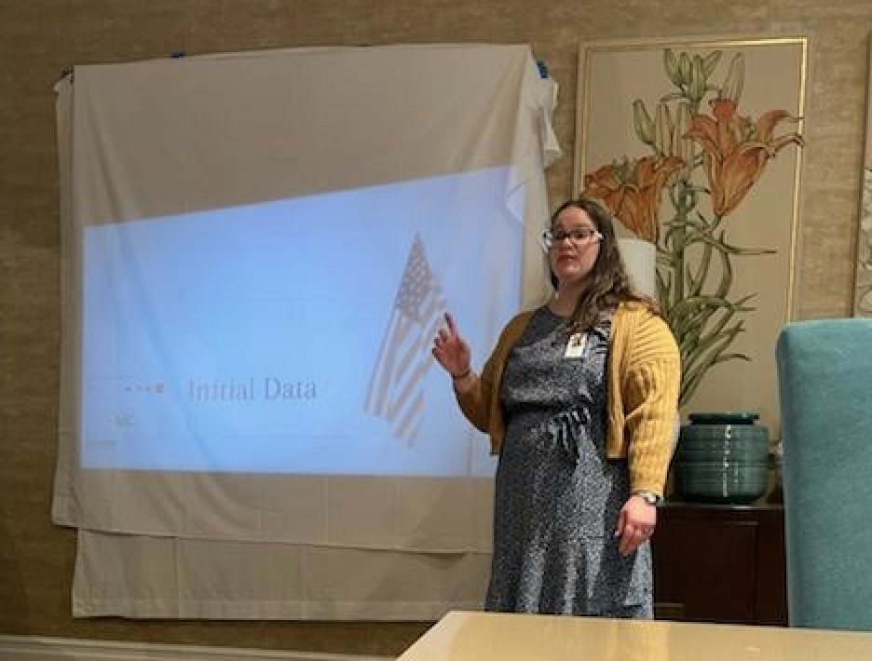
Deliverables Continued
Presentation to staff on handouts, information gathered, and ideas for sustainability
Handouts were uploaded to Fisher House Drive allowing national access to 52 Fisher Houses nationwide
Also added to the rooms and placed in the foyer
Manuscript was submitted to OT Practice magazine on how to gather data and create mental health interventions
A guidebook with mental health activities was printed and given digitally to staff
Notes:
Guidebook was uploaded to a national storage site for other Fisher Houses to use with ideas for implementing and sustaining activities. Lists lesson plans for the classes taught,

Slide 17
Potential Impact
Based on the literature and results of the survey, caregivers are stressed, anxious, and/or overwhelmed at least some of the time
There is a need for greater knowledge of holistic techniques and activities to improve mental health
Occupational Therapy Practitioners should be familiar in addressing the whole self, including any mental health challenges affecting ability to engage in activities of daily living that a patient may be facing
Article was submitted to OT Practice magazine to further disseminate findings and student's experience

Slide 18
Conclusion
Successful outcomes:
Improved ability to address mental health challenges holistically
Increased skills to educate caregivers and clients on mindfulness strategies through classes, activities, and creating educational resources
Initiated various activities and classes at the Charleston Fisher House to educate guests on mental health strategies and how to decrease stress

Slide 19
Acknowledgments
I would like to thank Mr. Erik Zielinski, Ms. Charity Anderson, Mr. Sheldon Jarmon, and Mr. Percy Jones for their support during my time at the Fisher House
I would also like to thank Dr. Scott Hutchison for his support and mentorship
Thank you to Dallin Edwards for his continuous love and support for me and our daughter

Slide 20
References
Adelman, R. D., Tmanova, L. L., Delgado, D., Dion, S., & Lachs, M. S. (2014). Caregiver Burden: A Clinical Review. JAMA : The Journal of the American Medical Association, 311(10), 1052-1060. 10.1001/jama.2014.304
Anderson, C. (2024). In Edwards A., Staff Meeting
Friends of Fisher House Charleston. (2022). Friends of Fisher House Charleston. Retrieved 15 August 2022, from https://friendsoffisherhousecharleston.org/
​Houses - Fisher House Foundation. (2022). Fisher House. Retrieved Aug 10, 2022, from https://fisherhouse.org/programs/houses/
​Zielinski, E. (2022). In Edwards A., Hutchison S. (Eds.), Capstone Meeting

Slide 21
Questions?

