Slide 1
Peer Support for Stroke Survivors
Doctoral Capstone Defense
MUSC Stroke Recovery Research Center
Brooke Garfield, OTD-S

Slide 2
Negative health outcome of a stroke
Peer support provides
An opportunity to connect with people who have gone through similar experiences
A supportive learning environment
A chance to engage in stroke-related discussions
Depression
Functional impairments
Decrease QOL
Inclusion of peer support can
Improve well-being
Increase QOL
Alawafi et al., 2021
Bello et al., 2020
Gucciardi et al., 2019
Soundy & Reid, 2019
Notes:
The effects of a stroke are substantial and possibly life-altering. A stroke can cause mental, physical, emotional and psycho-social impacts. Strokes affect people in different ways, but common health outcomes include depression and functional impairments. Unfortunately, strokes can result in decreased engagement and participation in ADLs and stroke survivors commonly report a decrease in QOL post-stroke.
The opportunity to be part of a peer support group allows stroke survivors to connect with people who have gone through similar experiences and can truly understand what they are going through.
A quote from my needs assessment “Being able to share the experience with others was helpful because I felt isolated. It was therapeutic and reassuring to listen to everybody and know you’re not alone.”
Peer support groups provide a supportive learning environment and give survivors the opportunity to engage in stroke-related discussions.
The inclusion of peer support can improve stroke survivors self-management, well-being, and overall QOL.
The findings of my literature reviews and needs assessment suggest the role peer support plays in the stroke recovery process is positive and powerful.

Slide 3
Problem
Transportation
Gap
Lack of access to peer support
Significance
Detrimental to stroke recovery
Mobility
Distance to resources/facilities
Barriers associated with in-person support groups
Opportunity
Overcome obstacles associated with in-person support groups
Bello et al., 2020
Notes:
Even though the inclusion of peer support is so important, many people do not have access to in-person support groups. Barriers preventing individuals from attending support groups include transportation issues, mobility or distance to resources and facilities. The lack of access to peer support can be detrimental to survivors’ recovery potential.

Slide 4
Conduct a support group for stroke survivors on a social media platform, allowing individuals accessible peer support.
Project purpose
Chen & Wang, 2021
Notes:
The purpose of my capstone project was to conduct a support group for stroke survivors on a social media platform, allowing individuals accessible peer support. Evidence-based research suggests that social media can be an effective platform in healthcare by providing accessible quality health education, advice, and information to social media followers. A virtual support group avoids the obstacles associated with in-person sessions.

Slide 5
Experience aims
2. Gain an in-depth knowledge of stroke recovery & peer support groups
3. Strengthen/demonstrate leadership & clinical skills
1. Learn how to create & market a virtual support group
Project aims
2. Conduct a virtual peer support group
3. Positively impact the lives of the participants
1. Increase access to peer support
Notes:
Here, the first column lists the aims of my capstone experience that guided me to achieve my projects’ aims, which is listed in the second column.
1st I learned how to create and market a virtual support group, in order to increase access to peer support.
2nd I gained an in-depth knowledge of stroke recovery and peer support groups, in order to prepare myself and be well-equipped to conduct my own group.
3rd I strengthened and demonstrated my leadership and clinical skills, in order to positively impact the lives of the participants.

Slide 6
1. Learned how to create & market a virtual support group
Increased access to peer support
Created platform
Recruited participants
Developed a clear understanding of the roles & responsibilities of a group facilitator
2 care partners
4 stroke survivors
Notes:
I developed clear understanding of a group facilitator, to best prepare me for this role.
I explored reliable sources online
I reached out to contacts through the Stroke Recovery Research Center to raise awareness of my project and recruit participants.
I was aiming for 5-10 people, to build a tight-knit group dynamic that encouraged participation. Originally, I had planned on all the group members being stroke survivors, but as my project evolved, care partners were included. My group consisted of 4 stroke survivors and 2 caregivers, which worked out well as it allowed us to hear and learn from different perspectives.
Created platform

Slide 7
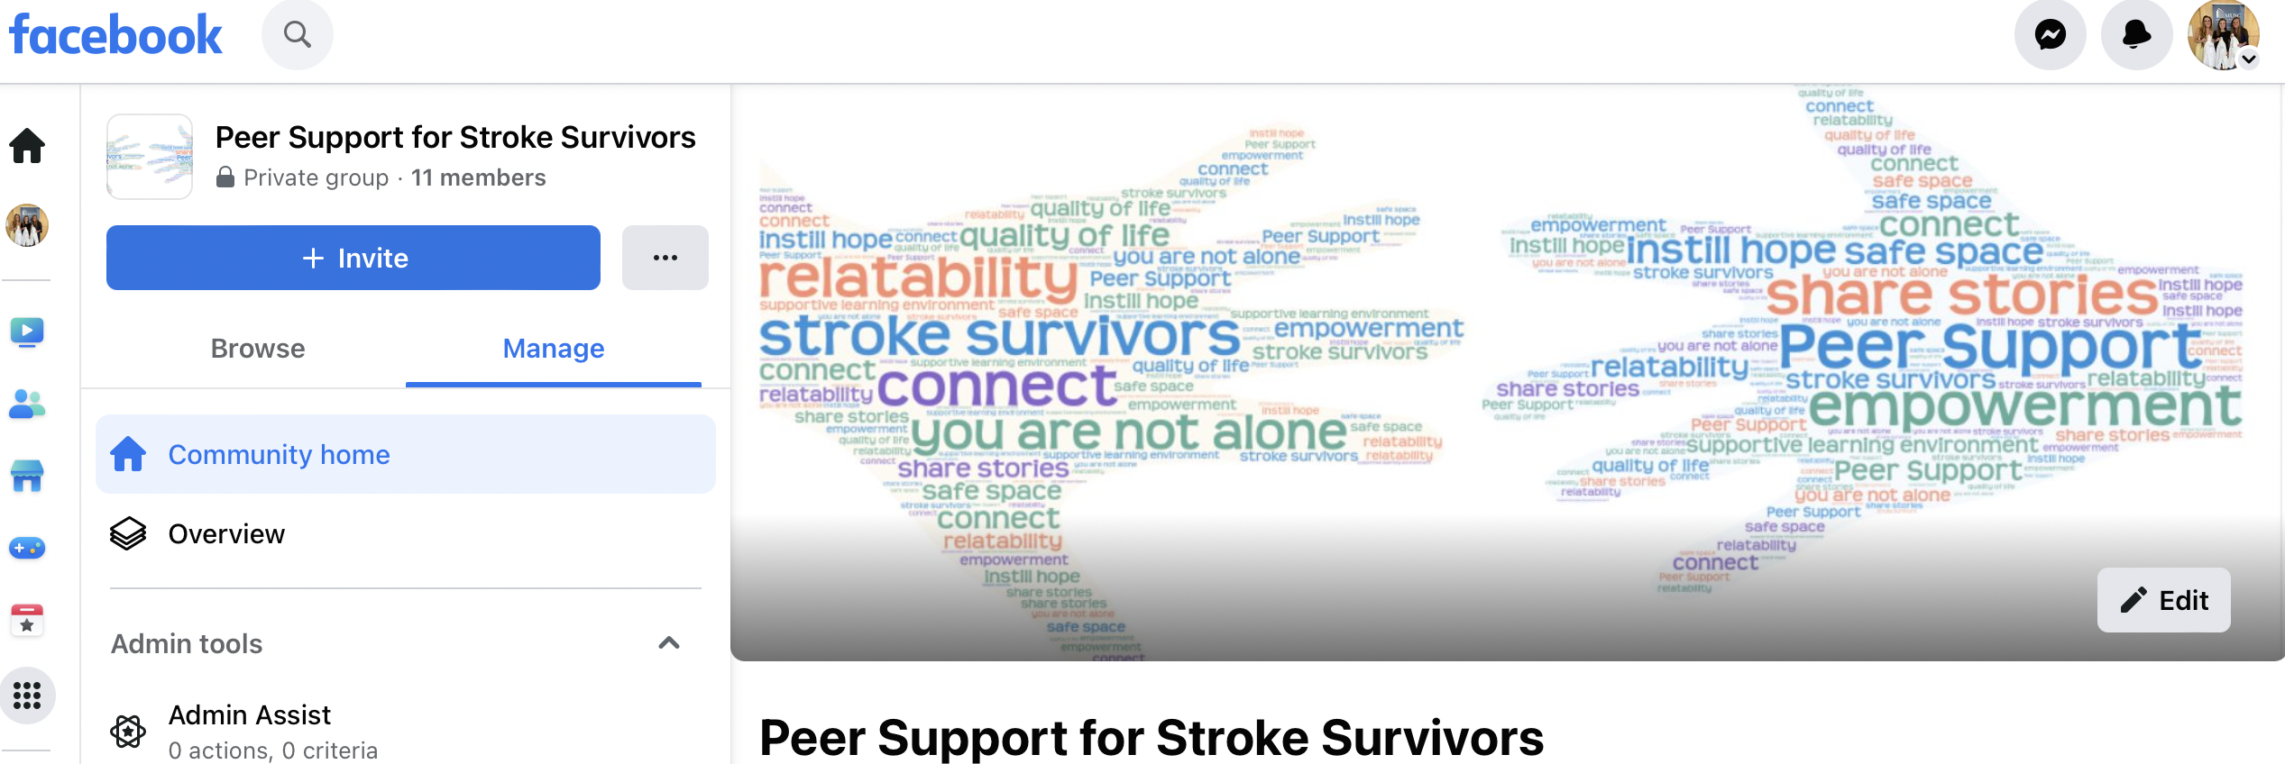
PEOP Model
Notes:
SS of the platform = FB since the results from needs assessment suggested this is the preferred form of social media
I created and conducted my support group, following the PEOP Model, focusing on one’s intrinsic factors (which is the p for person), their extrinsic factors (which is the e for environment), and how these factors impact their occupational performance (the OP).
Sent participants friend requests → invitation to join the private group
Once the participants all had access to the FB group, it was a convenient way to post information and share announcements with everyone at once.

Slide 8
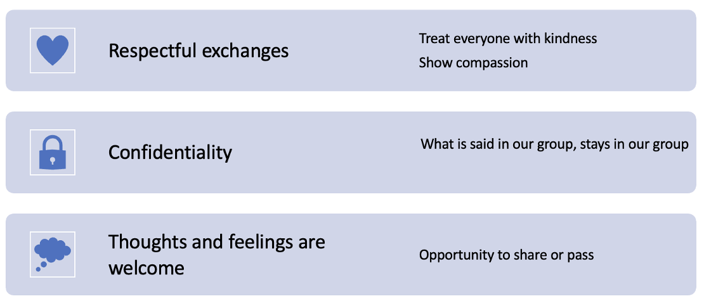
Ground rules
Notes:
I came up with these ground rules for my group because through my research I learned the importance of doing so to establish expectations.

Slide 9
2. Gained an in-depth knowledge of stroke recovery & peer support groups
Conducted a virtual peer support group
Hosted “Meet & Greet” Zoom
Tech prep
Learn from experts
Created a poll to determine participants availability
Research
Observation
Notes:
I engaged in extensive research to learn in depth knowledge about post-stroke life, stroke recovery and how to successfully lead a peer support group.
I spent time doing further lit searches, I listened to audio-podcasts, and I watched educational videos.
And observed another virtual peer support group “Young and young at heart” to learn from other group facilitators and experts in this area.
While I knew tech issues were likely to occur, I wanted to do everything I could on my end to avoid them or be best prepared to manage them.
I familiarized myself with zoom
I practiced 2 test calls prior to the 1st call.
I also sent the participants clear and concise instructions on navigating Zoom and offered to help further to maximize attendance and participation.
MUSC’s IT team upgraded my zoom account, so I was able to host calls for unlimited time periods, which was so helpful, because it eliminated the worry of running out of time and the process of re-joining a different meeting.
I created a poll to determine everyone’s availability
I hosted a “Meet & Greet Zoom” so we could all meet virtually.
I put together a PPT to elaborate on the plans I had for my support group, so I’ll share some of the slides from that.

Slide 10
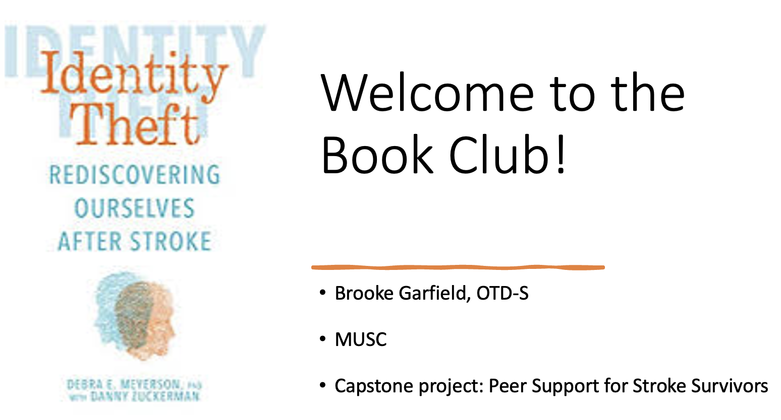
Notes:
As part of my project, I led a book club within my peer support group. We read the book “Identity Theft”, which is about the author, Debra Meyerson’s personal stroke recovery journey along with experiences of other survivors she interviewed.

Slide 11
Notes:
Debra Meyerson and her husband Steve founded an organization called Stroke Onward, raising awareness on how important the emotional journey is post-stroke, and the lack of resources there are. I signed up for access to Stroke Onward materials and resources for support group facilitators, which I used to help guide my book club discussions.
Leading up to our Zoom sessions, as I reviewed the material, I decided which questions to emphasize, edit, add onto to maximize meaningful discussions or skip over for time management.
https://strokeonward.org/bggroup/

Slide 12
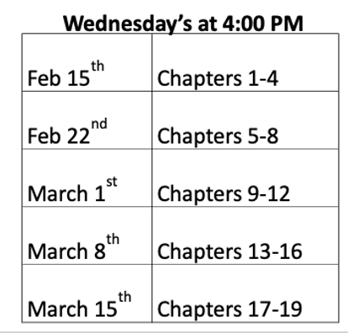
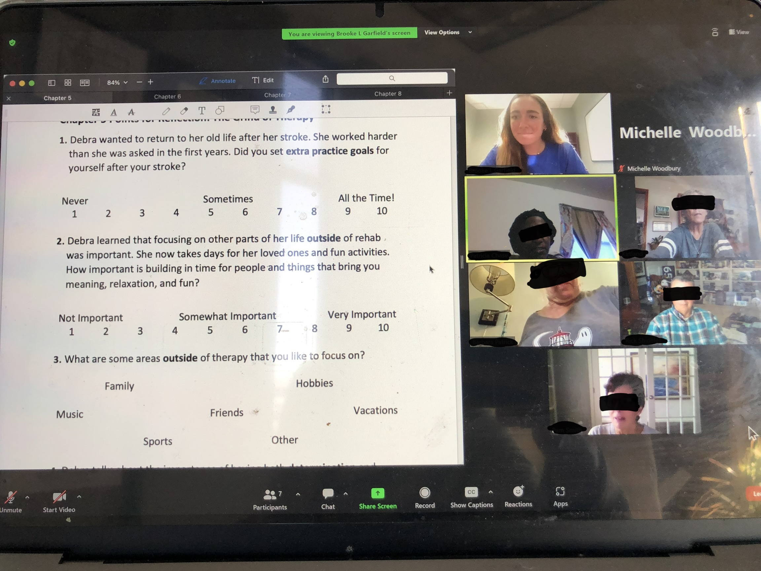
Tentative book club schedule
~1 hour discussions on Zoom
Notes:
Here was the tentative schedule I made for live book club discussions on Zoom.
Some weeks it was difficult to find a time that all the participants were available, so this schedule changed several times.
I wanted to be as accommodating and flexible as possible to increase participation and engagement, But this screenshot gives a general idea of the timeframe.
Each week, we would meet on Zoom for around 1 hour and discuss 3-4 chapters.

Slide 13
3. Strengthened/demonstrated leadership & clinical skills
Positively impacted the lives of the participants
Self-directed learning
Monitored FB group & facilitated discussions
Welcomed & incorporated feedback
Set goals
Identified resources
Implemented strategies
Evaluated outcomes
Notes:
Engaged in self-directed learning
I set goals for myself to accomplish my aims effectively and efficiently.
I identified resources to utilize and learn from and implemented learning strategies that would benefit myself and my peer support group.
I monitored the FB group & facilitated discussions
I posted the chapter materials for each week in the FB group, incase anyone wanted to look over the reflection questions ahead of time and during our zoom calls I shared my screen with the participants so they could see the questions as we talked about them.
I welcomed input from participants and used their feedback as constructive criticism to continue to shape the group and improve its potential outcome.
For example, at first I read the chapter summaries as planned, however, per participant feedback, we ended up skipping the summary readings and going straight into the discussion. This was because the summaries were time consuming and it wasn’t as valuable as the time spent reflecting and sharing personal stories.

Slide 14
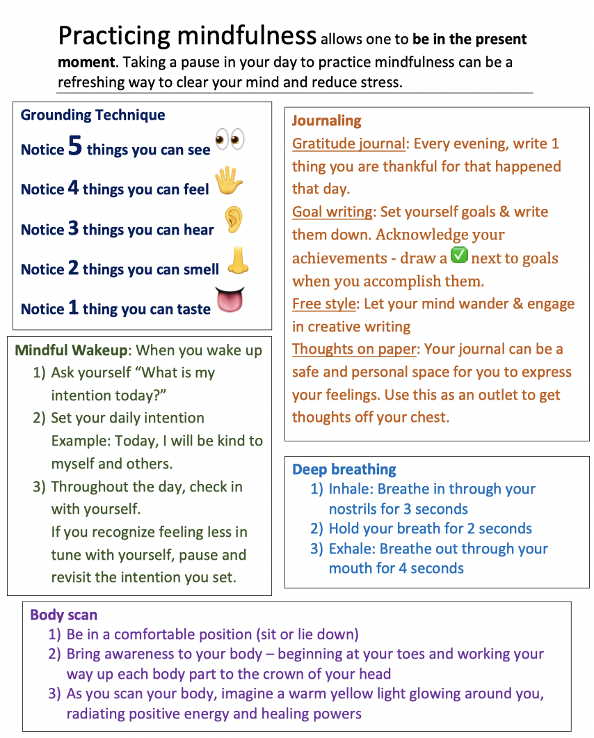
Notes:
Here’s an example of a time that I took initiative as the leader of the group. After a group discussion talking about the importance of a positive mindset, I put together this mindfulness handout and shared it in the FB group as a resource with different strategies the participants could try out.

Slide 15
Quality Improvement Project
Mixed methods approach
Evaluations
Data analysis
Observation
Focus group
Formative
Qualitative
Quantitative
Thematic analysis
Coding
Statistical analysis
Surveys
Interviews
Self-assessments
Summative
Notes:
This capstone project was designated as Quality Improvement Project, according to the MUSC Program Evaluation Self-Certification tool via the MUSC QI Self-Certification tool.
Methods that I used to collect data include observation during the group sessions, surveys, and interviews
I created pre and post-support group surveys using REDCap to ensure HIPAA compliance and appropriate data management.
The qualitative data provided meaningful, descriptive feedback which helped me gain insight
and the quantitative data allowed me to quantify and measure the impact of the group.
To assess my own personal development, I completed 2 leadership self-assessments at the beginning, middle and end of my experience to monitor growth and identify areas with room for improvement.

Slide 16
Results
Virtual group increased access to peer support
Support group positively impacted participants
Student strengthened leadership & clinical skills
Notes:
Potential impact written prior: The virtual support group will increase stroke survivors access to peer support, allowing participants the opportunity to reap its associated benefits. The group will positively impact the participants lives, improving their well-being and QOL post-stroke.

Slide 17
“In-person sessions would have been too much of a commitment”
“It’s nice that it’s convenient and I can do it while being comfortable at home”
“It’s been easier to squeeze in meetings since its virtual”
Notes:
Transportation = 1
Distance = 2
Other = 3
Convenience & comfort of being at home

Slide 18
Self-rated stroke recovery
Notes:
How would you rate your post-stroke recovery?

Slide 19
Self-rated support system
Notes:
How would you rate your support system? (0 being poor to 10 being excellent)

Slide 20
Self-rated QOL
Notes:
How would you rate your quality of life?

Slide 21
Beneficial aspects of the support group identified by participants
Learning from others
Sharing personal stories
Engaging in stroke-related discussions
Social interactions/building relationships
Acquiring resources
Educating others
Notes:
What aspects of our group were beneficial to you? (please select ALL that apply)

Slide 22
Areas of personal growth resulting from the support group identified by participants
Inspiration & motivation
Confidence & self-esteem
Self-management
Well-being
Notes:
In which of the following ways has our group helped you grow? (please select ALL that apply)

Slide 23
Positive impacts of the support group identified by participants
Increased knowledge
Provided a sense of validation
Provided the ability to relate to others
Helped cope with challenges
Reduced fear of the unknown
Instilled hope
Notes:
In which of the following ways did our group positively affect you? (please select ALL that apply)

Slide 24
Positive shifts in outlook
“There is hope out there for me”
“I was able to see that improvement can still occur years after the stroke…”
“Helped me validate my unnerving path to better my ability to control my future”
“Anything is possible”
Notes:
How has our group changed your outlook on the future?

Slide 25
Gained insight
Increased adaptability reflecting feedback
Practiced therapeutic use of self
Self reflection
Per Leadership Trait Questionnaire (LTQ) & Leadership Self-Assessment, student experienced personal growth and development
Participant feedback
100% of participants agreed that the facilitator created a safe & supportive learning environment
100% of participants reported that the overall experience was positive
Notes:
Leadership assessments will measure personal growth and development through a Leadership Trait Questionnaire (LTQ) and a Leadership Self-Assessment at the beginning, middle, and end of the capstone experience
Beneficial prep for the student → clinician transition

Slide 26
Purpose
Conduct a virtual support group to increase access to peer support
Strategy
Avoid barriers associated with in-person sessions
Limitations
Barriers associated with a virtual platform
Equipment (computer, iPad, etc.)
Technology literacy
Internet connection
Notes:
Equipment
computer, iPad, could be smart phone – something they can use to interact
The point of a virtual support group is to increase access to peer support
A virtual support group overcomes factors limiting ones ability to attend in-person support groups
Requires access to equipment, tech literacy, and internet connection
These could be limiting factors for individuals preventing them from accessing virtual peer support as well

Slide 27
Recommendations
Sustainable capstone project
Options for future students to use the same approach or try something different
Recruitment strategy
Book club
Inclusion criteria
Population
Size of group
Book choice or a different activity

Slide 28
Acknowledgements
Faculty & capstone site mentor
Capstone coordinator
Capstone site & capstone seminar meeting site
Dr. Woodbury, OTR/L, PhD
Dr. Crawford, OTD, MSRS, OTR/L
Stroke Recovery Research Center staff
NRI staff
Peer support group participants
Stroke survivors
Care partners
MUSC IT Team
Peers
Gordon Washington, OTD-S
Rachel Fate, OTD-S
Nancy Crawley, OTD-S
Shayna Faust, OTD-S

Slide 29
References
Alawafi, R., Rosewilliam, S., & Soundy, A. (2021). An Integrative Review Considering the Impact of Storytelling and Sharing Interventions in Stroke. Behavioral Sciences, 11(6), 88. https://doi.org/10.3390/bs11060088
Bello, U. M., Chutiyami, M., Salihu, D., Abdu, S. I., Tafida, B. A., Jabbo, A. A., Gamawa, A., Umar, L., Lawan, A., Miller, T., & Winser, S. J. (2020). Quality of life of stroke survivors in Africa: a systematic review and meta-analysis. Quality of Life Research, 30(1), 1–19. https://doi.org/10.1007/s11136-020-02591-6
Chen, J., & Wang, Y. (2021). Social Media Use for Health Purposes: Systematic Review. Journal of Medical Internet Research, 23(5). https://doi.org/10.2196/17917
Gucciardi, E., Reynolds, E., Karam, G., Beanlands, H., Sidani, S., & Espin, S. (2019). Group-based storytelling in disease self-management among people with diabetes. Chronic Illness, 174239531985939. https://doi.org/10.1177/1742395319859395
Soundy, A., & Reid, K. (2019). The Psychosocial Impact and Value of Participating in a Storytelling Intervention for Patients Diagnosed with Cancer: An Integrative Review. Open Journal of Therapy and Rehabilitation, 07(02), 35–77. https://doi.org/10.4236/ojtr.2019.72004

Slide 30
Thanks again to my capstone team.
This concludes my doctoral capstone defense.
I invite you to offer feedback or ask questions.

