Slide 1
Influence Networks to Improve Cancer Screening Follow Through Using Health System and Population Level Data
Cancer is a leading cause of death in the United States and cancer screening is primary tool to reduce mortality. This study indents to investigate whether electronic medical record data to predict which patients are at risk of missing recommended screenings. The goal of this investigation is to design a data informed clinical decisions support tool used by providers to increase cancer screening uptake
-- Author Matthew Davis
Ph.d Canidate in Biomedical data science and informatics at Medical University of South Carolina

Slide 2
Objectives
Demonstrate Application of NLP to Understanding Cancer Screening Uptake
Present Word to Vect Nearest Nieghbor Approach to ICD9cm mapping of free text.
Results and challenges of the approach
Discuss Influence Networks and application feature selection

Slide 3
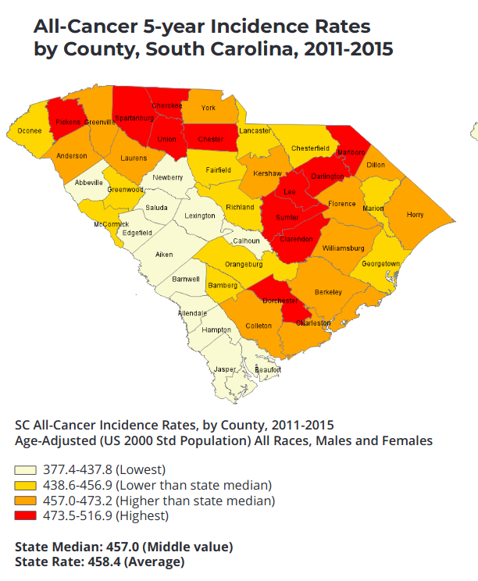
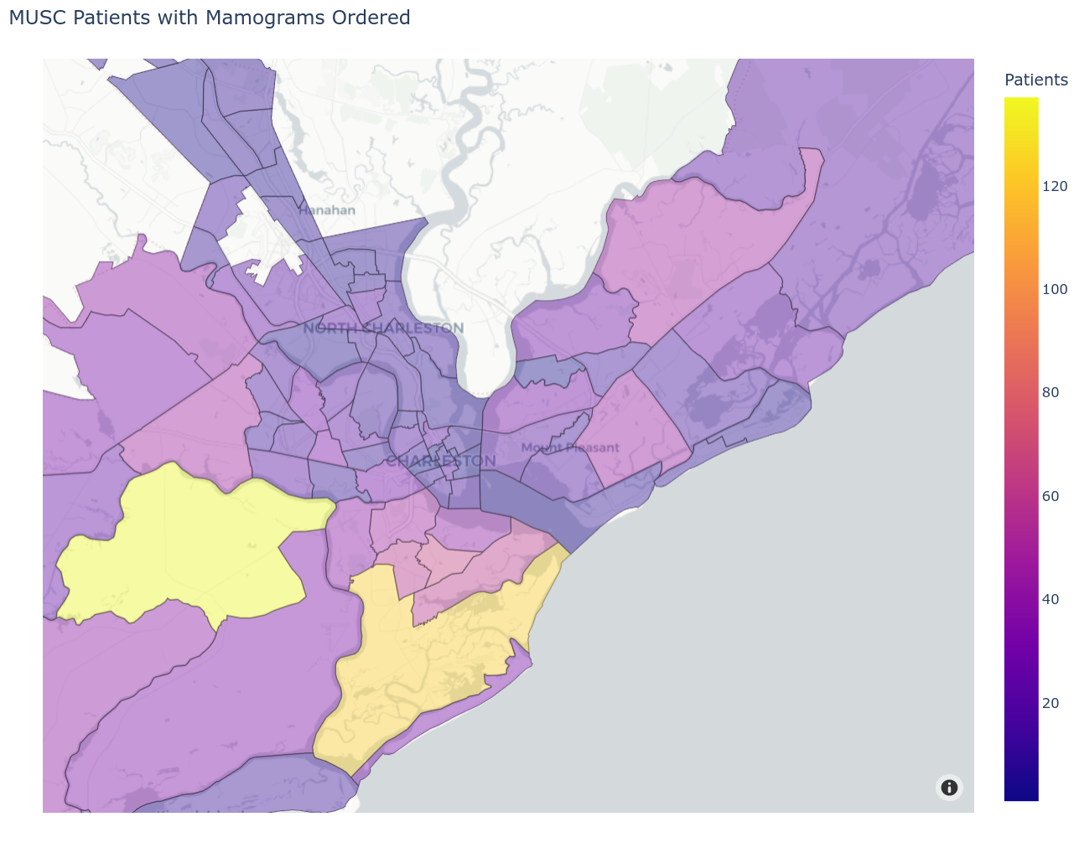
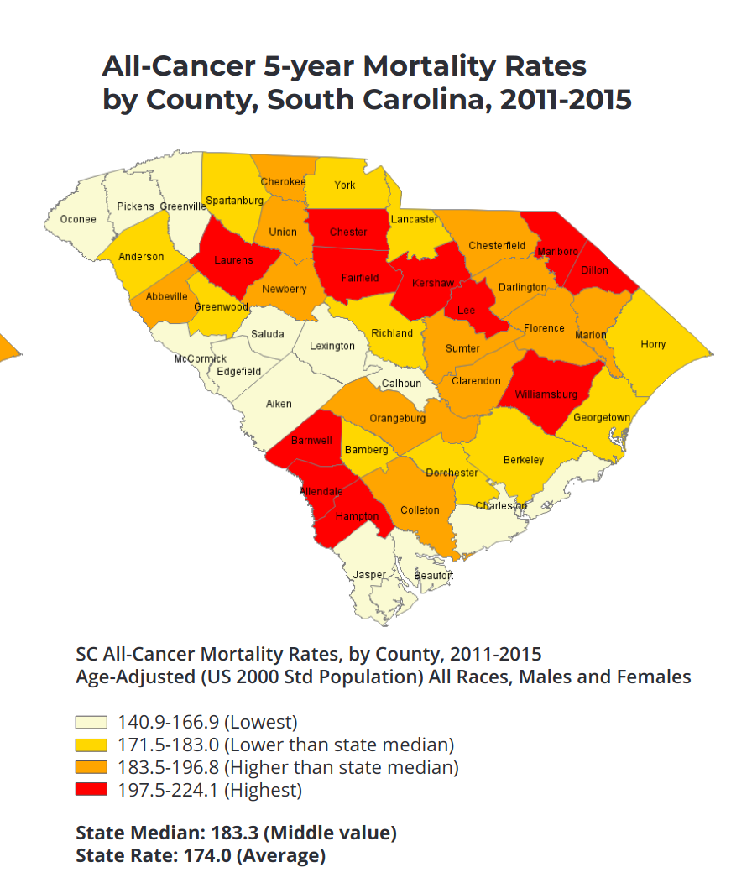
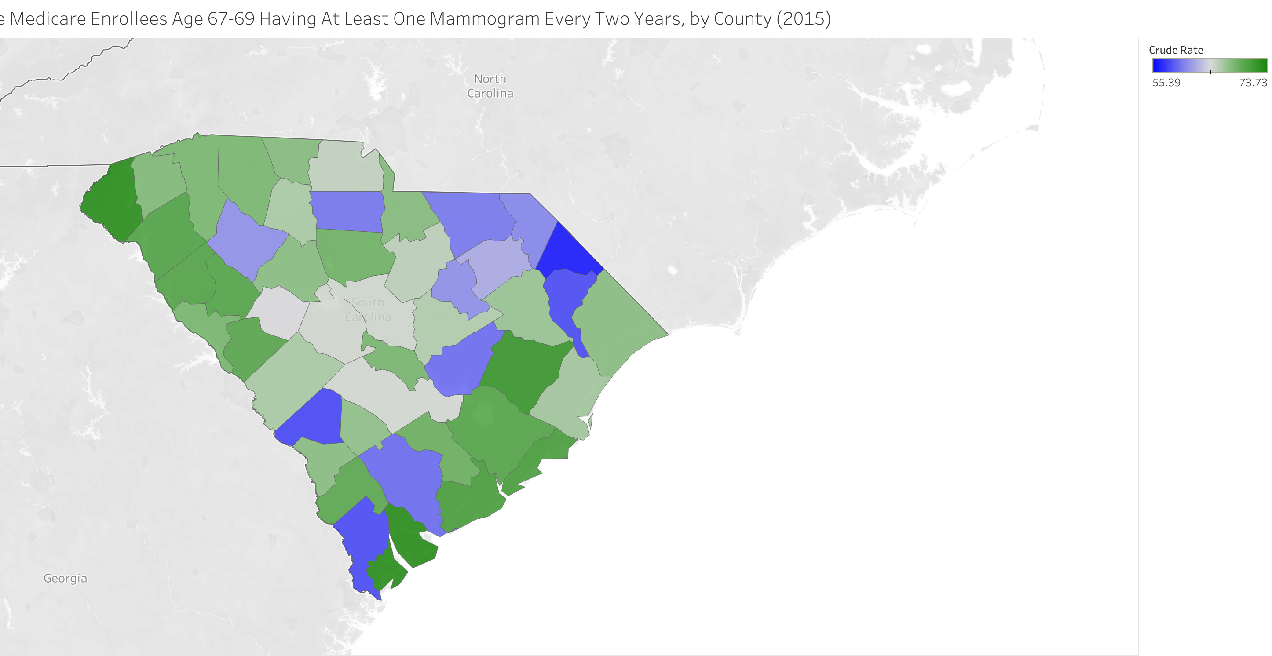
Cancer In the State of South Carolina
Sources: https://scdhec.gov/sites/default/files/media/document/20-year-cancer-report.pdf,
https://www.dartmouthatlas.org/interactive-apps/primary-care-access-quality-measures/#county

Slide 4
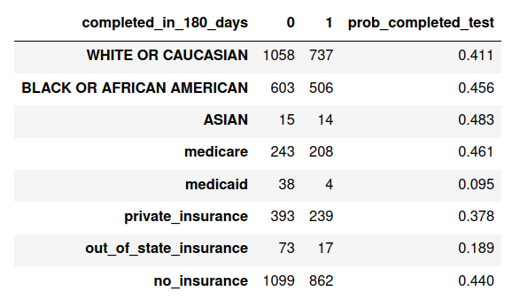
Research AIM
Design an explanatory system that explains and visualizes the barriers to cancer screening uptake that considers the complex network of factors potentially causal social determinants, and comorbidities
Data Sources
Deidentified EHR Data from MUSC including diagnoses, labs, observations, patient reported cancer histories, billed procedures, and screening tests, between 2016 and the end of 2019 (patients with at least one visit)
CDC Social Vulnerability Index (SVI) with census track level attributes
EHR Inclusion criteria:
One office visit between 1/1/2016 - 12/31/2019 at (Ellis Oak, Martello Drive, Ben Sawyer, Daniel Island, Peninsula Bee Street, West Ashley Medical Pavilion)
A mammogram screening test ordered by a healthcare provider
Female, Age >=18
Cases : Did NOT have an order status of “Completed” or “Sent” within 180 days of the first order
Controls: Had order status "Completed" within 180 days following the first test order date (excluding tests completed on the same days as ordered)
3,003 total patients.

Slide 5
Leveraging MUSC EMR DATA
This demonstrates processing data from MUSC's EMR for predicting cancer screening uptake. Self reported personal and family histories of cancer as well as natural text from problem lists are combined into registries with Elixhauser comorbidities based on billed ICD10 codes are combined to create a comprehensive view of patients family and personal cancer history. This is combined with insurance, demographics and track level social vulnerability flags from the CDC SVI to create basis for prediction cancer screening uptake in support of research aims 2 and 3.

Slide 6
What's the Problem with Problem Lists?
"A problem list is a document that states the most important health problems facing a patient such as nontransitive illnesses or diseases, injuries suffered by the patient, and anything else that has affected the patient or is currently ongoing with the patient."*
MUSC Problem list are a mix of free text and ICD9cm codes
Can coding of this be solved with word to vect and Nearest Neighbors? Sort of...
*https://www.techtarget.com/searchhealthit/definition/problem-list

Slide 7
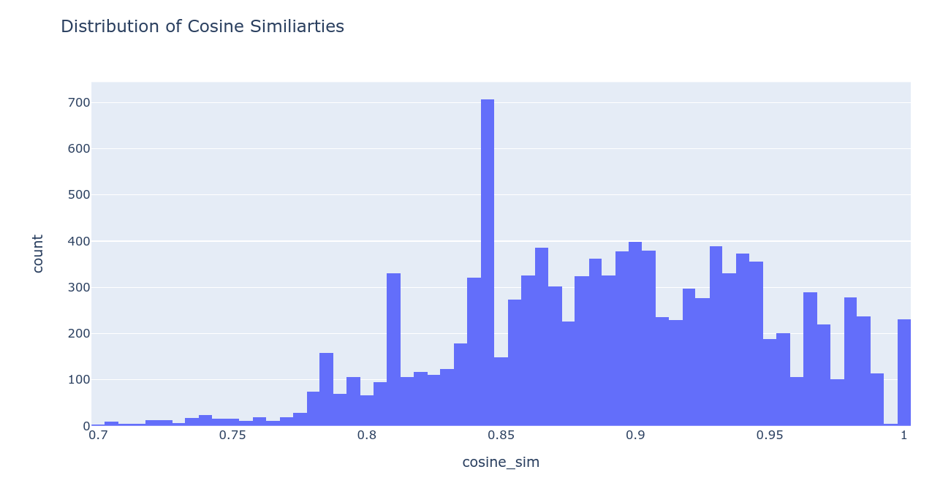
Problem List icd9 extraction Pipeline
NN is powerful, but results are not guaranteed to make sense, even at reasonably high cosine similarity thresholds
It works: "history of smoking" > V1582: Personal history of tobacco use, 0.86
It doesn't work: "smoking two packs a day" > V2032: Health supervision for newborn 8 to 28 days old, 0.804
It works: Abnormal TSH > 7945: Nonspecific abnormal results of function study of thyroid, 0.744
It's unclear "H/O echocardiogram" > '7852': Undiagnosed cardiac murmurs', 0.717
Zhang Y, Chen Q, Yang Z, Lin H, Lu Z. BioWordVec, improving biomedical word embeddings with subword information and MeSH. Sci Data. 2019;6(1):52. doi:10.1038/s41597-019-0055-0

Slide 8
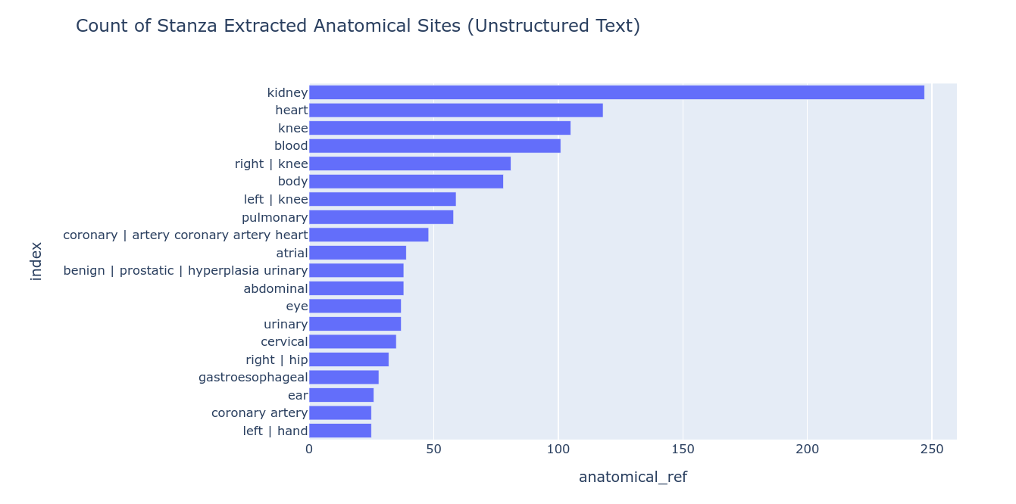
When Extracted ICD9cms are mapped to Elixhauser

Slide 9
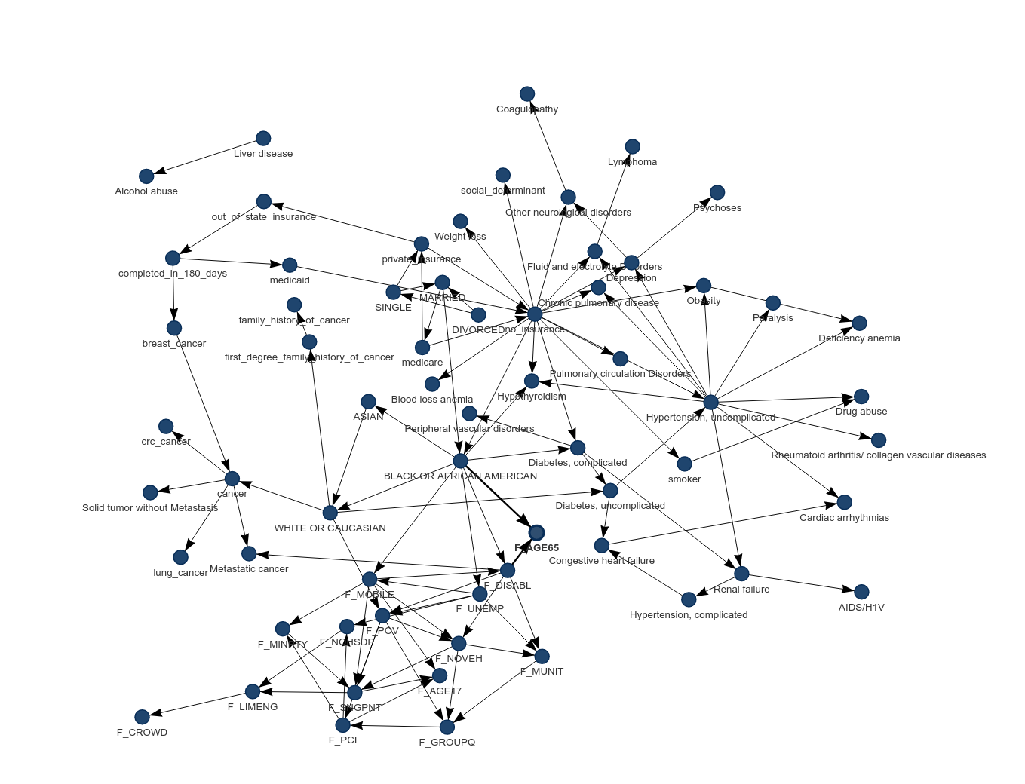
Influence Network on Patients With ORDERED Mammograms
BN Network is a DAG with Conditional Probabilities
Influence network discovery
Hypertension node, No insurance central to comorbidities
Completed in 180 day node, indicates breast cancer screening test was completed within 180s after order, influenced by out of state insurance, breast cancer and Medicaid insurance

Slide 10
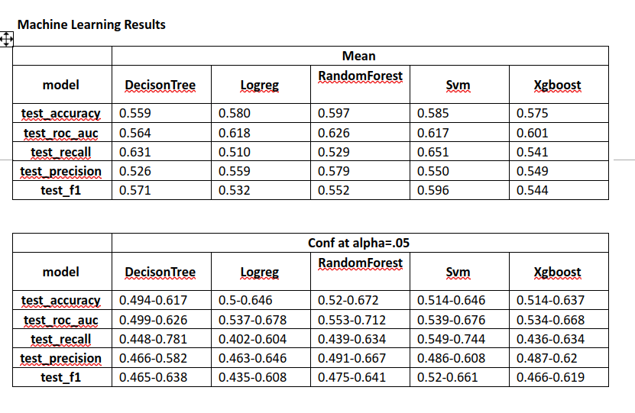
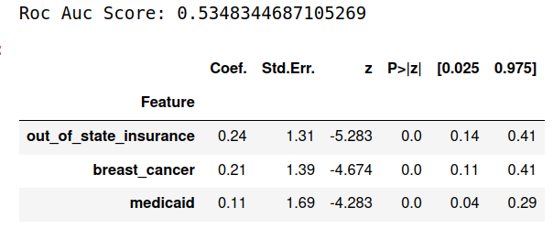
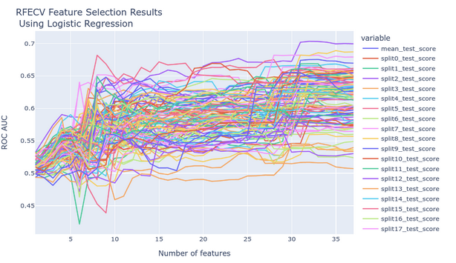
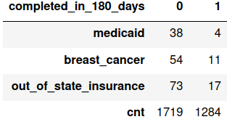
Machine Learning Approach vs BN Network Selection
Prediction Mammogram Completion with 180 days of order (masking same day completions) (MUSC 3,003 Patients)
Completing test in 1-180 days: 42.7%
(1719 Cases(no completion ), 1284 controls
Model built using only two features, found in Bayesian Network Analysis on 10 fold 10 repeated CV
TP: Completed Test in 180 days (and predicted to do so)
FP: Failed to complete test (and predicted to do so)
TN: Failed to complete test (and predicted not to complete)
FN: Completed test, (and predicted not to complete)
ML Models using RFE with Log Reg and 10 fold 10 repeated CV, after grid search

Slide 11
Conclusion
Word to Vect Nearest Nieghbor Approach to ICD9cm mapping of free text is a viable approach, however requires rules for sanity checks
BN Network Structure learning can be useful for discovering influential structures and for feature reduction

Slide 12
Questions?
Special Thanks to Dr. , Alexander Alekseyenko, Dr. Leslie Lenert, Dr. Dr Xia Jing, Dr. Vanessa Diaz, Dr. Kit Simpson
As part of NIH R61 AG068951-01​
ERIB: Study Short Title: Technology-Based Cancer Screening Intervention Pro00101494 ​
​

Slide 13
Recommendations for Screening from USPSTF

